Slide 1

MMP Retirement Strategies
Using machine learning predictions to time retirement contributions for maximum return

Slide 2
Summary
Compare retirement contribution strategies across investment portfolios to maximize retirement savings.
Contribution strategies:
Monthly dollar cost average
Annual dollar cost average
Machine Learning Predicted timing

Slide 3
How it started…
Whitecoat Investor Article – buy and hold strategy portfolios
Selected 4 portfolios to compare
Chose Vanguard Total Stock ETF as the basis to train our machine learning models

Slide 4
Machine Learning
Predicting market movements 1 month into the future.
Used SVM as a powerful classifier for 2 classes
AdaBoost to weight dataset to increase accuracy
+1
-1

Slide 5
Data Prep and Training
VTI as data through API
Training to predicting periods
Created function to process the data
Model classification results

Slide 6
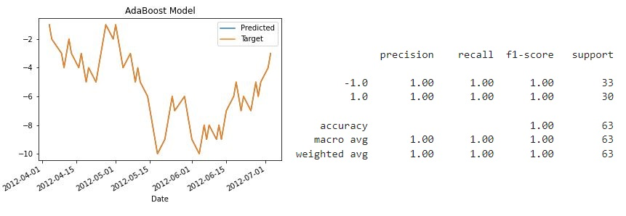
Outcome Predictions - AdaBoost

Slide 7
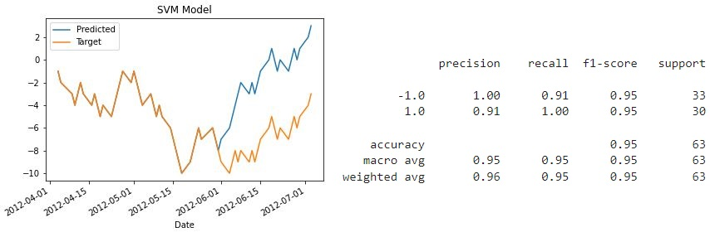
Outcome Predictions – SVM Model

Slide 8
How it’s going…
Demo application

Slide 9
Issues we encountered
Contribution strategy
Running neural networtk

Slide 10
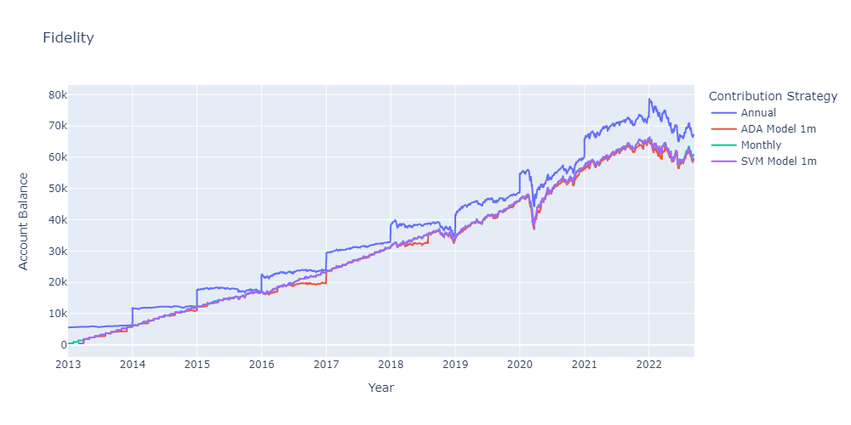
Conclusions

Slide 11
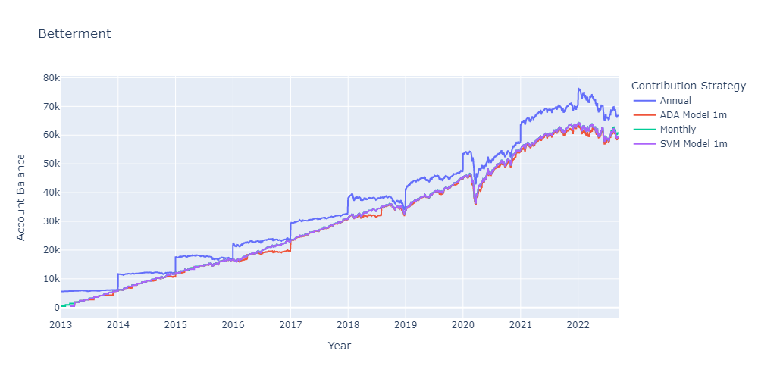
Conclusions

Slide 12
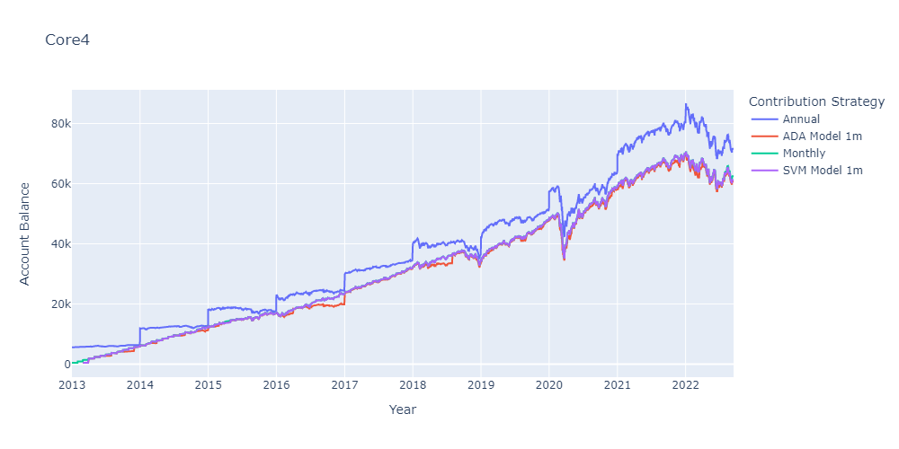
Conclusions

Slide 13
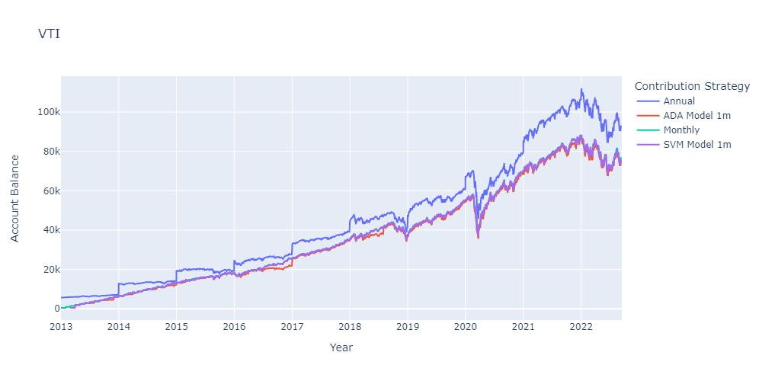
Conclusions

Slide 14
Time in the market beats timing the market

Slide 15
Ideas for the future
Change to daily predictions
Adjust the model to self test and re-train when required
Adjust the code to output a recommended contribution strategy per portfolio
Loop through all portfolios and contribution strategies
Continue to optimize models
Combine functionality so that python files don’t need to run separately to Jupyter Notebook

