Slide 1


INNOVAT BHARAT
2026 JOURNEY by FOUNDING TEAM

Slide 2
Context setting
Strategic Goal: Position Innovat Bharat as the preferred ecosystem partner for Tier-3 colleges
Vision Alignment: 1M rural entrepreneurs by 2047 from Tier-3/rural colleges
Competitive Landscape Review: (Mahesh ji to add)

Slide 3
Target Audience & Messaging
ICP Definition
Primary: Tier-3 autonomous/private college management (Principals, Deans, TPOs)
Secondary: Faculty champions, students/parents, CSR/ecosystem partners
Messaging Pillars
Not just training: Deep ecosystem transformation vs. one-off workshops
Bharat-centric: Grassroots entrepreneurship from small-town talent
Long-term impact: Multi-year transformation, not placement metrics alone

Slide 4
Innovat Bharat's ICP (Ideal Customer Profile)
Primary ICP: Tier-3 Colleges
Autonomous and private engineering/degree colleges
Pain Points
Weak placement records compared to Tier-1/2 colleges
Lack of industry connections and mentorship networks
Students have talent but lack direction and real-world exposure
Management wants to improve brand reputation and student outcomes
Ambition Level:
Principal/Management has vision for innovation but lacks structured framework
Open to multi-year partnerships (not just one-off events)
Willing to invest in ecosystem transformation (budget availability)
Decision Makers:
Principal/Director (final authority)
Dean (Academic)/HODs (influencers)
Training & Placement Officer (stakeholder)
Indicators of Good-Fit ICP:
College recently started innovation/incubation cell but lacks traction
Management has attended conferences about innovation/entrepreneurship
College has alumni who became entrepreneurs (untapped potential)
Located in district headquarters or small cities with local industry presence
Tier-3 cities and rural areas (focus: Telangana, Karnataka, Andhra Pradesh to start)
500-2,000 students
AICTE-approved, autonomous or affiliated to state universities

Slide 5
120-Day Roadmap
Objective: Launch pilots and generate social proof for case-study-driven selling
Objective: Establish regional ecosystem presence and hit 10-15 paying colleges
Objective: Move from vision to productized offering with validated messaging
2-3 Program SKUs — Packaged clear offerings (e.g., Year-long Campus Ecosystem, 6-month Innovation Track, Faculty Bootcamp)
Clarified ICP & Build Target List — Document ideal college profile (Tier-3 autonomous/private, weak placements, ambitious management) and create prioritized list of 30-40 colleges
Created Outcome Framework — Defined measurable impact metrics (# prototypes, startups launched, internship conversions, faculty trained)
Building GTM Assets v1 — One-pager for Principals, 6-slide sales deck, landing page copy, pricing tiers
Ran 10-15 Discovery Calls — Interview target colleges to validate pain points, and decision-making cycles
Launch 3-5 Pilot Campuses — Execute structured 90-day programs with defined cohorts, problem statements, mentor calendar, and demo days
Standardize Delivery Playbooks — Document program templates, weekly calendars, mentor guidelines, and college reporting dashboards
Produce 2-3 Case Studies — Publish mini-success stories with college names, starting maturity levels, outcomes, and testimonials
Build Thought Leadership Engine — Post 2x/week on LinkedIn about Tier-3 innovation, publish 5-10 student/faculty testimonial videos
Convert Pilots to Renewals — Secure multi-year commitments from pilot colleges and initiate 1-2 ecosystem partnerships (e.g., skill-tech or CSR tie-ups)
Launch Cluster Ecosystem Model — Identify 1 "lead college" + 3-5 surrounding colleges per district to create regional innovation hubs
Publish Impact Snapshot 2026 — Release mini annual report with metrics (colleges onboarded, students reached, prototypes, startups, regional breakdown)
Run Regional Campus Innovation Summit — Host offline event with 100-150 attendees (principals, faculty, students, local industry) for visibility and pipeline
Target 10-15 Paying Colleges — Close contracts with at least 3 colleges at Level 4 maturity (Ecosystem-Driven) showing demonstrable transformation
Build State/CSR Partnership Pipeline — Begin discussions with state education departments or corporate CSR programs to underwrite rural college programs
Days 60-90 — Build Foundation
Days 60-90 — Build Foundation
Days 0-60 — Build Foundation

Slide 6
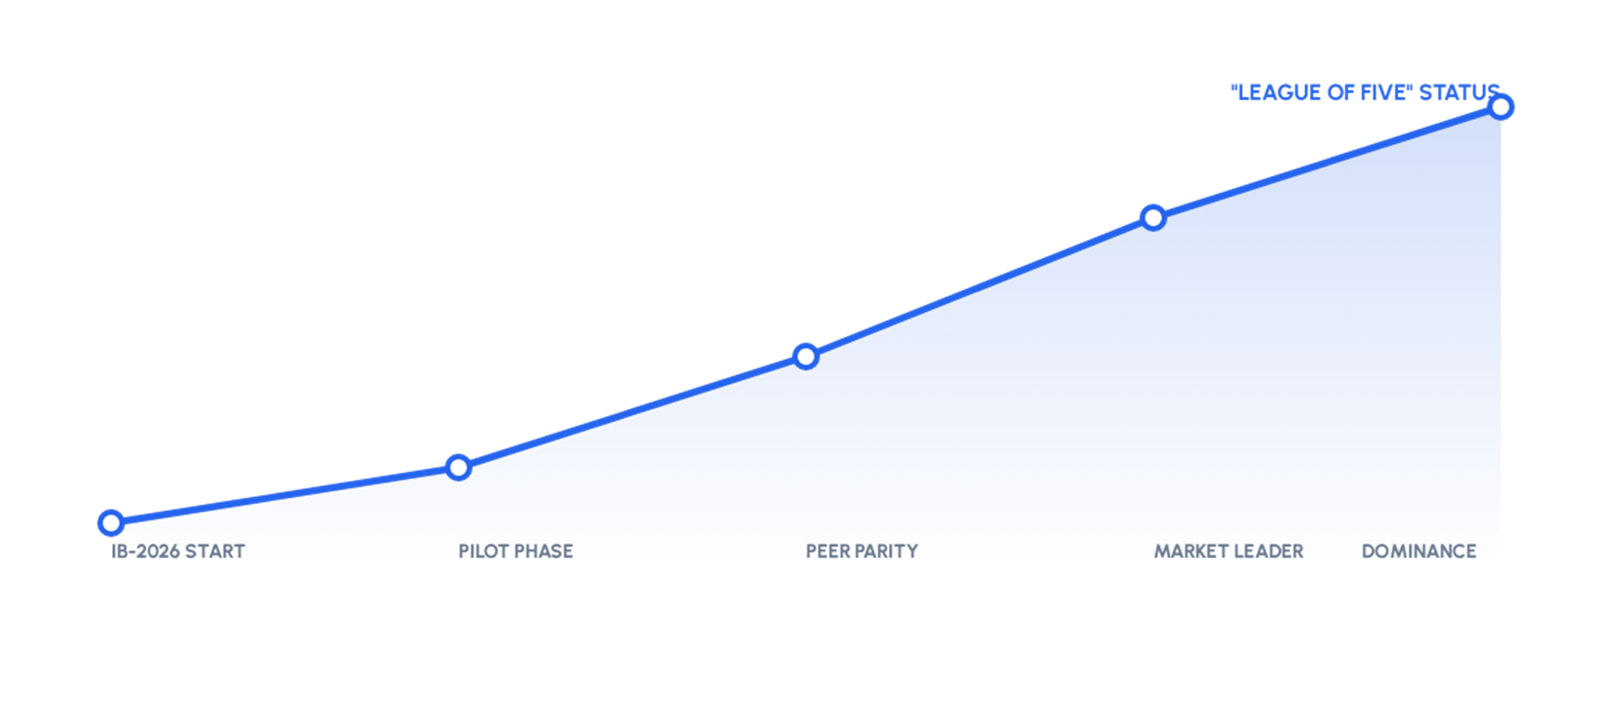
ROAD TO DOMINANCE: VALUE LEAP

Slide 7
Maturity matrix
Domain | Level 1: Portal (Testbed) | Level 2: Program (Defined) | Level 3: Platform (Managed) | Level 4: Peer League (Optimized)
Entrepreneurship Dept | IB-2026 (Current)
Scaling Reach | Limited Pilot |  | Regional Growth
Placement ROI | None/Implicit | Cert-focused | In-house Leads
Brand Value | Subdomain URL | Niche Credibility | Regional Trust | Global Recruiter Peer

Slide 8
SYNERGY MODEL
College Out Reach | Social Media | Information Systems & Research | Network with eminent personalities | Website, Data & Strategy | Sessions (SKUs)
Mahesh ji | Suma ji | Uday ji | Mahesh ji | Narayanamurthy ji | Amit ji
Suma ji | Mounika ji | Keerthan ji | Amit ji |  | Mahesh ji
Amit ji | Lalitha ji | Raghav ji | Vishal ji |  | Suma ji
Deepak ji | Kunal ji |  | Suma ji
Satyaprakash ji | Raghav ji
Founding Team
Guardian of the 120-Day Vision. Prioritizes the backlog to ensure we hit "League Peer" status, not just "Feature" status.
Extended Team
Translates Peer Benchmarks into technical requirements. Audits the Maturity Matrix periodically.
On Ground Team
Execute high-volume student acquisition through automation & campus networks.

Slide 9
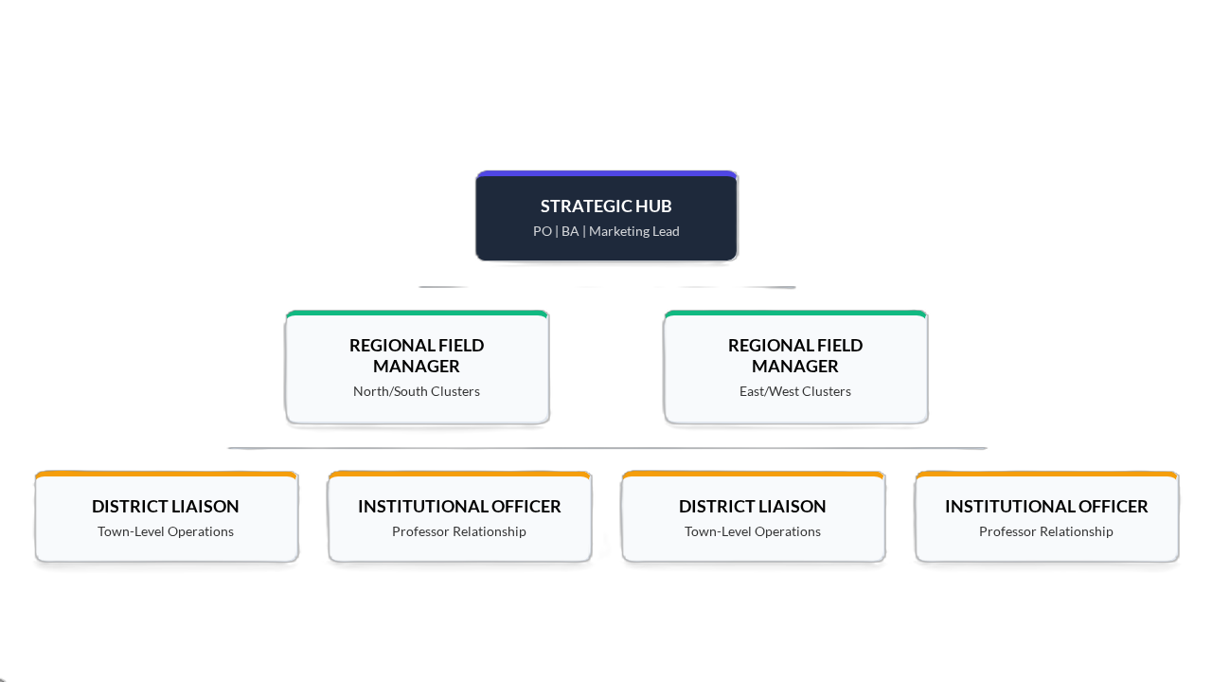
Strategic Enhancements
Level 1: Strategy Hub
Roadmap Alignment: Synthesizes high-level market data into a unified strategy to achieve parity with top-tier industry peers.
Resource Deployment: Directs the allocation of digital assets and funding to support hyper-local Tier 3 field logistics.
Level 2: Regional Execution
Cluster Supervision: Manages multiple district teams to ensure operational consistency and brand integrity across town-level nodes.
Institutional Access: Negotiates with University Boards and Deans to secure official academic credits and campus-wide recognition.
Level 3: On-Ground Force
Professor Stewardship: Conduct periodic face-to-face interactions with HODs to align student projects with faculty academic goals.
Student Mobilization: Lead peer-led labs and vernacular engagement to reduce technical intimidation in smaller campus environments.

Slide 10
So?
Ready for Takeover?
Join the Bridge. Become the League.

