Slide 1


Supply Chain
Enterprise Platform
Powered by Blockchain
DISRUPTING BUSINESS PROCESSES,
ONE BLOCK AT A TIME…
Delivering Digital Transformative Solutions to Dr. Agarwal’s

Slide 2


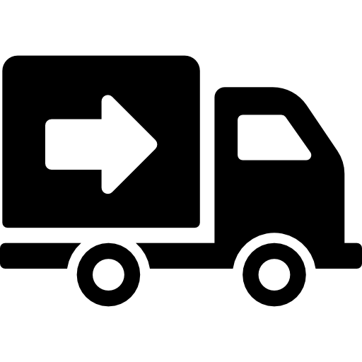



What We Do
AUTOMOTIVE
CONSUMER ELECTRONICS
Part Traceability
Purchase Order tracking
Recall Management
Digital Twin of a Vehicle
Supplier Warranty Recovery
Part Traceability
Purchase Order tracking
Digital Twin of an Electronic Item / White Goods
Supplier Warranty Recovery
WHAT WE DO
LOGISTICS
RETAIL
In transit tracking
Custom Clearance
Multimodal Shipment Tracking
Digital Provenance
Dealer Management System
Accounts Receivables
Account Payables
Tertiary Sales tracking
AVIATION
HEALTHCARE
Back to birth Traceability
Order Tracking
Digital Twin of an Aircraft/Component
Supplier Warranty Recovery
Rebate Management
Vendor Management
Contracts Management
Tertiary Sales tracking
2

Slide 3
What we have and our strengths ?
Realware platform to unify the current ERP / hospital software as decentralized system
1
Patients' records - Pan India ( Aadhar/ Pan card registration) to create Unique identifier
2
3
Payment Reconciliation's across all centers real time data
4
Management Dashboard ( High level view to know about business across all the centers)
5
Equipment Supplier - License, contractual Agreements & Renewals
6
Supplier warranty Tracking
3

Slide 4



RealReco
Distributor management tool
Customer warranty tracking
Salesman App
4

Slide 5




About Real Variable
Enterprise Supply Chain Platform, powered by digital technologies to create autonomous supply chain ecosystem
Enabling Seamless Multiparty Collaboration between Manufacturer & Tier 1,2...n Suppliers and Customers
PLATFORM & APPS
REALCOLLAB
REALTRACEABILITY
REALRECO
REALWARRANTY
Supplier Collaboration upto nth Tier Supplier
In-transit Tracking &
Digital Provenance
Distribution Management system
Supplier Warranty
Recovery Co-innovated with SAP
Zero Code Platform
Enterprise Supply Chain Platform
Digital Twins, with 1 to 5% reduction in CoCS, CoPQ, Targeted Product Recalls.
Real Time tracking, Digital provenance & 13% improved efficiently
About 5% to 10% increase in demand generation and ~10% on cost-reduction
About 8 to 10% additional warranty recovery from Suppliers (as a percentage of claims paid)
“1 million+ parts are tracked / quarter globally through the Digital SCM solutions built by us”

Slide 6








Why Real Variable - Digital SCM Platform
Developing Operating Model through the next level of SCM Organization and capabilities
Vision: Tomorrow’s supply chains will be connected and autonomous supply chain ecosystems
AI, IOT & Blockchain driven Supply Chain Management will be a new norm
Benefits: Estimated savings of 7% in supply chain costs and 7% increased revenues annually.
Creating Digital Champions
Business Efficiency & Increased Margins
Dynamic SCM enhances customer centricity and continuously balance service levels, costs and margins
Supply Chain Transparency and Sustainability is a high or top priority for 50% of Supply Chain leaders
Smart Logistics Flows is the key savings driver and a growth lever accounting for 50% of cost savings
Closed Loop and Integrated Planning is synchronized in real-time with execution, integrates supply chain partners and enables continuous optimizations.
REAL VARIABLE DOCUMENT DISTRIBUTION CONTROLLED
6

Slide 7












Our Services - Technical Capability
Digital Technologies
Skillsets
Architects
Distributed Architecture with Micro Services
Blockchain & AI
MEAN Stack
Blockchain
RPA
AI/ML
Cloud Enabled Services
IOT
Business Model
Project as a Service
RealWare - PaaS
Business Model
RealCollab, RealWarranty - SaaS
7

Slide 8



Real Variable - Case Study
Problem Statement | Lack of Real Time order ETA updates BMW APAC Dealers due to multi level aggregation of orders and bulk shipments.
Ecosystem Participants | Manufacturer – BMW Logistics – DHL, Geodis, Maersk Dealers – 200+ dealers across 21 countries in APAC
Solution Provided | Blockchain based parts tracking solution for Order / Shipments / Part Track & Trace with Real time ETA update with a Million+ SKU tracked every quarter.
Production Live | 18 Months+
Business Proposition | Dealer / End Customer satisfaction with real time tracking of orders. Cuts down manual coronation process between multiple organizations.
Value Proposition | Multi million USD savings annually in CoCS (Cost of Continuous Service) across network.
https://www.youtube.com/watch?v=KeMGcKn-EmI
8

Slide 9









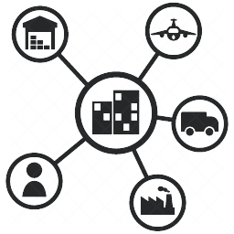
Our Partners & Differentiators
Our Differentiators
RealWarranty will be only SAP certified Blockchain product on Supplier Warranty Recovery
RealWare platform seamlessly Integrated with ERP Systems & Digital Technology Platform
RealWare is a Zero/Low Code SCM Platform which takes 1/3 Time & Cost to Customize
Filed Proven Expertise in Digital SCM Solutions with measurable Business benefits and multiple ROI

Slide 10


Thank you
UNITED STATES:
Real Variable Digital Asset Services Inc.
800 Town and Country Blvd., Suite 300, Houston, Texas 77024
INDIA:
Real Variable Digital AssetServices Pvt. Ltd.
&
Talia Tech
https://www.realvariable.com
https://taliatech.in
#20t8h1a14n11k25y15o21u

