Slide 1
Front-end Team Meeting #4
25/04/2019

Slide 2
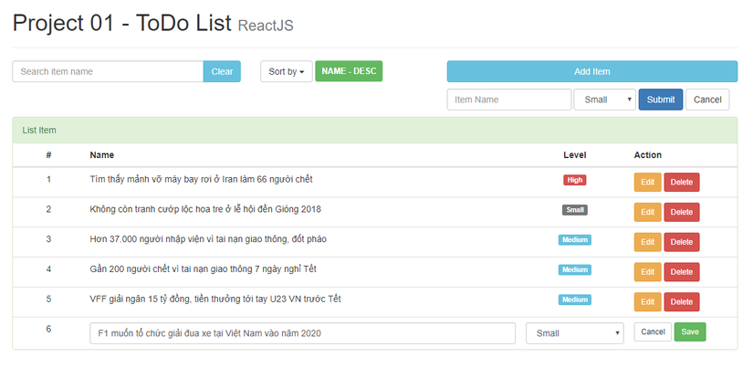
React-js Project 1: Todo List

Slide 3
React-js Project 1: Todo List
Reference links:
https://viblo.asia/p/hoc-reactjs-thong-qua-vi-du-phan-1-yMnKMnGaZ7P
https://www.youtube.com/watch?v=494HPoUmqdI&list=PLJ5qtRQovuEOoKffoCBzTfvzMTTORnoyp&index=16

Slide 4
React-js Project 1: Todo List
Complete this in 3 weeks.
Submit this project to git-hub before the next meeting 16 May 2019.
Git-hub repository link: https://github.com/tnnha76/reactjs-practice-projects

