Slide 1

ECONOMIC DATA DASHBOARD
Project 3 - Group 7

Slide 2
Team Members
Bill Johnson
Steven Broyles
Tamekia Phillips
Thea James
Tiera Nixon
Venkatesh Hegde
Wesley Watkins

Slide 3






Data Exploration
Question:
How is the Economy?
Connection between Institutional Economic Data and Individual Economic Data
“Big Business” vs the Average Person
Data:
Unemployment
Inflation
Stock Prices
Interest Rates
Money Supply
Housing Inventory
Visualization:
Dashboard
Charts
Financial News
Unemployment Map
Link to API Service

Slide 4






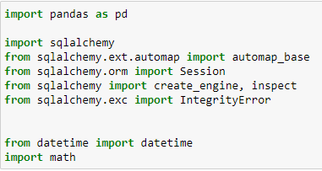
ETL Process
Transform
Conversion from csv to json
Available .js to read with d3 library
Read csv files in Pandas
Convert format of Date column
Filter rows to only include 5 years of data
Calculate difference of values and add column
Create new csv files for monthly average formula
Load
Extract

Slide 5
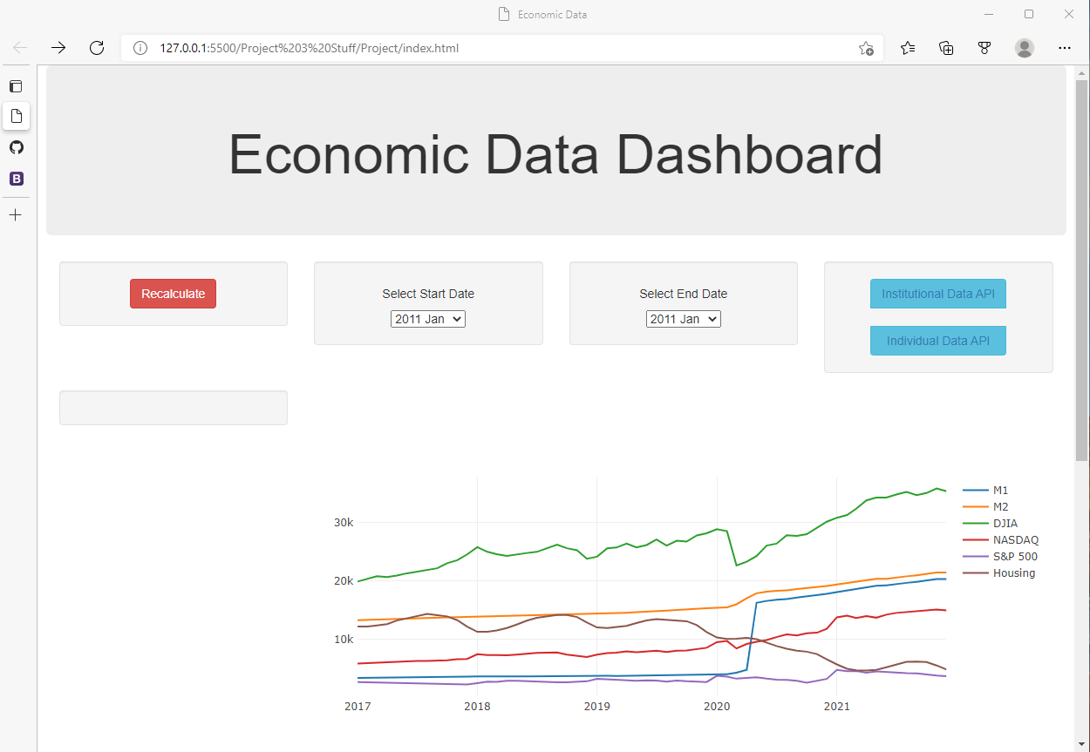
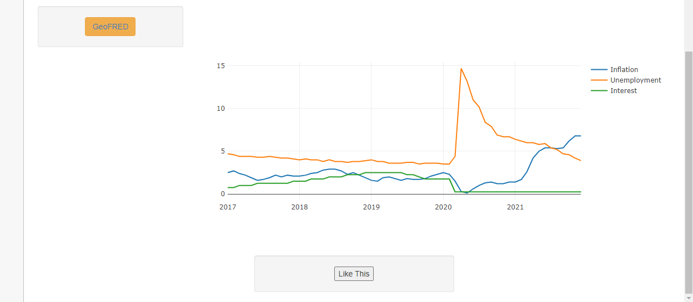
Dashboard
HTML/CSS
BootStrap Framework
JavaScript
Plotly
D3
Axios
Leaflet
React
Python
Flask

Slide 6
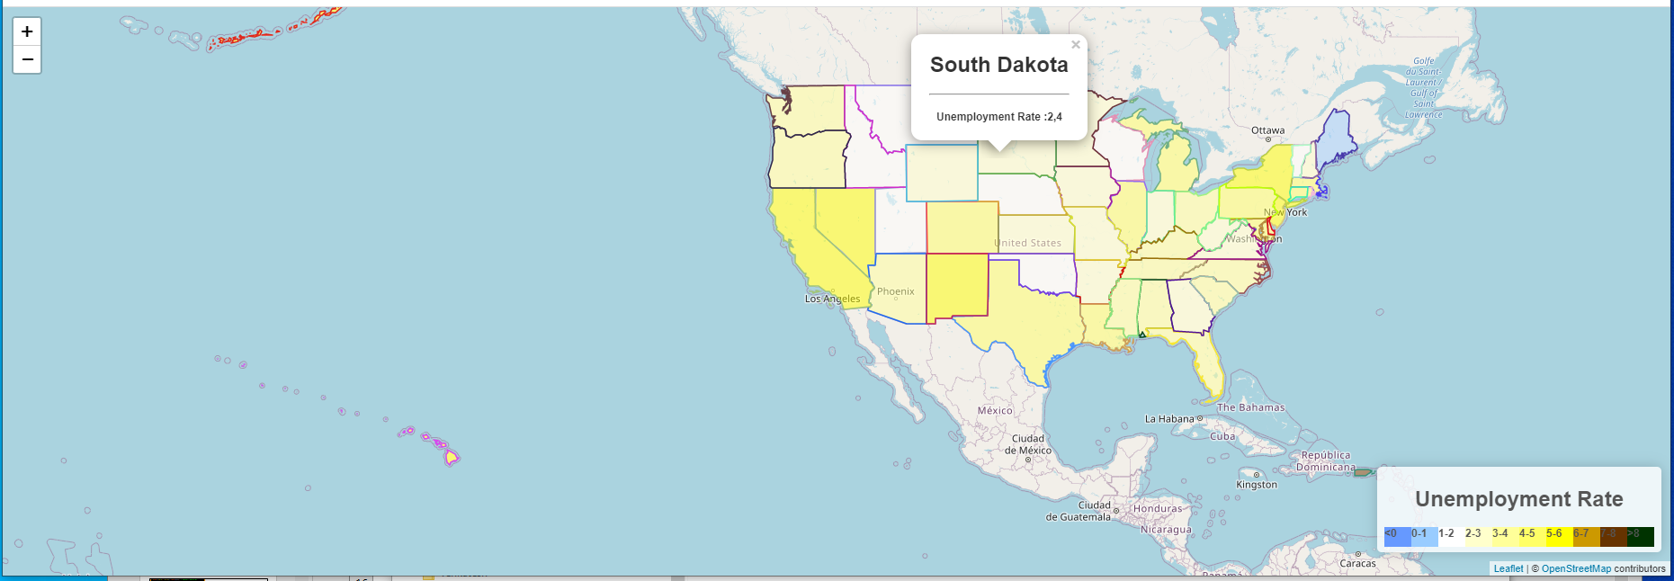
Unemployment Map
States are displayed using a geo json file.
The data for the individual states is fetched from the bls.gov using api and stored in individual files for each state.
The JS loads those files to calculate the latest unemployment rate.
Leaflet renders the color coding on the map using the latest updated unemployment average
A popup is bound to the features (state) to display the unemployment value.

Slide 7
Challenges
ETL
Data was limited
Had to convert daily data to monthly data (Had to find the averages)
Data overall - financial data unavailable due to fee being associated with viewing information
Dashboard
API calls through JavaScript- Axios (News API)
Date selection dropdown
Map
Javascript cannot use POST method for api fetches
Values being undefined
Had to ensure all data was fetched before rendering data
Notes:
challenges?

Slide 8
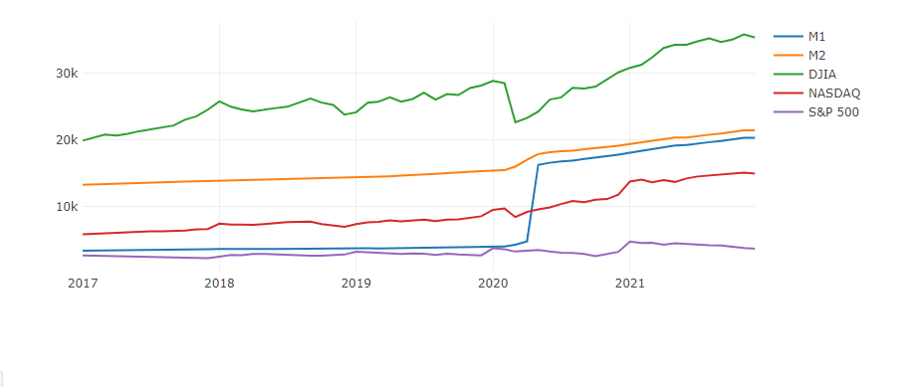
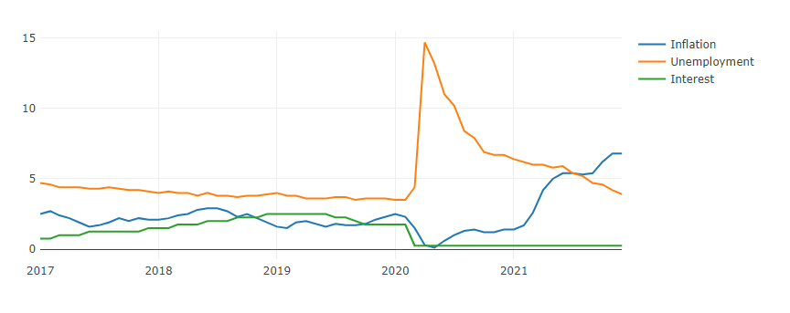
Conclusion: How is the Economy doing?
Institutional Economic Data:
In 2017 through 2019 there was a steady trend in:
Stock Prices
Interest Rates
Money Supply (1), (2)
Beginning of 2020 , we can see the gradual drop in most variables with the most significant being the
Dow Jones dropping by close to 6 points.
In contrast ,
Money supply (1) increased.
Individual Economic Data:
In 2017 through 2019 there was a steady trend in:
Unemployment
Inflation
Interest Rates
Unemployment 2020:
Peaked in April from 4.4 to 14.7 percent.
By December 2021 it went back down to 3.9 percent.
Inflation 2020:
In January , Inflation was at 2.5 percent and dropped to 0.25 percent and has gradually increased upward.
By December 2021 it has increased to 6.8 percent.
Interest Rate: Beginning of 2020 we can see a drop of interest rates from 1.75 percent in February 2020 to 0.25 in March which has stayed pretty consistent up to today.

Slide 9
Questions?

