Slide 1
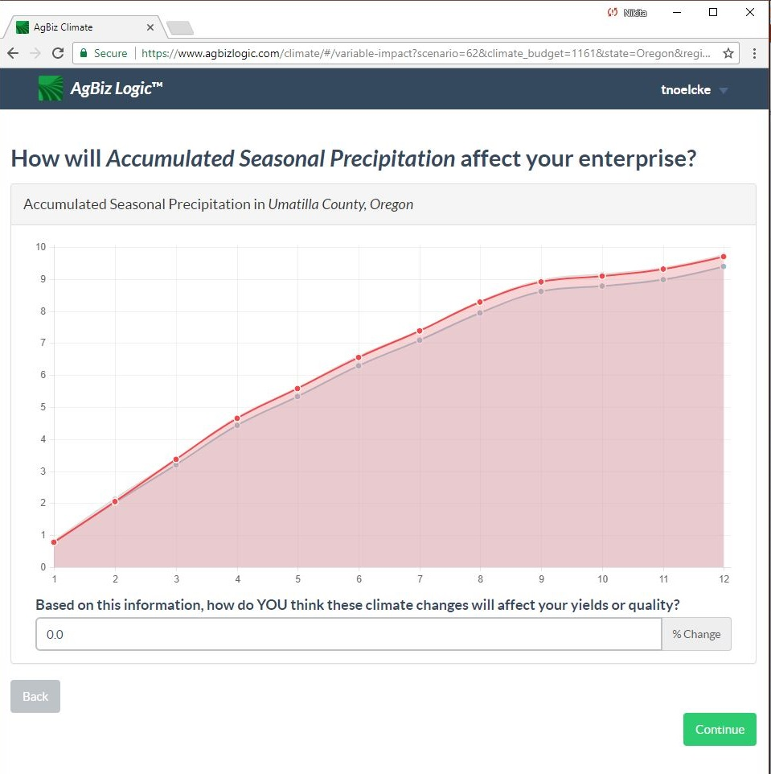
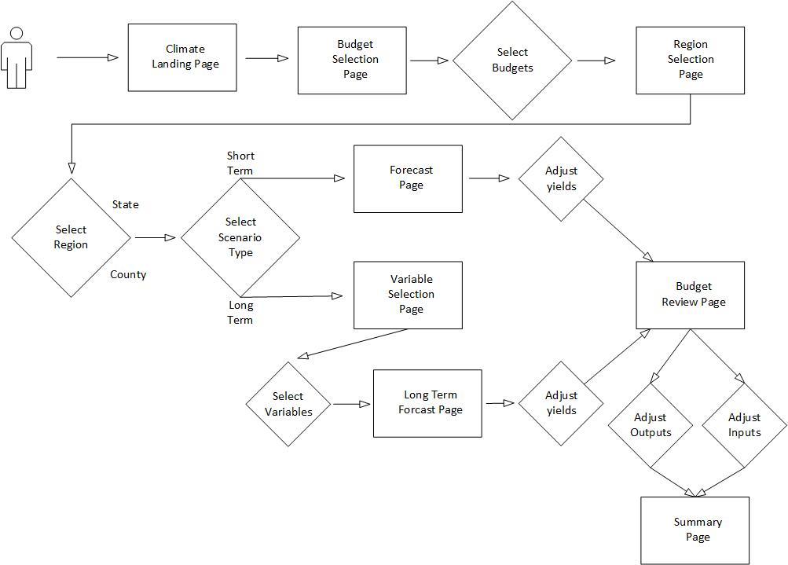
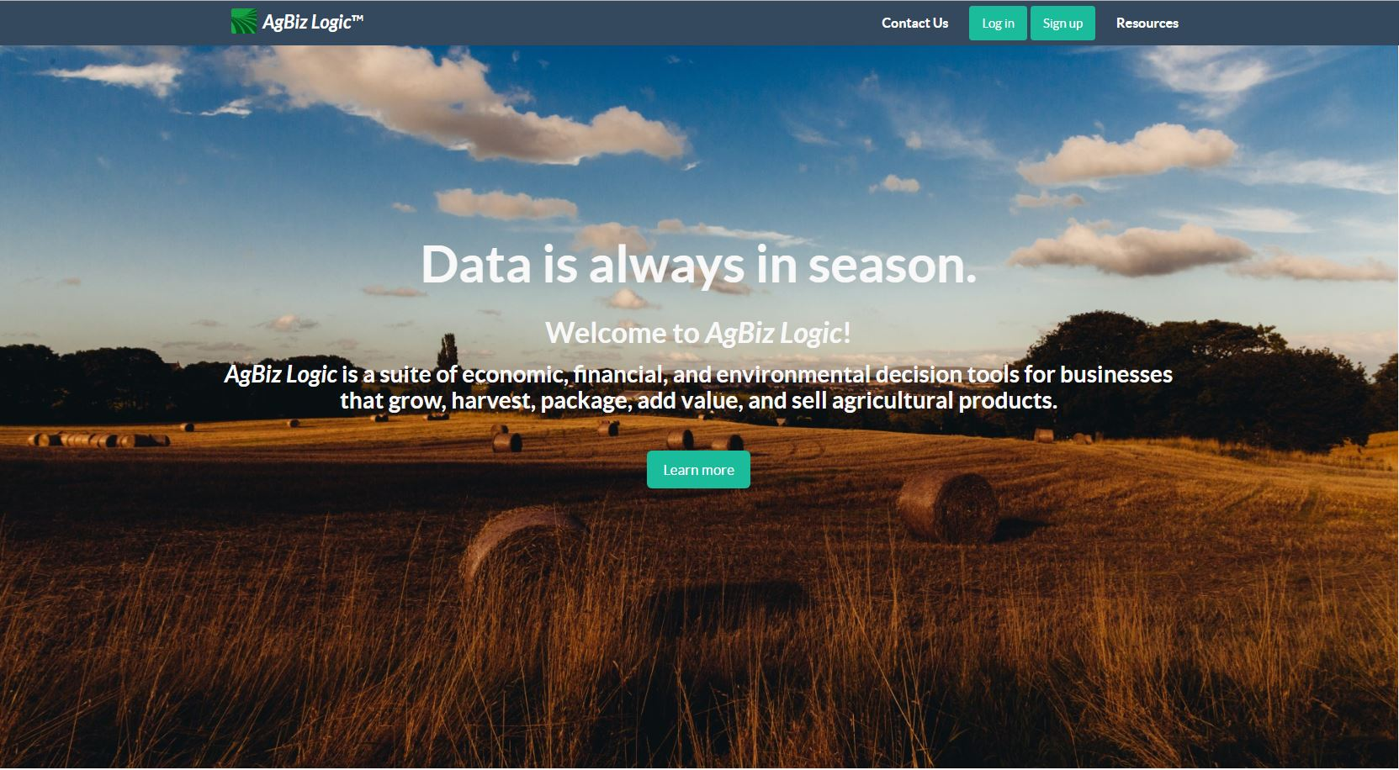
AgBiz-Logic
AgBizClimate
AgBizClimate Workflow
This workflow assumes that the users is already logged on and authenticated via the AgBizLogic Module and has navigated to the Climate Manager.
First, the user select the budgets that they want to analyze over the next 7 months.
2. Then They will then be redirected to the Region selection page. At this page they will select the location their crop is located at by latitude and longitude.
3. Next, The user selects the short term scenario type. Selecting A short term climate Scenario will redirect the user to the charts page where the climate data for their location will be shown on a graph. If the user selects a long term climate scenario the user will be redirected to a page where they will select which variables they would like to analyze.
4. Next, the user will be directed to a page where they will enter adjustments to the yield for each budget that they selected based on the climate variables they were shown.
5. Then user will then be directed to the budget page where they can make adjustments to prices, inputs and other budget parameters. For the budgets they selected.
6. Finally the user will be directed to a climate summary page summarizing how the climate projections will effect their budget.
What is AgBiz-Logic?​
- AgBiz-Logic is a suite of economic, financial, and environmental decision tools for businesses that grow, harvest, package, add value, and sell agricultural products.​
Where does the Financial Data come from?​
- AgBiz-Logic allows users to enter their own budgets or selects University budgets for varying livestock and crops to plan for the future with with AgBiz-Logic tools​
What are the actual components that make up AgBiz-Logic​
- AgBiz-Logic consists of five distinct submodules including AgBizProfit, AgBizLease, AgBizFinance, AgBizEnvironment, and AgBizClimate
AgBizClimate is a submodule of the AgBiz-Logic suite of decision tools. This submodule specializes in assisting farmers and ranchers by supplying them with short and long term weather data which they can use to make decisions on which direction to move their business. More specifically, AgBizClimate provides precipitation and temperature information in a series of graphs associated to the location the users selected via latitude and longitude. Users are then able to input the percent they believe these factors will influence their yields then return calculations to assist their decisions.
On the left is a screenshot of one of the charts used in the AgBizClimate tool to help farmers forecast how climate may affect their crops.
On the right is a use case diagram for the AgBizClimate tool.
Description of the problem
Api Design
Climate change is a huge problem facing many farmers and ranchers. As the climate changes farmers will need to adapt and modify what they grow and how they grow it. To solve this problem will require intelligent data driven solutions.
This project seeks to arm farmers and rancher with a suit of climate tools to help mitigate the effects of climate change. Currently there is already a long term climate tool that helps make longer term predictions. The focus of this project is providing seasonal guidance to farmers and ranches ultimately helping farmers to be more efficient and more profitable.
REST API that provides the climate data for the short term projections.​
This API Connects to a Database run by the University of Idaho .​
This database uses the NOAA’s NMME data set.​
This dataset includes 5 different models that provide short term climate forecasts.​
Provides Forecasts for Temperature and Precipitation.​
API connects to Threads server using the OPeNDAP protocol and reads NETCDF Files containing the relevant forecast data.​
API Uses latitude and longitude to determine the users location. ​
Gets the data for the nearest location within a radius of 16 miles if no data is available for a certain location.
Put Team PHOTO HEEEEEEEEEEER BOIIIIIIIIIIIIIIIIIIIIIII

