Slide 1
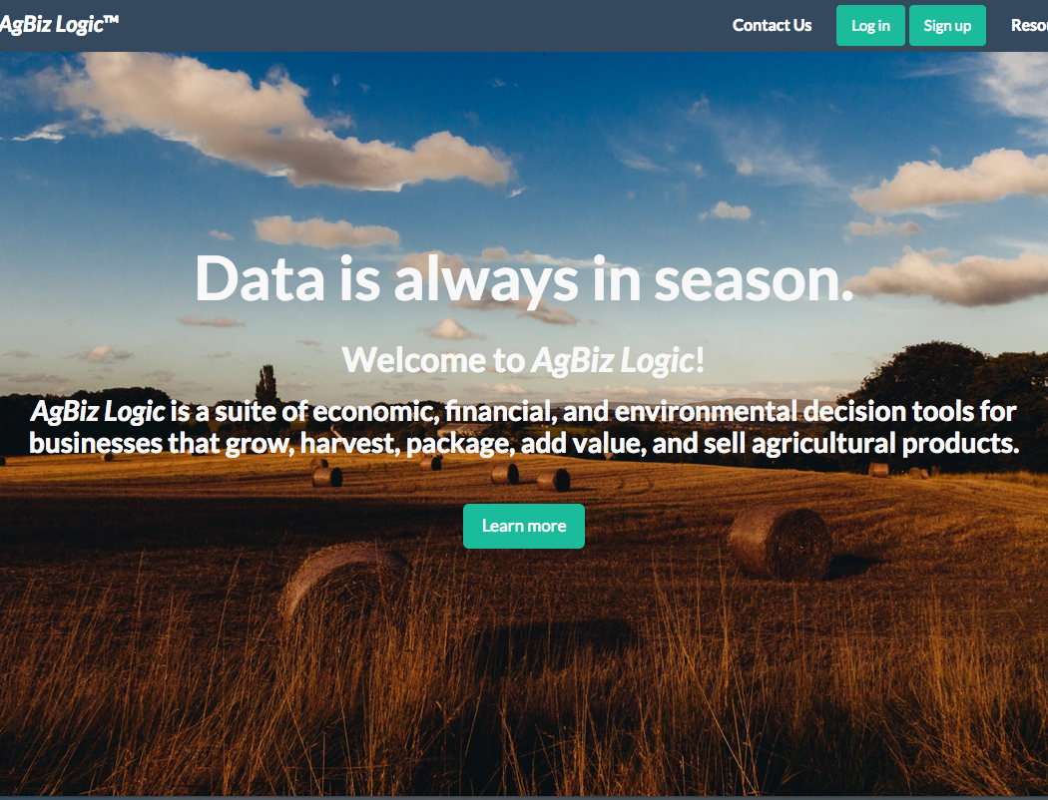
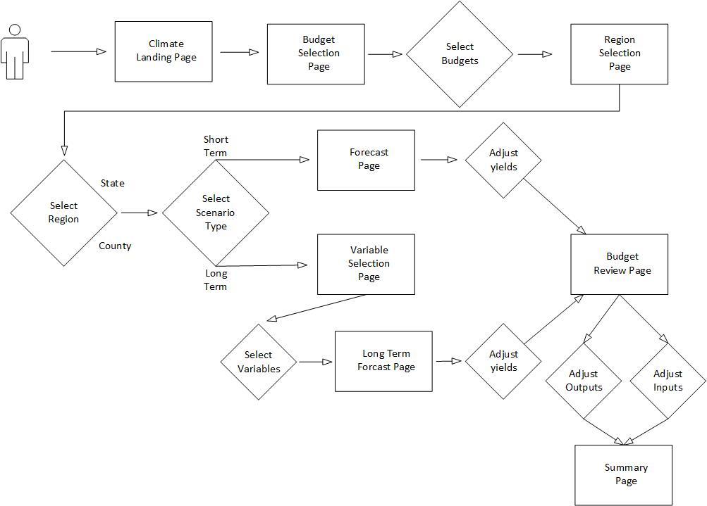
School of Electrical Engineering and Computer Science
AgBizClimate
AgBiz-Logic
What is AgBiz-Logic?
- AgBiz-Logic is Aasuite of economic, financial, and environmental decision tools for businesses that grow, harvest, package, add value, and sell agricultural products.
Where does the Financial Data come from?
- AgBiz-Logic allows users to enter their own budgets or selects University budgets for varying livestock and crops to plan for the future with with AgBiz-Logic tools
What are the actual components that make up AgBiz-Logic
- AgBiz-Logic consists of five distinct submodules including AgBizProfit, AgBizLease, AgBizFinance, AgBizEnvironment, and AgBizClimate
Caption: Dissintemquas dolorem poriaessime voluptati nam everore nobis pore eliquatur re apiet persperibus de maxim dolupta que laboreh enducillest demodi vendiant.
What is AgBizClimate
AgBizClimate Workflow
AgBizClimate Rest API
AgBizClimate is a submodule of the AgBiz-Logic suite of decision tools. This submodule specializes in assisting farmers and ranchers by supplying them with short and long term weather data which they can use to make decisions on which direction to move their business. More specifically, AgBizClimate provides precipitation and temperature information in a series of graphs associated to the location the users selected via latitude and longitude. Users are then able to input the percent they believe these factors will influence their yields then return calculations to assist their decisions.
This workflow assumes that the users is already logged on and authenticated via the AgBizLogic Module and has navigated to the Climate Manager.
The user will then select budgets that they would like to analyze using climate data.
They will then be redirected to the Region selection page. This page will allow users to select their location by state and county. On this page they will also select between long term and short term Scenarios.
Selecting A short term climate Scenario will redirect the user to a Chart page where 7 month temperature and precipitation forecasts will be plotted.
In A long term climate scenario the user will be redirected to the user to a page where they will select which variables they would like to analyze.
In both Scenarios the user will enter adjustments to the yield for each budget that they selected based on the climate variables they were shown.
The user will then be directed to the budget page where they can make adjustments to prices, inputs and other budget parameters.
Finally the user will be directed to a climate summary page summarizing what that scenario did to their budget.
In this section we will discuss the AgBizClimate Rest API that retrieves the long term climate data.
Description of the Problem
Summarize the problem statement here.
PUT TEAM PHOTO IN THIS SPACE HE-REEEEEEE

