Slide 1
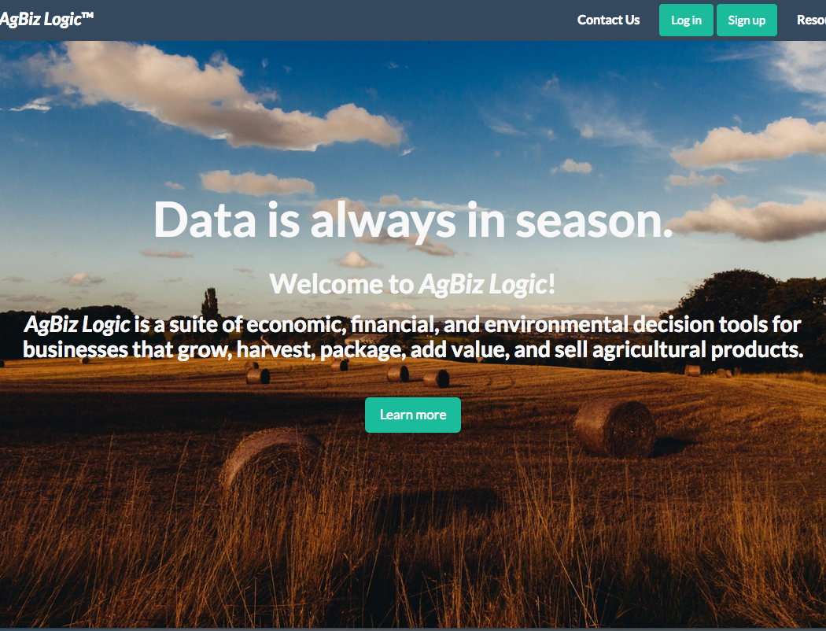
School of Electrical Engineering and Computer Science
AgBizClimate
AgBiz-Logic
What is AgBiz-Logic?
- AgBiz-Logic is Aasuite of economic, financial, and environmental decision tools for businesses that grow, harvest, package, add value, and sell agricultural products.
Where does the Financial Data come from?
- AgBiz-Logic allows users to enter their own budgets or selects University budgets for varying livestock and crops to plan for the future with with AgBiz-Logic tools
What are the actual components that make up AgBiz-Logic
- AgBiz-Logic consists of five distinct submodules including AgBizProfit, AgBizLease, AgBizFinance, AgBizEnvironment, and AgBizClimate
Caption: Dissintemquas dolorem poriaessime voluptati nam everore nobis pore eliquatur re apiet persperibus de maxim dolupta que laboreh enducillest demodi vendiant.
What is AgBizClimate
AgBizClimate Workflow
AgBizClimate Rest API
AgBizClimate is a submodule of the AgBiz-Logic suite of decision tools. This submodule specializes in assisting farmers and ranchers by supplying them with short and long term weather data which they can use to make decisions on which direction to move their business. More specifically, AgBizClimate provides precipitation and temperature information in a series of graphs associated to the location the users selected via lattitude and longitude. Users are then able to input the percent they believe these factors will influence their yields then return calculations to assist their decisions.
Bullet. lum exer adipsustrud doloree tuerat lorpera esenibh eu faccum eum iuscili quamcommy nit lorerillut ullam quat lore verostrud ming et, si tie faciliquisse modolortin volore
Vel et vel dionsenit adit, consenim zzrillute el euguerostie faci bla conse minim zzriure tio dolore tet, volobor si.
Velit vendipit, quat iustrud eraeseniat do conummod ea alisci tie vel ea commodo lortis aliquamcommy niat aliquat niam ercillan eu feugue magnisl utpat autat. Sim ipsum dolorem velis aut vulputpat eu facilit am delestrud eui blan vendre elisisc illaorp ercilisi blan eu faccumsandre tat dipit nis dionull amconsequat, senisi.
Bullet Inset. Amet lorper sit amet veliqui el dio dunt accumsandit ut prat. Duiscin utpat.
Lore del utatis amcorpercin henim zzriliq uismodo leniat aciduisl il eugait velis nos alit prat ad tionsecte conullan et, verit accum ad essi.
Description of the Problem
Body. Duismolessi. Del utem ex et, sumsan utat amet dolorero commy nulla feugait, sit alisci bla core doleniat, consectem volobore core eu facil irit dip et wis nim nostincin henim quamconsed tat veliscin ulputem vel ut Ovit eum facernatiunt harum as voloremquis ea si des alit, ant repuda ipietur rae apeditas maionserum vendaest?
Beremporem quias is eaqui coratia epudandaerum accuptat voluptur, idest, cusciates et et atat volorrum quataerovit, sequunt, omnihilia conet et atia num sinciis re nam quid eos ex erias rae nus quis maximus, et ommolupta sam fugit accab inctist, santota tinctur endessitio estion perempo reptatibus, id ut vernatur sunt mos mosam inihilissit quo con nos eume dolo quist, et laboria aciam. Obis erit erianti debit, odi consequate dolupta epudit et etur rempore, core corrovit aut ipsantiunt velit quas ipsant, consenis audis as por sit, quaeped ionsequia vel estibus estiusam il.
PUT TEAM PHOTO IN THIS SPACE HE-REEEEEEE

