Slide 1
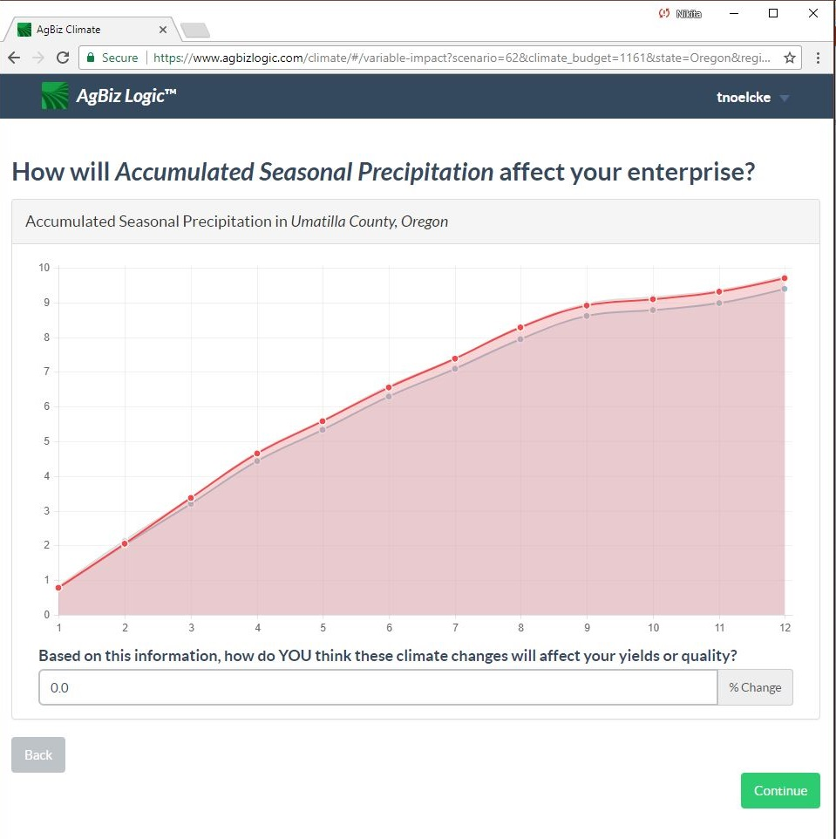
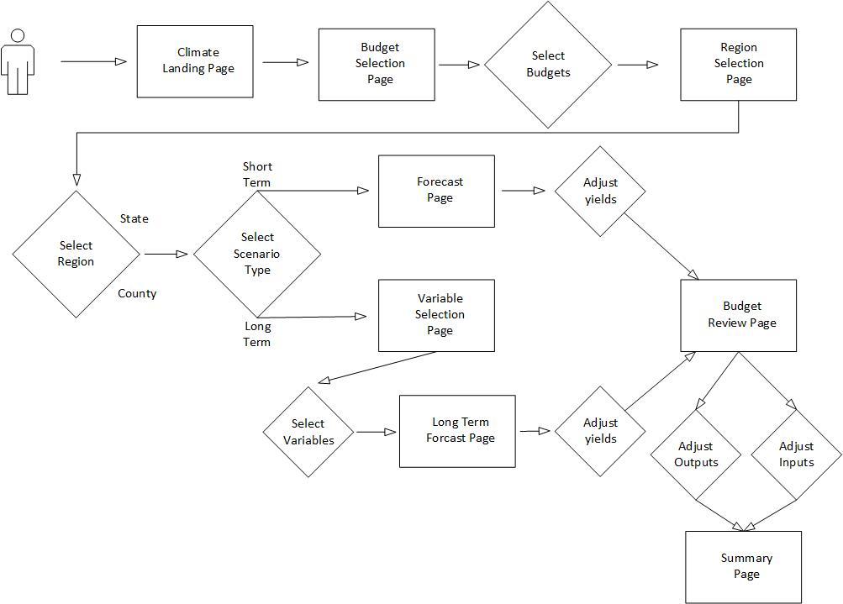
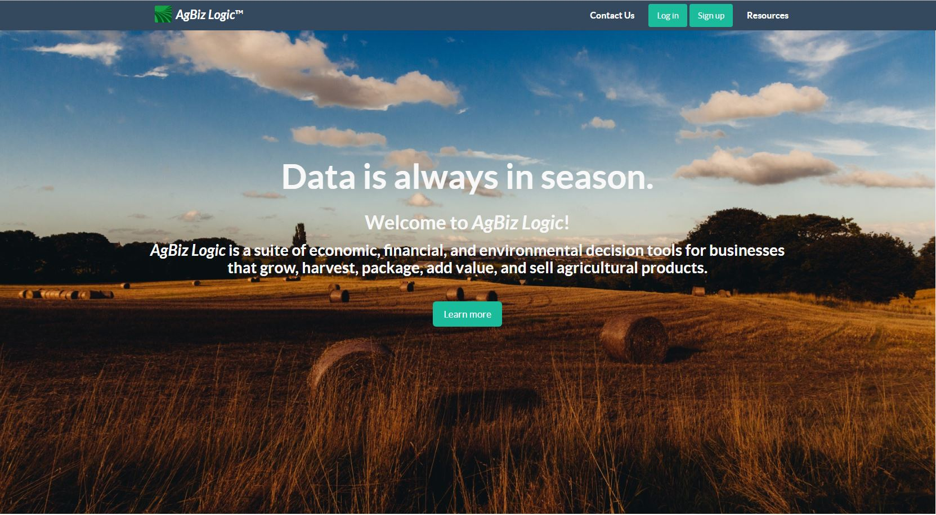



CS26
AgBiz-Logic: AgBizClimate
AgBizClimate Workflow
AgBiz-Logic
This workflow assumes that the users is already logged on and authenticated via the AgBizLogic Module and has navigated to the Climate Manager.
First, the user select the budgets that they want to analyze over the next 7 months.
Then they will then be redirected to the region selection page. At this page they will select the location by county state.
Next, The user selects the short term scenario type. Selecting short term climate Scenario will redirect the user to the charts page where the climate data for their location will be shown on a graph. If the user selects long term climate scenario the user will be redirected to a page where they will select which variables they would like to analyze.
Next, the user will be directed chart page where they may enter adjustments to the yield for each budget that they selected based on the climate variables shown.
The user will then be directed to the budget page where adjustments to prices, inputs, and other budget parameters may be made for selected budgets.
Finally the user will be directed to a climate summary page summarizing how the climate projections will affect their budget.
What is AgBiz-Logic?​
AgBiz-Logic is a suite of economic, financial, and environmental decision tools for businesses that grow, harvest, package, add value, and sell agricultural products.​
Where does the Financial Data come from?​
AgBiz-Logic allows users to enter their own budgets or selects University budgets for varying livestock and crops to plan for the future with with AgBiz-Logic tools​.
What are the actual components that make up AgBiz-Logic​?
AgBiz-Logic consists of five distinct submodules including AgBizProfit, AgBizLease, AgBizFinance, AgBizEnvironment, and AgBizClimate.
What are the goals of AgBiz-Logic?
AgBiz-Logic seeks to assist farmers and ranchers by supplying them with management tools. Additionally, the data produced by these modules will be used by researches to study the effects of climate change on farming and ranching.
AgBizClimate is a submodule of the AgBiz-Logic suite of decision tools. This submodule specializes in assisting farmers and ranchers by supplying them with short and long term weather data which they can use to make financial decisions. More specifically, AgBizClimate provides precipitation and temperature information in a series of graphs associated to the location the users selected via latitude and longitude. Users are then able to input the percent they believe these factors will influence their yields , AgBizClimate will then return the results of the calculations based on the users to assist their decisions.
Figure 1: A screenshot of the AgBiz-Logic Short term Climate tool. This Screen Shot shows the plotting tool where the user can make choices about their crop based on the plot.
Figure 2: Shown Above is a use case diagram for the AgBizClimate tool.
The Team
Description of the problem
Api Design
Thomas Noelcke
Climate change is a huge problem facing many farmers and ranchers. As the climate changes farmers will need to adapt and modify what they grow and how they grow it. To solve this problem will require intelligent data driven solutions.
This project seeks to arm farmers and rancher with a suit of climate tools to help mitigate the effects of climate change. Currently there is already a long term climate tool that helps make longer term predictions. The focus of this project is providing seasonal guidance to farmers and ranches, ultimately helping farmers to be more efficient and more profitable.
REST API that provides the climate data for the short term projections.​
Data: Downscaled version of NOAA’s NMME dataset hosted by University Of Idaho.
Data files are stored on the production server. The production sever updates the data at the same date every month.
API Connects Reads Data From the Production server via a Bind Mount to a directory on the production server.
API Uses latitude and longitude to determine the users location. ​
Gets the data for the nearest location within a radius of 20 miles if no data is available for a certain location.
Shane Barrantes
Shengpie Yuan

