Slide 1

Welcome to
Team Báo Đời

Slide 2
4 con BÁO
01
03
02
04
Trần Nguyên Phúc ITCSIU21097
Nguyễn Tuấn Khoa ITCSIU21140
Algorithms, Sound, UML, Git
Algorithms, Entities
Nguyễn Mạch Khang Huy ITCSIU21072
Võ Trần Khánh Quỳnh ITITIU21024
Objects, Debug, Design
Controls, Debug, Objects

Slide 3
Contents
Game description | Introduce the game, describe some features, how to play.
Game rule Game algorithm | Illustrate all the game rules. Show the path finding algorithm
Diagram | Show the diagram of the functions
Demo | A showcase of the game

Slide 4
Game description
01
01

Slide 5
About the game
Language | Java
IDEs | IntelliJ IDEA, VSCode
Library | JavaSwing
Game Engine | Java2D
Sound | JavaSound

Slide 6
About the game (Target)
Catch Me If You Can
Player need to survive as long as possible by running away from the boss and avoid being caught

Slide 7
About the game (Control)
Catch Me If You Can
UP | Move up
DOWN | Move down
LEFT | Move left
RIGHT | Move right

Slide 8
About the game (Objects)
Catch Me If You Can
Teleport In | Teleport the player to a random teleport out and cooldown immediately (30s) since the player went into the port
Teleport Out | An exit for player whenever they go into the Teleport In

Slide 9
Game Rule
02

Slide 10
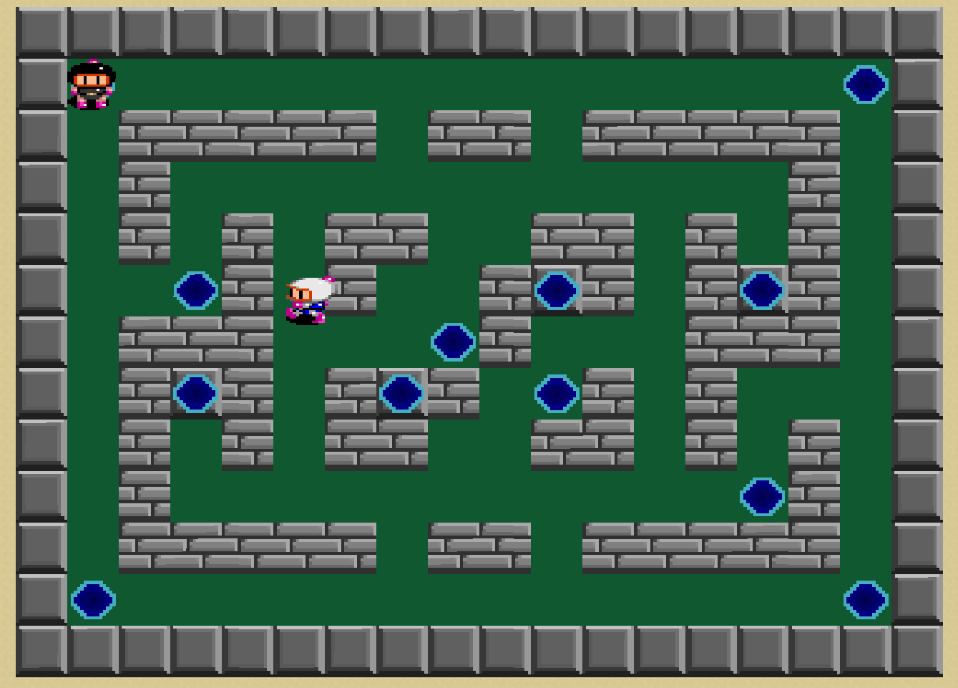
Rules

Slide 11



Rules
Teleport In
Teleport Out
Teleport In
(Cooldown)

Slide 12
Game Algorithm
03

Slide 13
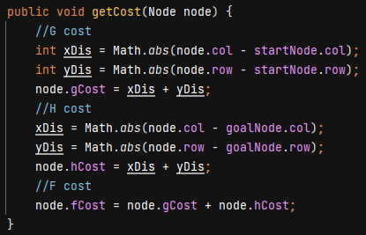
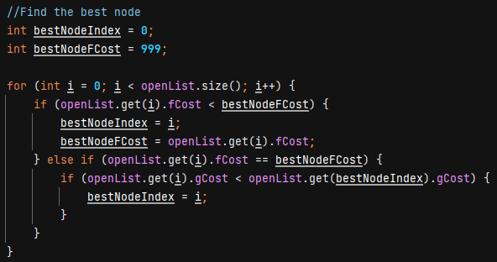
A* Algorithm

Slide 14
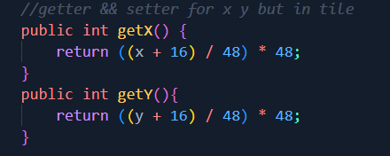
Private data with getter and setter
Why using it?
We must force user to manipulate data the way we want

Slide 15
Diagrams
03

Slide 16
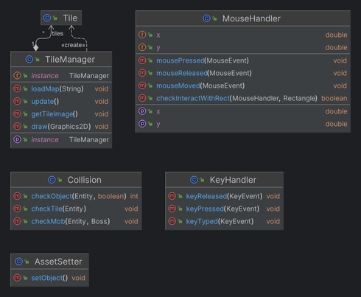
Utility

Slide 17
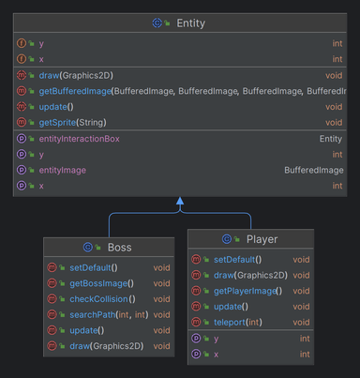
Entity

Slide 18
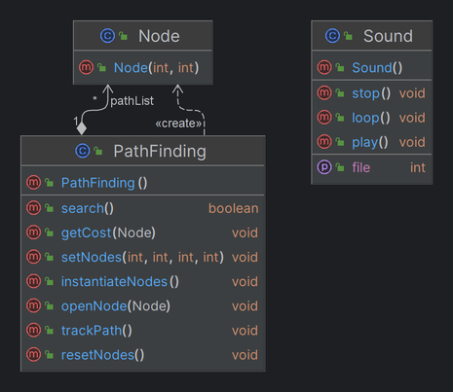
A* and Sound

Slide 19
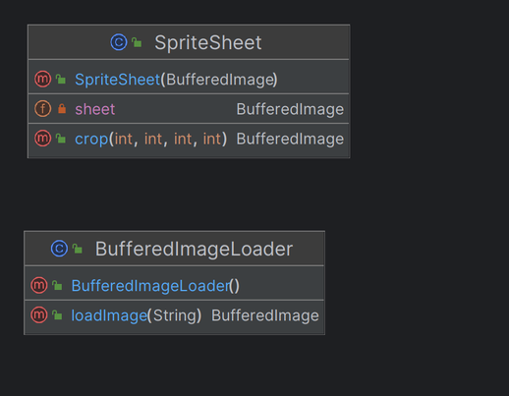
Graphic

Slide 20
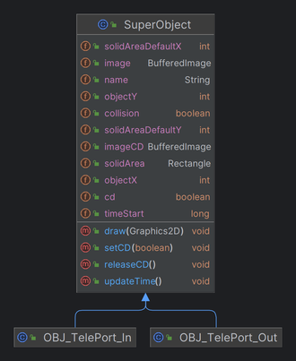
Object

Slide 21
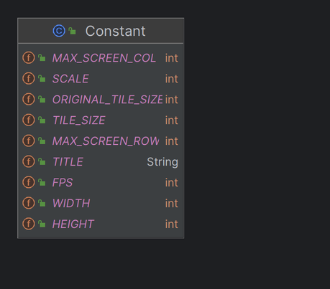
Constant

Slide 22
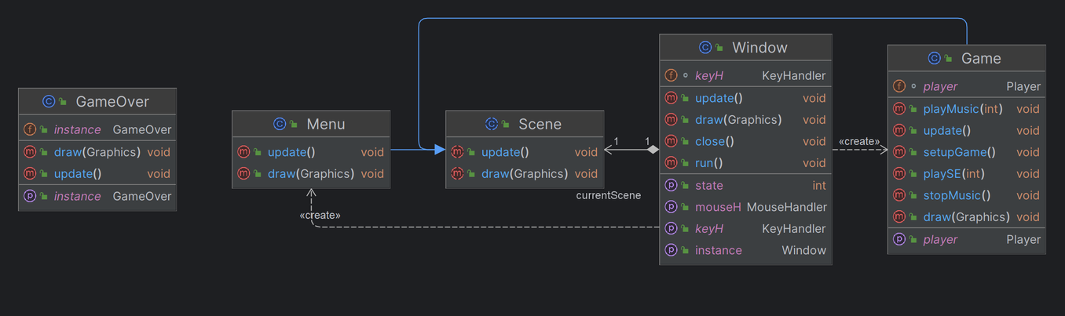
Configuration

Slide 23
Demo
04

