Slide 1
Collection In C Sharp
By
Durga Prasad manukonda

Slide 2
What is a Collection?
﻿A Collection is a group of objects stored together in a single variable.
It is used to store, manage, and manipulate multiple data items efficiently.
Collections are data structures that holds data in different ways for flexible operations. C# Collection classes are defined as part of the System.Collections or System.Collections.Generic namespace.
Most collection classes implement the same interfaces, and these interfaces may be inherited to create new collection classes that fit more specialized data storage needs.

Slide 3
Problem with Arrays (Fixed Size):
Arrays have several limitations when compared to collections.
Problems:
Array size is fixed once it is created.
Increasing size requires creating a new array and copying data.
Insertion and deletion operations are difficult because elements must be shifted.
Arrays have limited built-in functionality for data manipulation.
They are less flexible for handling changing data requirements.

Slide 4
Why Collections are Used in C#:
Collections are used to store and manage groups of data in a flexible and efficient way.
Collections allow dynamic resizing (can grow or shrink at runtime).
They provide built-in methods like Add(), Remove(), Contains(), Sort().
They improve performance through optimized data structures.
Generic collections provide type safety.
They are widely used in real-time applications such as managing student lists, product records, queues, and stacks.

Slide 5
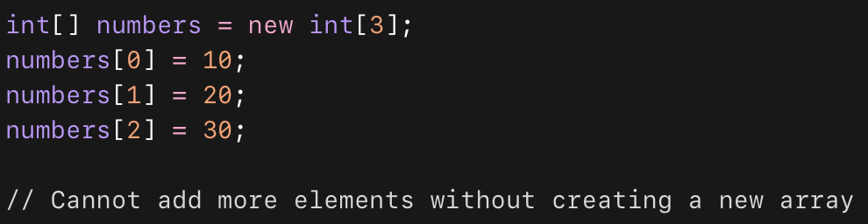
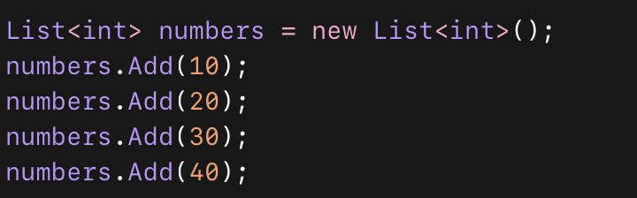
Simple Example For Array vs Collection:
Array(Fixed Size):
Collection:

Slide 6
Types of Collections:
Generic collections
Non-Generic collections
Specialized collections

Slide 7
Generic vs Non-Generic vs Specialized :
Feature | Generic | Non-Generic | Specialized
Namespace | System.Collections.Generic | System.Collections | System.Collections.Specialized
Type Safety | Yes | No | Limited
Performance | Fast | Slow | Limited
Casting | Not Required | Required | Sometimes
Usage | Modern / Recommended | Old / Legacy | Specific Purpose
Examples | List<T>, Dictionary<TKey,TValue> | ArrayList, Hashtable | StringCollection, NameValueCollection

Slide 8
Generic collections:
Generic Collections are collections that store data of a specific data type (type-safe).
They use type parameter <T>
This means:
Only one type of data can be stored
Errors are checked at compile time
No boxing / unboxing
Better performance

Slide 9
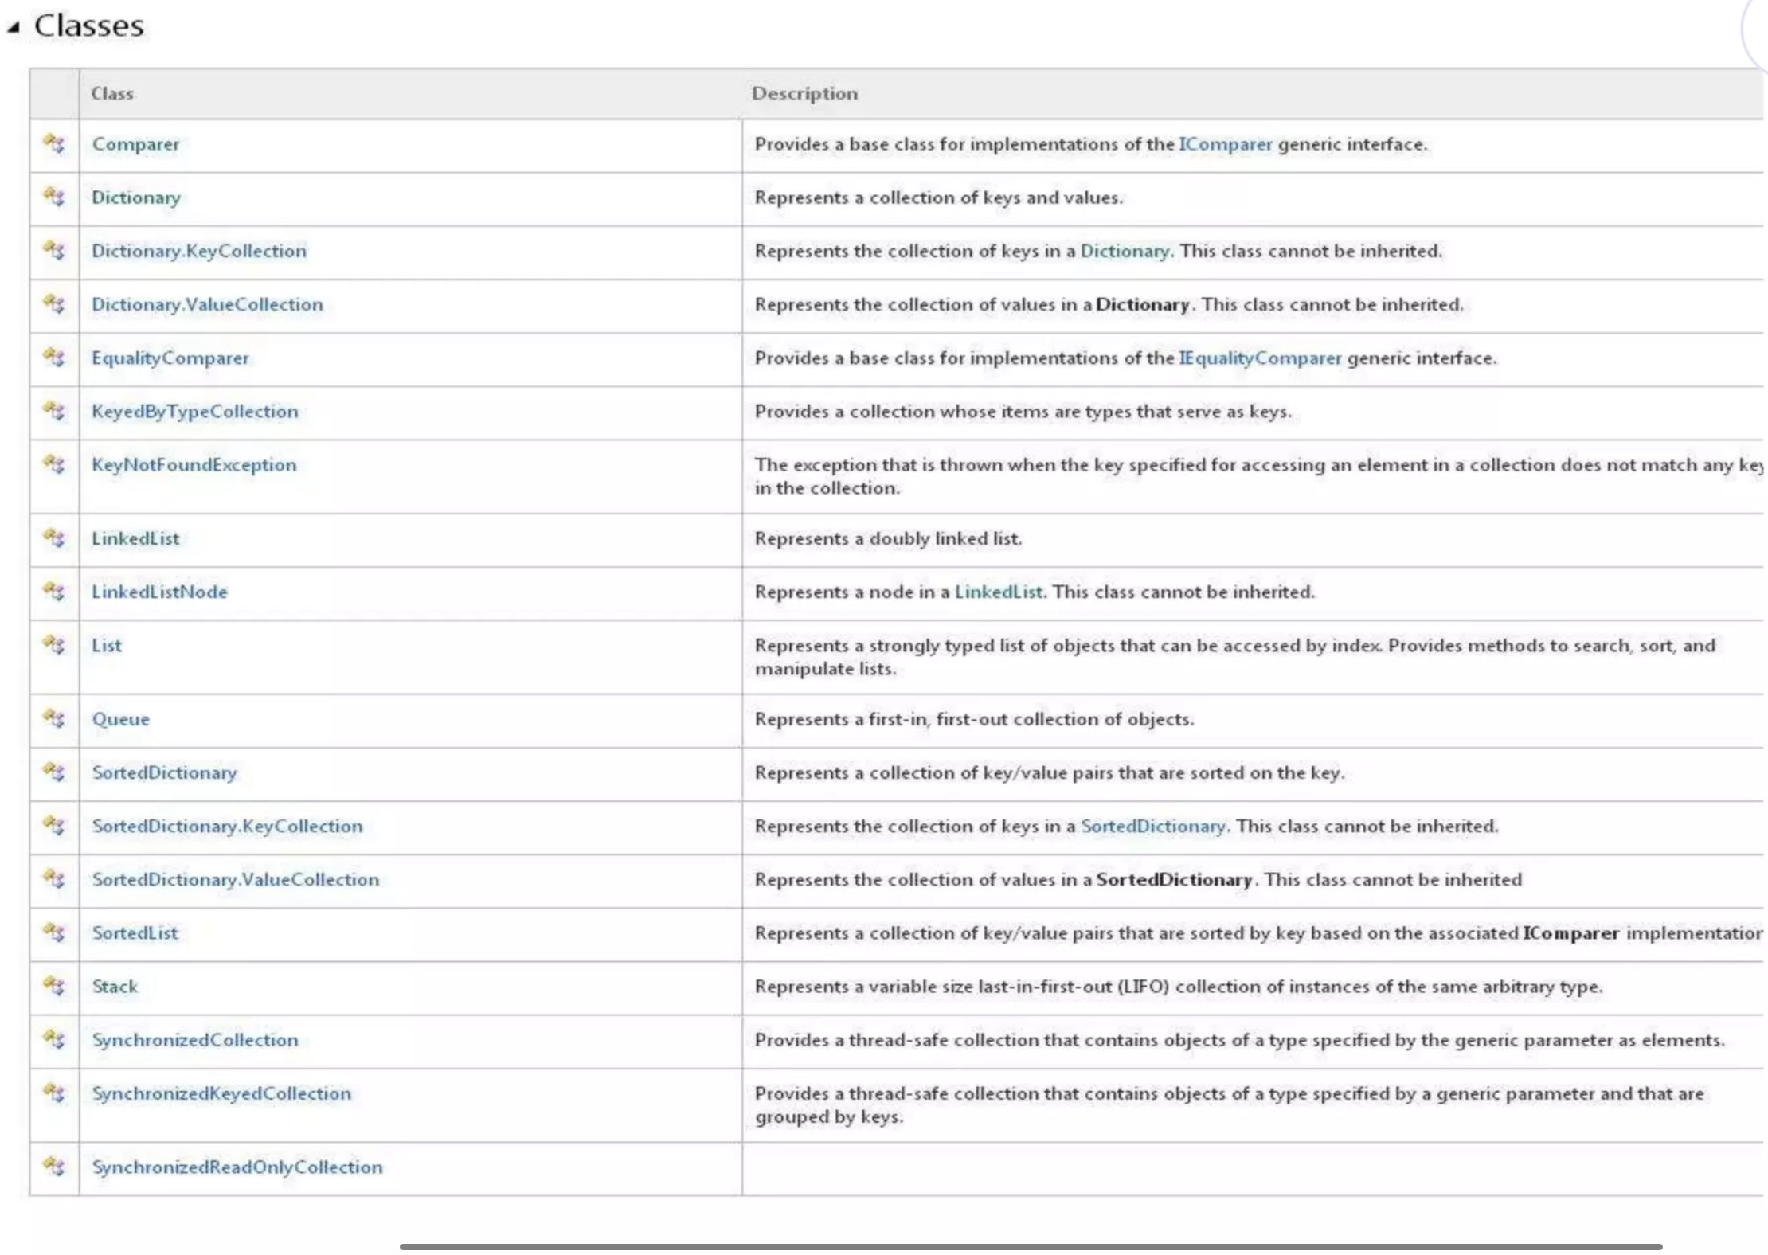

Slide 10
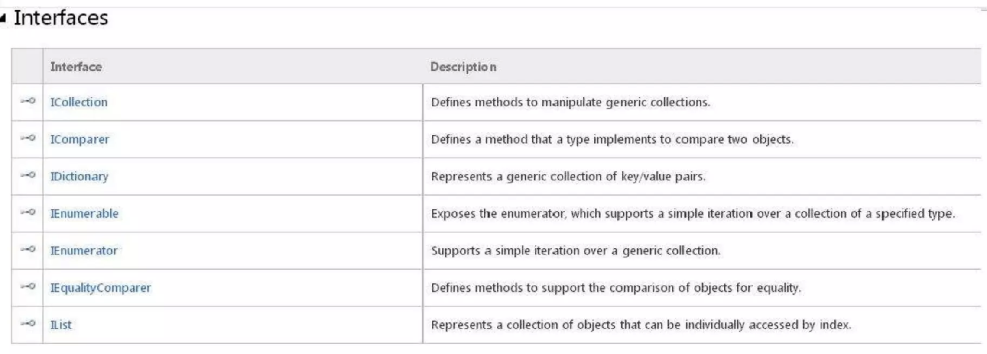
Generic Collection Interfaces:

Slide 11
Dictionary Generic Collection:
A Dictionary<TKey, TValue> is a generic collection that stores data in Key–Value pairs.
Fast lookups are critical. The Dictionary type provides fast lookups with keys to get values.
With it we use keys and values of any type, including int's and strings.
Each key must be unique
Values can be duplicate
Namespace:
using System.Collections.Generic;

Slide 12
Important Methods In Dictionary:
Method | Description
Add() | Adds new key-value
Remove() | Removes element using key
ContainsKey() | Checks key exists
ContainsValue() | Checks value exists
Clear() | Removes all elements
Count | Total elements
For Iterating Dictionary :
foreach (KeyValuePair<int, string> pair in students)
{
Console.WriteLine(pair.Key + " " + pair.Value);
}

Slide 13
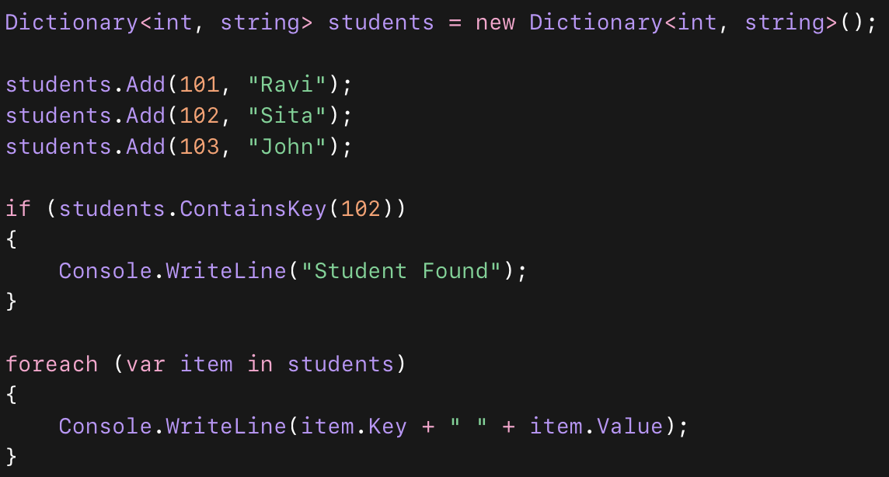
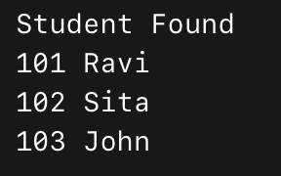
A simple code example of Dictionary Generic Class :
Output:

Slide 14
List Generic Class:
List<T> is a generic collection used to store multiple values of same data type.
It is dynamic (resizable)
Provides index-based access (like arrays)
Provides many built-in methods
Namespace:
using System.Collections.Generic;

Slide 15
C# List Methods Table:
Method/Property | Purpose | Example | Result
Add(item) | Add single Item at the end | List.Add(10) | [10]
AddRange(Collection) | Adds multiple elements | List.AddRange(new int[]{20,30}) | [10,20,30]
Insert(index,item) | Insert at specific position | List.Insert(1,15) | [10,15,20,30]
Remove(item) | Removes first matching value | List.Remove(20) | [10,15,30]
RemoveAt(index) | Removes element by index | List.RemoveAt(1) | [10,30]
RemoveAll(condition) | Removes elements based on condition | List.RemoveAll(x=>x>10) | [10]
Clear() | Removes all elements | List.Clear() | []
Contains(item) | Checks if element exists | List.Contains(10) | true / false
IndexOf(item) | Returns index of element | List.IndexOf(30) | 1
Sort() | Sorts elements ascending | List.Sort() | [10,30]
Count | Returns number of elements | List.Count | 2
List[index] | Access element by index | List[0] | 10

Slide 16
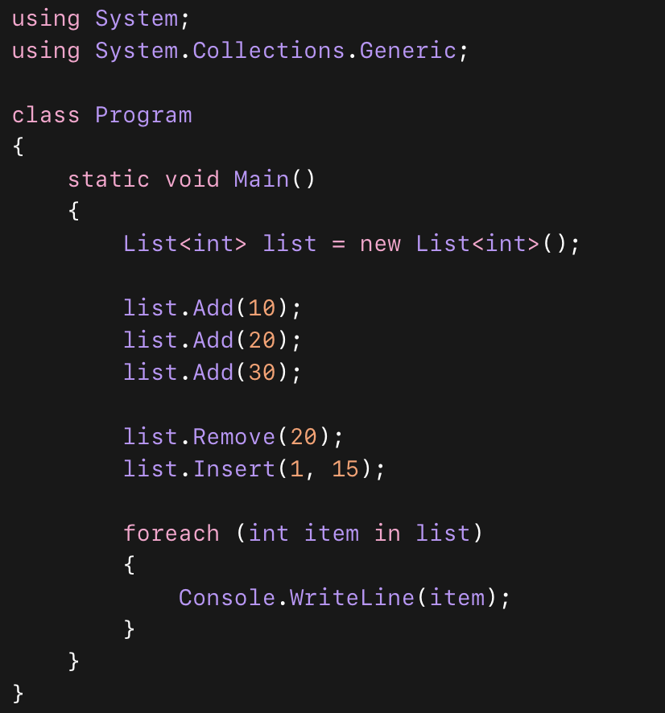

A Sample Code For List Generic Class:
Output:

Slide 17
Stack Generic Class:
A Stack is a collection that follows:
LIFO Principle (Last In First Out)
The element added last will be removed first.
Example real life:
Undo operation in editors
Stack of plates 🍽
NameSpace:
System.Collections.Generic

Slide 18
Stack Methods:
Method | Purpose | Example
Push() | Add element to top | stack.Push(10)
Pop() | Remove & return top element | stack.Pop()
Peek() | View top element | stack.Peek()
Contains() | Check element exists | stack.Contains(20)
Clear() | Remove all elements | stack.Clear()
Count | Number of elements | stack.Count

Slide 19
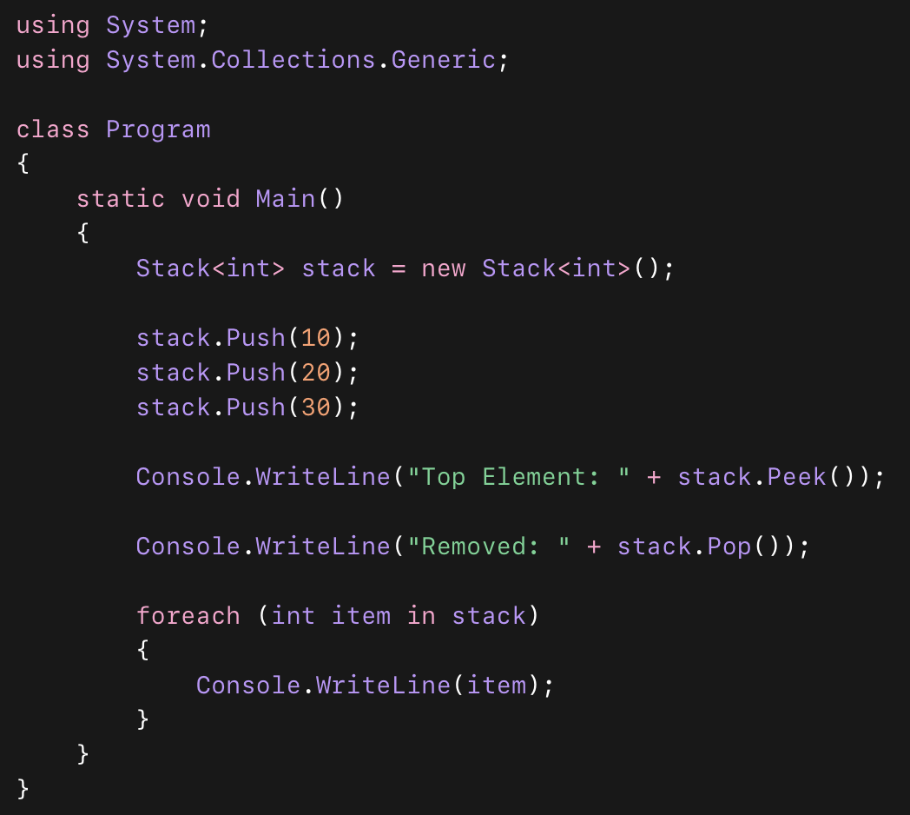
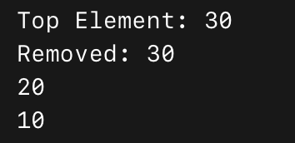
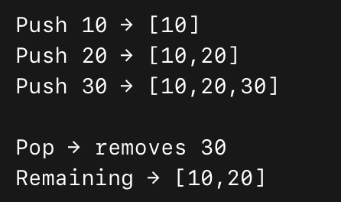
A Sample Code For Stack Generic Class:
Output:
Stack Visualization:

Slide 20
Queue Generic Class:
A Queue follows:
FIFO Principle (First In First Out)
The element added first will be removed first.
Real-life examples:
Ticket counter line 🎫
Printer queue 🖨
Namespace:
System.Collections.Generic

Slide 21
Queue Methods:
Method | Purpose | Example
Enqueue() | Add element at rear | queue.Enqueue(10)
Dequeue() | Remove & return front element | queue.Dequeue()
Peek() | View front element | queue.Peek()
Contains() | Check element exists | queue.Contains(20)
Clear() | Remove all elements | queue.Clear()
Count | Number of elements | queue.Count

Slide 22
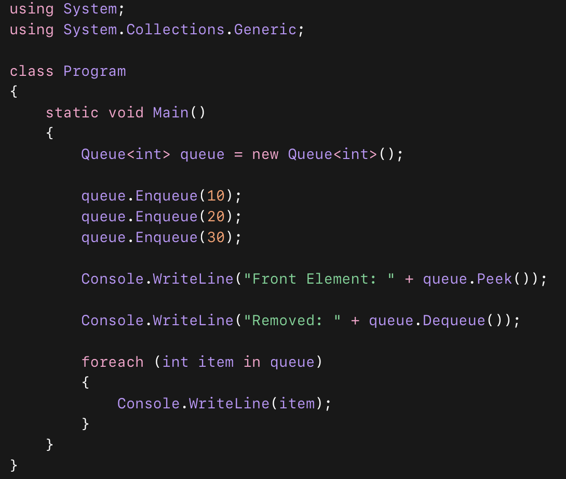
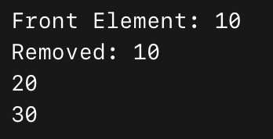
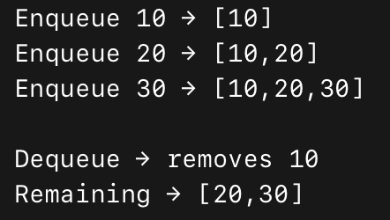
A Sample Code For Queue Generic Class:
Output:
Queue Visualization:

Slide 23
HashSet Generic Class:
A HashSet is a collection that:
Stores unique elements only
Does NOT allow duplicates
It is unordered (no index)
Uses hashing → very fast search
Dictionary stores duplicate values whereas HashSet stores Unique values

Slide 24
HashSet Methods:
Method | Purpose | Example
UnionWith() | Combine two sets | set1.UnionWith(set2)
IntersectWith() | Common elements | set1.IntersectWith(set2)
ExceptWith() | Remove matching elements | set1.ExceptWith(set2)

Slide 25
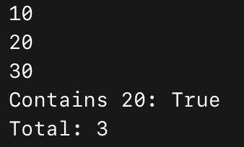
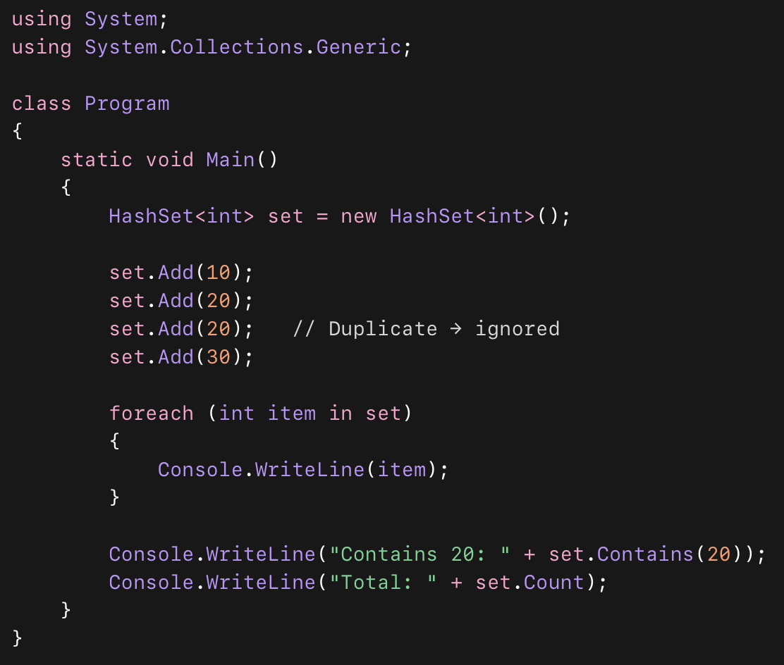
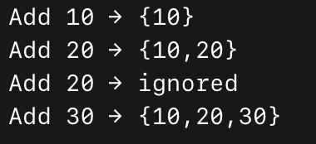
A Sample Code For HashSet Generic Class:
Output:
HashSet Visualization:

Slide 26
Non-Generic Collections
Non-Generic collections are collection classes that store data as object type.
They are available in the System.Collections namespace.
Because they store mixed data types, they are not type-safe and involve Boxing / Unboxing, which affects performance.
Generic collections are generally recommended over non-generic ones

Slide 27
Types of Non-Generic Collections in C#
ArrayList:
A dynamic array similar to List<T>, but it can store elements of different data types.
Hashtable:
Stores key-value pairs, where data is organized based on the hash code of the key for fast searching.
Queue:
A FIFO (First In First Out) collection — elements are added at the rear and removed from the front.
Stack:
A LIFO (Last In First Out) collection — elements are added and removed from the top.

Slide 28
Specialized Collections:
They are designed for specific purposes, mainly optimized for string handling, key-value storage, or notifications.
They are non-generic collections.
Efficient string storage
Small collection optimization
Multiple values per key
Bit-level memory saving
Automatic performance switching
Namespace:
System.Collections.Specialized

Slide 29
Types of Specialized Collections:
Collection Type | Description
NameValueCollection | Stores key-value pairs where both key and value are strings
NameObjectCollectionBase | Base class for collections that store string keys and object values
StringCollection | Stores only string values (like List<string>)
StringDictionary | Stores string key and string value pairs
HybridDictionary | Automatically switches between ListDictionary and Hashtable based on size
ListDictionary | Best for small collections (uses linked list internally)
BitVector32 | Efficient storage for Boolean flags or small integers

Slide 30
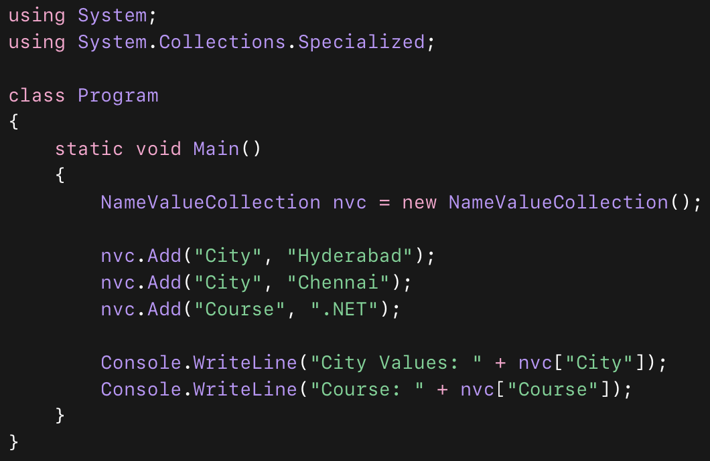
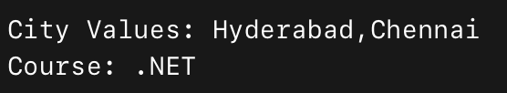
A Sample code for NameValueCollection:
Output:

Slide 31
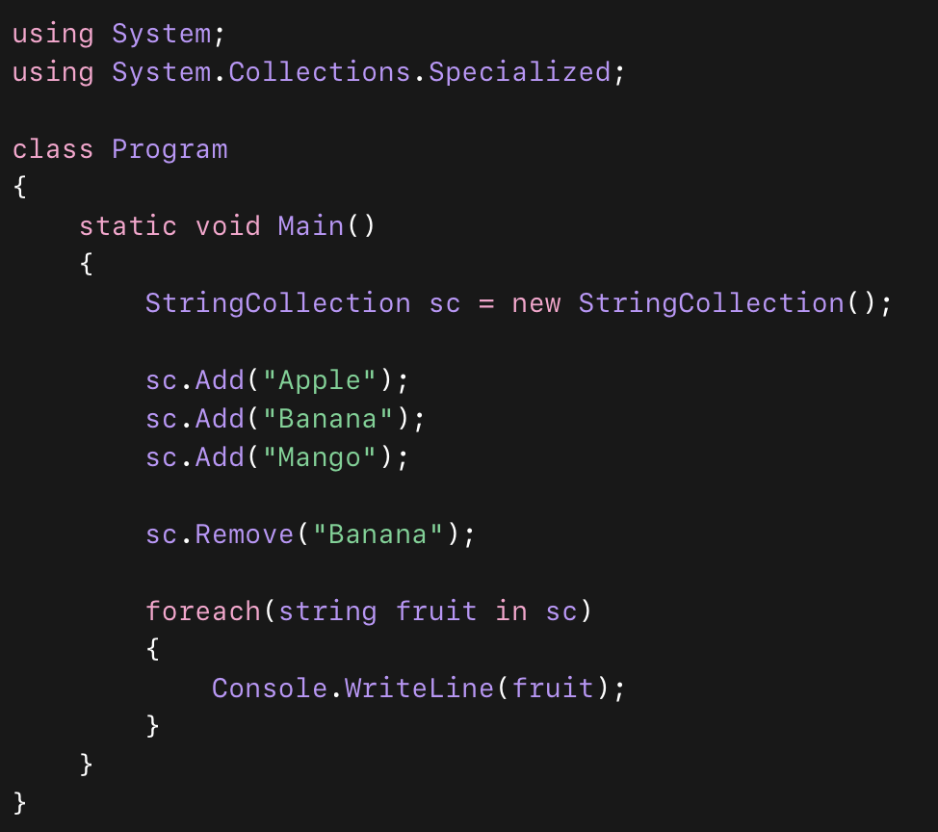
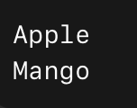
A Sample code for StringCollection:
Output:

Slide 32
Conclusion:
Collections in C# are used to store and manage groups of data efficiently.
There are three main types of collections: Generic, Non-Generic, and Specialized.
Generic collections provide type safety, better performance, and are widely used in modern development.
Non-Generic collections allow storing different data types but lack type safety.
Specialized collections are designed for specific scenarios like string handling and small data sets.
Choosing the right collection improves performance, code readability, and maintainability.
In real-time applications, developers mostly prefer Generic collections for effective data handling.

Slide 33
Thank You

