Slide 1


CAN BETTER REQUIREMENTS ENGINEERING EDUCATION
REDUCE PROJECT FAILURES? AN INDUSTRY-ACADEMIA
GAP ANALYSIS
Presentation By
Section 2 Group 4
Sajidur Rahman 2120352
Sindid Rahman 2131001
Md.Nawez Sharif 2030692
Towsif Islam 2010651
Tamanna Mannan 2010294
Mubasshira Siddiqua 2131278
MD Muhaiminul Islam 2030989
Abir Ehsan Evan 1930670
Jawhar Galib Milkan 2120947
Saikat Barua 2110205

Slide 2
Abstract
A significant number of software projects fail due to inefficiencies in requirements identification and management. This paper investigates whether bridging the gap between academic instruction in requirements engineering (RE) and the practical demands of industry professionals can mitigate costly project failures. We found that traditional RE education often misaligns with real-world practices, which leads to graduates being underprepared. Through surveys and data analysis, we propose modernizing RE education to incorporate agile practices, AI tools, and real-world case studies, thereby reducing failure rates stemming from requirements mismanagement.

Slide 3
INTRODUCTION
Background of the Topic
Requirements Engineering (RE) is a crucial phase in software development, yet a substantial portion of projects fail due to inadequate requirements management. Academic RE instruction often emphasizes rigid, theoretical frameworks, while industry practitioners face dynamic challenges like evolving stakeholder expectations, agile adoption, and stringent security standards. This disconnect leads to a gap between what is taught and what is needed in practice.
Objective
The primary objective of this study is to examine whether modernizing RE education through industry-academia collaboration can better prepare students for real-world challenges, ultimately reducing project failure rates

Slide 4
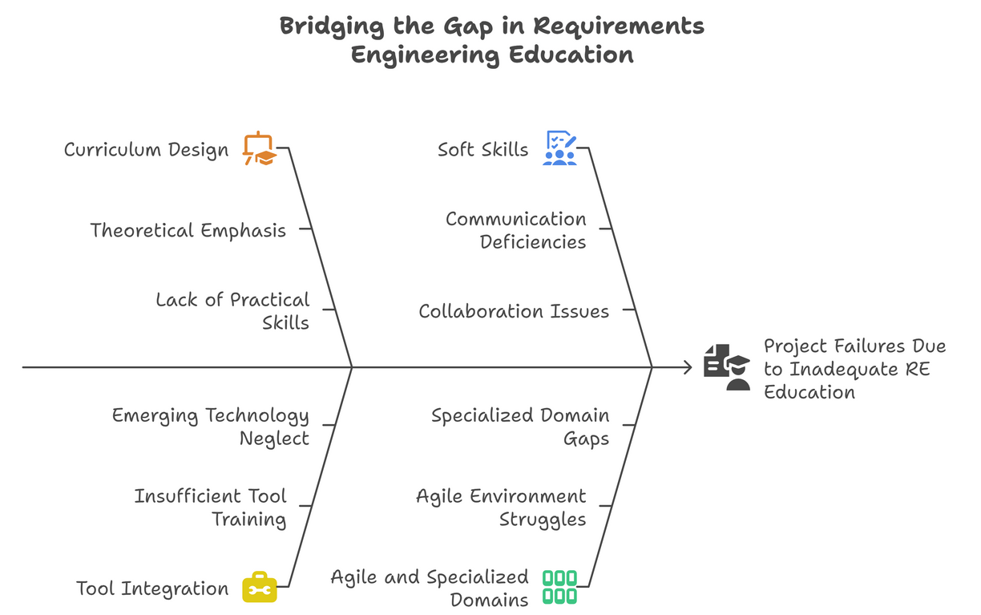
Problem Statement
Fig. 1
Challenges Faced
As illustrated in Figure 1 (which shows the Industry-Academia Gap leading to Project Failures), a significant misalignment exists between academic RE instruction and the practical demands of modern software development. Industry surveys consistently identify unclear requirements, scope creep, and poor stakeholder communication as primary contributors to project failures. Graduates often enter the workforce lacking proficiency in contemporary tools, struggling with iterative validation processes, and possessing insufficient soft skills for effective stakeholder collaboration. This skills gap is particularly pronounced in agile environments and specialized domains like autonomous systems and machine learning.

Slide 5
Approach to Overcome the Challenges
To overcome these challenges, the approach involves reforming RE education through industry-aligned curricula, practical training, and modern tool integration.

Slide 6
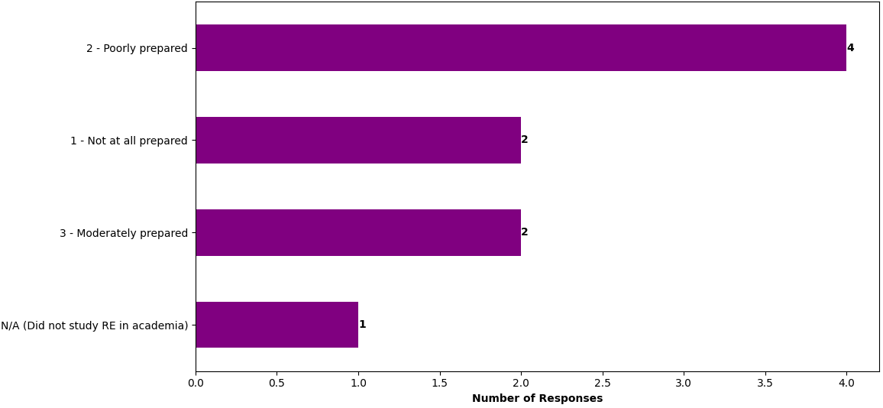
Our survey findings reveal critical insights into the perceived gaps and desired improvements in RE education.
Fig.2
Perceived Level of Academic Preparation: According to Our Survey (Perceived Level of Academic Preparation for Industry RE Challenges), 44% of respondents felt poorly or entirely unprepared by their academic education for real-world RE demands.

Slide 7
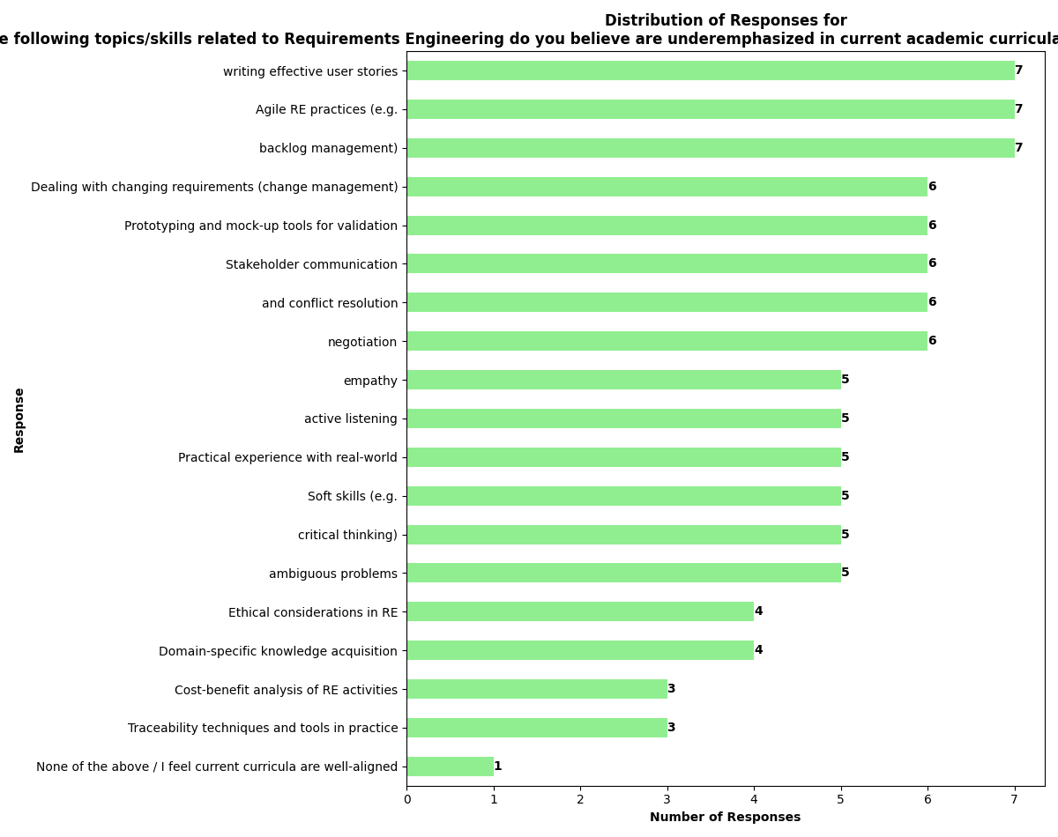
Fig.3
Underemphasized Topics/Skills: From our survey ,The chart (RE Topics and Skills Identified as Underemphasized in Academic Programs) highlights significant gaps in Agile requirements practices, stakeholder interaction, and managing evolving requirements, with writing effective user stories and Agile RE practices topping the list.

Slide 8
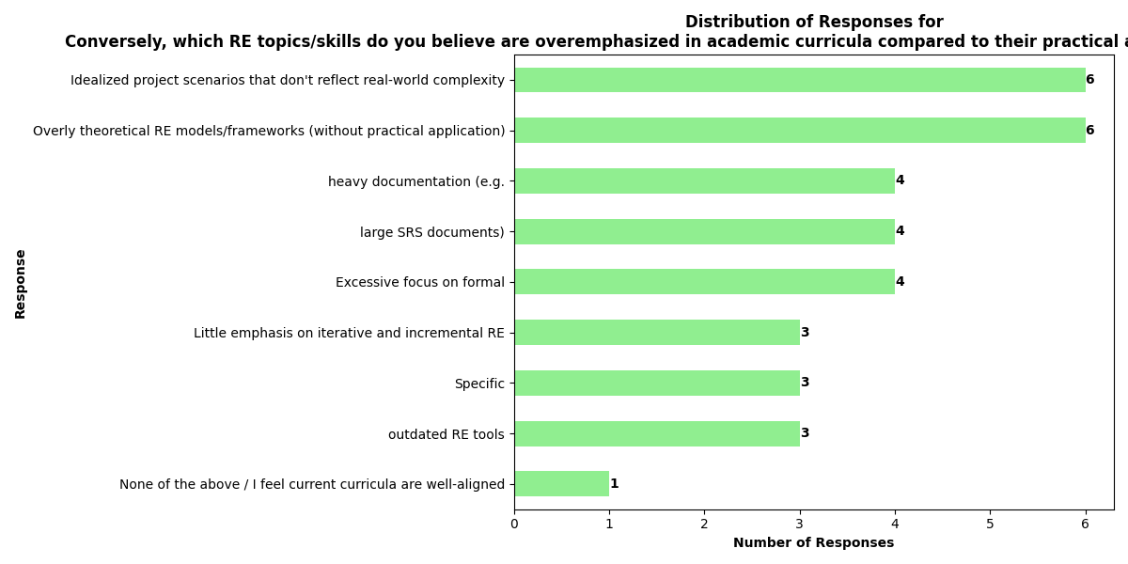
Fig.4
Overemphasized Topics/Skills: The bar chart, Conversely (RE Topics/Skills Overemphasized in Academic Curricula) indicates that idealized project scenarios and overly theoretical frameworks are often overemphasized.

Slide 9
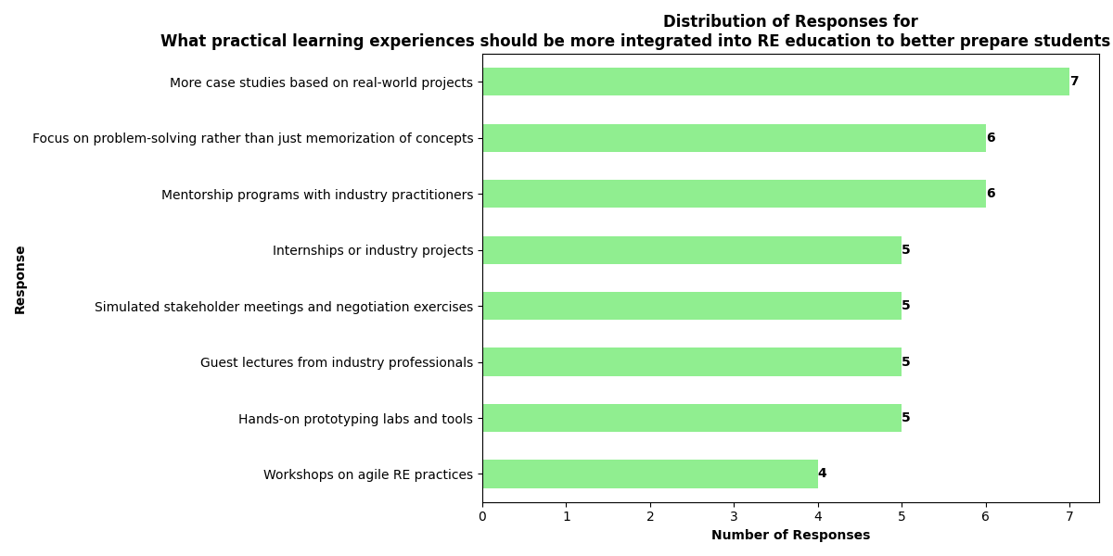
Fig.5
Recommended Practical Learning Experiences: The chart (Recommended Practical Instructional Methods for RE Education) shows a strong preference for practical instructional methods such as real-case scenarios, mentorship programs, and hands-on tool training.

Slide 10
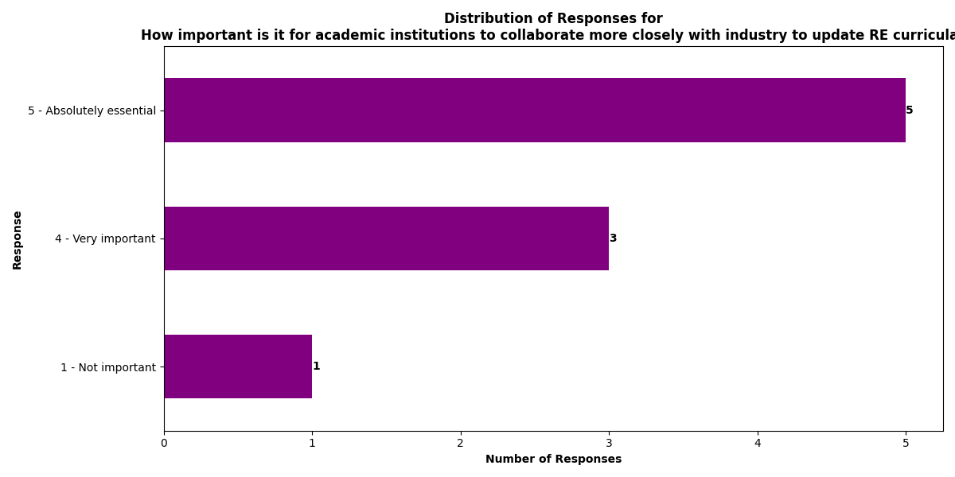
Fig.6
Importance of Collaboration: (Importance of Industry-Academia Collaboration for RE Curriculum Updates) demonstrates that 88% of respondents considered industry-academia collaboration "Very important" or "Absolutely essential" for updating RE curricula.

Slide 11
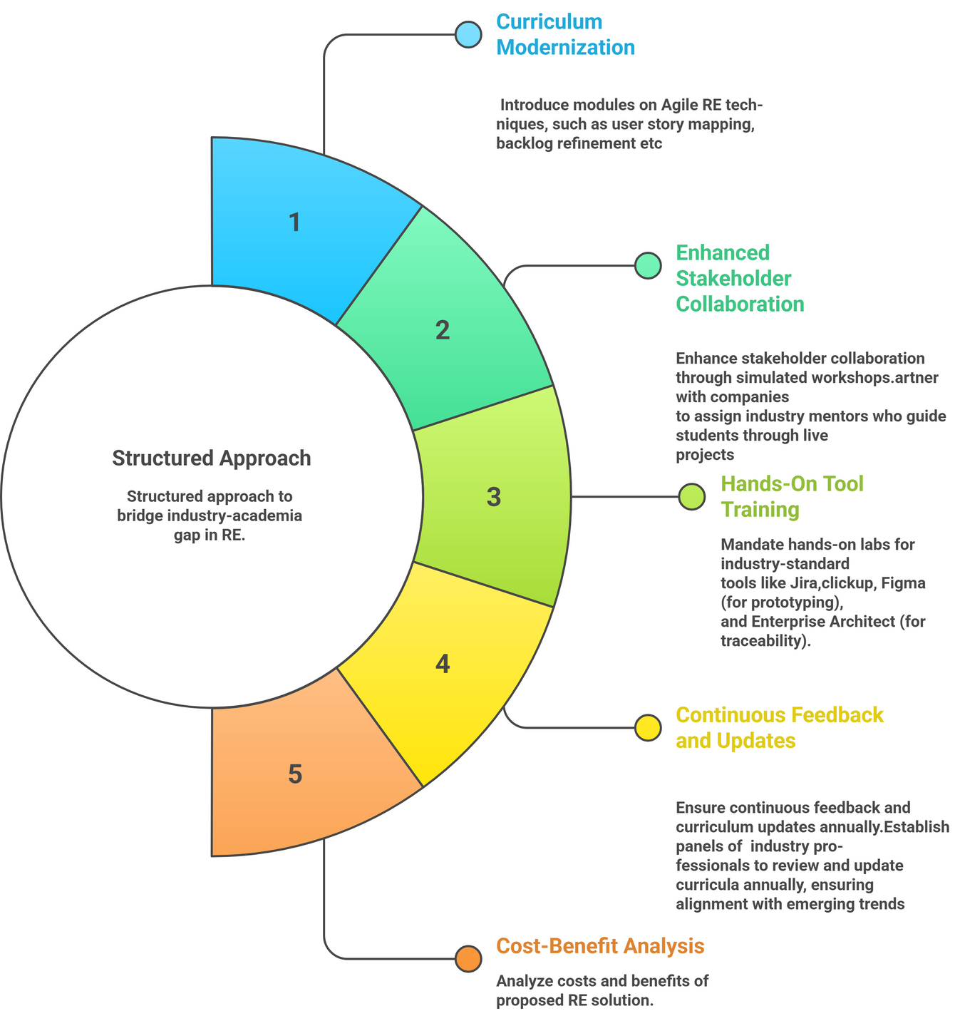
Proposed Suggestion to Overcome the Problems
Fig.7

Slide 12
As shown in the Previous Figure.7 (Proposed Solution), we propose a structured, multi-faceted approach to bridge the industry-academia gap in RE:
Curriculum Modernization: Introduce modules on Agile RE techniques (e.g., user story mapping, backlog refinement) and integrate AI-assisted RE tools (e.g., GPT for drafting requirements, NLP for ambiguity detection). Replace theoretical coursework with real-world case studies.
Enhanced Stakeholder Collaboration Training: Implement simulated stakeholder workshops and industry mentorship programs where students work on live projects, practicing negotiation and conflict resolution.
Hands-On Tool Training: Mandate hands-on labs for industry-standard tools like Jira, Figma, and Enterprise Architect. Offer optional certifications in tools like Confluence or Balsamiq.
Continuous Feedback and Curriculum Updates: Establish industry advisory panels to review and update curricula annually, ensuring alignment with emerging trends. Foster internship partnerships.
Cost-Benefit Analysis: An initial investment of $50,000 and recurring costs of $20,000/year are projected to lead to a 20-30% reduction in project failures over 3 years, saving firms $200,000 annually in rework. Graduates will also see higher employability and salaries, and companies will spend less on training new hires.
3. Future Prospect to Implement
The implementation of this structured approach aims to better prepare students for the complexities of real-world RE, ultimately leading to a reduction in project failure rates and a more skilled workforce.

Slide 13
Conclusion
Overall Summary of the Problem and Suggestion Relating the Topic
This research confirms a significant misalignment between academic Requirements Engineering education and the practical demands of the software industry, directly contributing to project failures. Our proposed solution advocates for integrating agile practices, AI-assisted tools, and experiential learning to equip students with the necessary skills in collaboration, modern tools, and iterative validation.
Progress Made and Limitations
We have identified key areas of disconnect through our survey and proposed a comprehensive solution. However, limitations include a relatively small survey sample and the need for longitudinal validation of the proposed educational model's long-term efficacy. Resource constraints may also impact wider implementation.
Recommendation of Future Work
Future efforts should prioritize larger, multi-regional surveys to strengthen generalization. Developing and evaluating pilot programs in partnership with industry is essential to quantitatively assess the impact on project outcomes. Further research should also investigate domain-specific RE adaptations for emerging fields and the implications of hybrid work environments. Sustained collaboration between academia and industry remains crucial to continuously refine RE education and effectively close the theory-practice divide.

