Slide 1
AquaShield Monitoring
Helping aquaculture farms catch water-quality problems before they cost a harvest
MTech in Software Engineering · Thet Naung Soe

Slide 2
Project Overview & Introduction
Helping aquaculture farms catch water-quality problems before they cost a harvest.
Fish, shrimp, and crab farmers monitor pond water by hand a few times a day — missed pH crashes, oxygen drops, or temperature spikes can wipe out an entire pond overnight.
A single bad pond costs thousands of dollars in lost stock, plus the operational time spent trying to recover it.
Our platform watches every pond continuously, raises alerts the moment readings drift out of safe range, and lets operators compare ponds side by side.
Built for aquaculture operators running multiple ponds across shrimp, fish, and crab hatchery profiles.
Delivers earlier detection, fewer stock losses, less manual labour, and data-backed farm decisions.

Slide 3
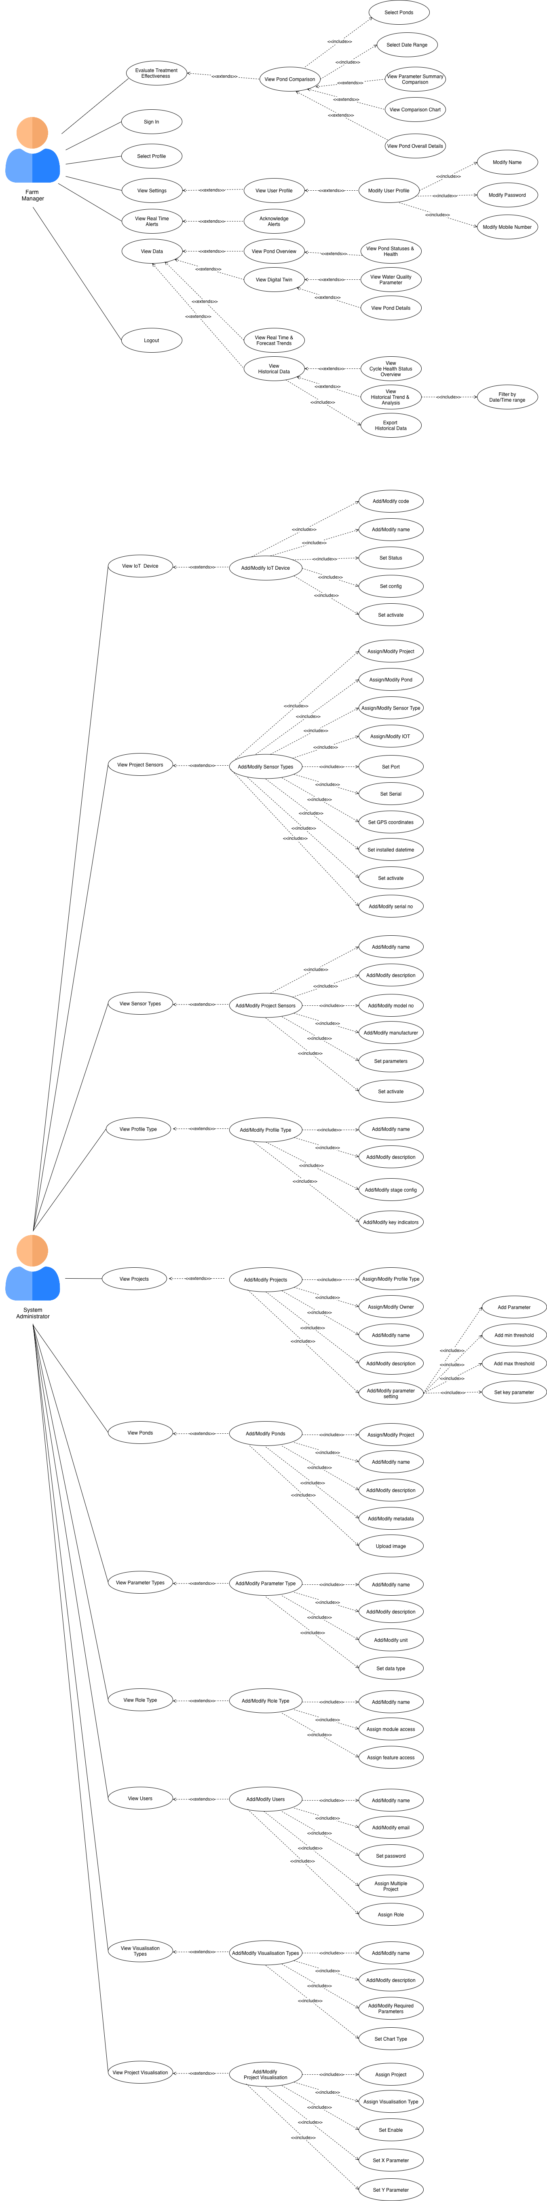
Overall Scope (Use Case Diagram)
AquaShield v2 · Slide 2 / 16

Slide 4
Project Roadmap & Key Milestones
# | Milestone | Status
1 | Stabilise Legacy — fix the most visible breakages inherited from the previous codebase | ✅ Done
2 | Design Kick-off — use case diagram · ERD draft · class diagram draft | ✅ Done
3 | Design Refinement — finalised ERD (23 tables, FK + JSONB) · high-level flow · logical + physical architecture · class diagram per module | ✅ Done
4 | User Management · Project · Profile — full module: models, serializers, API, frontend, RBAC, profile types, projects, ponds, parameter types, thresholds | ✅ Done
5 | Digital Twin & Visualisation — real-time per-pond view · multi-parameter historical trends with selectable time grouping · exportable data | ✅ Done
6 | Pond Comparison — multi-pond selector · parameter summary · comparison chart over a chosen date range | 🟡 In progress
7 | Deployment (CI/CD) & Security Hardening — CI pipeline (lint · type · unit · E2E · SAST · DAST · SCA · load · stress) · Terraform IaC · GCP demo · HttpOnly + CSRF + input validation | 🟡 In progress
8 | MQTT + IoT Pipeline — Mosquitto broker · Raspberry Pi adapter · WebSocket pipeline (Django Channels + Redis) · sensor message archive | 🟡 In progress
9 | Notification Service — multi-channel alert delivery (in-app · email · WhatsApp) · acknowledgement audit trail · per-user subscription preferences | ⚪ Upcoming
10 | Model Integration — predictive ML layer for water-quality forecasting · anomaly detection · treatment-effectiveness analytics | ⚪ Upcoming
AquaShield v2 · Slide 3 / 16
Notes:
"Here's the project roadmap — ten milestones across the lifecycle. Five are shipped, three are in progress and demoable today, and two are planned for the next delivery cycle.
The first three — stabilise legacy, design kick-off, and design refinement — covered the early sprints. The next two — User Management with Project and Profile, then Digital Twin and Visualisation — closed the core platform.
Where we are right now is the *in-progress band*: Pond Comparison, the CI/CD pipeline with security hardening, and the MQTT IoT pipeline. I'll show all three of these in the live demo at the end.
The last two — Notification Service for multi-channel alerts, and Model Integration for predictive analytics — are scoped but not yet started. They represent the next delivery cycle.
The slides that follow walk through each of the in-progress and shipped milestones in more detail."
---

Slide 5
Project Backlog (User Stories)

Slide 6
Epic 1 · Authentication & User Management
ID | User Story
US-01 | As a user, I want to sign in and out securely so that my session is protected.
US-02 | As a user, I want to view my own profile so that I can confirm my account details.
US-03 | As a user, I want to update my own profile (name, mobile, password) so that my information stays current.
US-04 | As a platform admin, I want to onboard new users with a default feature-access set so that new staff can start working immediately.
US-05 | As a platform admin, I want to manage another user's feature access and action controls so that permissions match each user's responsibilities.
US-06 | As a platform admin, I want to assign users to one or more projects so that they only see ponds in projects they own.
US-07 | As a platform admin, I want to deactivate a user account without deleting it so that I preserve audit history.

Slide 7
Epic 2 · Pond Operations
ID | User Story
US-08 | As a farm manager, I want to see all my ponds and their current health status on one overview screen so that I can spot problems at a glance.
US-09 | As a farm manager, I want to view a digital twin of each pond so that I can see live water-quality parameters in context.
US-10 | As a farm manager, I want to view real-time and forecasted parameter trends so that I can plan adjustments before conditions degrade.
US-11 | As a farm manager, I want to compare multiple ponds side by side over a chosen date range so that I can learn what's working in my best-performing pond.
US-12 | As a farm manager, I want a parameter-summary comparison and a comparison chart so that I have both tabular and visual views of the comparison.

Slide 8
Epic 3 · Cycle & Growth Management
ID | User Story
US-13 | As a farm manager, I want to start a new growth cycle for a pond so that all subsequent readings are attributed to that cycle.
US-14 | As a farm manager, I want to record daily health observations for each cycle so that I have a per-day record of growth quality.
US-15 | As a farm manager, I want to advance a cycle through its lifecycle stages (juvenile · grow-out · pre-harvest) so that the platform tracks where each pond is in its cycle.
US-16 | As a farm manager, I want a cycle-health overview that aggregates alerts and key indicators by cycle so that I can review the cycle's full health story when it closes.

Slide 9
Epic 4 · Sensor & IoT Management
ID | User Story
US-17 | As a system admin, I want to register IoT devices (code, status, configuration) so that incoming MQTT messages are accepted only from known devices.
US-18 | As a system admin, I want to declare sensor types (model number, manufacturer, parameters measured) so that the platform knows what each sensor reports.
US-19 | As a system admin, I want to attach project sensors to specific ponds with GPS coordinates and an installed datetime so that readings are spatially located.
US-20 | As a system admin, I want to activate or deactivate a sensor without deleting it so that I preserve historical data when a sensor is taken offline.
US-21 | As a system admin, I want incoming sensor messages to be archived (raw + parsed) so that any reading can be traced back to the original payload.

Slide 10
Epic 5 · Visualisation & Historical Trends
ID | User Story
US-22 | As a system admin, I want to declare visualisation types (chart type, required parameters) so that visualisations are reusable across projects.
US-23 | As a system admin, I want to configure project-level visualisations (which chart, which X/Y parameters, enable/disable) so that each project's dashboard reflects its parameter set.
US-24 | As a farm manager, I want to view multi-parameter historical trends with selectable time-range grouping (hourly · daily · weekly · monthly) so that I can analyse trends at the right resolution.
US-25 | As a farm manager, I want to export historical data filtered by date range so that I can share it with external advisors or research collaborators.

Slide 11
Epic 6 · Alerts & Notifications
ID | User Story
US-26 | As a farm manager, I want real-time alerts when a parameter crosses its safe threshold so that I can act before stock is lost.
US-27 | As a farm manager, I want to acknowledge alerts so that I can clear my dashboard once an issue is being handled.
US-28 | As a farm manager, I want every alert logged with its parameter, severity, and reading timestamp so that there is an audit trail of every incident.

Slide 12
Epic 7 · Treatment Management
ID | User Story
US-29 | As a farm manager, I want to record treatments applied to a pond (chemical, dosage, timestamp) so that the platform tracks what was done and when.
US-30 | As a farm manager, I want to evaluate treatment effectiveness by comparing pre- and post-treatment parameter readings so that I can decide whether the treatment worked.
US-31 | As a farm manager, I want to view a treatment history per pond so that I can avoid repeating an ineffective treatment.

Slide 13
Epic 8 · Project & Profile Configuration
ID | User Story
US-32 | As a system admin, I want to define profile types (shrimp · fish · crab hatchery) so that each farm type has its own schema of parameters and growth stages.
US-33 | As a system admin, I want to create projects and assign owners so that the platform supports multi-tenant farm operations.
US-34 | As a system admin, I want to add ponds (with metadata + image) under a project so that operators can identify each pond visually.
US-35 | As a system admin, I want to declare parameter types (name, unit, data type) so that readings are interpreted consistently across projects.
US-36 | As a system admin, I want to set min/max thresholds per project-parameter so that the alerting engine knows what "safe range" means per farm.

Slide 14
Epic 9 · Security & Compliance
ID | User Story
US-37 | As a security-conscious operator, I want authentication tokens stored in HttpOnly cookies so that XSS cannot exfiltrate my session.
US-38 | As a security-conscious operator, I want CSRF protection on state-changing endpoints so that cross-site requests cannot act on my behalf.
US-39 | As a platform admin, I want all sensitive secrets (DB password, JWT key) stored in Secret Manager rather than env files so that they never appear in logs or images.
US-40 | As a platform admin, I want every dependency scanned for known CVEs on every PR so that vulnerable packages don't ship to production.
US-41 | As a platform admin, I want static + dynamic security scanning (SAST + DAST) in the pipeline so that source-level and runtime issues are caught before deploy.

Slide 15
Epic 10 · Infrastructure & DevOps
ID | User Story
US-42 | As a developer, I want unit and end-to-end tests to run on every PR so that regressions are caught before merge.
US-43 | As a developer, I want load and stress tests in CI so that performance changes are visible per commit.
US-44 | As a platform admin, I want the GCP infrastructure provisioned via Terraform so that the environment is reproducible and tear-down is one command.
US-45 | As a platform admin, I want a containerised, scale-to-zero deploy on Cloud Run so that the demo environment costs almost nothing between

Slide 16
Epic 11 · Notification Service
ID | User Story
US-46 | As a farm manager, I want critical alerts delivered via email so that I can react even when I'm not logged into the dashboard.
US-47 | As a farm manager, I want critical alerts delivered via WhatsApp so that I can react on mobile within seconds.
US-48 | As a farm manager, I want to configure which alert severities go to which channel so that low-severity alerts don't disrupt me out of hours.
US-49 | As a farm manager, I want an audit trail of which notifications were delivered to which channels so that I can investigate missed-alert disputes.

Slide 17
Epic 12 · Model Integration
ID | User Story
US-50 | As a farm manager, I want a predictive forecast of water-quality parameters for the next 24 hours so that I can plan interventions before conditions degrade.
US-51 | As a farm manager, I want anomaly detection that flags unusual sensor patterns so that I can investigate before they become alert events.
US-52 | As a farm manager, I want a model-driven evaluation of treatment effectiveness so that I can quantify whether a treatment actually improved water quality.
US-53 | As a platform admin, I want the predictive model to be re-trainable on new sensor data so that the platform improves as the data set grows.

Slide 18
Sprint Effort (Estimate vs Actual, All Sprints)
Sprint | Roadmap milestone(s) covered (slide 3) | Estimate | Actual | Variance note
1 | M1 — Stabilise Legacy | 70 | 85 | Legacy bug surface larger than first-pass triage suggested
2 | M2 — Design Kick-off (use case · ERD draft · class diagram draft) | 80 | 95 | Mentor review pushed an extra iteration on the use case + ERD draft
3 | M3 — Design Refinement I (ERD final · high-level flow · logical architecture) | 80 | 90 | ERD finalisation touched 23 tables; JSONB references took extra time
4 | M3 continued — Design Refinement II (class diagram per module · physical architecture) | 80 | 95 | Physical architecture diagram redrawn twice after Sprint 4 mentor review
5 | M4 — User Management · Project · Profile · Cycle | 90 | 110 | User Management went through 3 implementation passes (Part 1 → Part 2 → Part 3) per consultant feedback
6 | M5 — Digital Twin · Visualisation · Treatment · Alerts (operational features) | 90 | 105 | Bringing legacy Digital Twin onto the new schema took longer than expected; fresh builds (Treatment, Alerts, Viz) were on-budget
7 | M7 (partial) — Security Hardening (HttpOnly · CSRF · input validation · secret-mgmt strategy) | 60 | 70 | HttpOnly + CSRF edge cases; secret-management strategy required extra design
8 | Current — M6 Pond Comparison · M7 CI/CD + IaC + GCP demo · M8 MQTT + Pi + WebSocket | 100 | 125 | Densest sprint — MQTT broker + Raspberry Pi adapter + WebSocket/Channels/Redis learning curve · Pond Comparison build · CI workflow iterations (Node version, ZAP action version, SARIF upload) · GCP cross-origin cookie debugging · Terraform IaC bootstrap
Total | M1 → M8 (M9, M10 scoped but not in this delivery) | 650 | 775 | Project-wide variance: +19 %

Slide 19
Tech Stack
IoT Edge | Raspberry Pi · Mosquitto MQTT broker
Real-time Pipeline | Django Channels · Redis (channel layer) · Daphne (ASGI server)
Backend | Django 5.2 · Django REST Framework · djangorestframework-simplejwt · drf-spectacular · django-unfold · Python 3.12
Frontend | React 19 · TypeScript · Vite 7 · shadcn/ui · Radix · Tailwind CSS · Zustand · react-hook-form · Zod · Recharts · @tanstack/react-table
Data & Persistence | PostgreSQL 15 · psycopg2 · managed = False (database-first schema)
Security | HttpOnly JWT cookies · CSRF double-submit · Bandit (SAST) · Semgrep (SAST) · pip-audit (SCA) · npm audit (SCA) · OWASP ZAP (DAST)
CI/CD & Quality | GitHub Actions · pytest · Vitest · Playwright · k6 (load + stress) · Ruff · ESLint · mypy · tsc
Infrastructure & Hosting | Terraform (IaC) · GCP Cloud Run · Artifact Registry · Cloud SQL (Postgres 15) · Secret Manager · Docker
Notes:
"Quick tour of the stack, grouped by what it does.
**At the edge**, sensors talk to a Raspberry Pi over GPIO/serial; the Pi publishes to **Mosquitto MQTT**. We chose MQTT because it's built for unreliable networks — the Pi buffers and retries when the broker is unreachable.
**The real-time pipeline** is **Django Channels** on **Daphne** with **Redis** as the channel layer. That means HTTP and WebSocket run on the same Django process, and Redis lets us scale to multiple workers later without a rewrite.
**The backend** is **Django 5.2** with **DRF** for the JSON API, **simplejwt** for auth issued as **HttpOnly cookies**, and **drf-spectacular** auto-generating the OpenAPI schema the SPA consumes. Schema-first via **`managed=False`** — the consultant reviews SQL files, not migrations.
**The frontend** is **React 19 with TypeScript** on **Vite**, **shadcn/ui** for design-system components, **Zustand** for state, **react-hook-form + Zod** for forms, and **Recharts** for the historical trends and comparison views.
**Database** is **Postgres 15** — JSONB for the feature-access permissions blob, composite primary keys for user-project links, partitioning for high-volume sensor readings.
**Security** is a layered set: HttpOnly cookies plus CSRF for the runtime model, **Bandit** and **Semgrep** for static scanning, **pip-audit** and **npm audit** for dependency CVEs, **OWASP ZAP** for dynamic scanning in CI.
**CI/CD** runs in **GitHub Actions** — pytest, Vitest, Playwright, k6 load and stress, all on every PR.
**Hosting** for the demo is **GCP Cloud Run + Artifact Registry + Cloud SQL**, provisioned via **Terraform**. Cloud Run scales to zero between rehearsals so the demo environment costs almost nothing when idle."
---

Slide 20
Architectural Constraints & Decisions
# | Constraint | Decision
1 | Offline-tolerant IoT edge — pond networks are unreliable; sensors must keep collecting when the broker is unreachable. | Raspberry Pi + Mosquitto MQTT in-house — the Pi buffers readings locally and replays them when the broker comes back. The broker runs on the same VM as the Django backend.
2 | Avoid cloud-provider IoT services — AWS IoT Core and Azure IoT Hub were both evaluated; the team chose against them to keep cost, control, and edge-side flexibility. | Self-hosted MQTT broker + Pi adapter — no vendor SDK on the edge, no per-message billing, full visibility of every payload through the broker we own.
3 | Unified platform — AquaMonitoring v2 + BioBloc, delivered as a subscription-based multi-tenant product. Different tenants will need different feature sets and different farm profiles. | JSONB feature_access + action_control per user, gated by the user's subscription. Profile types (shrimp · fish · crab hatchery, with BioBloc profiles next) plug into the same schema without table changes.

Slide 21
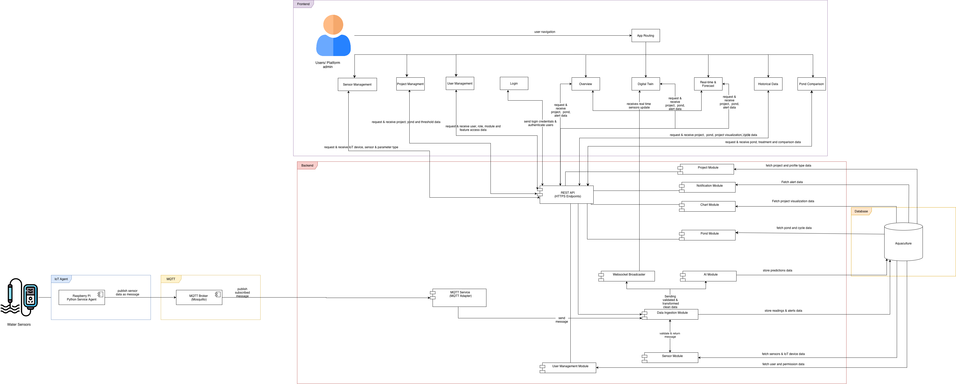
Logical Architecture

Slide 22
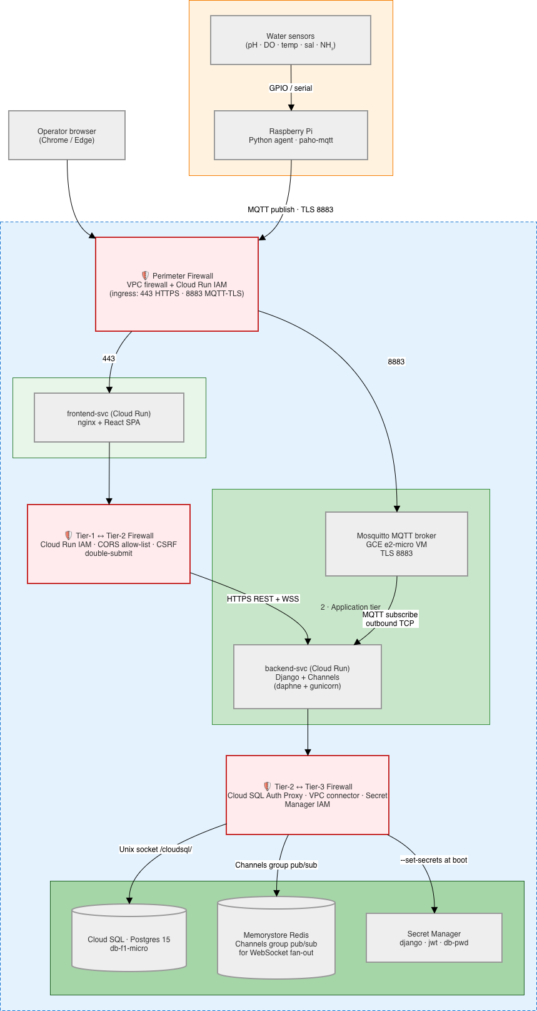
Physical Architecture
AquaShield v2 · Slide 8 / 16

Slide 23
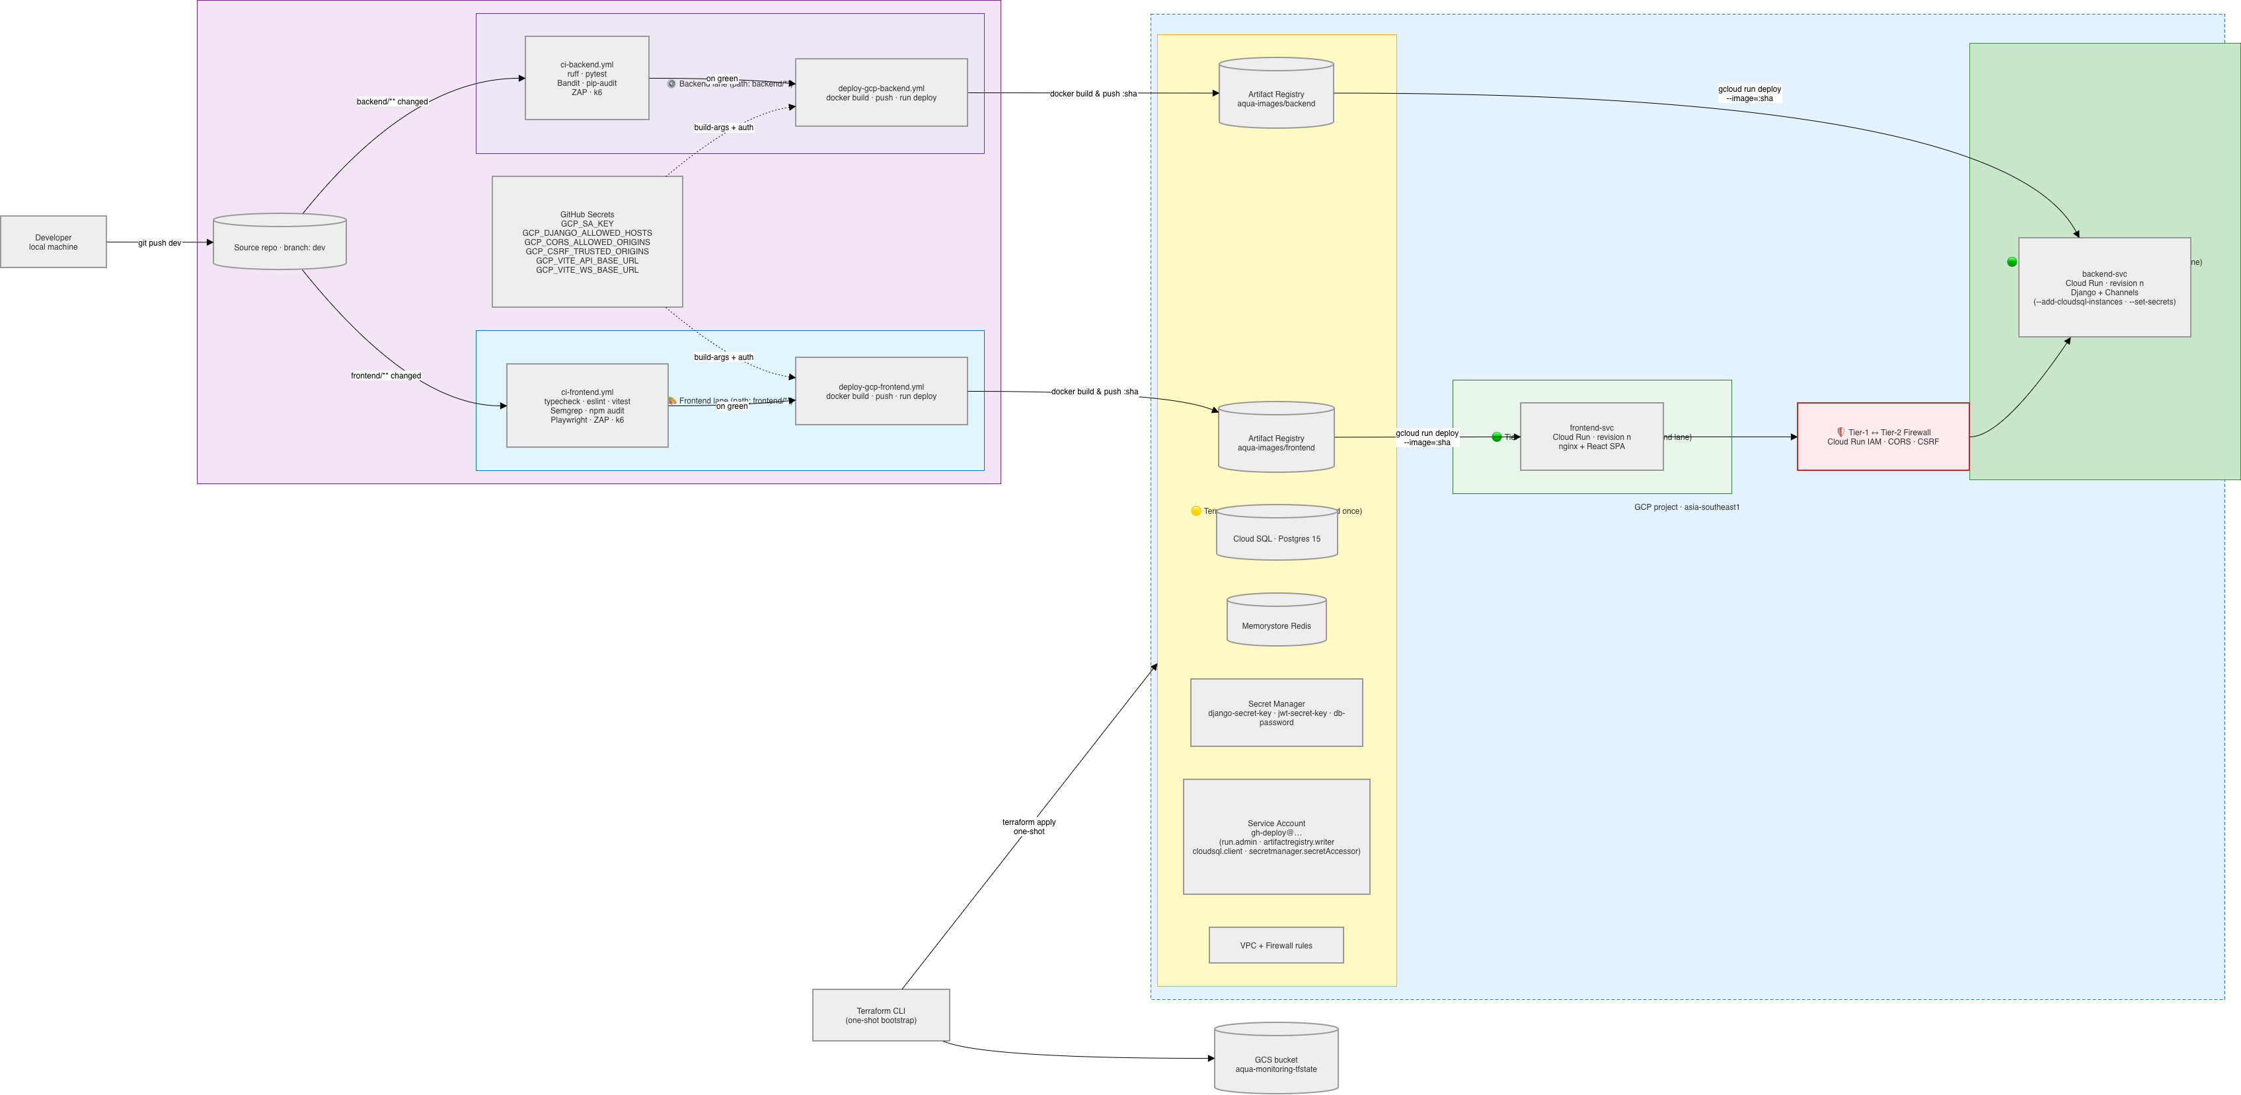
Deployment Diagram
AquaShield v2 · Slide 9 / 16
Notes:
"Here's how a `git push` becomes a live Cloud Run revision. There are **three flows** on this diagram.
**The first runs once** — Terraform bootstrap from a developer machine. It provisions the entire platform: Artifact Registry, Cloud SQL, Memorystore Redis, Secret Manager, the deploy service account with scoped IAM bindings, and the VPC firewall rules. Terraform's state lives in a GCS bucket so the same apply works from any machine with credentials.
**The other two flows run on every push to `dev`**, but they're independent of each other.
The **frontend lane** fires when a commit touches `frontend/**`. The `ci-frontend.yml` workflow runs typecheck, ESLint, Vitest, Semgrep SAST, npm audit SCA, Playwright E2E, ZAP DAST, and k6 load and stress. On green, `deploy-gcp-frontend.yml` builds the frontend Docker image, pushes it to the `aqua-images/frontend` repository in Artifact Registry tagged with the commit SHA, then calls `gcloud run deploy` to roll out a new `frontend-svc` revision in **Tier 1**.
The **backend lane** fires when a commit touches `backend/**`. `ci-backend.yml` runs Ruff, pytest, Bandit SAST, pip-audit SCA, ZAP DAST, k6 load and stress. On green, `deploy-gcp-backend.yml` builds the backend image, pushes it to `aqua-images/backend`, then deploys to `backend-svc` in **Tier 2**, attaching the Cloud SQL connection and the runtime secrets at deploy time.
The two lanes never overlap. A frontend-only change never triggers a backend deploy, and vice versa. The tier boundary that appears in the physical diagram — Cloud Run IAM plus CORS plus CSRF — is preserved here: the two services run separately, they get their own image, they're rolled forward and rolled back independently."
---

Slide 24
Domain Driven Design
AquaShield v2 · Slide 10 / 16

Slide 25
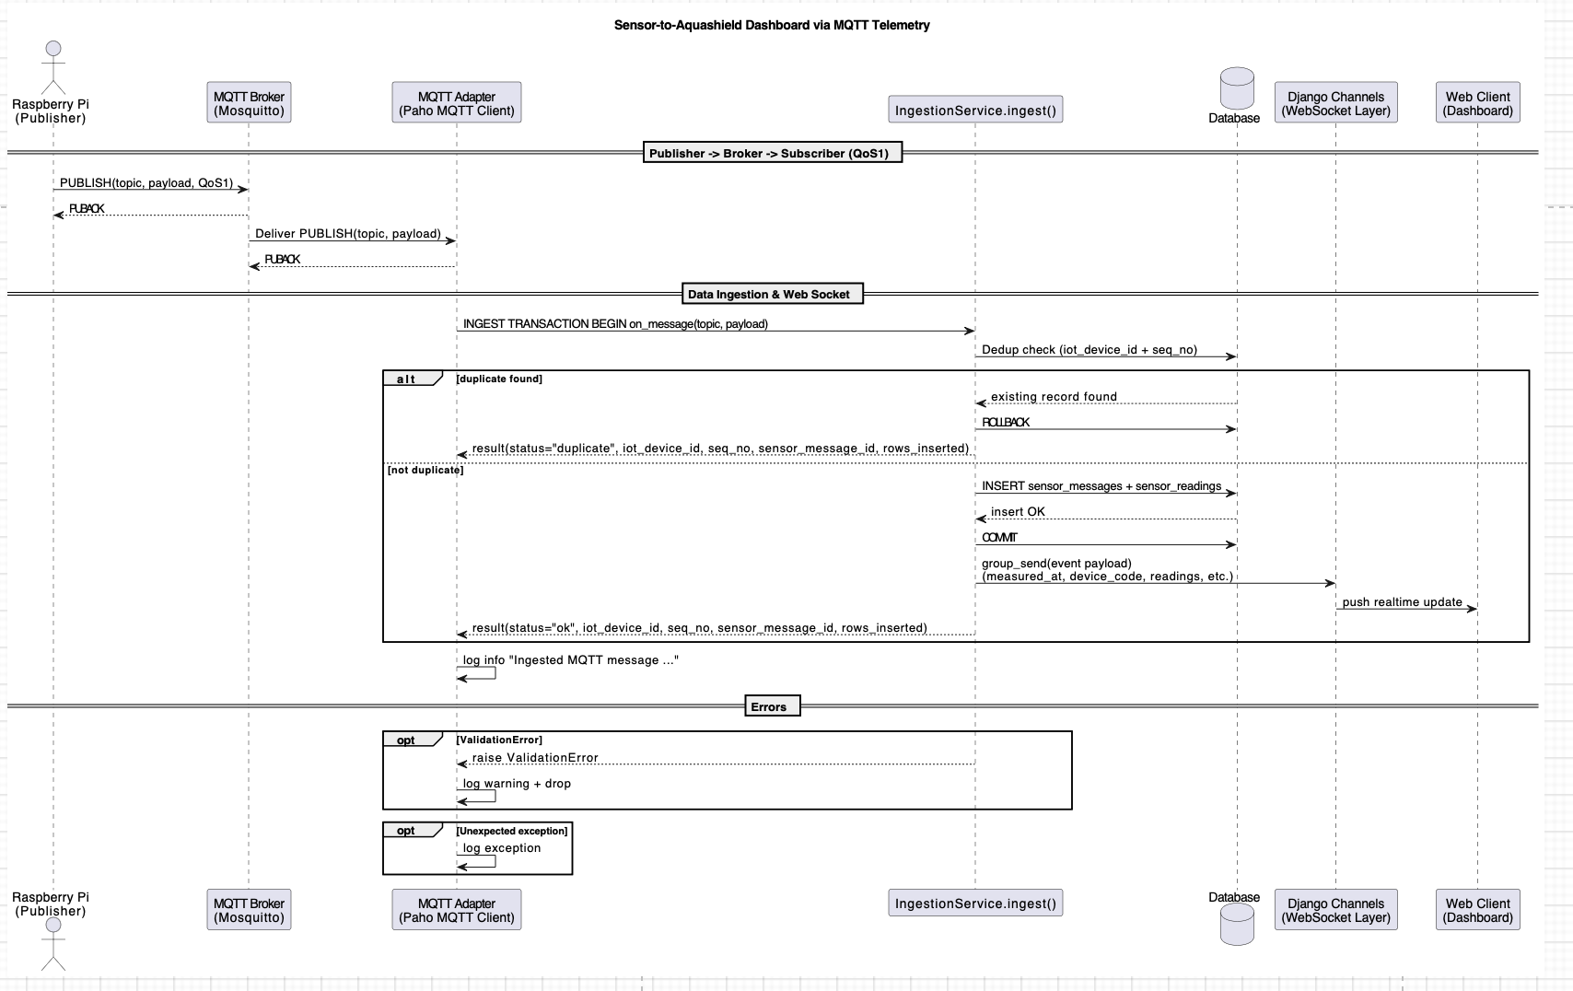
Software Design
AquaShield v2 · Slide 11 / 16

Slide 26
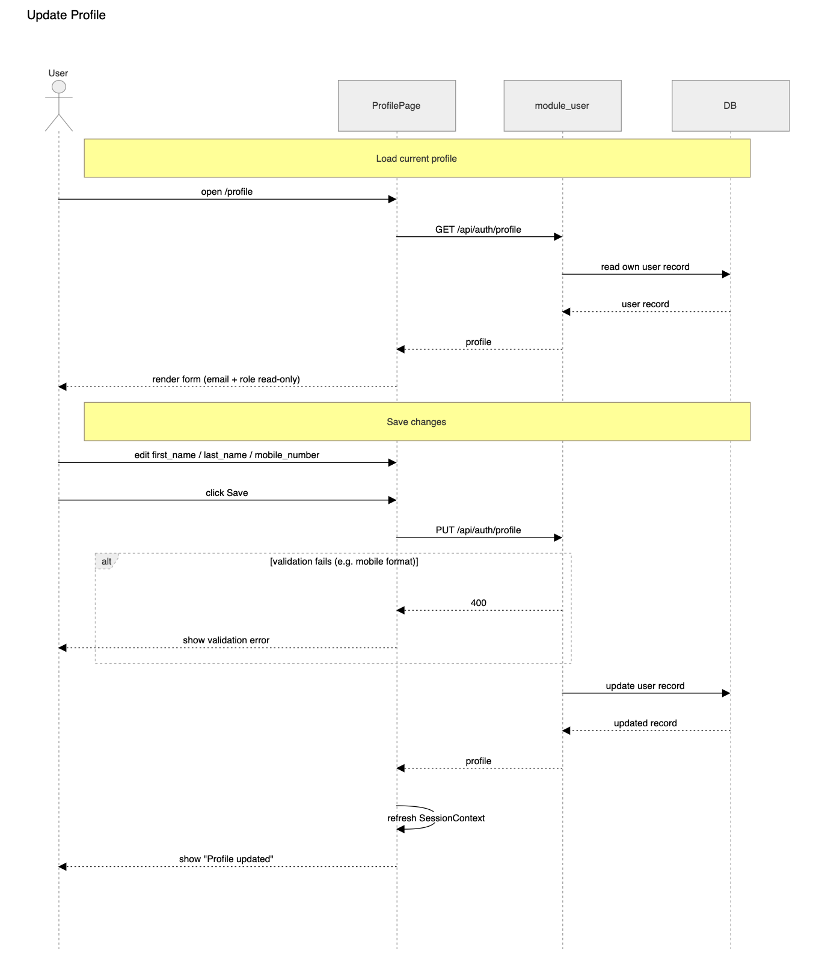
Software Design

Slide 27
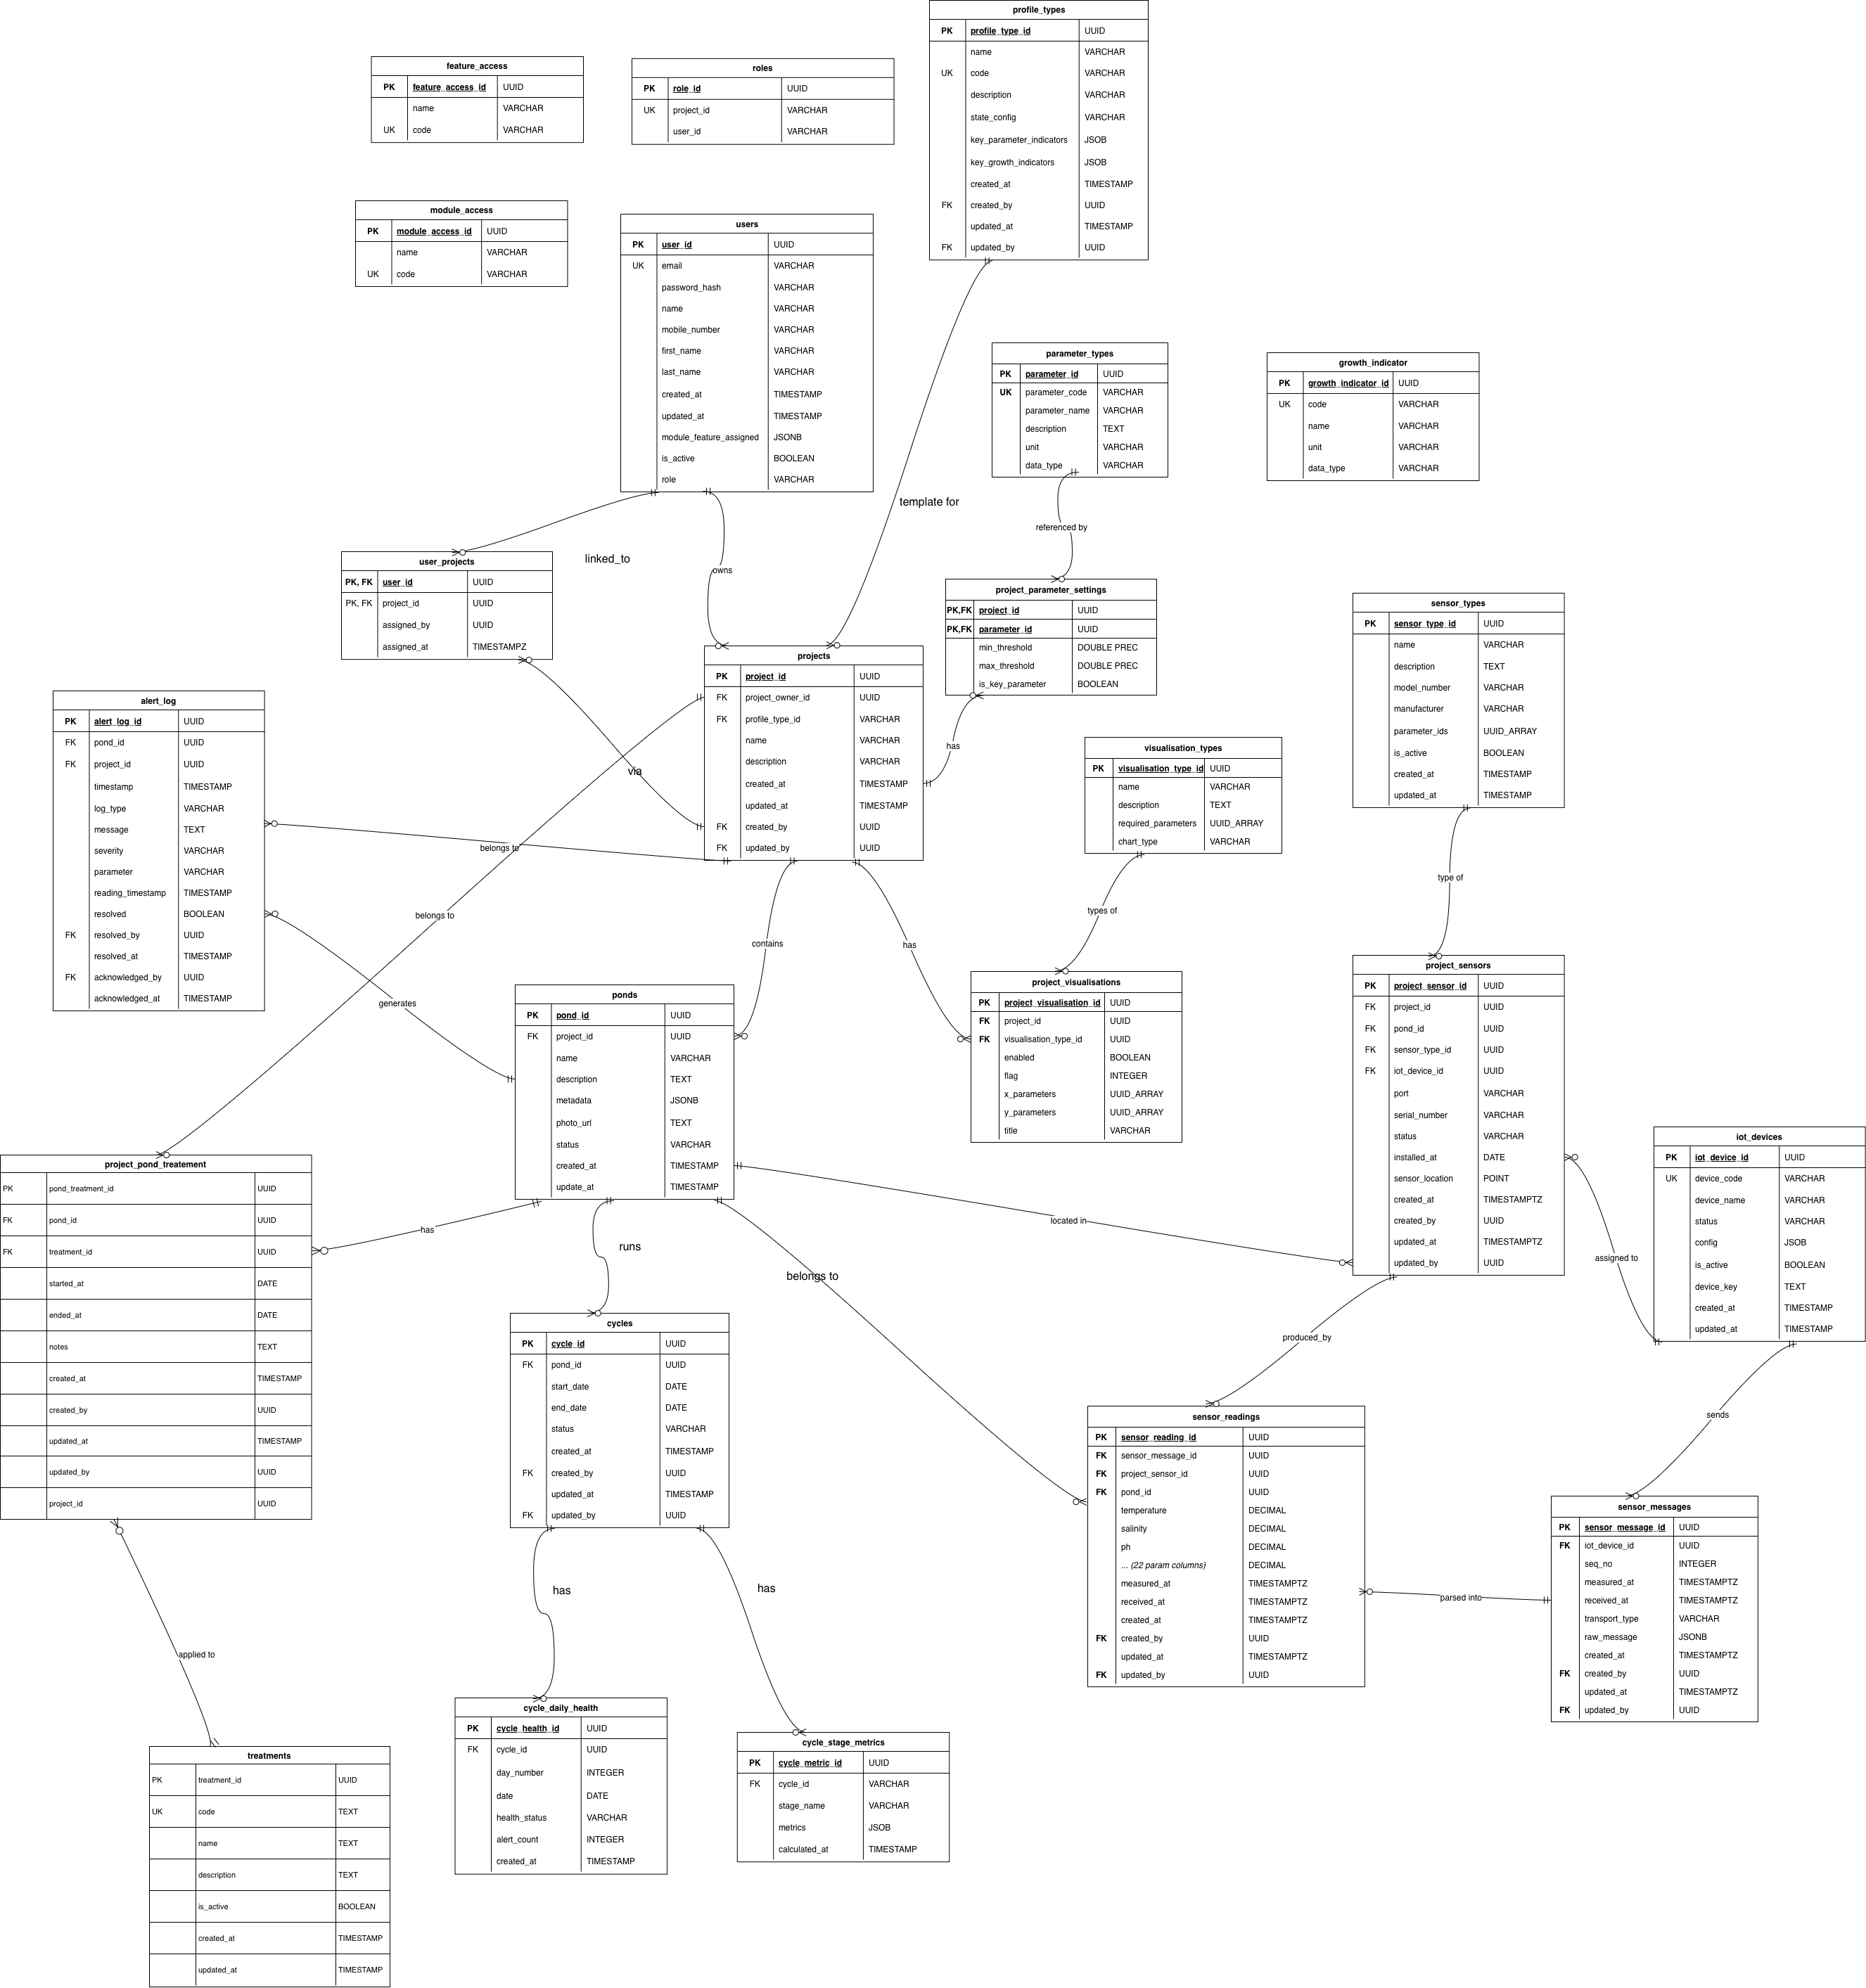
Relational ER Design + NoSQL Schema Design
AquaShield v2 · Slide 12 / 16

Slide 28
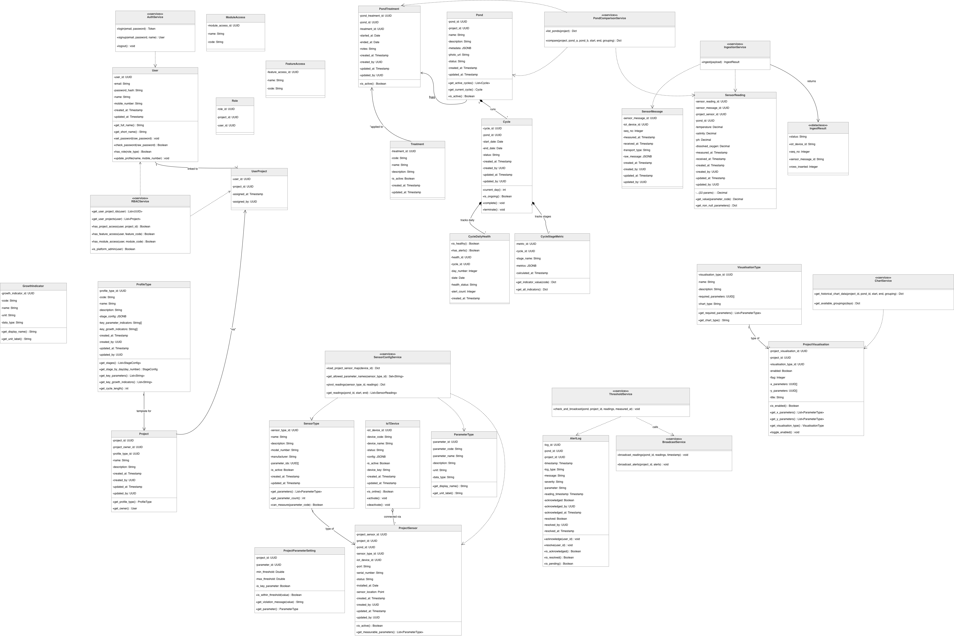
Class Diagram

Slide 29
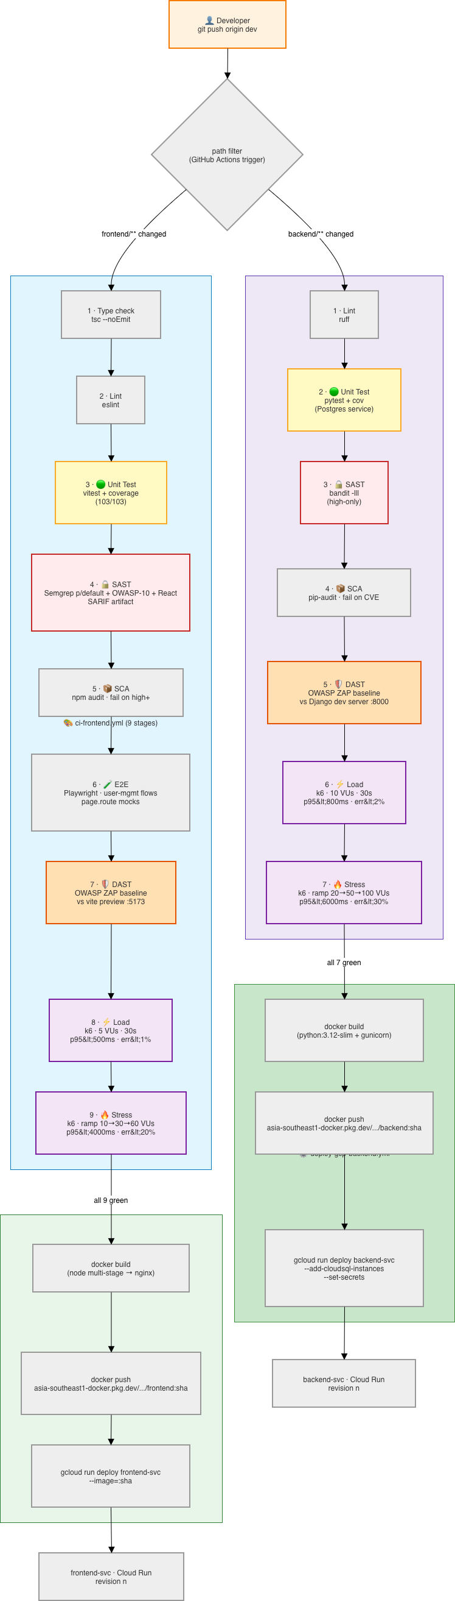
CI/CD Pipeline
AquaShield v2 · Slide 13 / 16

Slide 30
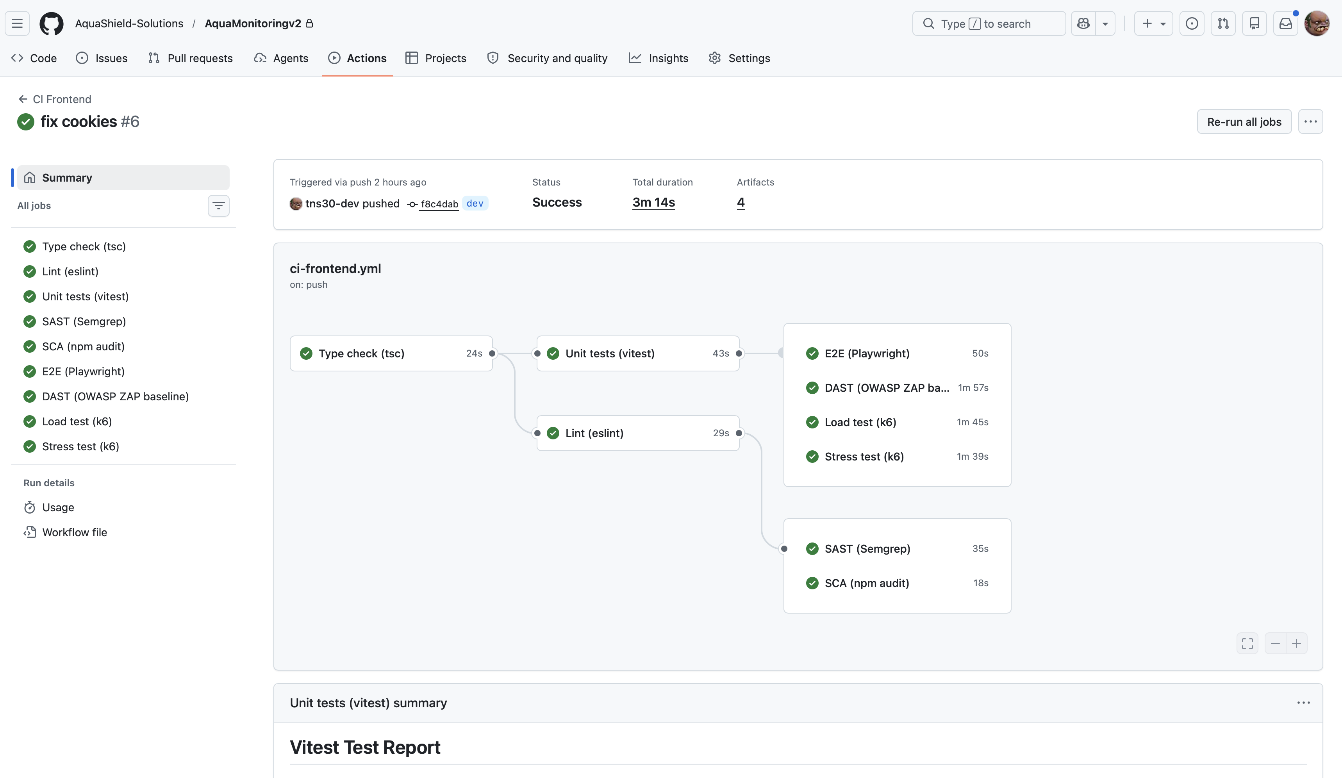

Slide 31
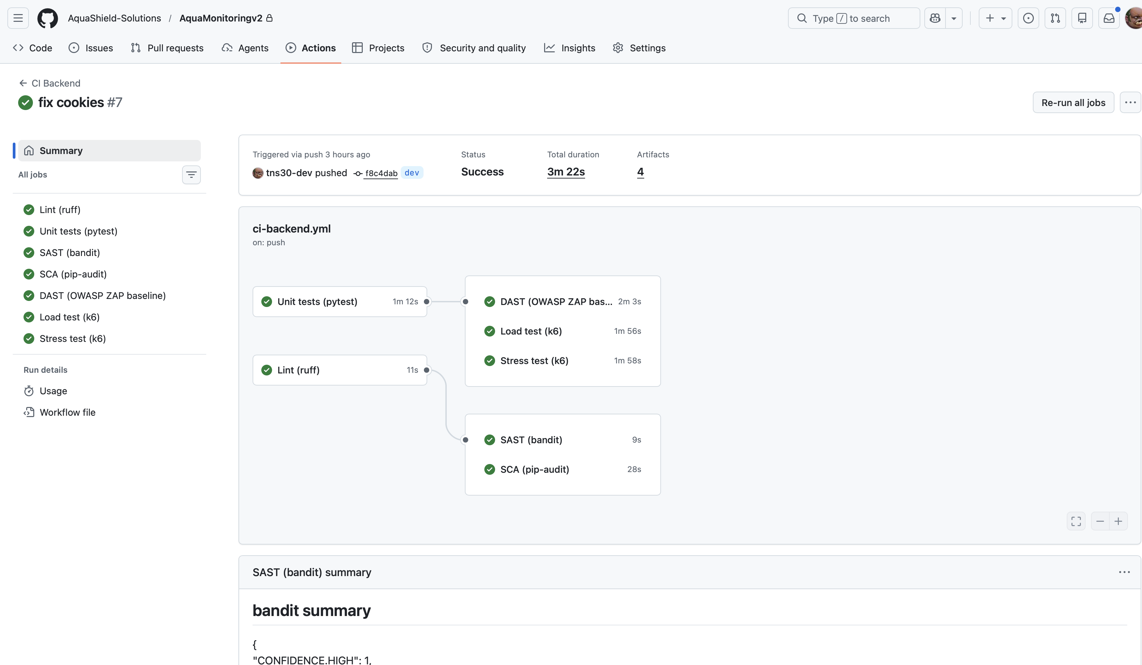

Slide 32
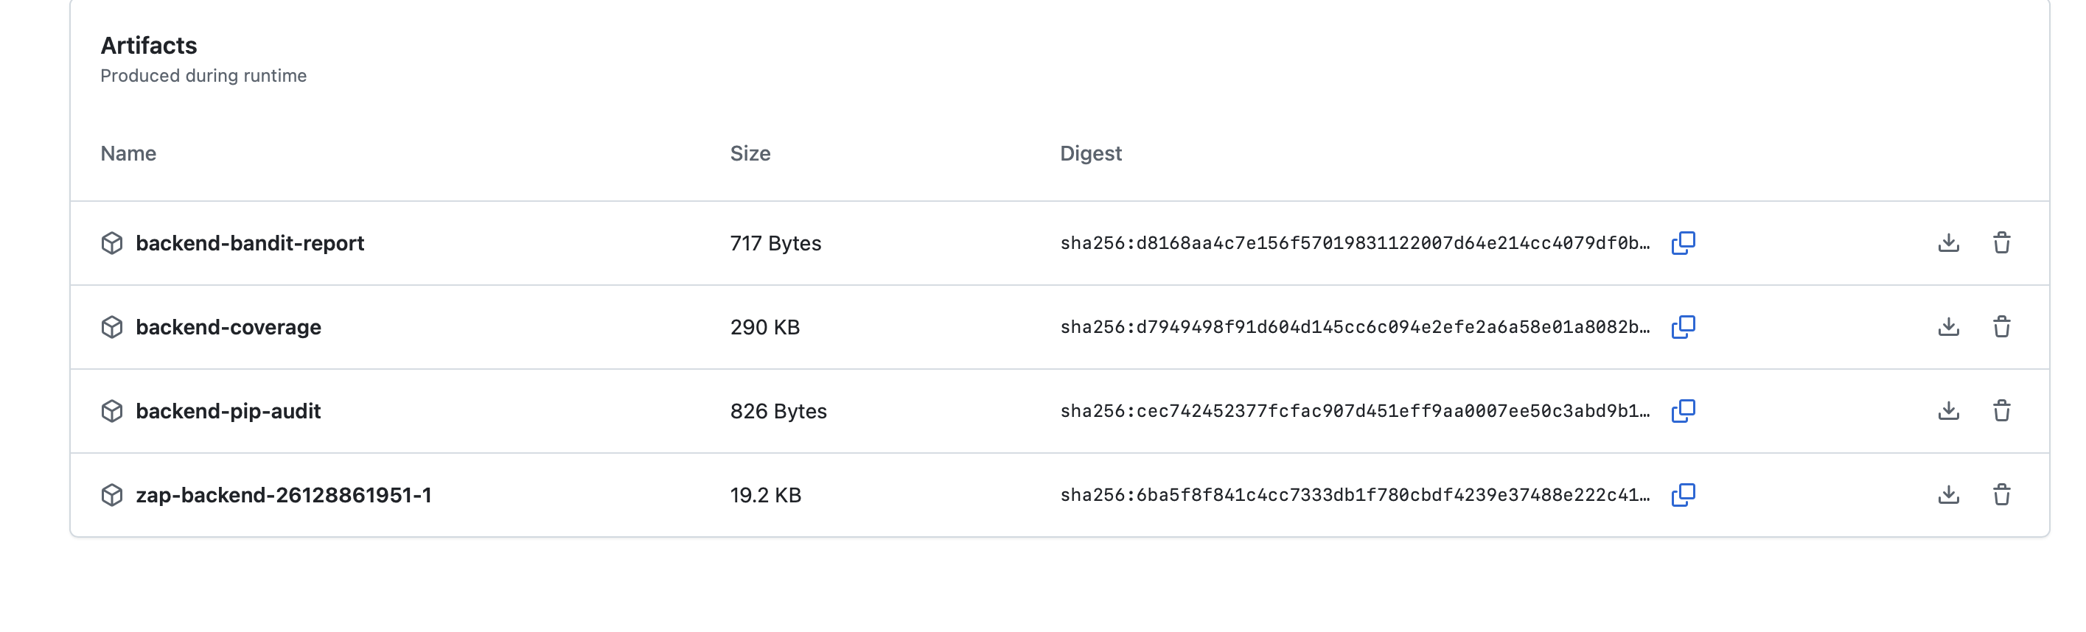
Testing Artifacts
AquaShield v2 · Slide 14 / 16

Slide 33
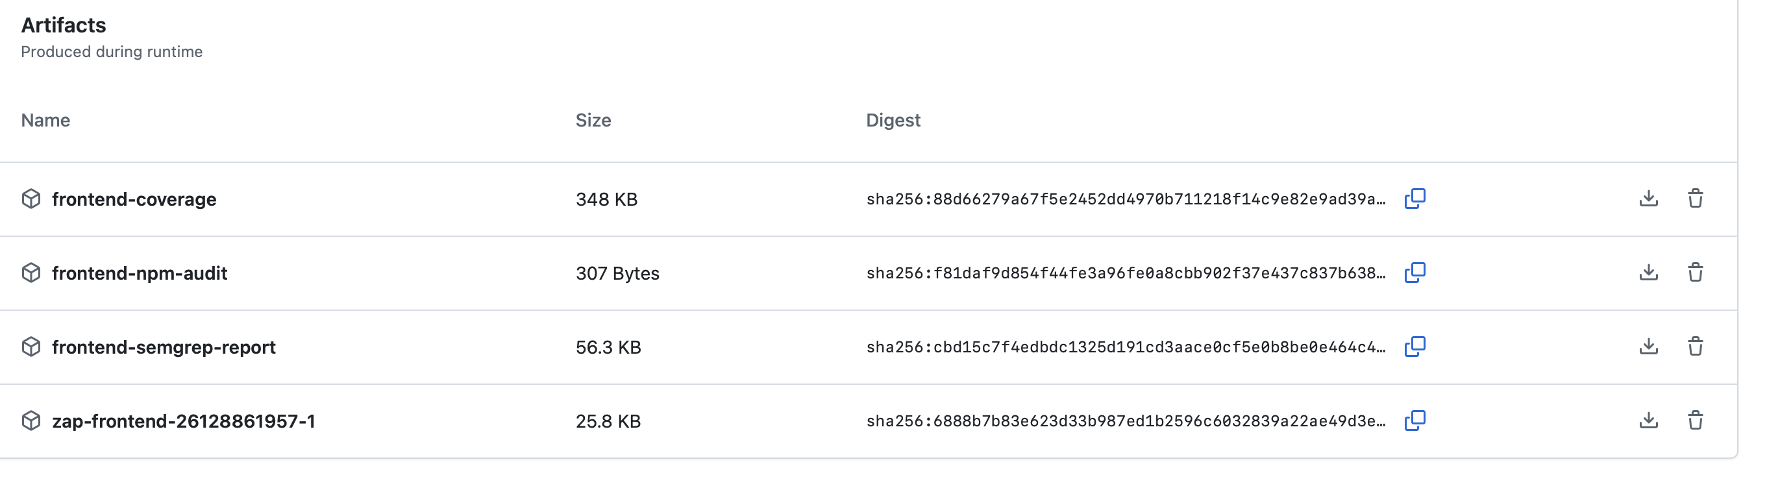

Slide 34
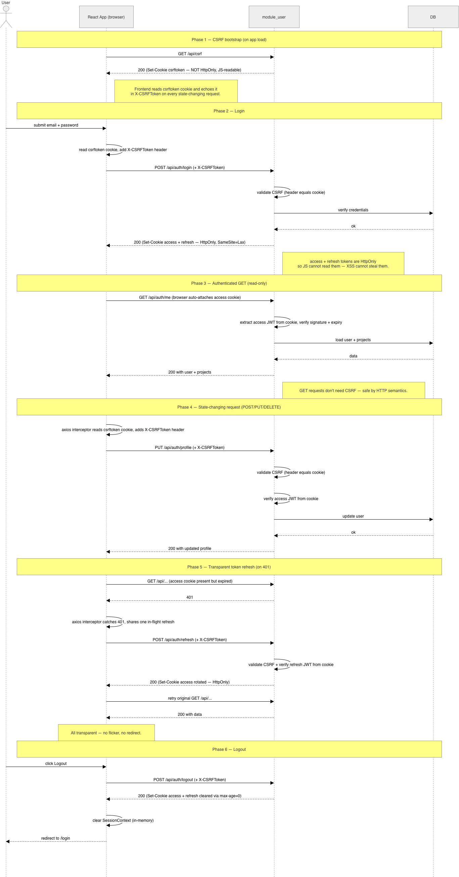
Security
AquaShield v2 · Slide 15 / 16

Slide 35
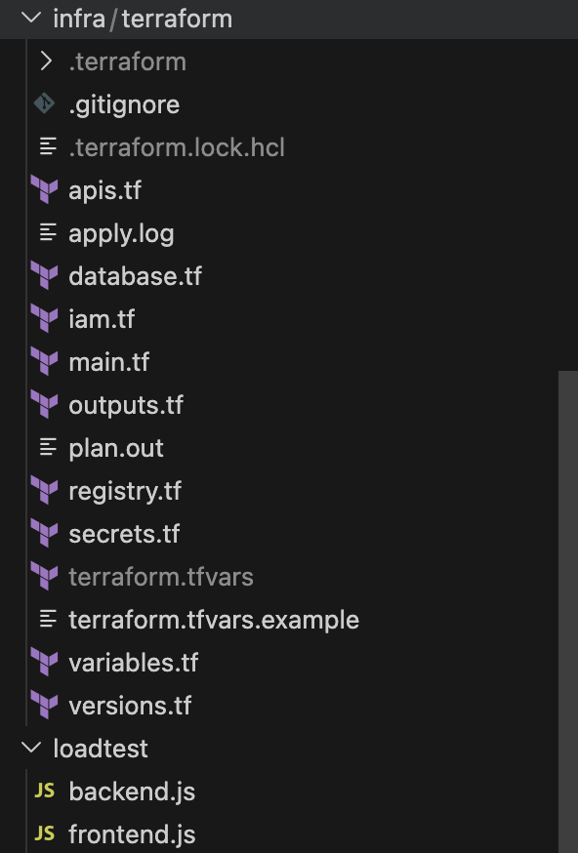
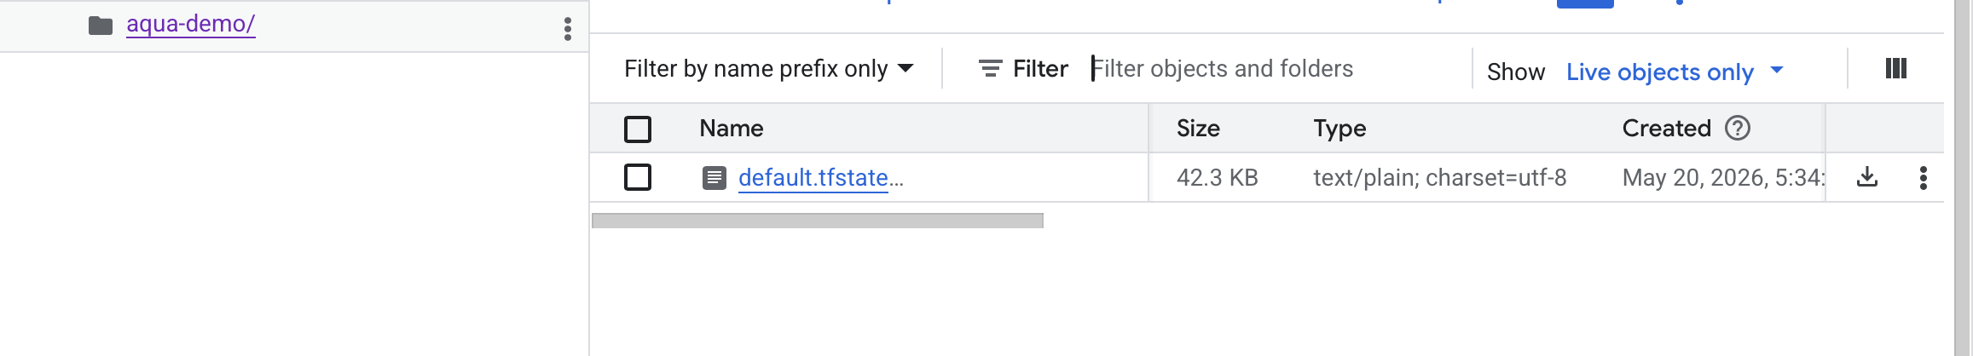
Infrastructure-as-Code (IaC)
AquaShield v2 · Slide 16 / 16

