Slide 1
LeakSurvivor: Towards Safely Tolerating Memory Leaks for Garbage-Collected Languages
Yan Tang, Qi Gao, and Feng Qin
The Ohio State University

Slide 2
Agenda
Authors
Introduction
Main Idea
Design and Implementation
Leak Detectors
Swap-Out Component
Swat-In Component
Evaluation

Slide 3
Authors
Yan Tang
Graduated from Tsinghua University
First-Aid: Providing Emergency Treatments to Memory Bugs in Software during Production Runs
Feng Qin
Assistant professor
Graduate student in Yuanyuan Zhou’s OPERA group

Slide 4
Agenda
Authors
Introduction
Main Idea
Design and Implementation
Leak Detectors
Swap-Out Component
Swat-In Component
Evaluation

Slide 5
Introduction
Memory leaks
Occur in a garbage-collected program
Take up more and more space in the heap
Cannot be completely solved by
Paging mechanism: virtual memory space still un-reclaimed
Increasing the heap size: increased memory paging during each GC phase

Slide 6
Introduction
A safe method for tolerating continuous memory leaks
Periodically move the Potentially Leaked memory objects to disks
If a swapped-out PL object is accessed later, restore it from disks to the memory
No modification in the applications’ source codes
Provide false positive information

Slide 7
Agenda
Authors
Introduction
Main Idea
Design and Implementation
Leak Detectors
Swap-Out Component
Swat-In Component
Evaluation

Slide 8
Main Idea
Periodically swap out PL objects from the vm to disks
GC can reclaim the heap space occupied by PL objects
Avoid cumulative program performance degradation and future program crashes

Slide 9
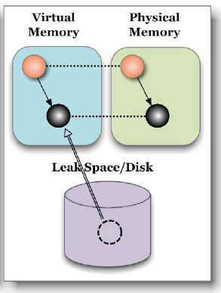
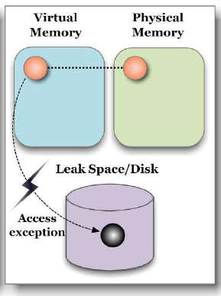
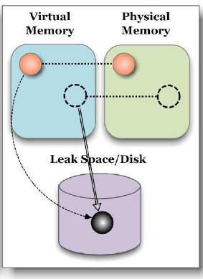
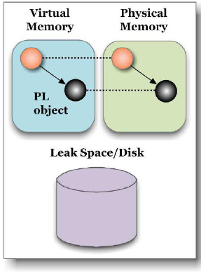
Main Idea
Access a PL object
Mar k a PL object
1. Copy back
2. Restoring references
1. Copy
2. Modify references
(incoming & outgoint)

Slide 10
Agenda
Authors
Introduction
Main Idea
Design and Implementation
Leak Detectors
Swap-Out Component
Swat-In Component
Evaluation

Slide 11
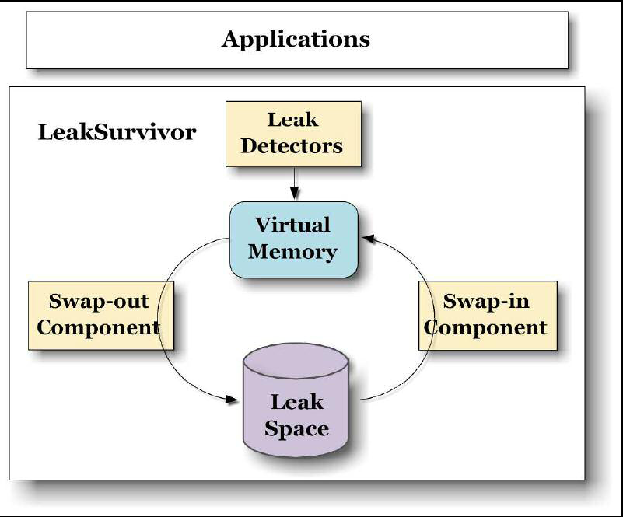
Design and Implementation

Slide 12
Leak Detectors
Only report potentially leaked objects that are still reachable from roots as PL objects.
Two types of leak detectors
Exploit heap growth and help difference
Exploit the lifetime or staleness of each object
LeakSurvivor uses the second type - Sleigh

Slide 13
Leak Detector - Sleigh
Designate two bits as the stale count for each object
Reset the stale counter to zero upon allocation and accesses
Increases the stale counter in logarithmic scale at GC time
Both stale bits become ones -> deemed as stale
Focus on application classes instead of primitive types

Slide 14
Swap-Out Component – Leak Space
Mainly uses disks for storing PL objects
Organizes the leak space in a way similar to Log-structured File System
The disk space occupied by the PL objects will not reclaimed
Trade disk capacity for slow write operations

Slide 15
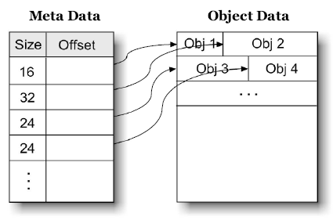
Leak Space
Fix-sized meta data
Size, disk address
Other related information

Slide 16
Incoming References and Reserved Addresses
Make reference modification at GC phases
Modify references to reserved address
Any future access to a PL object
At the user level – triggers an OS exception
At the kernel level – no exception raised, so LeakSurvivor intercepts system calls
GC should not follow reserved addresses

Slide 17
Outgoing References and SOT
Why outgoing references should be handled
The pointed-to objects may be moved to different memory locations
GC need to traverse the outgoing references during GC phases

Slide 18
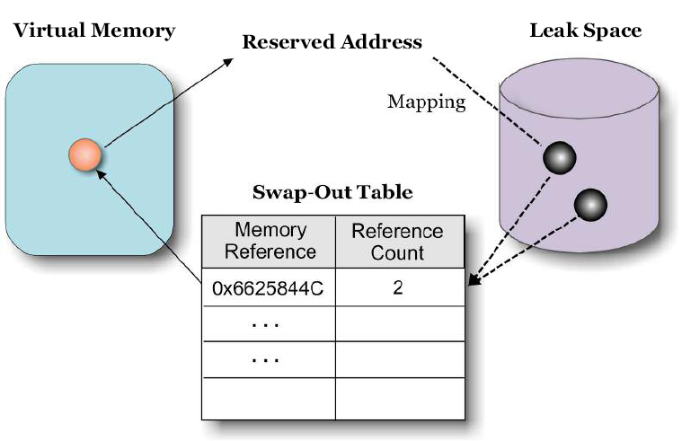
Swap-Out Table

Slide 19
Swap-Out Table
Memory Consumption
Many objects in GCed languages only have 1 to 2 incoming reference
Need not to create a SOT entry for many PL objects

Slide 20
Instruction Execution
Three types of instructions
Operands have nothing to do with PL objects
Perform non-dereferencing operations (==, =)
Can be correctly executed
De-reference the references to some PL objects
Triggers OS exceptions
Needs to bring the PL objects to the memory

Slide 21
Swap-out Process
Three steps
Move the children objects to the leak space if they are stale
Copy the content of PL object (depth-first order)
Create a SOT entry for each outgoing references

Slide 22
Incoming and Outgoing References
The incoming references from three sources
Register – scans the general registers and modifies their values
Memory – traverse all the live objects from roots (delay this process to the next GC phase)
From other PL objects – too expensive to scan all the PL objects, so a Swap-In Table is needed

Slide 23
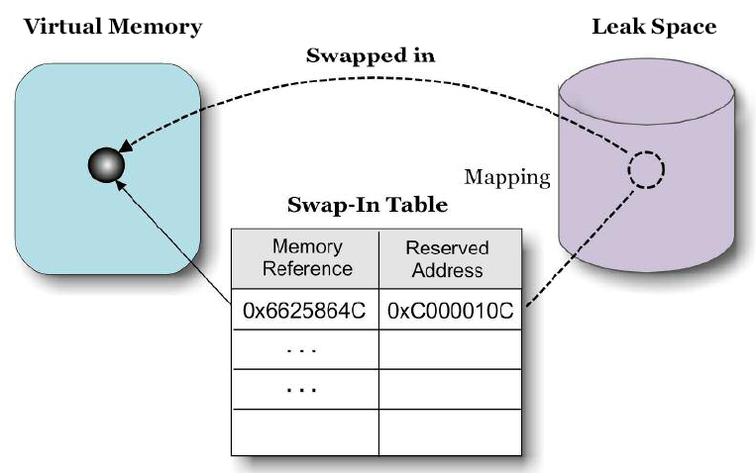
Swap-In Table

Slide 24
Incoming and Outgoing References
Only modifies the incoming references from registers and retries the faulty instruction
May severely hurt performance
De-references a reserved address in a loop
Raise exception repetitively by the same faulty instruction

Slide 25
Agenda
Authors
Introduction
Main Idea
Design and Implementation
Leak Detectors
Swap-Out Component
Swat-In Component
Evaluation

Slide 26
Evaluation
Two machines
2.8 GHz Intel Xeon processor
512 KB L2 cache
1GB memory
120GB hard drive
Linux 2.4.27-no-SMP
100Mbps Ethernet connection

Slide 27
Applications Used in Evaluation
Application | Version | #LOC | Description
Eclipse | 3.1.2 | 2813358 | An IDE
SPECjbb-2000 | 1.02 | 30486 | A server simulator
Jigsaw | 2.0.2 | 121776 | A web server
SPECjbb-2000-fp | 1.02 | 30586 | SPECjbb2000 with controlled false positive
DaCapo | 2006-10 MR2 | N/A | A standard Java benchmark suit

Slide 28
Evaluation Details
Eclipse
Each comparison between two directories triggers memory leaks
Repeatedly compare the source code of Jikes RVM
SPECjbb2000
Inject a memory leak
Jigsaw
The leak occurs during a client disconnection
Write a client with 10 threads each sends 20 connect and disconnect request per second

Slide 29
Overall Performance
Apps | Tolerable? |  | Live Time |  | Performance Ratio (w /LS: w/o LS)
 | w/LS | w/o LS | w/LS | w/o LS
Eclipse | Yes | No | >7626 | 555 | 1.27:1
SPECjbb2000 | Yes | No | >7135 | 328 | 1.24:1
Jigsaw | No | No | 3402 | 1147 | 1.46:1
Jigsaw has semantic memory leaks, which are not detected by the integrated leak detector.

Slide 30
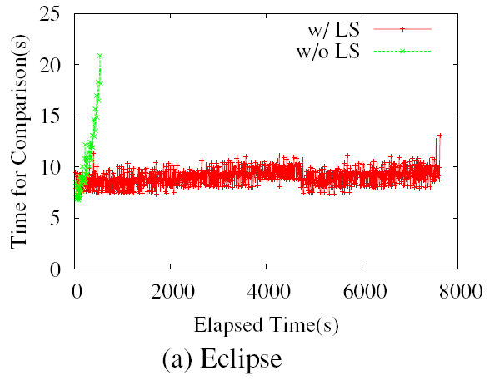
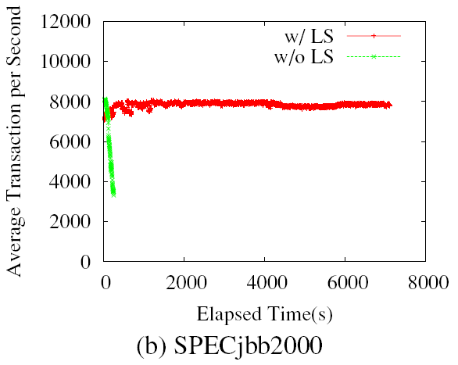
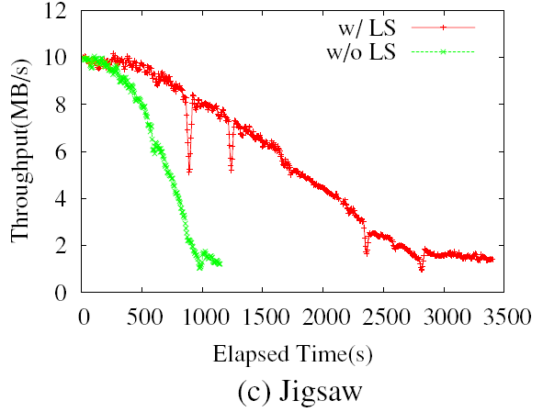
Overall Performance

Slide 31
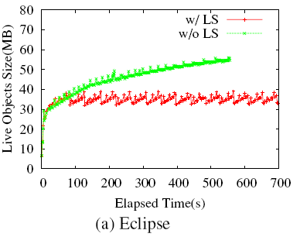
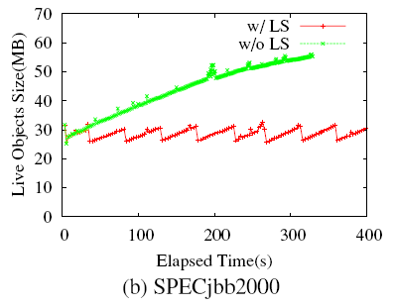
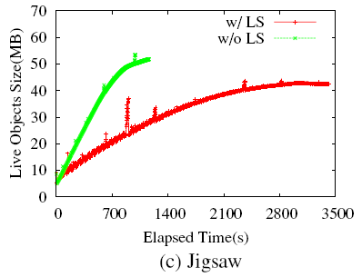
Live Object Sizes

Slide 32
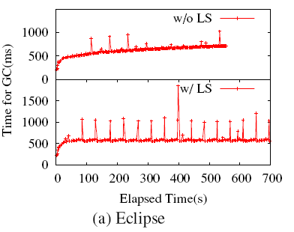
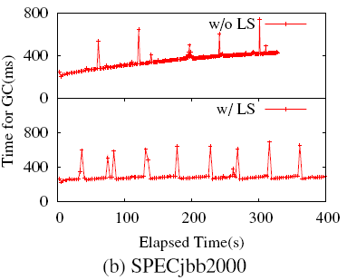
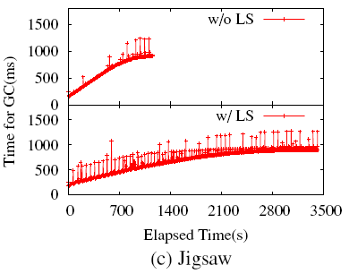
GC Performance

Slide 33
Thank you

