Slide 1
Application-Level Isolation and Recovery with Solitude
Shvetank Jain, Fareha Shafique, Vladan Djeric, Ashvin Goel, Department of Electrical and Computer Engineering, University of Toronto
Wang Yuanxuan, May.28th, 2008

Slide 2
Agenda
Authors
Introduction
Motivation
Overview
Approach
Implementation
Evaluation

Slide 3
Authors
Ashvin Goal
Primarily in the area of operating systems
Currently focusing on security on end systems
University of Toronto

Slide 4
Agenda
Authors
Introduction
Motivation
Overview
Approach
Implementation
Evaluation

Slide 5
Introduction
The Problem
It’s difficult to untangle the state changes made by an attacker
Choice of either removing all attacker modification or preserving all valid user activity
Solitude
Limit the effects of attacks
Simplify the post-intrusion recovery process

Slide 6
Solitude
Provides a file-system based isolation environment for running untrusted applications
Copy-on-write isolation file system
Called IFS
Taint propagation layer
Tracks the changes made to the base

Slide 7
Agenda
Authors
Introduction
Motivation
Overview
Approach
Implementation
Evaluation

Slide 8
Motivation
Taser
Securely audits all system-level activities
Can revert the persistent changes made by attacks
Costs
Need to log all system-call activities
Raises problems in implicitly sharing file-systems
If a hacker edit the password file in a Unix system

Slide 9
Agenda
Authors
Introduction
Motivation
Overview
Approach
Implementation
Evaluation

Slide 10
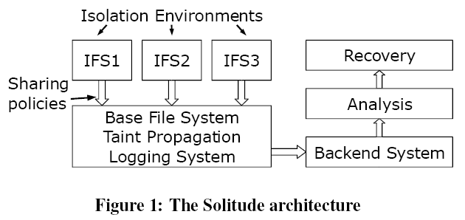
Overview

Slide 11
Overview – Usage model
Client-side
Instant messaging
Preserve chat logs
All other persistent updates remain isolated
Server-side
An on-line photo album web site
Shares only users’ photo data with the base system
IFS allows running multiple, related applications in a session.

Slide 12
Threat Model
Protect the system from malware
Limiting access privileges to the trusted file system by isolating the file modifications
Limiting system-wide capabilities available to an untrusted application
Provide a system-wide recovery mechanism
Since malwares may trick a user into granting additional privileges
Does not provide any additional protection for privacy leak

Slide 13
Agenda
Authors
Introduction
Motivation
Overview
Approach
Implementation
Evaluation

Slide 14
Approach – IFS Isolation Environment
Copy-on-Write
User can discard the entire IFS environment at any point
Limits attack propagation across IFS environment
Enables read sharing between the base and the IFS

Slide 15
IFS Isolation Environment
Isolation Model
Mount the copy-on-write IFS file system
Start untrusted applications within a chroot jail
Enhance the capability system in Linux
Traditional: coarse grained
Solitude: Per-file privileges

Slide 16
IFS Isolation Environment
IFS capability model
Child process does not inherit any capabilities from the parent
Setuid applications have no additional privileges in IFS
Capability | Parameters
Fcap | FilePath [owner.group] [perm]
CAP | [AppPath] CAP_SET

Slide 17
IFS Isolation Environment
Example: Policy for the Apache web server (In the base System)
Application /usr/sbin/apache2 www-data.www-data
Fcap /var/run/apache2.pid www-data.www-data
Fcap /var/log/apache2/error.log www-data.www-data
Fcap /var/log/apache2/access.log www-data.www-...
CAP net_bind_service
Wcommit /var/log/apache2/error.log
Wcommit /var/log/apache2/access.log

Slide 18
Sharing Policies
No support for sharing between two IFS environments directly
Must be performed via the base system
IFS sharing modes
Read/Write Mode | Description
Rshare | Allow file read sharing (default)
Rsnapshot | Allow file read from a snapshot
Rdeny | Deny file read
Wisolate | Deny file write to base (default)
Wcommit | Allow file write during commit
Wshare | Allow file write sharing

Slide 19
IFS Sharing Modes
Rshare: default, COW
Rsnapshop: COW in both directions, the IFS makes a snapshot of the base upon start-up
Rdeny: read-deny

Slide 20
IFS Sharing Modes
Wisolate: default, confine all writes to the IFS
Wcommit: Changes may be committed to the base system, with a Commit ID, only by the IFS owner
Wshare: immediate write-sharing of changes from the IFS to the base file system

Slide 21
A Sample Policy Snippet
Application /usr/bin/firefox
Wcommit /home/djeric/downloads/
Wcommit /home/djeric/.mozilla/
Rdeny /home/djeric/private_info.txt

Slide 22
Taint Propagation
Taint propagation rules
Taint at the process level
Low overhead
Introduces a large number of false sharing dependencies
Operation | Propagation Rules
File and directory read operations, execute file | Tainted file -> Taint process
File and directory modification operations | Tainted process -> Taint file
Create child process | Tainted process -> Taint child process

Slide 23
Logging System
Log all operations according to the rules
Use a separate privileged commit process to generate a commit log that stores an IFS ID, a commit ID

Slide 24
Recovery
Generate the tainting dependency graph
List all the files the depends on a particular commit ID
Roll back the files to an untainted state

Slide 25
Agenda
Authors
Introduction
Motivation
Overview
Approach
Implementation
Evaluation

Slide 26
Implementation
IFS Isolation Environment
Developed using FUSE
FUSE intercepts operations at the VFS layer

Slide 27
IFS Isolation Environment
Copy-on-Write
Recording all file deletions and the delete time
Recording the time when a file is first created
Using two mapping tables to deal with hard links
Isolation Model
Applications can only acquire the capabilities if the corresponding policy file is root owned

Slide 28
Sharing Policies
Implemented within the IFS monitor process
A simple tool for profiling an application’s file I/O behavior

Slide 29
Agenda
Authors
Introduction
Motivation
Overview
Approach
Implementation
Evaluation

Slide 30
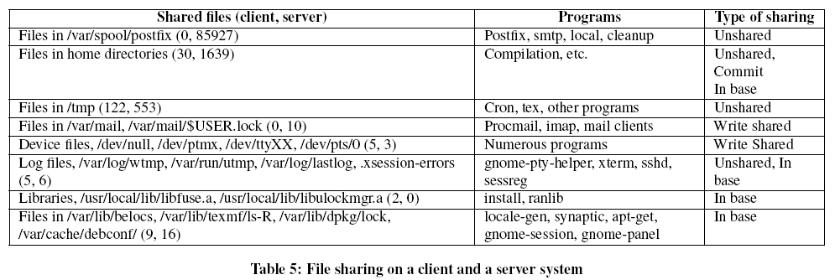
Measurement of Sharing
Forensix
A system that logs all system calls

Slide 31
Measurement of Sharing
Potential write-write sharing
Client: relatively uncommon
Server: majority of the sharing occurs due to mail programs
 | Client | Server
Experiment dates | Jul 26 – Aug 23 | Jul 25 – Aug 13
Experiment time | 29 days | 20 days
Files written | 30353 | 151856
Write shared files | 173 | 88154

Slide 32
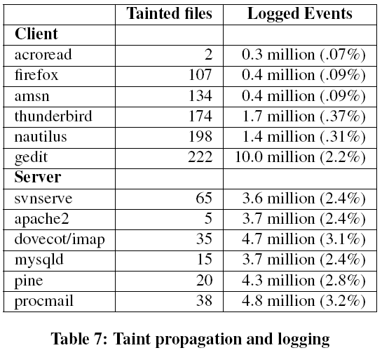
Taint Propagation and Logging
Relatively small

Slide 33
Performance Overhead
Client workloads
1. untar of a Linux kernel source tarball
2. kernel build of the Linux source
Server workloads
1. A large 230 MB file download
2. A large 230 MB file upload
The Apache ab benchmark
Stresses a standard apache server with four concurrent processes running 20 clients

Slide 34
Performance Overhead

Slide 35
Performance Overhead

Slide 36
Thank you

