Slide 1
Spectator: Detection and Containment of JavaScript Worms
Benjamin Livshits, Weidong Cui
Microsoft Research
2008 USENIX Annual Technical Conference

Slide 2
Outline
Introduction
Design
Implementations
Evaluation

Slide 3
Introduction
JavaScript worms are enabled by cross-site scripting vulnerabilities in Web apps.
Their threat is now significantly amplified with the advent of Ajax.
Ajax allows requests to the server to be done without user’s knowledge

Slide 4
The Samy Worm
Released on MySpace.com
Caused an explosion in the number of entries in the friends list across the site
Two steps
Download: A visitor downloads and executes the JS payload
Propagation: The payload is added to the viewer’s profile

Slide 5
Spectator
The first practical solution to detecting JS worms
Adds a small constant-time overhead to the latency of an HTTP request

Slide 6
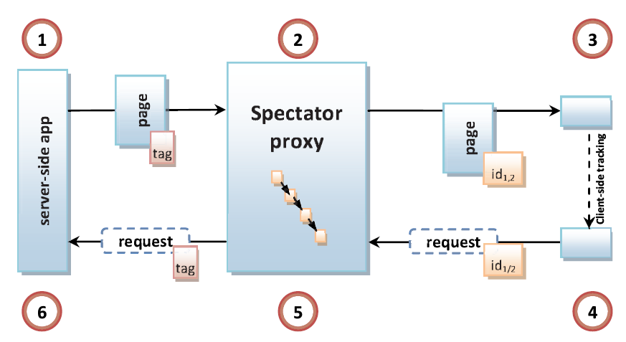
Design
Spectator Architecture

Slide 7
Propagation Graph
Definitions
A tag is a long integer uniquely identifying an HTML upload
A causality edge <(t₁, ip₁), (t₂, ip₂)>
Propagation graph G = <V, E>
The distance between two nodes
D(G): Diameter of a propagation graph G
G contains a worm if D(G) exceeds a user-provided threshold d

Slide 8
Implementations
Client-side
We would like to have a per-page cookie
For HTTP-only uploads, the id is contained in the cookie
For injected JS unloads, before passing the page to the client, add an unload event handler to invalidate the current session

Slide 9
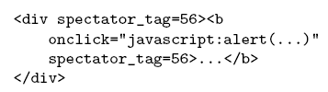
Implementations
Server-side
Primary goal: embed tags into suspicious data

Slide 10
Evaluation
Machine
Pentium 4 3.6 Ghz
3GB Memory
Windows Xp
Apache 2.2 Web server
Large-scale simulations
OurSpace, a simple Web app mimics MySpace
Data is stored in an in-memory database

Slide 11
OurSpace: Simulating User Behavior
Scenario 1: Worm outbreak
At every step, a random user wakes up and visits a random page
Scenario 2: A single long blog entry
N users access the same blog page one after another
Scenario 3: A model of worm propagation
Bias user selection towards users with a smaller ID

Slide 12
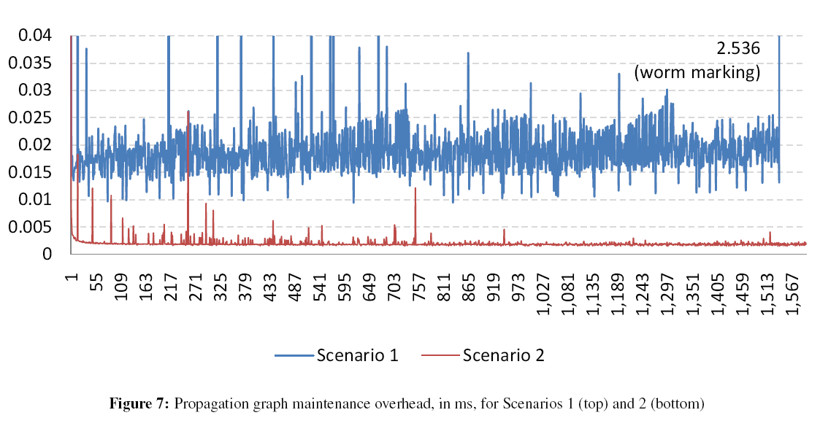
Propagation Graph

Slide 13
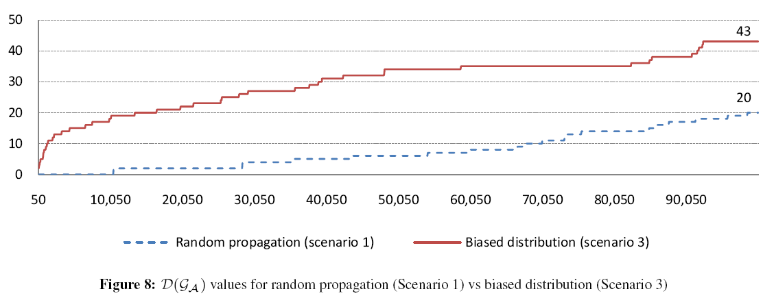
D(G) Values

Slide 14
Thank you

