Slide 1
Streamware: Programming General-Purpose Multicore Processors Using Streams (ASPLOS ’08)
Jayanth Gummaraju, Joel Coburn, Yoshio Turner, Mendel Rosenblum

Slide 2
Agenda
About Authors
Introduction
Stream Programming Model
Streamware Software Environment
Evaluation
Conclusions

Slide 3
About Authors
Computer System Laboratory, Stanford University
Architecture
Core System Software
Graphics
Human Computer Interaction
Interdisciplinary
Information Management
Security and Cryptography
System Networking
Ubiquitous Computing
VLSI

Slide 4
About Authors (cont.)
Jayanth Gummaraju
Mainly focus on many-core applications
Mendel Rosenblum
Virtualization
Architecture
Many-core

Slide 5
Agenda
About Authors
Introduction
Stream Programming Model
Streamware Software Environment
Evaluation
Conclusions

Slide 6
Introduction
Developing software to fully exploit the many cores is a big challenge
Programming model
Synchronization, scheduling, communication
Different platforms and APIs

Slide 7
Introduction (cont.)
Streamware - use the stream programming model to fully exploit multicore processors
Written sequentially
Automatically parallelized
Mapped to a wide variety of platforms
Cache hierarchy aware dynamic scheduling

Slide 8
Agenda
About Authors
Introduction
Stream Programming Model
Streamware Software Environment
Evaluation
Conclusions

Slide 9
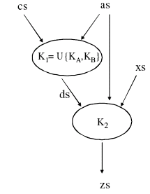
Stream Programming Model
Originally developed for media and image processing
Data is
encapsulated into contiguous array of records called streams
operated on by a series of computation kernels
Stream dependency

Slide 10
Stream Programming Model (cont.)
Benefits
Makes explicit the parallelism and locality
Limitations
Large amounts of data to operate on
High arithmetic intensity
Memory access can be determined in advance
Producer-consumer locality between computation kernels

Slide 11
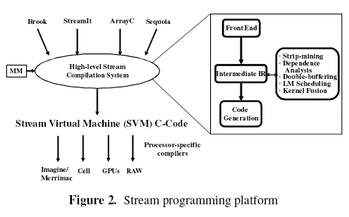
Stream Programming Model (cont.)
Stream programming platforms

Slide 12
Agenda
About Authors
Introduction
Stream Programming Model
Streamware Software Environment
Evaluation
Conclusions

Slide 13
Streamware Software Environment
Streamware
A platform independent stream virtual machine abstraction
Low overhead

Slide 14
Streamware API
APIs:
svmInit, svmExit
addDep, executeWork, Barrier
kernelCall
streamLoad, streamStore
streamGather, streamScatter
streamScatterOP
Write once, run everywhere

Slide 15
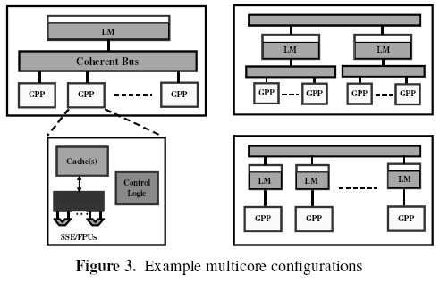
Mapping to the Hardware
Stream data are staged in the cache hierarchy
Run-time system implements DMA
Quad-word memory copy (SIMD)
Prefetching

Slide 16
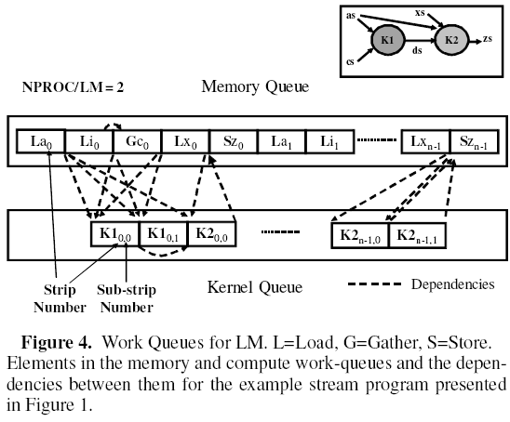
Cache Hierarchy Aware Dynamic Scheduling
Work Queues for LM

Slide 17
Cache Hierarchy Aware Dynamic Scheduling
Interleave consecutive control loop iterations across the set of LMs
May result in cache misses
Piecewise splitting
Limited size groups of loop iterations are assigned dynamically to LMs
Adapts to different rates of execution by processor cores and DMA engines

Slide 18
Agenda
About Authors
Introduction
Stream Programming Model
Streamware Software Environment
Evaluation
Conclusions

Slide 19
Evaluations
Configuration
Intel 6.4GB/s Front Side Bus
8GB DDR2 RAM
RedHat FC6 (2.6 SMP Kernel)
Two dual-core processors (Intel Xeon 5140)
Four scientific applications
FEM: compute-intensive
SPAS: memory-intensive

Slide 20
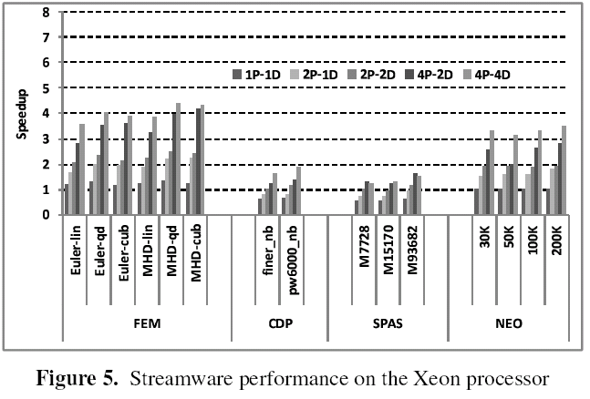
Evaluating Streamware on Xeon
4P-2D means
4 processors
2 DMAs
More efficient locality
(1P-1D runs 1.1x to 1.4x faster)

Slide 21
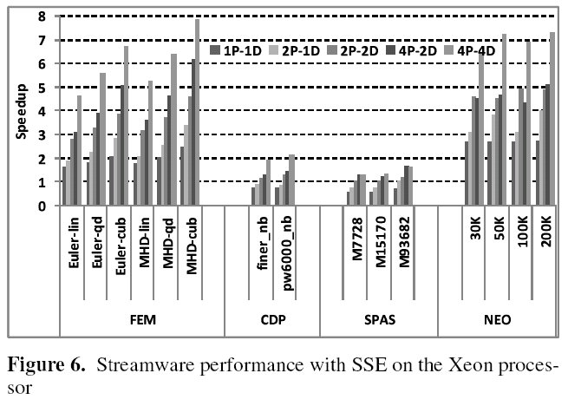
Performance with SSE on Xeon

Slide 22
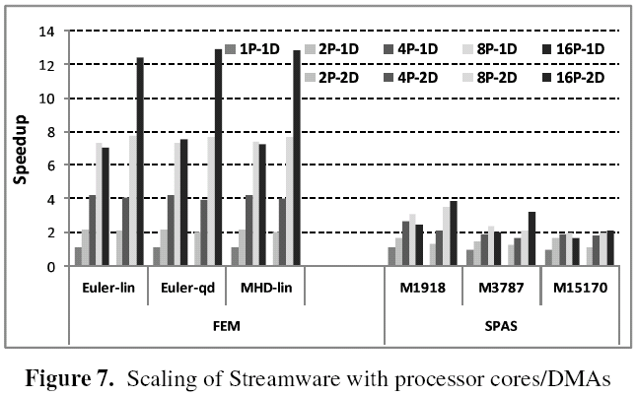
Scaling of Streamware

Slide 23
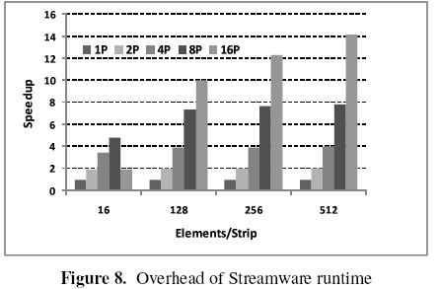
Overhead of Streamware Runtime System
Contention for the queue lock is the dominant source of the overhead.

Slide 24
Agenda
About Authors
Introduction
Stream Programming Model
Streamware Software Environment
Evaluation
Conclusions

Slide 25
Conclusions
Streamware provides
a way to utilize increasing number of on-chip resources
support to make applications portable across different hardwares
cache hierarchy aware optimization
Nearly linear speedup with an increasing number of cores

Slide 26
Thank you

