Slide 1
Bits, Bytes, Integers, and Floats
Instructor:
Susmit Shannigrahi
Adapted from Bryant and O’Hallaron, Computer Systems: A Programmer’s Perspective, Third Edition

Slide 2
Today: Bits, Bytes, and Integers
Representing information as bits
Bit-level manipulations
Integers
Representation: unsigned and signed
Conversion, casting
Expanding, truncating
Addition, negation, multiplication, shifting
Summary
Representations in memory, pointers, strings

Slide 3
Recap: Everything is bits
Each bit is 0 or 1
By encoding/interpreting sets of bits in various ways
Computers determine what to do (instructions)
… and represent and manipulate numbers, sets, strings, etc…
Why bits? Electronic Implementation
Easy to store with bistable elements
Reliably transmitted on noisy and inaccurate wires
0
1
0
1.1V
0.9V
0.2V
0.0V

Slide 4
For example, can count in binary
Base 2 Number Representation
Represent 15213₁₀ as 11101101101101₂
Represent 1.20₁₀ as 1.0011001100110011[0011]…₂
Represent 1.5213 X 10⁴ as 1.1101101101101₂ X 2¹³

Slide 5
Encoding Byte Values
Byte = 8 bits
Binary 000000002 to 111111112
Decimal: 010 to 25510
Hexadecimal 0016 to FF16
Base 16 number representation
Use characters ‘0’ to ‘9’ and ‘A’ to ‘F’
Write FA1D37B16 in C as
0xFA1D37B
0xfa1d37b
Decimal
Hex
Binary
0
0
0000
1
1
0001
2
2
0010
3
3
0011
4
4
0100
5
5
0101
6
6
0110
7
7
0111
8
8
1000
9
9
1001
A
10
1010
B
11
1011
C
12
1100
D
13
1101
E
14
1110
F
15
1111

Slide 6
Example Data Representations
C Data Type | Typical 32-bit | Typical 64-bit | x86-64
char | 1 | 1 | 1
short | 2 | 2 | 2
int | 4 | 4 | 4
long | 4 | 8 | 8
float | 4 | 4 | 4
double | 8 | 8 | 8
long double | − | − | 10/16
pointer | 4 | 8 | 8

Slide 7
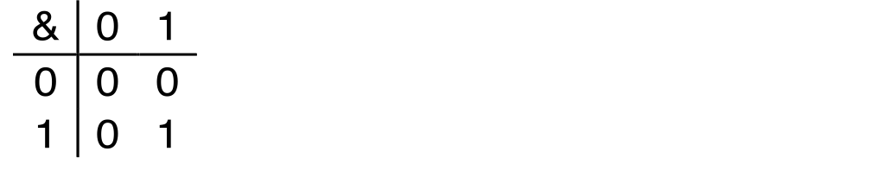
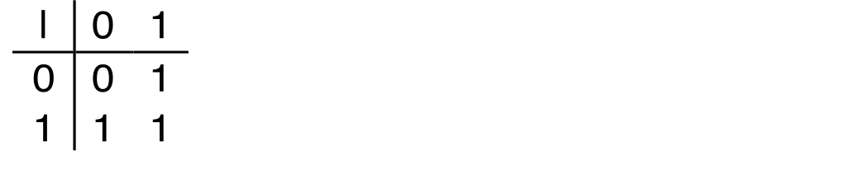
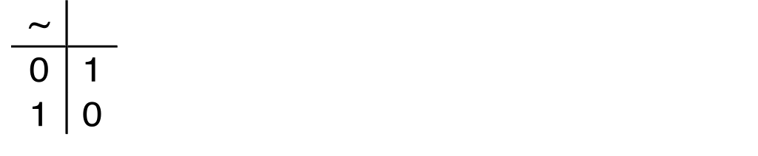
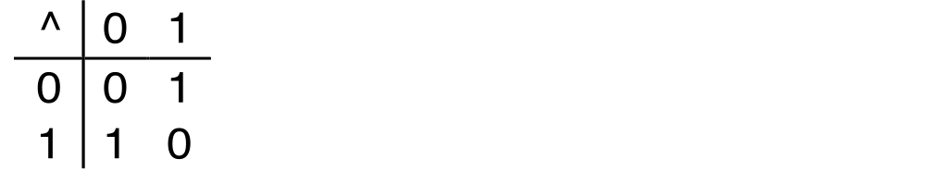
Boolean Algebra
Developed by George Boole in 19th Century
Algebraic representation of logic
Encode “True” as 1 and “False” as 0
And
A&B = 1 when both A=1 and B=1
Or
A|B = 1 when either A=1 or B=1
Not
~A = 1 when A=0
Exclusive-Or (Xor)
A^B = 1 when either A=1 or B=1, but not both

Slide 8
Today: Bits, Bytes, and Integers
Representing information as bits
Bit-level manipulations
Integers
Representation: unsigned and signed
Conversion, casting
Expanding, truncating
Addition, negation, multiplication, shifting
Summary
Representations in memory, pointers, strings
Summary

Slide 9
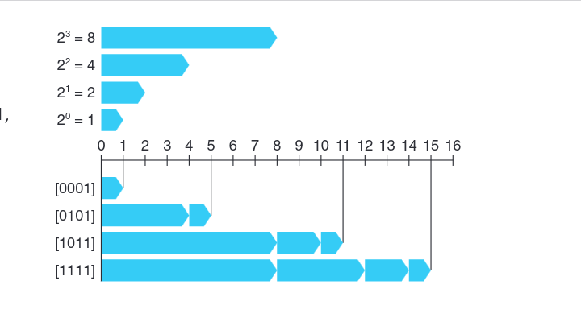
Encoding Integers
Integer data type of w bits → A bit vector as either x, to
denote the entire vector, or as [xw−1, xw−2, . . . , x0 ] to represent individual bits

Slide 10
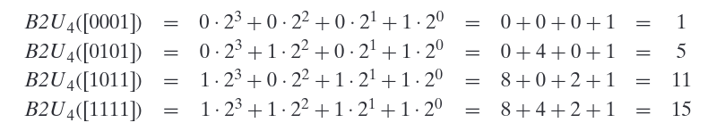
Unsigned representation of Integers
Integer data type of w bits → A bit vector as either x, to
denote the entire vector, or as [xw−1, xw−2, . . . , x0 ] to represent individual bits

Slide 11
Two’s complement → Signed Representation
Unsigned
Two’s Complement
short int x = 15213;
short int y = -15213;
Sign
Bit
C short 2 bytes long
Sign Bit
For 2’s complement, most significant bit indicates sign
0 for nonnegative
1 for negative

Slide 12
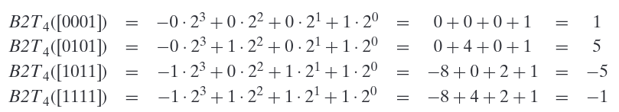
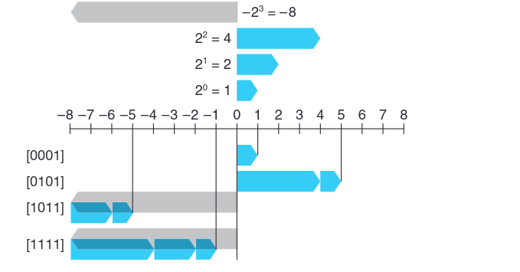
Signed representation of Integers
Integer data type of w bits → A bit vector as either x, to
denote the entire vector, or as [xw−1, xw−2, . . . , x0 ] to represent individual bits

Slide 13
Two-complement Encoding Example (Cont.)
x = 15213: 00111011 01101101
y = -15213: 11000100 10010011

Slide 14
Numeric Ranges
Unsigned Values
UMin = 0
000…0
UMax = 2^{w} – 1
111…1
Two’s Complement Values
TMin = –2^{w–1}
100…0
TMax = 2^{w–1} – 1
011…1
Other Values
Minus 1
111…1
Values for W = 16

Slide 15
Values for Different Word Sizes
Observations
|TMin | = TMax + 1
Asymmetric range
UMax = 2 * TMax + 1
C Programming
#include <limits.h>
Declares constants, e.g.,
ULONG_MAX
LONG_MAX
LONG_MIN
Values platform specific

Slide 16
Unsigned & Signed Numeric Values
Equivalence
Same encodings for nonnegative values
Uniqueness
Every bit pattern represents unique integer value
Each representable integer has unique bit encoding
⇒ Can Invert Mappings
U2B(x) = B2U⁻¹(x)
Bit pattern for unsigned integer
T2B(x) = B2T⁻¹(x)
Bit pattern for two’s comp integer
X
B2U(X)
B2T(X)
0000
0
0
0001
1
1
0010
2
2
0011
3
3
0100
4
4
0101
5
5
0110
6
6
0111
7
7
1000
8
–8
1001
9
–7
1010
10
–6
1011
11
–5
1100
12
–4
1101
13
–3
1110
14
–2
1111
15
–1

Slide 17
Today: Bits, Bytes, and Integers
Representing information as bits
Bit-level manipulations
Integers
Representation: unsigned and signed
Conversion, casting
Expanding, truncating
Addition, negation, multiplication, shifting
Summary
Representations in memory, pointers, strings

Slide 18
Mapping Between Signed & Unsigned
Two’s Complement
Unsigned
T2U
x
T2B
B2U
ux
X
Maintain Same Bit Pattern
Unsigned
U2T
Two’s Complement
ux
U2B
B2T
x
X
Maintain Same Bit Pattern
Mappings between unsigned and two’s complement numbers: Keep bit representations and reinterpret

Slide 19
Mapping Signed ↔ Unsigned
Bits
0000
0001
0010
0011
0100
0101
0110
0111
1000
1001
1010
1011
1100
1101
1110
1111
Signed
0
1
2
3
4
5
6
7
-8
-7
-6
-5
-4
-3
-2
-1
Unsigned
0
1
2
3
4
5
6
7
8
9
10
11
12
13
14
15
=
+/- 16

Slide 20
Signed vs. Unsigned in C
Constants
By default are considered to be signed integers
Unsigned if have “U” as suffix
0U, 4294967259U
Casting
Explicit casting between signed & unsigned same as U2T and T2U
int tx, ty;
unsigned ux, uy;
tx = (int) ux;
uy = (unsigned) ty;
Implicit casting also occurs via assignments and procedure calls
tx = ux;
uy = ty;

Slide 21
Casting Surprises
Expression Evaluation
If there is a mix of unsigned and signed in single expression, signed values implicitly cast to unsigned
Including comparison operations <, >, ==, <=, >=
Examples for W = 32: TMIN = -2,147,483,648 , TMAX = 2,147,483,647
Constant₁ Constant₂ Relation Evaluation
0 0U
-1 0
-1 0U
2147483647 -2147483647-1
2147483647U -2147483647-1
-1 -2
(unsigned)-1 -2
2147483647 2147483648U
2147483647 (int) 2147483648U
0 0U == unsigned
-1 0 < signed
-1 0U > unsigned
2147483647 -2147483648 > signed
2147483647U -2147483648 < unsigned
-1 -2 > signed
(unsigned) -1 -2 > unsigned
2147483647 2147483648U < unsigned
2147483647 (int) 2147483648U > signed

Slide 22
Today: Bits, Bytes, and Integers
Representing information as bits
Bit-level manipulations
Integers
Representation: unsigned and signed
Conversion, casting
Expanding, truncating
Addition, negation, multiplication, shifting
Summary
Representations in memory, pointers, strings

Slide 23
Today: Bits, Bytes, and Integers
Representing information as bits
Bit-level manipulations
Integers
Representation: unsigned and signed
Conversion, casting
Expanding, truncating
Addition, negation, multiplication, shifting
Representations in memory, pointers, strings
Summary

Slide 24
Unsigned Addition
u
Operands: w bits
• • •
+
v
• • •
True Sum: w+1 bits
u + v
• • •
Discard Carry: w bits
UAdd_{w}(u , v)
• • •
Standard Addition Function
Ignores carry output
Implements Modular Arithmetic
s = UAdd_{w}(u , v) = u + v mod 2^{w}

Slide 25
Visualizing (Mathematical) Integer Addition
Integer Addition
4-bit integers u, v
Compute true sum Add₄(u , v)
Values increase linearly with u and v
Forms planar surface
Add₄(u , v)
v
u

Slide 26
Visualizing Unsigned Addition
Wraps Around
If true sum ≥ 2^{w}
At most once
Overflow
UAdd₄(u , v)
True Sum
2^{w+1}
Overflow
2^{w}
v
0
Modular Sum
u

Slide 27
Two’s Complement Addition
Operands: w bits
u
• • •
+
v
• • •
True Sum: w+1 bits
u + v
• • •
Discard Carry: w bits
TAdd_{w}(u , v)
• • •
TAdd and UAdd have Identical Bit-Level Behavior
Signed vs. unsigned addition in C:
int s, t, u, v;
s = (int) ((unsigned) u + (unsigned) v);
t = u + v
Will give s == t

Slide 28
Multiplication
Goal: Computing Product of w-bit numbers x, y
Either signed or unsigned
But, exact results can be bigger than w bits
Unsigned: up to 2w bits
Result range: 0 ≤ x * y ≤ (2^{w} – 1) ² = 2^{2w} – 2^{w+1} + 1
Two’s complement min (negative): Up to 2w-1 bits
Result range: x * y ≥ (–2^{w–1})*(2^{w–1}–1) = –2^{2w–2} + 2^{w–1}
Two’s complement max (positive): Up to 2w bits, but only for (TMin_{w})²
Result range: x * y ≤ (–2^{w–1}) ² = 2^{2w–2}
So, maintaining exact results…
would need to keep expanding word size with each product computed
is done in software, if needed
e.g., by “arbitrary precision” arithmetic packages

Slide 29
Unsigned Multiplication in C
u
• • •
Operands: w bits
*
v
• • •
True Product: 2*w bits
u · v
• • •
• • •
UMult_{w}(u , v)
Discard w bits: w bits
• • •
Standard Multiplication Function
Ignores high order w bits
Implements Modular Arithmetic
UMult_{w}(u , v) = u · v mod 2^{w}

Slide 30
Signed Multiplication in C
u
• • •
Operands: w bits
*
v
• • •
True Product: 2*w bits
u · v
• • •
• • •
TMult_{w}(u , v)
Discard w bits: w bits
• • •
Standard Multiplication Function
Ignores high order w bits
Some of which are different for signed vs. unsigned multiplication
Lower bits are the same

Slide 31
Power-of-2 Multiply with Shift
Operation
u << k gives u * 2^{k}
Both signed and unsigned
Examples
u << 3 == u * 8
(u << 5) – (u << 3) == u * 24
Most machines shift and add faster than multiply
Compiler generates this code automatically
k
u
• • •
Operands: w bits
*
2^{k}
0
•••
0
1
0
•••
0
0
True Product: w+k bits
u · 2^{k}
• • •
0
•••
0
0
Discard k bits: w bits
UMult_{w}(u , 2^{k})
•••
0
•••
0
0
TMult_{w}(u , 2^{k})

Slide 32
Unsigned Power-of-2 Divide with Shift
Quotient of Unsigned by Power of 2
u >> k gives ⎣ u / 2^{k} ⎦
Uses logical shift
k
u
•••
•••
Binary Point
Operands:
/
2^{k}
0
•••
0
1
0
•••
0
0
Division:
u / 2^{k}
0
.
0
•••
0
0
•••
•••
Result:
⎣ u / 2^{k} ⎦
0
0
•••
0
0
•••

Slide 33
Today: Bits, Bytes, and Integers
Representing information as bits
Bit-level manipulations
Integers
Representation: unsigned and signed
Conversion, casting
Expanding, truncating
Addition, negation, multiplication, shifting
Summary
Representations in memory, pointers, strings

Slide 34
Floating Point
Carnegie Mellon

Slide 35
Today: Floating Point
Carnegie Mellon
Background: Fractional binary numbers
IEEE floating point standard: Definition
Example and properties
Rounding, addition, multiplication
Floating point in C
Summary

Slide 36
Fractional binary numbers
Carnegie Mellon
What is 1011.101₂?

Slide 37
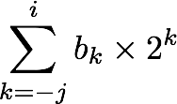
Fractional Binary Numbers
Carnegie Mellon
2^{i}
2^{i-1}
4
2
1
• • •
bi | bi-1 | ••• | b2 | b1 | b0 | b-1 | b-2 | b-3 | ••• | b-j
1/2
1/4
1/8
2^{-j}
• • •
Representation
Bits to right of “binary point” represent fractional powers of 2
Represents rational number:
Notes:
Latex source for equation: \sum_{k=-j}^i b_k \times 2^k

Slide 38
Fractional Binary Numbers: Examples
Carnegie Mellon
Value Representation
5 3/4 101.112
2 7/8 010.1112
1 7/16 001.01112
Observations
Divide by 2 by shifting right (unsigned)
Multiply by 2 by shifting left
Numbers of form 0.111111…2 are just below 1.0
1/2 + 1/4 + 1/8 + … + 1/2^{i} + … ➙ 1.0
Use notation 1.0 – ε

Slide 39
Representable Numbers
Carnegie Mellon
Limitation #1
Can only exactly represent numbers of the form x/2^{k}
Other rational numbers have repeating bit representations
Value Representation
1/3 0.0101010101[01]…2
1/5 0.001100110011[0011]…2
1/10 0.0001100110011[0011]…2
Limitation #2
Just one setting of binary point within the w bits
Limited range of numbers (very small values? very large?)

Slide 40
Today: Floating Point
Carnegie Mellon
Background: Fractional binary numbers
IEEE floating point standard: Definition
Example and properties
Rounding, addition, multiplication
Floating point in C
Summary

Slide 41
IEEE Floating Point
Carnegie Mellon
IEEE Standard 754
Established in 1985 as uniform standard for floating point arithmetic
Before that, many idiosyncratic formats
Supported by all major CPUs
Driven by numerical concerns
Nice standards for rounding, overflow, underflow
Hard to make fast in hardware
Numerical analysts predominated over hardware designers in defining standard

Slide 42
Floating Point Representation
Carnegie Mellon
Numerical Form: (–1)^{s} M 2E
Sign bit s determines whether number is negative or positive
Significand M normally a fractional value in range [1.0,2.0).
Exponent E weights value by power of two
Encoding
MSB s is sign bit s
exp field encodes E (but is not equal to E)
frac field encodes M (but is not equal to M)
s | exp | frac

Slide 43
Precision options
Carnegie Mellon
Single precision: 32 bits
Double precision: 64 bits
Extended precision: 80 bits (Intel only)
s | exp | frac
1 | 8-bits | 23-bits
s | exp | frac
1 | 11-bits | 52-bits
s | exp | frac
1 | 15-bits | 63 or 64-bits

Slide 44
“Normalized” Values
Carnegie Mellon
v = (–1)^{s} M 2E
When: exp ≠ 000…0 and exp ≠ 111…1
Exponent coded as a biased value: E = Exp – Bias
Exp: unsigned value of exp field
Bias = 2^{k-1} - 1, where k is number of exponent bits
Single precision: 127 (Exp: 1…254, E: -126…127)
Double precision: 1023 (Exp: 1…2046, E: -1022…1023)
Significand coded with implied leading 1: M = 1.xxx…x2
xxx…x: bits of frac field
Minimum when frac=000…0 (M = 1.0)
Maximum when frac=111…1 (M = 2.0 – ε)
Get extra leading bit for “free”

Slide 45
Example
Step 1: Convert 9.75 to Binary
9.75 in decimal is represented as:
9 in binary: 1001
0.75 in binary: To convert this, repeatedly multiply by 2 and track the whole number part:
0.75×2=1.50 → whole part = 1
0.5×2=1.00→ whole part = 1
So, 0.75 in binary is 0.11.
Thus, 9.75 in binary is:
1001.11 or 1.00111×2^3 (in normalized scientific notation).

Slide 46
Example – contd.
Step 2: Breaking into IEEE 754 Components
Sign bit (S): Since 9.75 is positive, the sign bit is 0.
Exponent (E): The actual exponent here is 3, because we shifted the decimal point three places to the left to normalize the number.
Mantissa (M): The mantissa is the binary digits after the leading 1 (which is implied in IEEE 754). So, the mantissa is 00111. Step 3: Encode the Exponent with Bias For IEEE 754 single-precision, the exponent is stored with a bias of 127. So, to store the exponent, we add the bias to the actual exponent:
Encoded Exponent = Actual Exponent + Bias
Encoded Exponent = 3 + 127 = 130
In binary, 130 is represented as: 10000010

Slide 47
Example
Step 4: Assembling the Final IEEE 754 Representation
Now, let's combine the components:
Sign bit: 0
Exponent: 10000010 (which is 130 in decimal)
Mantissa: 00111000000000000000000 (with 23 bits)
So, the 32-bit IEEE 754 single-precision representation of 9.75 is:
0 10000010 00111000000000000000000

Slide 48
Normalized Encoding Example
v = (–1)^{s} M 2E
E = Exp – Bias
Value: float F = 15213.0;
15213₁₀ = 11101101101101₂
= 1.1101101101101₂ x 2¹³
Significand
M = 1.1101101101101₂
frac = 11011011011010000000000₂
Exponent
E = 13
Bias = 127
Exp = 140 = 10001100₂
Result: 0 10001100 11011011011010000000000
s
exp
frac

Slide 49
Denormalized Values
Carnegie Mellon
v = (–1)^{s} M 2E
E = 1 – Bias
Condition: exp = 000…0
Exponent value: E = 1 – Bias (instead of E = 0 – Bias)
Significand coded with implied leading 0: M = 0.xxx…x2
xxx…x: bits of frac
Cases
exp = 000…0, frac = 000…0
Represents zero value
Note distinct values: +0 and –0 (why?)
exp = 000…0, frac ≠ 000…0
Numbers closest to 0.0
Equispaced

Slide 50
Special Values
Carnegie Mellon
Condition: exp = 111…1
Case: exp = 111…1, frac = 000…0
Represents value ∞ (infinity)
Operation that overflows
Both positive and negative
E.g., 1.0/0.0 = −1.0/−0.0 = +∞, 1.0/−0.0 = −∞
Case: exp = 111…1, frac ≠ 000…0
Not-a-Number (NaN)
Represents case when no numeric value can be determined
E.g., sqrt(–1), ∞ − ∞, ∞ × 0

Slide 51
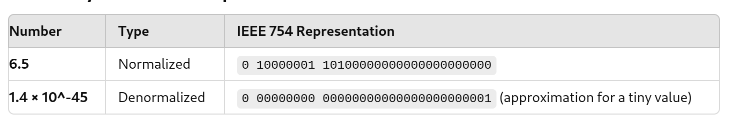
Normalized vs Denormalized

Slide 52
Visualization: Floating Point Encodings
Carnegie Mellon
−∞
+∞
−Normalized
−Denorm
+Denorm
+Normalized
NaN
NaN
−0
+0

Slide 53
Today: Floating Point
Carnegie Mellon
Background: Fractional binary numbers
IEEE floating point standard: Definition
Example and properties
Rounding, addition, multiplication
Floating point in C
Summary

Slide 54
Tiny Floating Point Example
Carnegie Mellon
s | exp | frac
1 | 4-bits | 3-bits
8-bit Floating Point Representation
the sign bit is in the most significant bit
the next four bits are the exponent, with a bias of 7
the last three bits are the frac
Same general form as IEEE Format
normalized, denormalized
representation of 0, NaN, infinity

Slide 55
Dynamic Range (Positive Only)
Carnegie Mellon
v = (–1)^{s} M 2E
n: E = Exp – Bias
d: E = 1 – Bias
s exp frac E Value
0 0000 000 -6 0
0 0000 001 -6 1/8*1/64 = 1/512
0 0000 010 -6 2/8*1/64 = 2/512
…
0 0000 110 -6 6/8*1/64 = 6/512
0 0000 111 -6 7/8*1/64 = 7/512
0 0001 000 -6 8/8*1/64 = 8/512
0 0001 001 -6 9/8*1/64 = 9/512
…
0 0110 110 -1 14/8*1/2 = 14/16
0 0110 111 -1 15/8*1/2 = 15/16
0 0111 000 0 8/8*1 = 1
0 0111 001 0 9/8*1 = 9/8
0 0111 010 0 10/8*1 = 10/8
…
0 1110 110 7 14/8*128 = 224
0 1110 111 7 15/8*128 = 240
0 1111 000 n/a inf
closest to zero
Denormalized
numbers
largest denorm
smallest norm
closest to 1 below
Normalized
numbers
closest to 1 above
largest norm

Slide 56
Distribution of Values
Carnegie Mellon
6-bit IEEE-like format
e = 3 exponent bits
f = 2 fraction bits
Bias is 2³⁻¹-1 = 3
Notice how the distribution gets denser toward zero.
s | exp | frac
1 | 3-bits | 2-bits
8 values

Slide 57
Distribution of Values (close-up view)
Carnegie Mellon
6-bit IEEE-like format
e = 3 exponent bits
f = 2 fraction bits
Bias is 3
s | exp | frac
1 | 3-bits | 2-bits

Slide 58
Special Properties of the IEEE Encoding
Carnegie Mellon
FP Zero Same as Integer Zero
All bits = 0
Can (Almost) Use Unsigned Integer Comparison
Must first compare sign bits
Must consider −0 = 0
NaNs problematic
Will be greater than any other values
What should comparison yield?
Otherwise OK
Denorm vs. normalized
Normalized vs. infinity

Slide 59
Today: Floating Point
Carnegie Mellon
Background: Fractional binary numbers
IEEE floating point standard: Definition
Example and properties
Rounding, addition, multiplication
Floating point in C
Summary

Slide 60
Floating Point Operations: Basic Idea
Carnegie Mellon
x +f y = Round(x + y)
x ×f y = Round(x × y)
Basic idea
First compute exact result
Make it fit into desired precision
Possibly overflow if exponent too large
Possibly round to fit into frac

Slide 61
Rounding
Carnegie Mellon
Rounding Modes (illustrate with $ rounding)
$1.40 $1.60 $1.50 $2.50 –$1.50
Towards zero $1 $1 $1 $2 –$1
Round down (−∞) $1 $1 $1 $2 –$2
Round up (+∞) $2 $2 $2 $3 –$1
Nearest Even (default) $1 $2 $2 $2 –$2

Slide 62
Closer Look at Round-To-Even
Carnegie Mellon
Default Rounding Mode
Hard to get any other kind without dropping into assembly
All others are statistically biased
Sum of set of positive numbers will consistently be over- or under- estimated
Applying to Other Decimal Places / Bit Positions
When exactly halfway between two possible values
Round so that least significant digit is even
E.g., round to nearest hundredth
7.8949999 7.89 (Less than half way)
7.8950001 7.90 (Greater than half way)
7.8950000 7.90 (Half way—round up)
7.8850000 7.88 (Half way—round down)

Slide 63
Rounding Binary Numbers
Carnegie Mellon
Binary Fractional Numbers
“Even” when least significant bit is 0
“Half way” when bits to right of rounding position = 100…2
Examples
Round to nearest 1/4 (2 bits right of binary point)
Value Binary Rounded Action Rounded Value
2 3/32 10.000112 10.002 (<1/2—down) 2
2 3/16 10.001102 10.012 (>1/2—up) 2 1/4
2 7/8 10.111002 11.002 ( 1/2—up) 3
2 5/8 10.101002 10.102 ( 1/2—down) 2 1/2

Slide 64
FP Multiplication
Carnegie Mellon
(–1)^{s1} M1 2^{E1} x (–1)^{s2} M2 2^{E2}
Exact Result: (–1)^{s} M 2E
Sign s: s1 ^ s2
Significand M: M1 x M2
Exponent E: E1 + E2
Fixing
If M ≥ 2, shift M right, increment E
If E out of range, overflow
Round M to fit frac precision
Implementation
Biggest chore is multiplying significands

Slide 65
Floating Point Addition
Carnegie Mellon
(–1)^{s1} M1 2^{E1} + (-1)^{s2} M2 2^{E2}
Assume E1 > E2
Exact Result: (–1)^{s} M 2E
Sign s, significand M:
Result of signed align & add
Exponent E: E1
Fixing
If M ≥ 2, shift M right, increment E
if M < 1, shift M left k positions, decrement E by k
Overflow if E out of range
Round M to fit frac precision
Get binary points lined up
E1–E2
(–1)^{s1} M1
+
(–1)^{s2} M2
(–1)^{s} M

Slide 66
Mathematical Properties of FP Add
Carnegie Mellon
Compare to those of Abelian Group
Closed under addition?
But may generate infinity or NaN
Commutative?
Associative?
Overflow and inexactness of rounding
(3.14+1e10)-1e10 = 0, 3.14+(1e10-1e10) = 3.14
0 is additive identity?
Every element has additive inverse?
Yes, except for infinities & NaNs
Monotonicity
a ≥ b ⇒ a+c ≥ b+c?
Except for infinities & NaNs
Yes
Yes
No
Yes
Almost
Almost

Slide 67
Mathematical Properties of FP Mult
Carnegie Mellon
Compare to Commutative Ring
Closed under multiplication?
But may generate infinity or NaN
Multiplication Commutative?
Multiplication is Associative?
Possibility of overflow, inexactness of rounding
Ex: (1e20*1e20)*1e-20= inf, 1e20*(1e20*1e-20)= 1e20
1 is multiplicative identity?
Multiplication distributes over addition?
Possibility of overflow, inexactness of rounding
1e20*(1e20-1e20)= 0.0, 1e20*1e20 – 1e20*1e20 = NaN
Monotonicity
a ≥ b & c ≥ 0 ⇒ a * c ≥ b *c?
Except for infinities & NaNs
Yes
Yes
No
Yes
No
Almost

Slide 68
Today: Floating Point
Carnegie Mellon
Background: Fractional binary numbers
IEEE floating point standard: Definition
Example and properties
Rounding, addition, multiplication
Floating point in C
Summary

Slide 69
Floating Point in C
Carnegie Mellon
C Guarantees Two Levels
float single precision
double double precision
Conversions/Casting
Casting between int, float, and double changes bit representation
double/float → int
Truncates fractional part
Like rounding toward zero
Not defined when out of range or NaN: Generally sets to TMin
int → double
Exact conversion, as long as int has ≤ 53 bit word size
int → float
Will round according to rounding mode

Slide 70
Floating Point Puzzles
Carnegie Mellon
For each of the following C expressions, either:
Argue that it is true for all argument values
Explain why not true
x == (int)(float) x
x == (int)(double) x
f == (float)(double) f
d == (double)(float) d
f == -(-f);
2/3 == 2/3.0
d < 0.0 ⇒ ((d*2) < 0.0)
d > f ⇒ -f > -d
d * d >= 0.0
(d+f)-d == f
int x = …;
float f = …;
double d = …;
Assume neither
d nor f is NaN

Slide 71
Summary
Carnegie Mellon
IEEE Floating Point has clear mathematical properties
Represents numbers of form M x 2E
One can reason about operations independent of implementation
As if computed with perfect precision and then rounded
Not the same as real arithmetic
Violates associativity/distributivity
Makes life difficult for compilers & serious numerical applications programmers

