Slide 1
CSC2770 – Intro to Systems and Networking
DNS and Networked applications
Instructor: Susmit Shannigrahi
sshannigrahi@tntech.edu

Slide 2

Apps (HTTP)
Data
Apps (HTTP)
Segments
Transport (TCP/UDP)
Transport (TCP/UDP)
Network (IP)
Packets
Network (IP)
Link (Ethernet)
Frames
Link (Ethernet)
Ethernet Interface
Ethernet Interface
Bits (1010001)

Slide 3
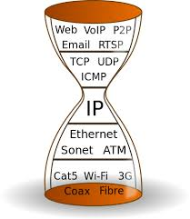
IP Based Communication
youtube.com/catvideo1
Notes:
Mention interest aggregation
Caching

Slide 4




IP Based Communication
google.com
216.58.217.46
GET google.com/index.html
Lookup google.com
216.58.217.46
Get Data
google.com
216.58.217.49
Notes:
Mention interest aggregation
Caching

Slide 5
DNS – IP to Name
People: Good with names
Machines: Good with numbers
Ask a person to remember 100s of Ips
- May not work well
DNS maps IP addresses to human readable names.

Slide 6
DNS: a distributed, hierarchical database
Root DNS Servers
…
…
com DNS servers
org DNS servers
edu DNS servers
yahoo.com
DNS servers
pbs.org
DNS servers
poly.edu
DNS servers
umass.edu
DNS servers
amazon.com
DNS servers
client wants IP for www.amazon.com;
client queries root server to find com DNS server
client queries .com DNS server to get amazon.com DNS server
client queries amazon.com DNS server to get IP address for www.amazon.com

Slide 7

DNS: root name servers
contacted by local name server that can not resolve name
root name server:
  contacts authoritative name server if name mapping not known
  gets mapping
  returns mapping to local name server
c. Cogent, Herndon, VA (5 other sites)
d. U Maryland College Park, MD
h. ARL Aberdeen, MD
j. Verisign, Dulles VA (69 other sites )
k. RIPE London (17 other sites)
i. Netnod, Stockholm (37 other sites)
e. NASA Mt View, CA
f. Internet Software C.
Palo Alto, CA (and 48 other sites)
m. WIDE Tokyo
(5 other sites)
13 root name “servers” worldwide
a. Verisign, Los Angeles CA
(5 other sites)
b. USC-ISI Marina del Rey, CA
l. ICANN Los Angeles, CA
(41 other sites)
g. US DoD Columbus, OH (5 other sites)

Slide 8
TLD, authoritative servers
top-level domain (TLD) servers:
  responsible for com, org, net, edu, aero, jobs, museums, and all top-level country domains, e.g.: uk, fr, ca, jp
  Network Solutions maintains servers for .com TLD
  Educause for .edu TLD
authoritative DNS servers:
  organization’s own DNS server(s), providing authoritative hostname to IP mappings for organization’s named hosts
  can be maintained by organization or service provider

Slide 9
Local DNS name server
does not strictly belong to hierarchy
each ISP (residential ISP, company, university) has one
  also called “default name server”
when host makes DNS query, query is sent to its local DNS server
  Served from cache
  Looked up
  Attack?

Slide 10

DNS name resolution example -Iterative
root DNS server
2
host at tntech.edu wants IP address for youtube.com
3
TLD DNS server
4
5
iterated query:
contacted server replies with name of server to contact
“I don’t know this name, but ask this server”
local DNS server
dns.tntech.edu
7
6
1
8
authoritative DNS server
dns.youtube.com
requesting host
your laptop
Youtube.com

Slide 11
DNS name resolution example- Recursive
root DNS server
2
3
recursive query:
puts burden of name resolution on contacted name server
heavy load at upper levels of hierarchy?
7
6
TLD DNS
server
local DNS server
dns.poly.edu
5
4
1
8
authoritative DNS server
dns.cs.umass.edu
requesting host
cis.poly.edu
gaia.cs.umass.edu
Application Layer
2-<number>

Slide 12
DNS protocol, messages
query and reply messages, both with same message format
2 bytes
2 bytes
msg header
identification: 16 bit # for query, reply to query uses same #
flags:
  query or reply
  recursion desired
  recursion available
  reply is authoritative
identification
flags
# questions
# answer RRs
# authority RRs
# additional RRs
questions (variable # of questions)
answers (variable # of RRs)
authority (variable # of RRs)
additional info (variable # of RRs)

Slide 13
Inserting records into DNS
example: new startup “tornadogurard”
register name tornadoguard.com at DNS registrar (godaddy, gandi.net)
  Tell them the IP of your local DNS server and name
  registrar inserts two RRs into .com TLD server

Slide 14
Attacking DNS
DDoS attacks
Bombard root servers with traffic
  Not successful to date
  Traffic Filtering
  Local DNS servers cache IPs of TLD servers, allowing root server bypass
Bombard TLD servers
  Potentially more dangerous
Redirect attacks
Man-in-middle
  Intercept queries
DNS poisoning
  Send bogus relies to DNS server, which caches
Exploit DNS for DDoS
Send queries with spoofed source address: target IP
Requires amplification

Slide 15
Applications – HTTP and P2P

Slide 16
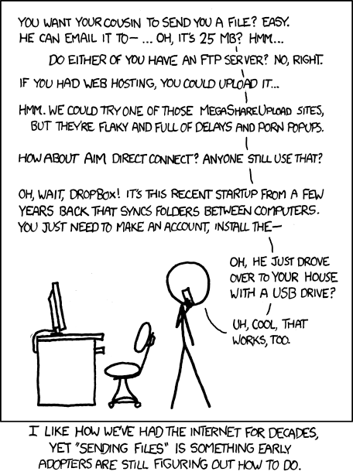
How do you send the cat picture?
Write your own cat picture transfer app
In an email
Upload to a webserver and download using FTP
Upload to dropbox/AWS/Google cloud
Use a bit-torrent like protocol
Use a CDN
And many other ways….
https://xkcd.com/949/
Notes:
Ndn can help organizing the namespaces
Once that’s done, data discovery and provenance is
Straight forward
Retrieval, transparent failover, and specialized operations
In this work, we take a real access log and try to quantify NDN’s improvements to a climate
workflow

Slide 17

















Creating a network app
application
transport
network
data link
physical
write programs that:
run on (different) end systems
communicate over network
e.g., web server software communicates with browser software
no need to write software for network-core devices
network-core devices do not run user applications
applications on end systems allows for rapid app development, propagation
application
transport
network
data link
physical
application
transport
network
data link
physical

Slide 18
Creating a network app
application
transport
network
data link
physical
write programs that:
run on (different) end systems
communicate over network
e.g., web server software communicates with browser software
no need to write software for network-core devices
network-core devices do not run user applications
applications on end systems allows for rapid app development, propagation
application
transport
network
data link
physical
application
transport
network
data link
physical

Slide 19
Application architectures
possible structure of applications:
client-server
peer-to-peer (P2P)

Slide 20
Client-server architecture
server:
always-on host
permanent IP address
data centers for scaling
clients:
communicate with server
may be intermittently connected
may have dynamic IP addresses
do not communicate directly with each other
client/server

Slide 21
P2P architecture
no always-on server
arbitrary end systems directly communicate
Services between peers
  self scalability
peers are intermittently connected and change IP addresses
  complex management
peer-peer

Slide 22
Example of each?
Client server ?
P2P?

Slide 23
Web and HTTP
web page consists of objects
object can be HTML file, JPEG image, Java applet, audio file,…
web page consists of base HTML-file which includes several referenced objects
each object is addressable by a URL, e.g.,
www.someschool.edu/someDept/pic.gif
host name
path name

Slide 24
Web vs Internet?
http://info.cern.ch/
http://info.cern.ch/hypertext/WWW/TheProject.html

Slide 25

HTTP overview
HTTP - hypertext transfer protocol
Web’s application layer protocol
client/server model
  client: browser that requests, receives, (using HTTP protocol) and “displays” Web objects
  server: Web server sends (using HTTP protocol) objects in response to requests
PC running
Firefox browser
HTTP request
HTTP response
HTTP request
server
running
Apache Web
server
HTTP response
iphone running
Safari browser

Slide 26
HTTP overview (continued)
uses TCP:
client initiates TCP connection (creates socket) to server, port 80
server accepts TCP connection from client
HTTP messages (application-layer protocol messages) exchanged between browser (HTTP client) and Web server (HTTP server)
TCP connection closed
HTTP is “stateless”
server maintains no information about past client requests
Applications may make it almost “stateful”

Slide 27
HTTP connections (Remember it uses TCP)
non-persistent HTTP
at most one object sent over TCP connection
  connection then closed
downloading multiple objects required multiple connections
persistent HTTP
multiple objects can be sent over single TCP connection between client, server

Slide 28
HTTP request message
two types of HTTP messages: request, response
HTTP request message:
  ASCII (human-readable format)
carriage return character
request line
(GET, POST,
HEAD commands)
line-feed character
GET /index.html HTTP/1.1\r\n
Host: www-net.cs.umass.edu\r\n
User-Agent: Firefox/3.6.10\r\n
Accept: text/html,application/xhtml+xml\r\n
Accept-Language: en-us,en;q=0.5\r\n
Accept-Encoding: gzip,deflate\r\n
Accept-Charset: ISO-8859-1,utf-8;q=0.7\r\n
Keep-Alive: 115\r\n
Connection: keep-alive\r\n
\r\n
header
lines
carriage return,
line feed at start
of line indicates
end of header lines

Slide 29
HTTP response message
status line
(protocol
status code
status phrase)
HTTP/1.1 200 OK\r\n
Date: Sun, 26 Sep 2010 20:09:20 GMT\r\n
Server: Apache/2.0.52 (CentOS)\r\n
Last-Modified: Tue, 30 Oct 2007 17:00:02 GMT\r\n
ETag: "17dc6-a5c-bf716880"\r\n
Accept-Ranges: bytes\r\n
Content-Length: 2652\r\n
Keep-Alive: timeout=10, max=100\r\n
Connection: Keep-Alive\r\n
Content-Type: text/html; charset=ISO-8859-1\r\n
\r\n
data data data data data ...
header
lines
data, e.g.,
requested
HTML file

Slide 30
HTTP response status codes
status code appears in 1st line in server-to-client response message.
some sample codes:
200 OK
  request succeeded, requested object later in this msg
301 Moved Permanently
  requested object moved, new location specified later in this msg (Location:)
400 Bad Request
  request msg not understood by server
404 Not Found
  requested document not found on this server
505 HTTP Version Not Supported

Slide 31
Cookies: keeping “state”
client
server
ebay 8734
usual http request msg
Amazon server
creates ID
1678 for user
cookie file
usual http response
set-cookie: 1678
backend
database
create
entry
ebay 8734
amazon 1678
usual http request msg
cookie: 1678
cookie-
specific
action
access
usual http response msg
one week later:
access
ebay 8734
amazon 1678
usual http request msg
cookie: 1678
cookie-
specific
action
usual http response msg

Slide 32
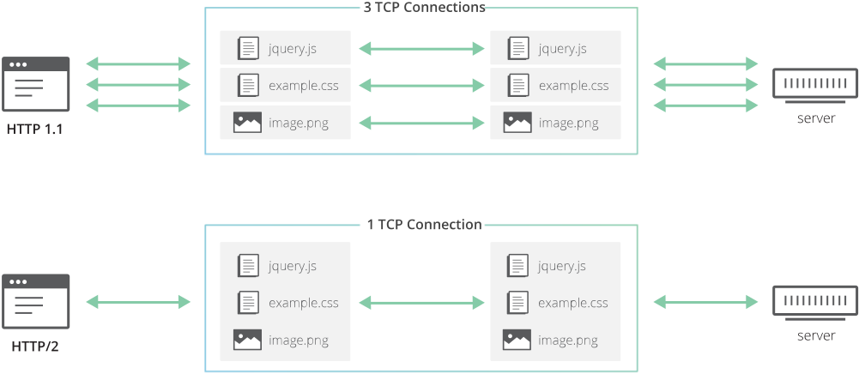
HTTP 1 vs 2
https://blog.cloudflare.com/the-road-to-quic/

Slide 33
HTTP 2 Head-of-the-line Blocking
Shared connection = Shared loss
https://blog.cloudflare.com/the-road-to-quic/

Slide 34

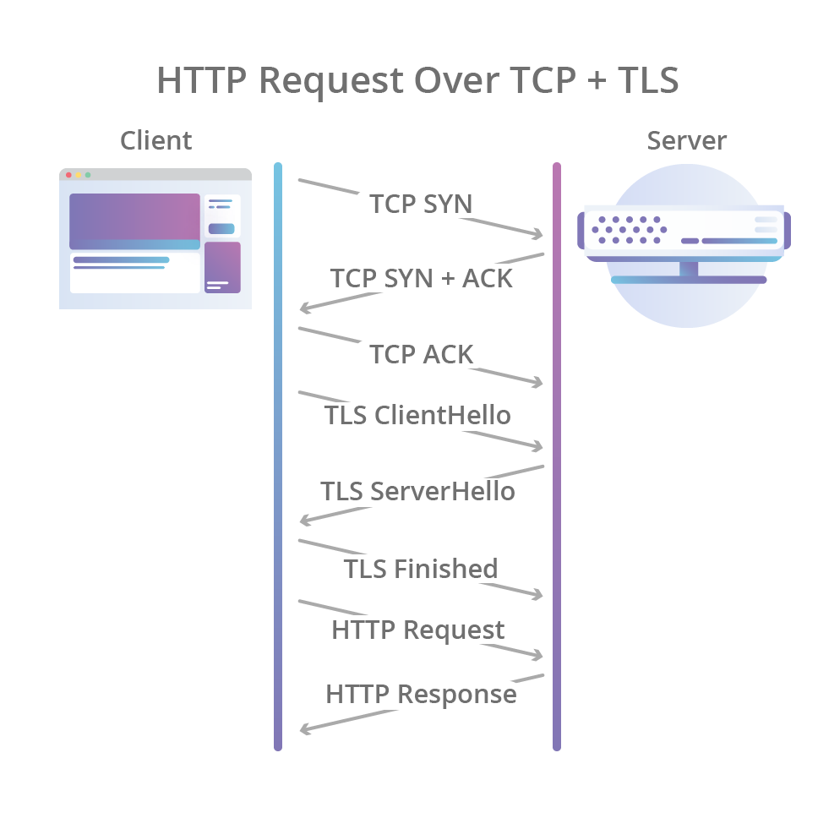
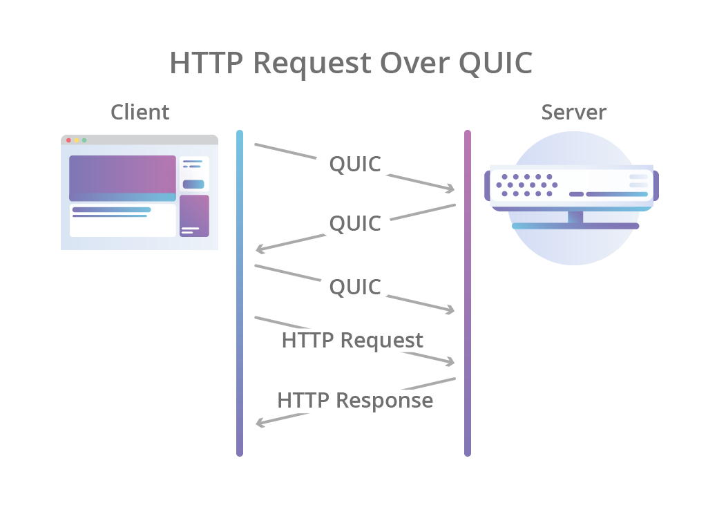
QUIC
https://blog.cloudflare.com/the-road-to-quic/

Slide 35
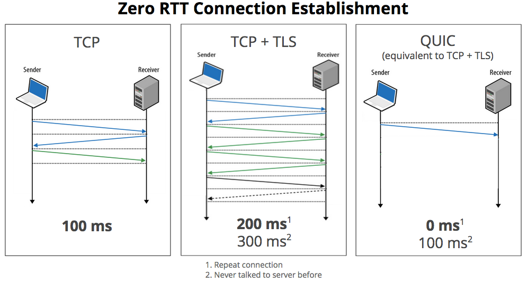
QUIC is Quick(er)
https://blog.chromium.org/2015/04/a-quic-update-on-googles-experimental.html

Slide 36
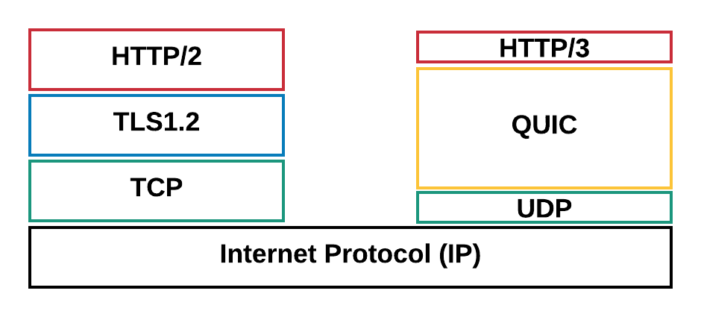
HTTP 2/TCP vs HTTP 3/QUIC
1. Faster connection establishment
2. No HoL blocking
3. Multiplexing connections with ability to differentiate
4. Connection migration
https://eng.uber.com/employing-quic-protocol/

Slide 37
Apps (HTTP)
Data
Apps (HTTP)
Segments
Transport (TCP/UDP)
Transport (TCP/UDP)
Network (IP)
Packets
Network (IP)
Link (Ethernet)
Frames
Link (Ethernet)
Ethernet Interface
Ethernet Interface
Bits (1010001)

