Slide 1
CSC2710 – Intro to Systems and Networking
SPANNING TREE
Instructor: Susmit Shannigrahi
sshannigrahi@tntech.edu

Slide 2

Apps (HTTP)
Data
Apps (HTTP)
Segments
Transport (TCP/UDP)
Transport (TCP/UDP)
Network (IP)
Packets
Network (IP)
Link (Ethernet)
Frames
Link (Ethernet)
Ethernet Interface
Ethernet Interface
Bits (1010001)

Slide 3
So far...
we saw how to build a local network
How do we interconnect different types of networks to build a large global network?
Notes:
Ndn can help organizing the namespaces
Once that’s done, data discovery and provenance is
Straight forward
Retrieval, transparent failover, and specialized operations
In this work, we take a real access log and try to quantify NDN’s improvements to a climate
workflow

Slide 4
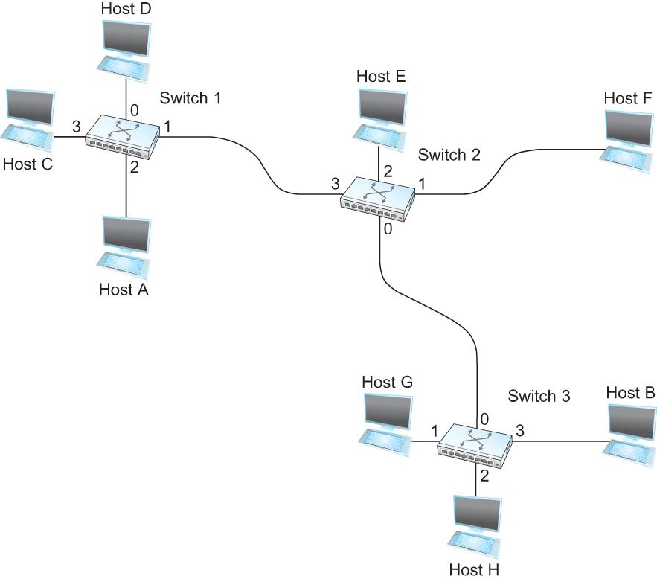
Switching
Switch
A mechanism to interconnect
links to form a large network
Forward frames
Separate the collision domains
Filter packets between LANs
Connects two or more LAN segments - Bridging
LAN 1
Collision domain 1
LAN 2
Collision domain 2
Notes:
Ndn can help organizing the namespaces
Once that’s done, data discovery and provenance is
Straight forward
Retrieval, transparent failover, and specialized operations
In this work, we take a real access log and try to quantify NDN’s improvements to a climate
workflow

Slide 5
Switches are self learning!
Inspect the source MAC address
What is a mac address?
Associate mac address and incoming interface
Store this association for later use, (for some time)
aging-timer
Notes:
Ndn can help organizing the namespaces
Once that’s done, data discovery and provenance is
Straight forward
Retrieval, transparent failover, and specialized operations
In this work, we take a real access log and try to quantify NDN’s improvements to a climate
workflow

Slide 6

Switching Table
To decide how to forward a packet, a switch consults a forwarding table
Destination, Port
-------------------------------------
A 3
B 0
C 3
D 3
E 2
F 1
G 0
H 0
Forwarding Table for Switch 2
Notes:
Ndn can help organizing the namespaces
Once that’s done, data discovery and provenance is
Straight forward
Retrieval, transparent failover, and specialized operations
In this work, we take a real access log and try to quantify NDN’s improvements to a climate
workflow

Slide 7
Switching Table
Unknown destination → send out on all Interfaces (flooding)
Skip the incoming interface
Destination, Port
-------------------------------------
A 3
B 0
C 3
D 3
E 2
F 1
G 0
H 0
Forwarding Table for Switch 2
Notes:
Ndn can help organizing the namespaces
Once that’s done, data discovery and provenance is
Straight forward
Retrieval, transparent failover, and specialized operations
In this work, we take a real access log and try to quantify NDN’s improvements to a climate
workflow

Slide 8
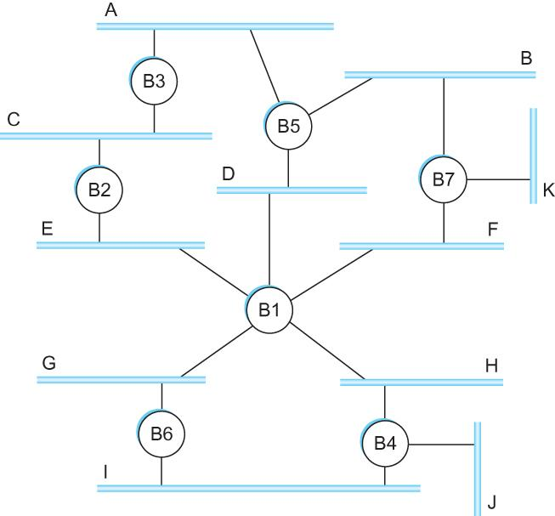
Loop
Spot the loop
Why?
Notes:
Ndn can help organizing the namespaces
Once that’s done, data discovery and provenance is
Straight forward
Retrieval, transparent failover, and specialized operations
In this work, we take a real access log and try to quantify NDN’s improvements to a climate
workflow

Slide 9
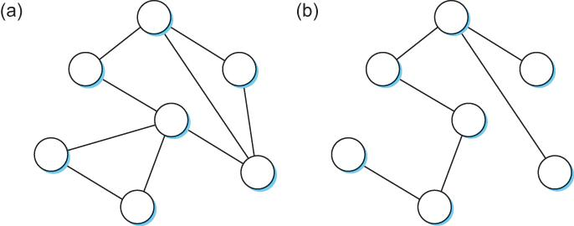
Solution? Spanning Tree
Think of the extended LAN as being represented by a graph that possibly has loops (cycles)
A spanning tree is a sub-graph of this graph that covers all the vertices but contains no cycles
Spanning tree keeps all the vertices of the original graph but throws out some of the edges
Example of (a) a cyclic graph; (b) a corresponding spanning tree.
Notes:
Ndn can help organizing the namespaces
Once that’s done, data discovery and provenance is
Straight forward
Retrieval, transparent failover, and specialized operations
In this work, we take a real access log and try to quantify NDN’s improvements to a climate
workflow

Slide 10
How do we create a spanning tree?
Properties: No loops
How?
Selectively flood
Distributed algorithm, no coordination!
Automatic reconciliation when failure occurs
Notes:
Ndn can help organizing the namespaces
Once that’s done, data discovery and provenance is
Straight forward
Retrieval, transparent failover, and specialized operations
In this work, we take a real access log and try to quantify NDN’s improvements to a climate
workflow

Slide 11
How do we create a spanning tree?
Properties: No loops
How?
Selectively flood
Distributed algorithm, no coordination!
Automatic reconciliation when failure occurs
Switches elect a root
The switch with the smallest identifier
Each switch identifies if its interface is on the shortest path from the root
Exclude if not
Send message (Y,d,X)
From x, claims Y is the root, distance is d
Notes:
Ndn can help organizing the namespaces
Once that’s done, data discovery and provenance is
Straight forward
Retrieval, transparent failover, and specialized operations
In this work, we take a real access log and try to quantify NDN’s improvements to a climate
workflow

Slide 12
How do we create a spanning tree?
1
Message (Y, d, X) - (to, distance, from)
4 thinks it’s the root
Sends (4, 0, 4) to 3 and 5
Receives (3,0,3) from 3
Sets it to as the root since 3 < 4
Receives (3,1,5) from 5
Sees that this is a longer path to 3
2 hops vs direct path (1 hop)
Removes 4-5 link from the tree
2
7
3
6
4
5
Notes:
Ndn can help organizing the namespaces
Once that’s done, data discovery and provenance is
Straight forward
Retrieval, transparent failover, and specialized operations
In this work, we take a real access log and try to quantify NDN’s improvements to a climate
workflow

Slide 13
What does 4 do when it hears from 2?
1
Message (Y, d, X) - (to, distance, from)
2 hears (1, 0, 1) from 1
2 sends (1, 1, 2) to 3
3 sends (1, 2, 3) to 5 and 4
4 receives (1, 2, 3) from 3
4 receives (1, 3, 5) from 5
Sets 1 as root (id=1 is < id=4)
Prunes the 4-5 path since it is 4 hops compared to 3 hops via 3
2
7
3
6
4
5
Notes:
Ndn can help organizing the namespaces
Once that’s done, data discovery and provenance is
Straight forward
Retrieval, transparent failover, and specialized operations
In this work, we take a real access log and try to quantify NDN’s improvements to a climate
workflow

Slide 14
Failure and Downsides
1
Even after the system has stabilized, the root continues to send messages periodically
Other bridges continue to forward these messages
When a bridge fails, the downstream bridges will not receive the configuration messages
After waiting a specified period of time, they will
once again claim to be the root and the
algorithm starts again
No load balancing
2
7
3
6
4
5
Notes:
Ndn can help organizing the namespaces
Once that’s done, data discovery and provenance is
Straight forward
Retrieval, transparent failover, and specialized operations
In this work, we take a real access log and try to quantify NDN’s improvements to a climate
workflow

Slide 15
Virtual LAN (VLANs)
LANs are on the same Ethernet segments
Does not scale very well – too many wires
How can we put multiple people in different locations on the same Ethernet segment (LAN)?
How do we create multiple LANs over the same wire?
Notes:
Ndn can help organizing the namespaces
Once that’s done, data discovery and provenance is
Straight forward
Retrieval, transparent failover, and specialized operations
In this work, we take a real access log and try to quantify NDN’s improvements to a climate
workflow

Slide 16

Why separate at all?
LANs are on the same Ethernet segments! Security.
Isolation – sensitive traffic vs normal traffic
Containment of traffic – your for loop broke the internet
How do we create multiple LANs over the same wire?
Notes:
Ndn can help organizing the namespaces
Once that’s done, data discovery and provenance is
Straight forward
Retrieval, transparent failover, and specialized operations
In this work, we take a real access log and try to quantify NDN’s improvements to a climate
workflow

Slide 17
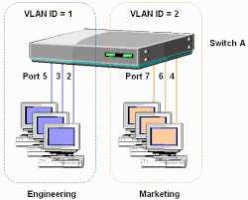
VLANs
Switches specify which VLAN is accessible over which interface
Each interface can have a VLAN color
Each Mac address can have a interface color
Add VLAN tag to the Ethernet header
Notes:
Ndn can help organizing the namespaces
Once that’s done, data discovery and provenance is
Straight forward
Retrieval, transparent failover, and specialized operations
In this work, we take a real access log and try to quantify NDN’s improvements to a climate
workflow

Slide 18
Link Layer Recap – All this for a cat picture
Apps (HTTP)
Data
Apps (HTTP)
Segments
Transport (TCP/UDP)
Transport (TCP/UDP)
Network (IP)
Packets
Network (IP)
Link (Ethernet)
Frames
Link (Ethernet)
Ethernet Interface
Ethernet Interface
Bits (1010001)

