Slide 1
CSC6730 – Advanced Networking
End-to-End Argument
Susmit Shannigrahi
Computer Science
sshannigrahi@tntech.edu

Slide 2
Discussions from previous class - logistics
Ilearn, Class website, and Slack
  iLearn – Only for assignments and announcements, nothing else!
  Class website – Video recording, survey links, papers, and slides
  Slack – I am (almost) always available on Slack.
Use of technology
  Let’s blame the chip shortage for everything
  Nothing I can do at this moment
  Department and ITS knows about this and is working on fixing it
What is the main goal of the survey questions?
  Understanding what needs to be discussed more
  Clarify any problems
  Fill out after every class, reusable link!
Can not download papers
  Has this been fixed?
Notes:
Ndn can help organizing the namespaces
Once that’s done, data discovery and provenance is
Straight forward
Retrieval, transparent failover, and specialized operations
In this work, we take a real access log and try to quantify NDN’s improvements to a climate
workflow

Slide 3
Discussions from your feedback – class direction
Why should I read these papers and how do they relate to the class
  Course objectives:
    The design rationale of the Internet
    how the Internet supports contemporary applications
    the shortcomings of the current design, and
    the future research directions that can address those challenges.
    This should enable you to:
      understanding of the networking research landscape
      present your work to a larger group, both orally and in writing
      Identify and present design choices, tradeoffs, and research gaps
      design new network protocols and apply them to your applications ← Network should not be a black box!
Notes:
Ndn can help organizing the namespaces
Once that’s done, data discovery and provenance is
Straight forward
Retrieval, transparent failover, and specialized operations
In this work, we take a real access log and try to quantify NDN’s improvements to a climate
workflow

Slide 4
Discussions from your feedback – class direction
How do I read and understand the papers?
  Read the papers linked from the first lecture
  Meet with me – slack or email to set up a time
More time for discussion
  From next week, we have dedicated one day/week for discussion
Notes:
Ndn can help organizing the namespaces
Once that’s done, data discovery and provenance is
Straight forward
Retrieval, transparent failover, and specialized operations
In this work, we take a real access log and try to quantify NDN’s improvements to a climate
workflow

Slide 5
Discussions from your feedback – technical questions
Security ramification of broadcast signals ← Anthony
  Not all traffic need to be secure ← Superbowl
  Use encryption if needed ← End-to-end argument
Notes:
Ndn can help organizing the namespaces
Once that’s done, data discovery and provenance is
Straight forward
Retrieval, transparent failover, and specialized operations
In this work, we take a real access log and try to quantify NDN’s improvements to a climate
workflow

Slide 6
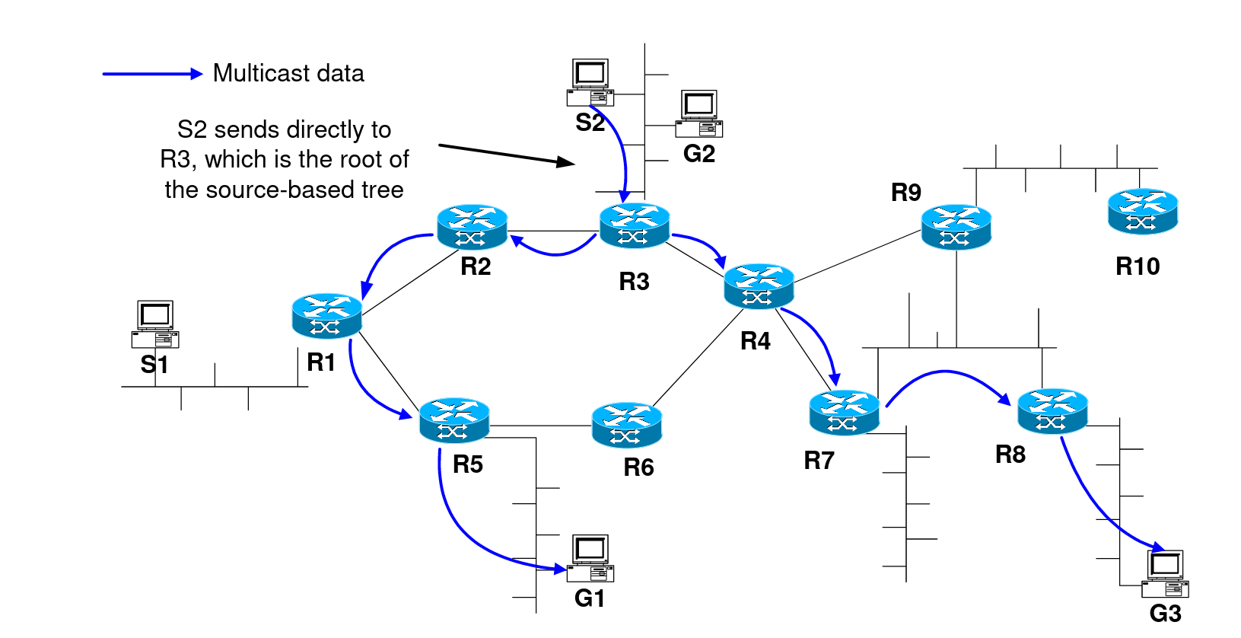
Discussions from your feedback – technical questions
Had trouble understanding the issue with broadcast and multicast. I understand that TCP/IP is point-to-point, but it seems like switches are pretty good at broadcasting and multicasting despite this. ← Jordan
Switches are at Layer2, IP is at Layer 3
Technically you don’t need an IP address in your LAN
Beyond your LAN:
Multicast works by creating a multicast tree, state Explosion
Broadcast – traffic explosion
https://ftp.unpad.ac.id/orari/library/library-ref-eng/ref-eng-3/network/multicast.pdf
Notes:
Ndn can help organizing the namespaces
Once that’s done, data discovery and provenance is
Straight forward
Retrieval, transparent failover, and specialized operations
In this work, we take a real access log and try to quantify NDN’s improvements to a climate
workflow

Slide 7
Multicast TCP vs UDP
Mentioned broadcasting on TCP a challenge. Is it just as much of a challenge on UDP?
Are there good set ways to do this?
  Problems with IP remain
  UDP is unreliable
  Still does not scale over the Internet
Notes:
Ndn can help organizing the namespaces
Once that’s done, data discovery and provenance is
Straight forward
Retrieval, transparent failover, and specialized operations
In this work, we take a real access log and try to quantify NDN’s improvements to a climate
workflow

Slide 8
Other problems with Multicast
State explosion
Access controls, including group creation and membership
Security. Potential for DDoS, no authentication
Address allocation – anyone can send anything anywhere
Congestion control and more
These are excellent questions for this class!
Suggested read:
C. Diot, B. N. Levine, B. Lyles, H. Kassem and D. Balensiefen, "Deployment issues for the IP multicast
service and architecture," in IEEE Network, vol. 14, no. 1, pp. 78-88, Jan.-Feb. 2000, doi: 10.1109/65.819174.
Notes:
Ndn can help organizing the namespaces
Once that’s done, data discovery and provenance is
Straight forward
Retrieval, transparent failover, and specialized operations
In this work, we take a real access log and try to quantify NDN’s improvements to a climate
workflow

Slide 9
End-to-End Argument – Saltzer et. al.
Why should anyone care?
When designing a computer system (software, network, hybrid), you need to make a conscious decision where to include certain functionality.
First sentence of the paper “Choosing the proper boundaries between functions is perhaps the primary activity of the computer system designer.”
“This paper discusses one class of function placement argument that has been used for many years with neither explicit recognition nor much conviction.”
Writing tip - Mention your goals early and concisely
Notes:
Ndn can help organizing the namespaces
Once that’s done, data discovery and provenance is
Straight forward
Retrieval, transparent failover, and specialized operations
In this work, we take a real access log and try to quantify NDN’s improvements to a climate
workflow

Slide 10
What is this paper about?
We learned about network layers.
When you are developing networked applications, at which layer would you put various functions ?
This paper provides some guideline about that.
Apps (HTTP)
Transport (TCP/UDP)
Network (IP)
Link (Ethernet)
Notes:
Ndn can help organizing the namespaces
Once that’s done, data discovery and provenance is
Straight forward
Retrieval, transparent failover, and specialized operations
In this work, we take a real access log and try to quantify NDN’s improvements to a climate
workflow

Slide 11
Should you treat the network as a Black-Box?
You have a bunch of requirements for your application
  Security, error checking, reliable delivery, in-order message delivery
Should you implement them in the network? Should you implement them in the application? Doing it in both layers? Is more better?
  What are the trade-offs?
Apps
Network
Notes:
Ndn can help organizing the namespaces
Once that’s done, data discovery and provenance is
Straight forward
Retrieval, transparent failover, and specialized operations
In this work, we take a real access log and try to quantify NDN’s improvements to a climate
workflow

Slide 12
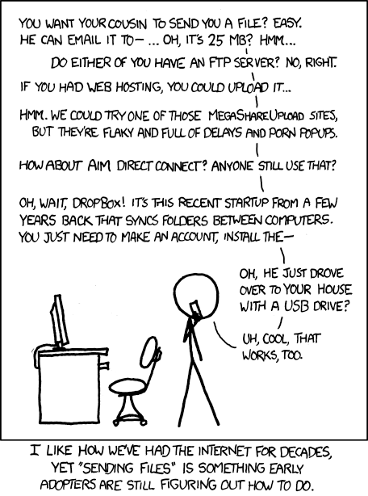



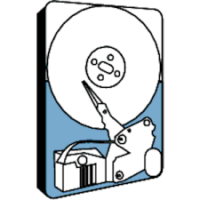
File transfer
Oldest use case on the Internet – still happening
Goal – send a file from Host A to Host B over the network.
Notes:
Ndn can help organizing the namespaces
Once that’s done, data discovery and provenance is
Straight forward
Retrieval, transparent failover, and specialized operations
In this work, we take a real access log and try to quantify NDN’s improvements to a climate
workflow

Slide 13
File transfer – Possible failures
Disk
Software buffer
Memory
Communication system
Hosts may crash
Notes:
Ndn can help organizing the namespaces
Once that’s done, data discovery and provenance is
Straight forward
Retrieval, transparent failover, and specialized operations
In this work, we take a real access log and try to quantify NDN’s improvements to a climate
workflow

Slide 14
File transfer – Where to fix?
At each step
+ More checks
- Correctness is hard to achive
- Uneconomical
- Errors might still happen
End-to-end check and retry
+ Applications’ control
- Might not work well for some
Applications
-example?
Why not do both?
- Does not add value
- Does add complexity
Notes:
Ndn can help organizing the namespaces
Once that’s done, data discovery and provenance is
Straight forward
Retrieval, transparent failover, and specialized operations
In this work, we take a real access log and try to quantify NDN’s improvements to a climate
workflow

Slide 15
Another example - Security
Secure host to host communication
A malware on your laptop can
read everything
The applications must still check the
authenticity of the data
Notes:
Ndn can help organizing the namespaces
Once that’s done, data discovery and provenance is
Straight forward
Retrieval, transparent failover, and specialized operations
In this work, we take a real access log and try to quantify NDN’s improvements to a climate
workflow

Slide 16
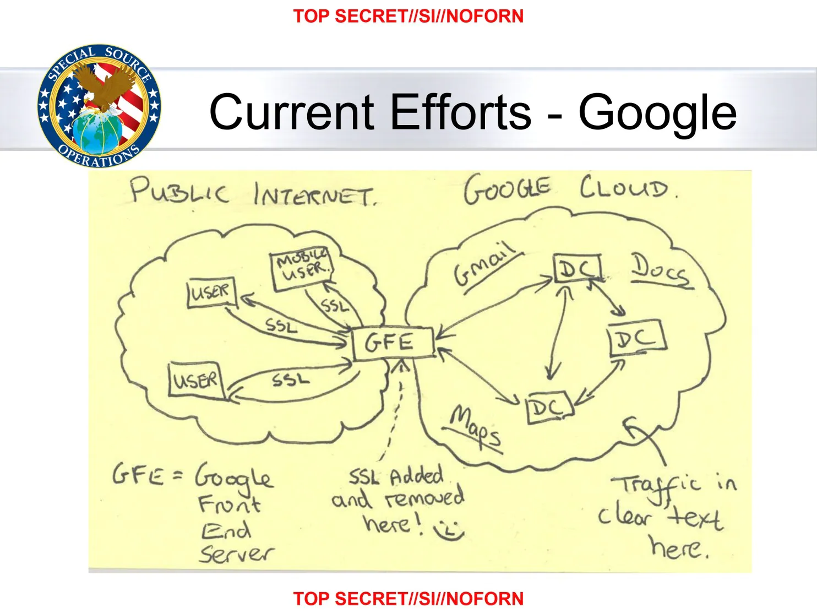
Another example – NSA breaches Google
Secure host to host communication
No SSL on data center links
Has since been fixed
Good argument for end-to-end
encryption
Notes:
Ndn can help organizing the namespaces
Once that’s done, data discovery and provenance is
Straight forward
Retrieval, transparent failover, and specialized operations
In this work, we take a real access log and try to quantify NDN’s improvements to a climate
workflow

Slide 17
Alternative – the application performs encryption
Application performs all encryption and decryption
  Works beautifuly!
No need for the network to perform any additional tasks
BUT, if you are concerted about data exfiltration by a rouge application
  You might want to have some sort of network encryption
  Can be cheap – reuse keys between end-points, use same keys for all traffic and so on.
  Exactly what SSL/TLS does!
Notes:
Ndn can help organizing the namespaces
Once that’s done, data discovery and provenance is
Straight forward
Retrieval, transparent failover, and specialized operations
In this work, we take a real access log and try to quantify NDN’s improvements to a climate
workflow

Slide 18
End-to-End Argument
Thus the argument:
In order to achieve careful file transfer, the application program that performs the transfer must supply a file-transfer-specific, end-to-end reliability guarantee – in this case, a checksum to detect failures and a retry/commit plan.
For the data communication system to go out of its way to be extraordinarily reliable does not reduce the burden on the application program to ensure reliability.
Notes:
Ndn can help organizing the namespaces
Once that’s done, data discovery and provenance is
Straight forward
Retrieval, transparent failover, and specialized operations
In this work, we take a real access log and try to quantify NDN’s improvements to a climate
workflow

Slide 19
But the communication system should not be a black box
Inherent dangers of a black box -
Example – file transfer protocol at MIT
  Assumed the network is reliable
  Ended up matching files manually due to a corrupt gateway
Some low level assurance is needed
  Big file transfers – petabyte files
  Correcting all errors are the application are very expensive!
  Allow the network to put “some” efforts
    But don’t go out of the way to solve every problem
  Engineering trade-off rather than correctness
Notes:
Ndn can help organizing the namespaces
Once that’s done, data discovery and provenance is
Straight forward
Retrieval, transparent failover, and specialized operations
In this work, we take a real access log and try to quantify NDN’s improvements to a climate
workflow

Slide 20
Don’t try to anticipate application’s needs
Example – ARPANET ACK messages - "Request For Next Message" (RFNM)
Every time the network delivers a message, the other end point returns an RFNM message.
Useful for the network – what if your application crashed?
You need an acknowledgment from the application itself, not the network!
Notes:
Ndn can help organizing the namespaces
Once that’s done, data discovery and provenance is
Straight forward
Retrieval, transparent failover, and specialized operations
In this work, we take a real access log and try to quantify NDN’s improvements to a climate
workflow

Slide 21
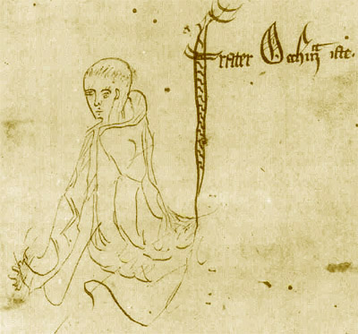
Occam’s Razor
Proposed by the British philosopher – William of Ockham
Also called the “law of parsimony” -
"entities should not be multiplied beyond necessity"
The razor cuts away unnecessary things
Do not duplicate work at multiple layers unless it benefits you.
Useful whenever you are designing a system
Notes:
Ndn can help organizing the namespaces
Once that’s done, data discovery and provenance is
Straight forward
Retrieval, transparent failover, and specialized operations
In this work, we take a real access log and try to quantify NDN’s improvements to a climate
workflow

Slide 22
How do I identify the end points?
Good question - depends on your application!
If you are on a phone call or watching a video, you can rely on the listener or viewer to act as the end
  Ask to repeat
  Refresh the video or ignore momentary disruptions
If you are archiving data for long term
  Your software is your end-point, you must ensure correctness!
Notes:
Ndn can help organizing the namespaces
Once that’s done, data discovery and provenance is
Straight forward
Retrieval, transparent failover, and specialized operations
In this work, we take a real access log and try to quantify NDN’s improvements to a climate
workflow

Slide 23
Conclusions
End-to-end argument is a principle that helps the design of networked systems
Keep Occam’s razor in mind – start simple, and think where functionality is best implemented
When designing a network, do not try to help the users too much
  You don’t know what they want
  They don’t know what they want
When designing an application, do not treat the network as a black box
Some functions are obvious function of a particular layer
  Err
Notes:
Ndn can help organizing the namespaces
Once that’s done, data discovery and provenance is
Straight forward
Retrieval, transparent failover, and specialized operations
In this work, we take a real access log and try to quantify NDN’s improvements to a climate
workflow

Slide 24
Deliverable before the next class
Fill out the survey - https://tntech.co1.qualtrics.com/jfe/preview/SV_bjT8BpnRABUxZ7o
Read the paper “The Design Philosophy of the DARPA Internet Protocols”.
  We will discuss in the next class.
Set up a time to meet with me about your presentation
  Jordan
  Luke
If you want to meet during my office hours:
  Please email me or ping me on Slack.
  David
Notes:
Ndn can help organizing the namespaces
Once that’s done, data discovery and provenance is
Straight forward
Retrieval, transparent failover, and specialized operations
In this work, we take a real access log and try to quantify NDN’s improvements to a climate
workflow

