Slide 1
CSC6730 – Advanced Networking
Review of Critical reviews
and
design of darpa internet
Susmit Shannigrahi
Computer Science
sshannigrahi@tntech.edu

Slide 2
Discussions from previous class - logistics
Can not download papers
  Google the paper title – I have checked all of them are publicly available.
  If you still can’t find me, email me.
Skipped Slides
  No exam, so don’t worry about those. If you need clarification, ask.
Notes:
Ndn can help organizing the namespaces
Once that’s done, data discovery and provenance is
Straight forward
Retrieval, transparent failover, and specialized operations
In this work, we take a real access log and try to quantify NDN’s improvements to a climate
workflow

Slide 3
Discussions from your feedback – technical questions
Are there some instances where at a big picture level there are net gains from having a functionality at a certain layer that might share resources with another function, but at an individual level there is a loss?
  Yes! In-network caching vs application layer caching
  Application layer caching
    faster for YOUR subsequent requests
    Does not help others
  In-network caching
    Slightly slower for your requests
    Does help the others
Notes:
Ndn can help organizing the namespaces
Once that’s done, data discovery and provenance is
Straight forward
Retrieval, transparent failover, and specialized operations
In this work, we take a real access log and try to quantify NDN’s improvements to a climate
workflow

Slide 4
Discussions from your feedback – technical questions
The 16 bit checksum possibly needing to be larger. Is it not possible to calculate the probability of the checksums overlapping from an error and the cost of having a larger checksum to determine the net worth? Do we need proof to move forward?
We already know the error probability – 1 in 65536 (2^16)
Checksums are tailored to particular errors
  Currently, they are tuned for burst errors
  Are the burst errors from the ‘80s still relevant?
See more here
  “Huge Data is outgrowing the Internet’s file transfer protocols” by Craig Partridge
  “https://tigerprints.clemson.edu/cgi/viewcontent.cgi?article=1075&context=hugedata”
Notes:
Ndn can help organizing the namespaces
Once that’s done, data discovery and provenance is
Straight forward
Retrieval, transparent failover, and specialized operations
In this work, we take a real access log and try to quantify NDN’s improvements to a climate
workflow

Slide 5
Discussions from Reviews
Overall observations – mostly good reviews
  In the summary section, DON’T summarize the paper.
  Summarize YOUR UNDERSTANDING of the paper.
Criticizing papers
  Think of a problem you are working on. If you apply the technique/method to your problem, does that benefit you?
Future research directions
  This needs some work
  Use your imagination!
Notes:
Ndn can help organizing the namespaces
Once that’s done, data discovery and provenance is
Straight forward
Retrieval, transparent failover, and specialized operations
In this work, we take a real access log and try to quantify NDN’s improvements to a climate
workflow

Slide 6
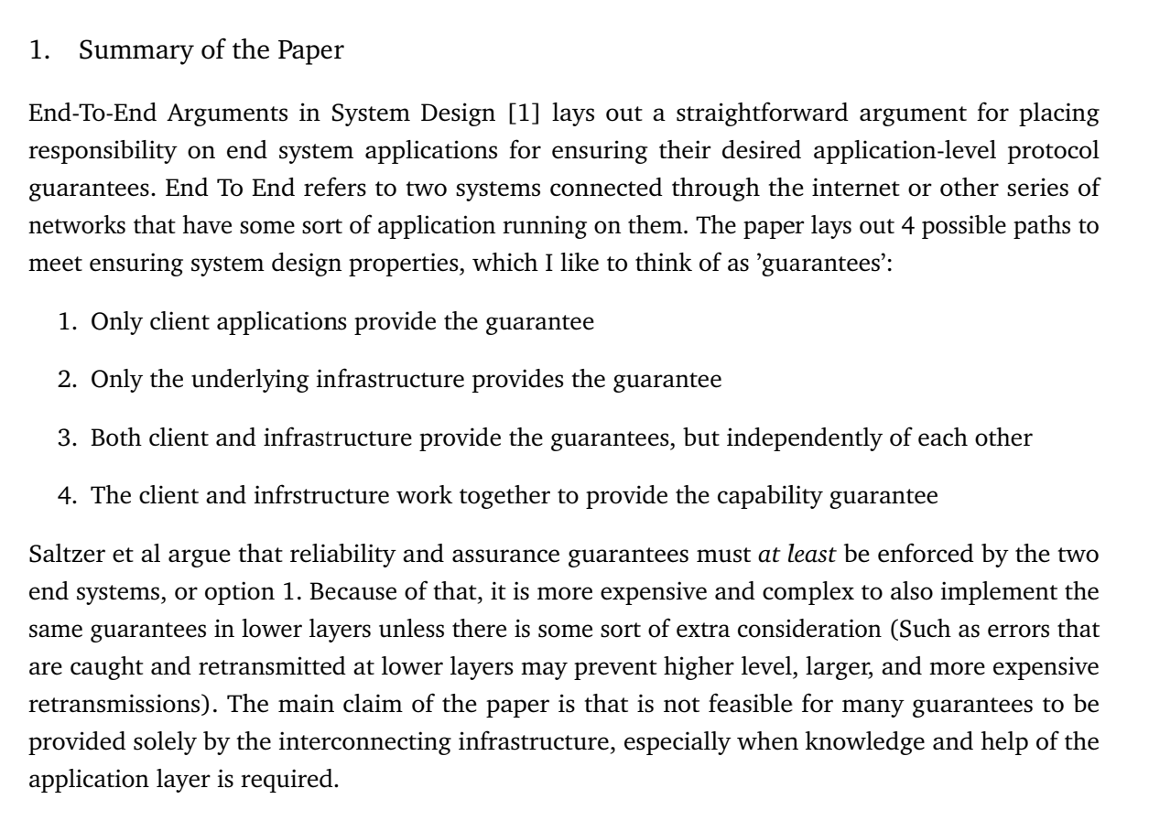
Discussions from Reviews – A Great Summary!
Notes:
Ndn can help organizing the namespaces
Once that’s done, data discovery and provenance is
Straight forward
Retrieval, transparent failover, and specialized operations
In this work, we take a real access log and try to quantify NDN’s improvements to a climate
workflow

Slide 7
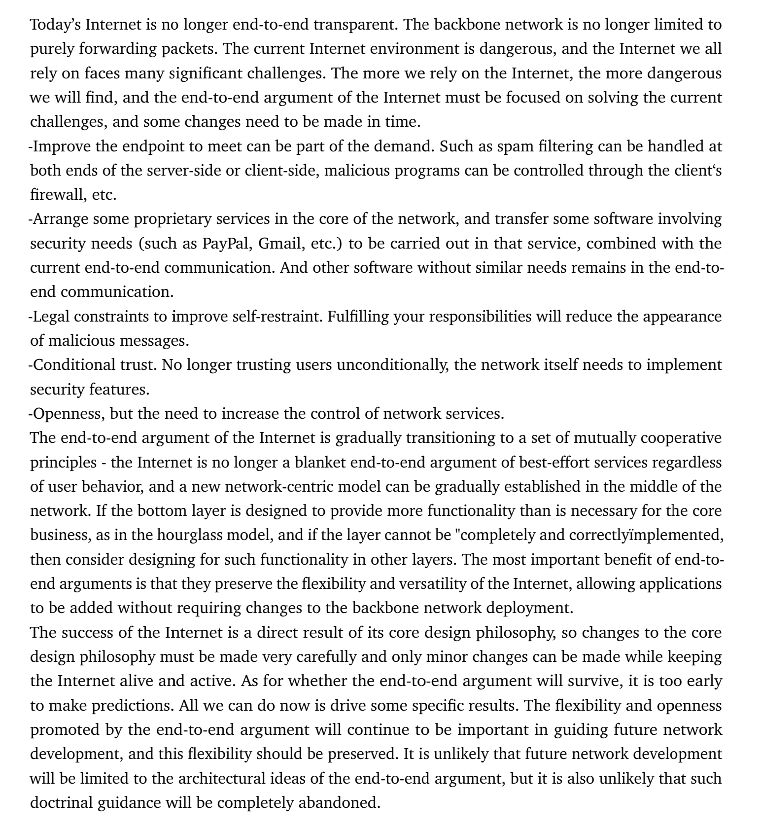
Discussions from Reviews
– Critical Review
Notes:
Ndn can help organizing the namespaces
Once that’s done, data discovery and provenance is
Straight forward
Retrieval, transparent failover, and specialized operations
In this work, we take a real access log and try to quantify NDN’s improvements to a climate
workflow

Slide 8
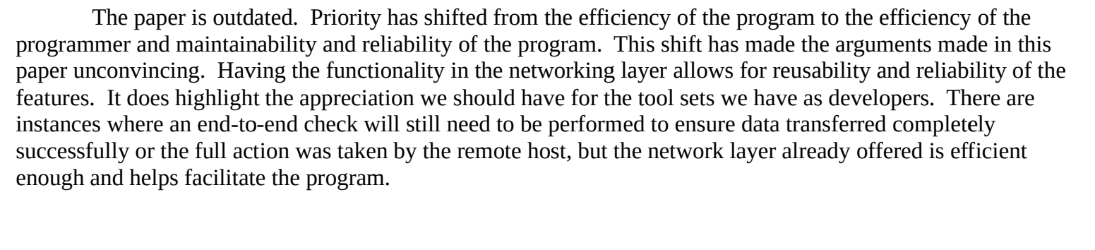
Discussions from Reviews
– Critical Review
Notes:
Ndn can help organizing the namespaces
Once that’s done, data discovery and provenance is
Straight forward
Retrieval, transparent failover, and specialized operations
In this work, we take a real access log and try to quantify NDN’s improvements to a climate
workflow

Slide 9

The Design of the DARPA Internet Protocol
David D. Clark - MIT
  One of the most influential protocol architect for the Internet
  Continues to be a visionary today
If you enjoy reading the history of the Internet, read his book
  Designing an Internet – MIT Press 2018
Notes:
Ndn can help organizing the namespaces
Once that’s done, data discovery and provenance is
Straight forward
Retrieval, transparent failover, and specialized operations
In this work, we take a real access log and try to quantify NDN’s improvements to a climate
workflow

Slide 10
Main Focus
Why the Internet was designed this way?
  Captures some of the reasoning
  Connectionless
  Packet switching
  TCP over IP
Why do we care?
  Still need to connect different networks!
Notes:
Ndn can help organizing the namespaces
Once that’s done, data discovery and provenance is
Straight forward
Retrieval, transparent failover, and specialized operations
In this work, we take a real access log and try to quantify NDN’s improvements to a climate
workflow

Slide 11
Fundamental Goal 0 – Connect the networks
“Develop an effective technique for multiplexed utilization of existing
interconnected networks”
  Interconnect networks – backward compatibility
  Keep the administrative control/boundaries
  Packet switched networks since they fit the applications
  Store and forward packets - the concept of gateways
Notes:
Ndn can help organizing the namespaces
Once that’s done, data discovery and provenance is
Straight forward
Retrieval, transparent failover, and specialized operations
In this work, we take a real access log and try to quantify NDN’s improvements to a climate
workflow

Slide 12
Secondary Goals 1-7
Goal 1: Internet communication must continue despite loss of networks or gateways.
Goal 2: The Internet must support multiple types of communication service.
Goal 3: The Internet architecture must accommodate a variety of networks.
Goal 4: The Internet architecture must permit distributed management of its resources.
Goal 5: The Internet architecture must be cost effective.
Goal 6: The Internet architecture must permit host attachment with a low level of effort.
Goal 7: The resources used in the internet architecture must be accountable.
Notes:
Ndn can help organizing the namespaces
Once that’s done, data discovery and provenance is
Straight forward
Retrieval, transparent failover, and specialized operations
In this work, we take a real access log and try to quantify NDN’s improvements to a climate
workflow

Slide 13
Goal 1 – Network failure should not affect the applications
Goal 1: Internet communication must continue despite loss of networks or gateways. The failure should be
transparent to the applications.
  Fate sharing – if your endpoints fail, there is no harm is losing the state. Otherwise, the applications
  should perform as usual. Example?
  Stateless packet switching → Datagrams
Does the Internet still support this goal?
Notes:
Ndn can help organizing the namespaces
Once that’s done, data discovery and provenance is
Straight forward
Retrieval, transparent failover, and specialized operations
In this work, we take a real access log and try to quantify NDN’s improvements to a climate
workflow

Slide 14
Goal 2
Goal 2: The Internet must support multiple types of communication service.
How do we accomplish this?
  Example application - Remote login
  TCP – reliable sequenced data delivery
  UDP – basic datagram service – a debugger should not be reliable, real time speech
  TCP/IP was a single layer, what was then broken into two to achieve goal #2
Notes:
Ndn can help organizing the namespaces
Once that’s done, data discovery and provenance is
Straight forward
Retrieval, transparent failover, and specialized operations
In this work, we take a real access log and try to quantify NDN’s improvements to a climate
workflow

Slide 15
Goal 3
Goal 3: The Internet architecture must accommodate a variety of networks.
  A variety of networks – long haul, local area, satellite, and more
  Is this still true?
  Minimum set of assumptions
  Job of the transport layer to provide additional services – TCP or UDP
    Not the job of IP
    End-to-end – only that your endpoint here is the transport layer
Notes:
Ndn can help organizing the namespaces
Once that’s done, data discovery and provenance is
Straight forward
Retrieval, transparent failover, and specialized operations
In this work, we take a real access log and try to quantify NDN’s improvements to a climate
workflow

Slide 16
Secondary Goals 4-7
Goal 4: The Internet architecture must permit distributed management of its resources.
  Tools for distributed management
  Still does not exist
  Is this still necessary?
Goal 5: The Internet architecture must be cost effective.
  Not always money – also overhead
  How many bytes can you fit in?
  Retransmission? At which layer?
Goal 6: The Internet architecture must permit host attachment with a low level of effort.
  Somehow easy but not too difficult once you know how
Goal 7: The resources used in the internet architecture must be accountable.
  Does it exist?
Notes:
Ndn can help organizing the namespaces
Once that’s done, data discovery and provenance is
Straight forward
Retrieval, transparent failover, and specialized operations
In this work, we take a real access log and try to quantify NDN’s improvements to a climate
workflow

Slide 17
Conclusions
The Internet goals are mostly successful
Datagram works for 1st three goals, not for the rest
Maybe there is a better building block for the next architecture?
  How about content names?
Notes:
Ndn can help organizing the namespaces
Once that’s done, data discovery and provenance is
Straight forward
Retrieval, transparent failover, and specialized operations
In this work, we take a real access log and try to quantify NDN’s improvements to a climate
workflow

Slide 18
Deliverable for the next class
Fill out the survey - https://tntech.co1.qualtrics.com/jfe/preview/SV_bjT8BpnRABUxZ7o
Critical review due on 09/08
  P. Mockapetris, K. Dunlap, “Development of Domain Name System”, ACM SIGCOMM Computer Communication Review, 1988
Presentation – Max Layer
  “Is Internet routing undermining DNS anycast benefits?"
Notes:
Ndn can help organizing the namespaces
Once that’s done, data discovery and provenance is
Straight forward
Retrieval, transparent failover, and specialized operations
In this work, we take a real access log and try to quantify NDN’s improvements to a climate
workflow

