Slide 1
CSC6730 – Advanced Networking
Review of DNS and BGP
Susmit Shannigrahi
Computer Science
sshannigrahi@tntech.edu

Slide 2
Q/A from your feedback
Structure of the Critical Review
  You don’t need to follow the existing template exactly, it’s there to help you.
If we do more than eight critical reviews, will you take the highest scores out of the ones we turn in? Or will you only accept the first eight?
  If you do more that 8, we will take the top 8 CRs
Anycast vs Broadcast
  Anycast is when you use one IP for multiple servers
  Broadcast is when you send something to everyone, regardless of their (IP) addresses
Observation
  Not all Critical Reviews are “Critical” – don’t just summarize the papers
Notes:
Ndn can help organizing the namespaces
Once that’s done, data discovery and provenance is
Straight forward
Retrieval, transparent failover, and specialized operations
In this work, we take a real access log and try to quantify NDN’s improvements to a climate
workflow

Slide 3
Discussions from your feedback – technical questions
What is the time range for paper reading for the presentations?
  Typically hours – but it gets better as you practice
  Budget about an hour, towards the end of the semester ~30 minutes
  Critical thinking, research, and writing takes longer
What can be done to reduce the computational overhead for the solutions?
  I am not sure what the question is.
Notes:
Ndn can help organizing the namespaces
Once that’s done, data discovery and provenance is
Straight forward
Retrieval, transparent failover, and specialized operations
In this work, we take a real access log and try to quantify NDN’s improvements to a climate
workflow

Slide 4
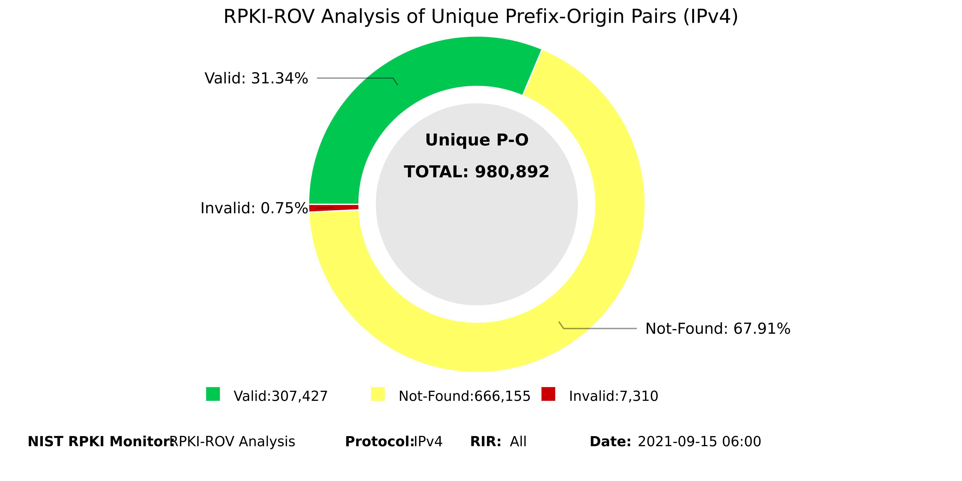
Discussions from your feedback – technical questions
  How widespread is BGPSec? It was said every AS needs to support it for it to work. Do we have that most of the time or is BGPSec rarely implemented?
    https://rpki-monitor.antd.nist.gov/
Notes:
Ndn can help organizing the namespaces
Once that’s done, data discovery and provenance is
Straight forward
Retrieval, transparent failover, and specialized operations
In this work, we take a real access log and try to quantify NDN’s improvements to a climate
workflow

Slide 5
Discussions from your feedback – technical questions
  NDSS Paper from 2017: Are We There Yet? On RPKI's Deployment and Security: Author(s): Yossi Gilad, Avichai Cohen, Amir Herzberg, Michael Schapira, Haya Shulman
    https://www.ndss-symposium.org/ndss2017/ndss-2017-programme/are-we-there-yet-rpkis-deployment-and-security/
    https://www.youtube.com/watch?v=XQ9UY9_GWuU
Notes:
Ndn can help organizing the namespaces
Once that’s done, data discovery and provenance is
Straight forward
Retrieval, transparent failover, and specialized operations
In this work, we take a real access log and try to quantify NDN’s improvements to a climate
workflow

