Slide 1
CSC6730 – Advanced Networking
A 30,000 foot overview of the internet
Susmit Shannigrahi
Computer Science
sshannigrahi@tntech.edu

Slide 2
Topics covered in this Lecture
Where the Internet came from
Design decisions
Mechanisms that drive it
Problems
Where do we go from here?
Notes:
Ndn can help organizing the namespaces
Once that’s done, data discovery and provenance is
Straight forward
Retrieval, transparent failover, and specialized operations
In this work, we take a real access log and try to quantify NDN’s improvements to a climate
workflow

Slide 3
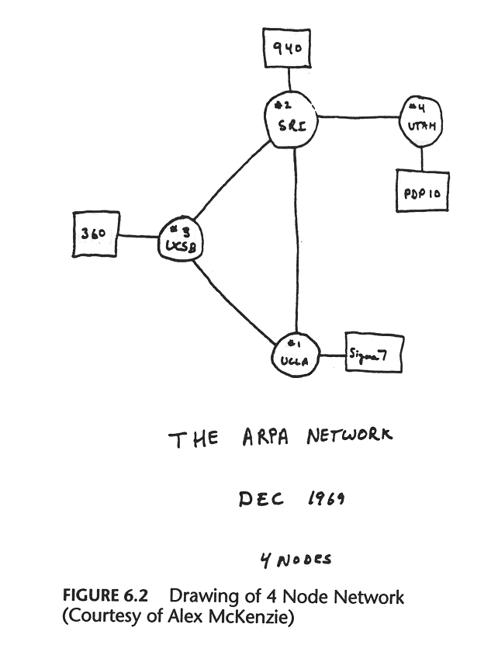
Early days of the Internet
Notes:
Ndn can help organizing the namespaces
Once that’s done, data discovery and provenance is
Straight forward
Retrieval, transparent failover, and specialized operations
In this work, we take a real access log and try to quantify NDN’s improvements to a climate
workflow

Slide 4
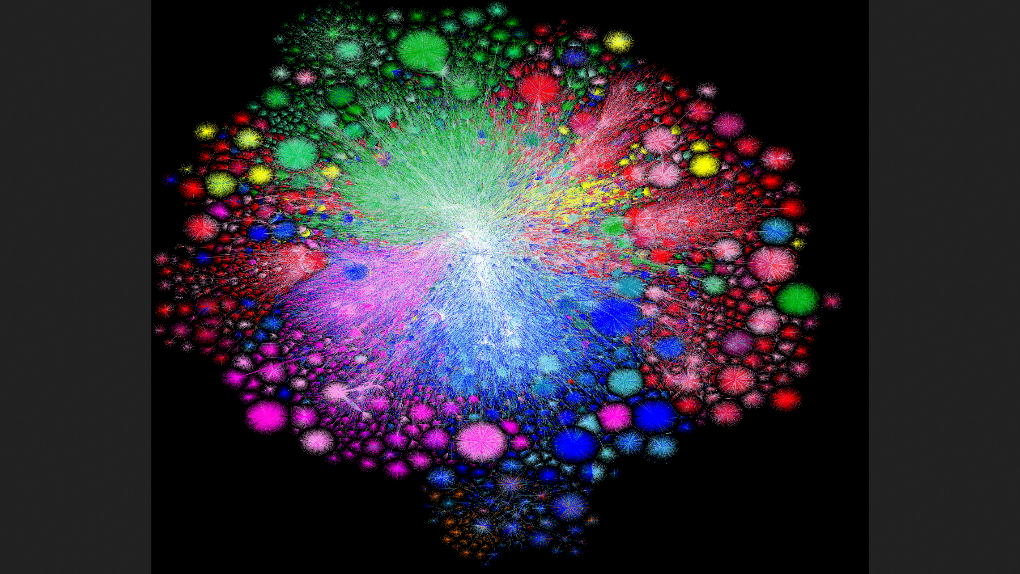
Fast forward a few years - 2021
https://www.youtube.com/watch?v=DdaElt6oP6w&t=64s
Each blob is an autonomous system
Colors represent geographical region
http://renderbot.nyc1.opte.org/20210116.1200.attempt_1/attempt_1_run_20210116.1200.coords_10000x8000_dark.png
Notes:
There are many Ases
The network is not centralized – it’s a collaboration of
People
It has grown in every direction

Slide 5
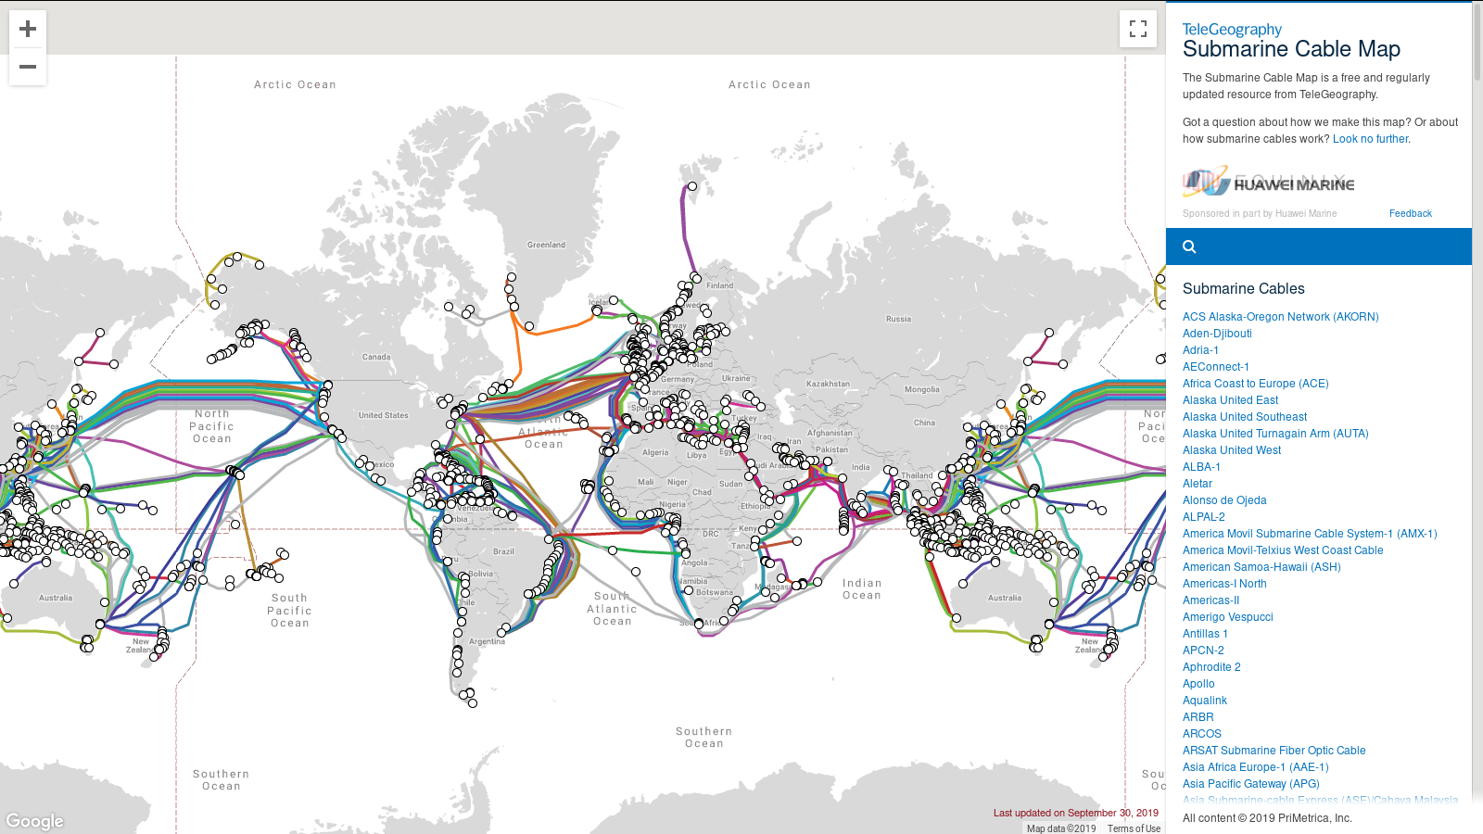
What does the infrastructure look like?
https://www.submarinecablemap.com/
Notes:
Ndn can help organizing the namespaces
Once that’s done, data discovery and provenance is
Straight forward
Retrieval, transparent failover, and specialized operations
In this work, we take a real access log and try to quantify NDN’s improvements to a climate
workflow

Slide 6
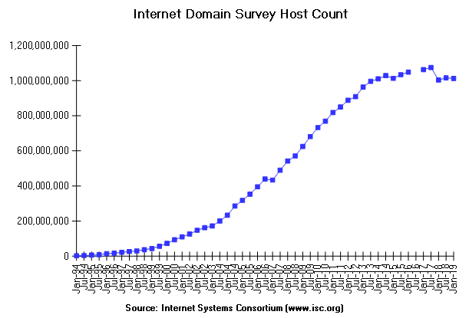
Number of hosts on the Internet in 2018
What is missing from this?
Notes:
There are many Ases
The network is not centralized – it’s a collaboration of
People
It has grown in every direction

Slide 7
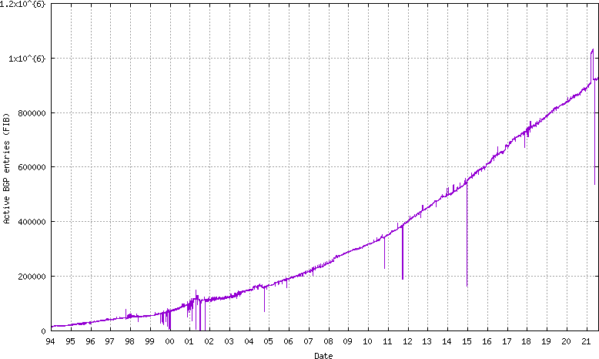
How many Autonomous Systems?
What is missing from this?
Notes:
There are many Ases
The network is not centralized – it’s a collaboration of
People
It has grown in every direction

Slide 8
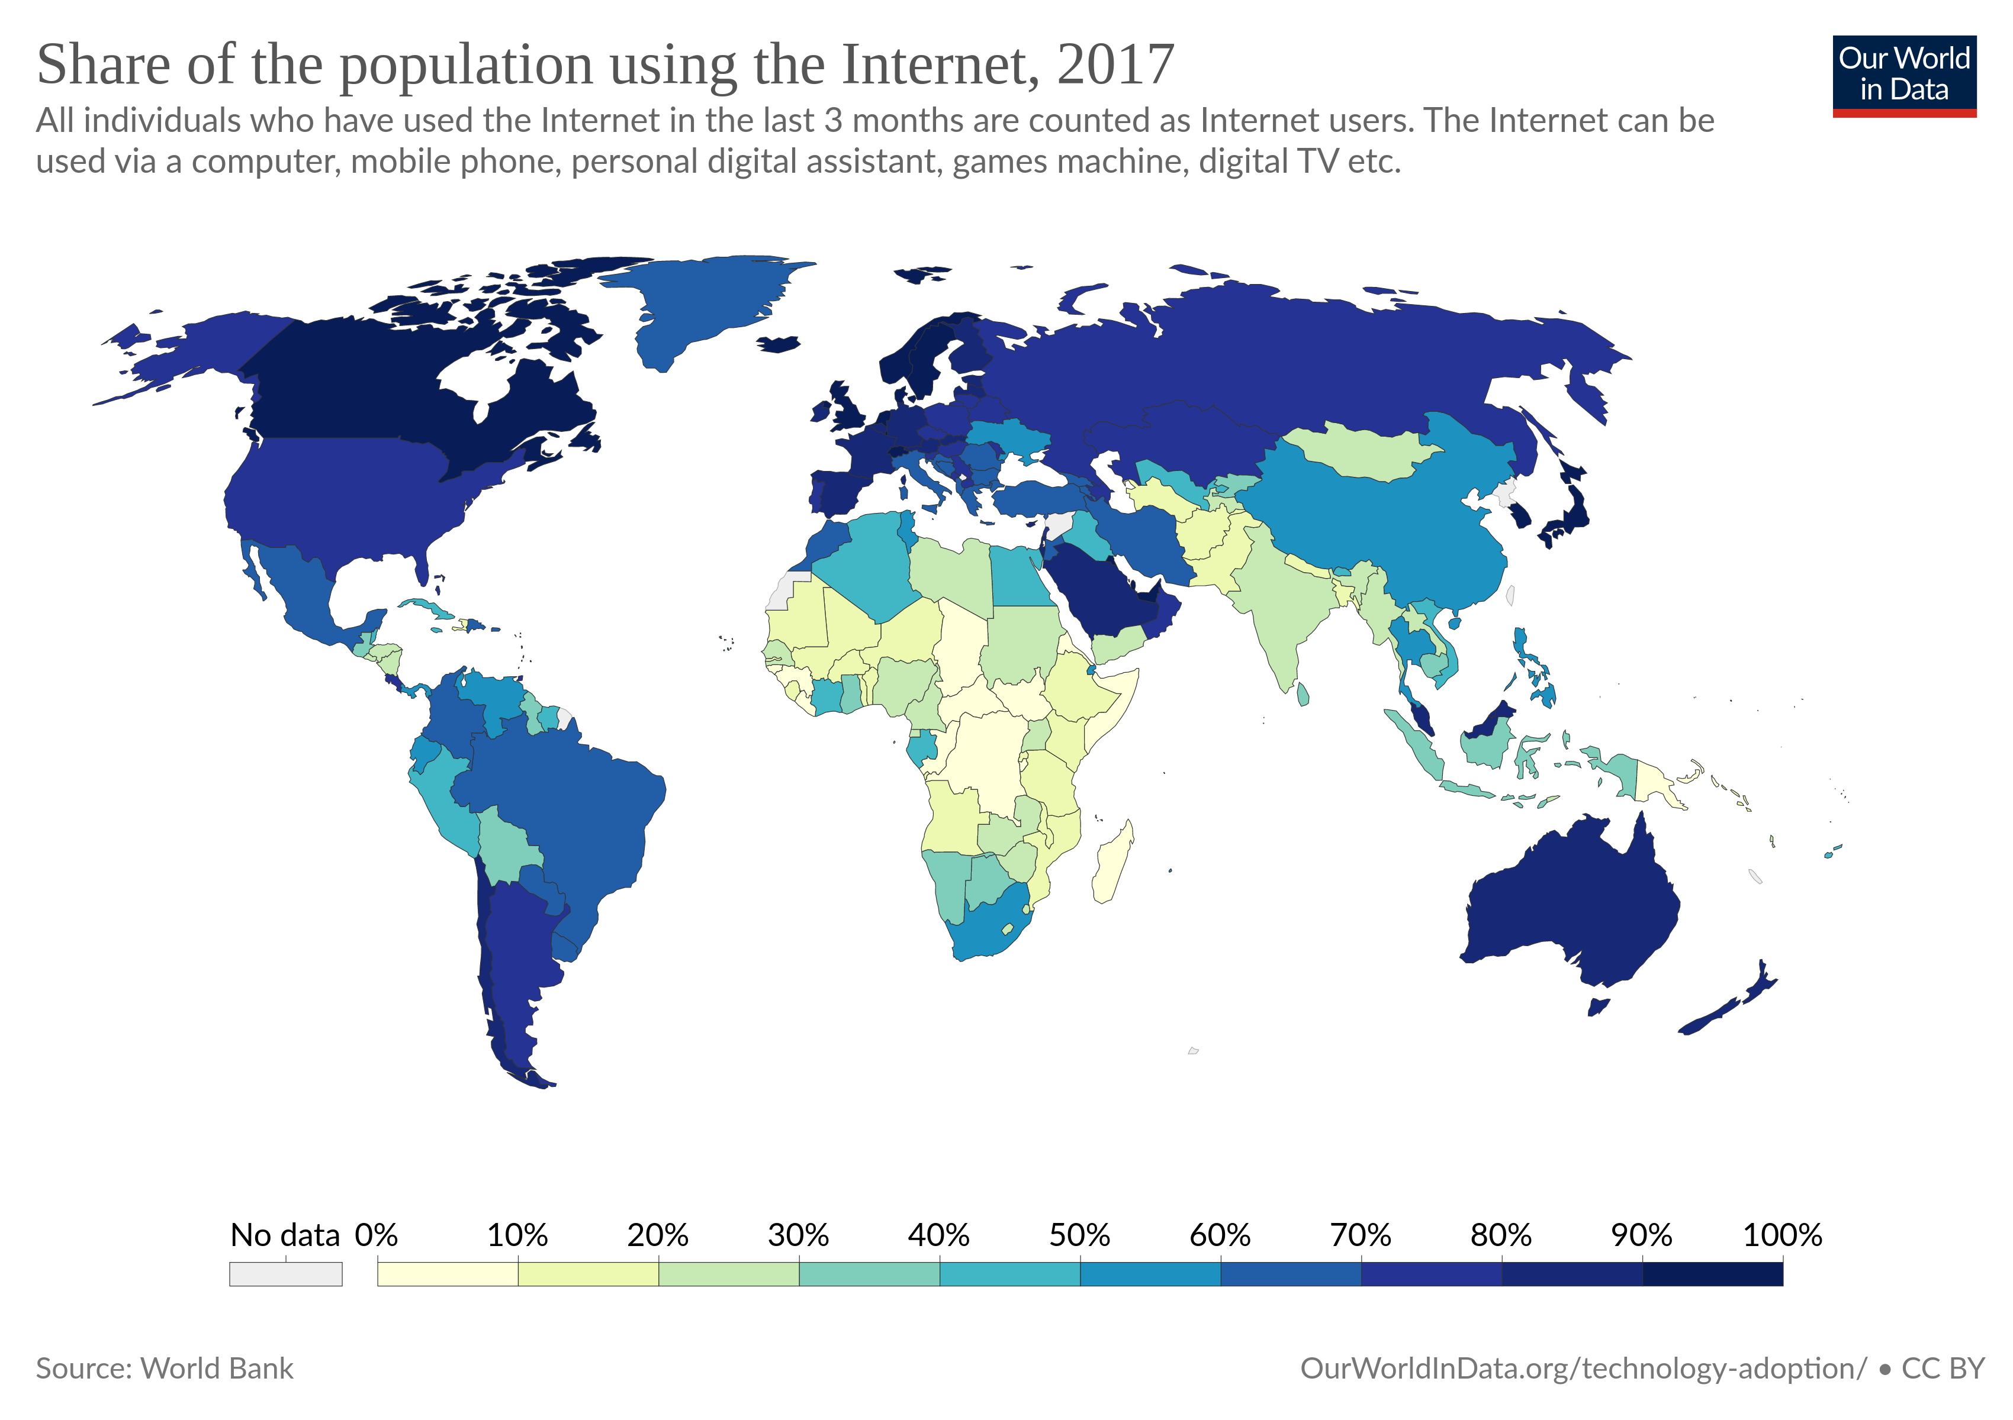
How many Users?
Notes:
There are many Ases
The network is not centralized – it’s a collaboration of
People
It has grown in every direction

Slide 9
Topics covered in this Lecture
Where the Internet came from
Design decisions
Mechanisms that drive it
Problems
Where do we go from here?
Notes:
Ndn can help organizing the namespaces
Once that’s done, data discovery and provenance is
Straight forward
Retrieval, transparent failover, and specialized operations
In this work, we take a real access log and try to quantify NDN’s improvements to a climate
workflow

Slide 10
Bob Kahn’s 4 ground rules
Each distinct network would have to stand on its own and no internal changes could be required to any such network to connect it to the Internet.
- Network of Networks!
Communications would be on a best effort basis. If a packet didn't make it to the final destination, it would shortly be retransmitted from the source.
- Collisions!
Black boxes would be used to connect the networks; these would later be called gateways and routers. There would be no information retained by the gateways about the individual flows of packets passing through them, thereby keeping them simple and avoiding complicated adaptation and recovery from various failure modes.
- Intelligence at the end-points not in the network
There would be no global control at the operations level.
https://arxiv.org/html/cs/9901011
Notes:
Ndn can help organizing the namespaces
Once that’s done, data discovery and provenance is
Straight forward
Retrieval, transparent failover, and specialized operations
In this work, we take a real access log and try to quantify NDN’s improvements to a climate
workflow

Slide 11
Layering
Common and stable interfaces between layers
Internal changes do not affect the other layers
Notes:
Ndn can help organizing the namespaces
Once that’s done, data discovery and provenance is
Straight forward
Retrieval, transparent failover, and specialized operations
In this work, we take a real access log and try to quantify NDN’s improvements to a climate
workflow

Slide 12
Open Design
Open standards
Open protocols
Open Code!
Has greatly helped with the Internet’s spread!
Notes:
Ndn can help organizing the namespaces
Once that’s done, data discovery and provenance is
Straight forward
Retrieval, transparent failover, and specialized operations
In this work, we take a real access log and try to quantify NDN’s improvements to a climate
workflow

Slide 13
Topics covered in this Lecture
Where the Internet came from
Design decisions
Mechanisms that drive it
Problems
Where do we go from here?
Notes:
Ndn can help organizing the namespaces
Once that’s done, data discovery and provenance is
Straight forward
Retrieval, transparent failover, and specialized operations
In this work, we take a real access log and try to quantify NDN’s improvements to a climate
workflow

Slide 14

What do the Internet layers look like?
Apps (HTTP)
Apps (HTTP)
Segments
Transport (TCP/UDP)
Transport (TCP/UDP)
Network (IP)
Packets
Network (IP)
Link (Ethernet)
Frames
Link (Ethernet)
Ethernet Interface
Ethernet Interface
Bits (1010001)
Notes:
Ndn can help organizing the namespaces
Once that’s done, data discovery and provenance is
Straight forward
Retrieval, transparent failover, and specialized operations
In this work, we take a real access log and try to quantify NDN’s improvements to a climate
workflow

Slide 15
Link Layer!
https://www.submarinecablemap.com/
Notes:
Ndn can help organizing the namespaces
Once that’s done, data discovery and provenance is
Straight forward
Retrieval, transparent failover, and specialized operations
In this work, we take a real access log and try to quantify NDN’s improvements to a climate
workflow

Slide 16
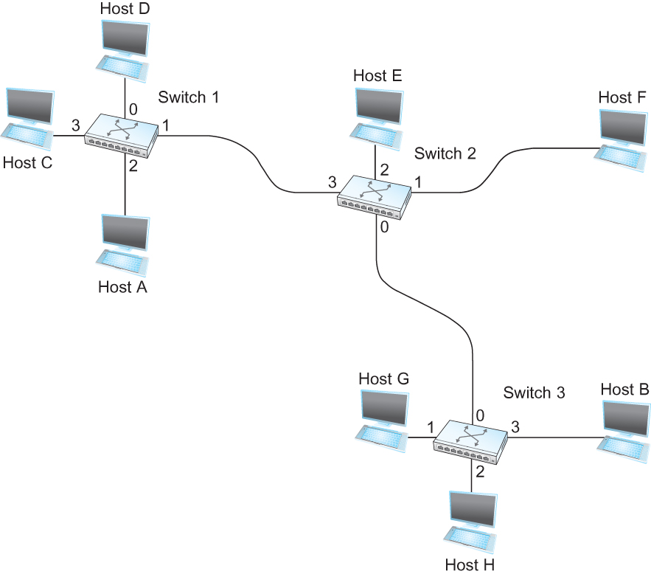
Switching
Switch
  A mechanism to interconnect
  links to form a large network
  Forward frames
  Separate the collision domains
  Filter packets between LANs
  Connects two or more LAN segments - Bridging
LAN 1
Collision domain 1
LAN 2
Collision domain 2
Notes:
Ndn can help organizing the namespaces
Once that’s done, data discovery and provenance is
Straight forward
Retrieval, transparent failover, and specialized operations
In this work, we take a real access log and try to quantify NDN’s improvements to a climate
workflow

Slide 17
Switching Table
Unknown destination → send out on all Interfaces (flooding)
  Skip the incoming interface
Destination, Port
-------------------------------------
A 3
B 0
C 3
D 3
E 2
F 1
G 0
H 0
Forwarding Table for Switch 2
Notes:
Ndn can help organizing the namespaces
Once that’s done, data discovery and provenance is
Straight forward
Retrieval, transparent failover, and specialized operations
In this work, we take a real access log and try to quantify NDN’s improvements to a climate
workflow

Slide 18
Switches are self learning!
Inspect the source MAC address
  What is a mac address?
Associate mac address and incoming interface
Store this association for later use, (for some time)
  aging-timer
Notes:
Ndn can help organizing the namespaces
Once that’s done, data discovery and provenance is
Straight forward
Retrieval, transparent failover, and specialized operations
In this work, we take a real access log and try to quantify NDN’s improvements to a climate
workflow

Slide 19
Switches are self learning!
Inspect the source MAC address
  What is a mac address?
Associate mac address and incoming interface
Store this association for later use, (for some time)
  aging-timer
Notes:
Ndn can help organizing the namespaces
Once that’s done, data discovery and provenance is
Straight forward
Retrieval, transparent failover, and specialized operations
In this work, we take a real access log and try to quantify NDN’s improvements to a climate
workflow

Slide 20
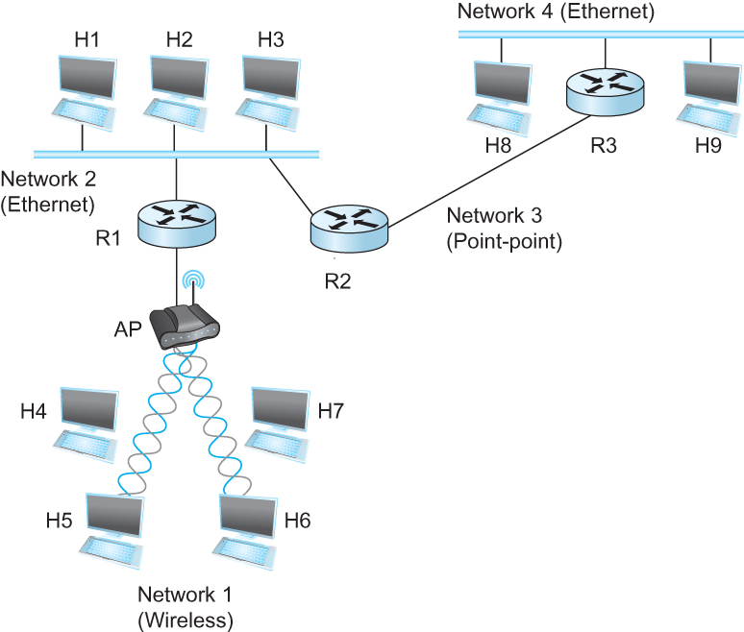
Internet Protocol (IP)
    What is an internetwork?
      An arbitrary collection of networks interconnected to provide some sort of host-host to packet delivery service
      Note the different types of network
Notes:
Ndn can help organizing the namespaces
Once that’s done, data discovery and provenance is
Straight forward
Retrieval, transparent failover, and specialized operations
In this work, we take a real access log and try to quantify NDN’s improvements to a climate
workflow

Slide 21
Internet Protocol (IP)
    What is an internetwork?
      An arbitrary collection of networks interconnected to provide some sort of host-host to packet delivery service
      Note the different types of network
Notes:
Ndn can help organizing the namespaces
Once that’s done, data discovery and provenance is
Straight forward
Retrieval, transparent failover, and specialized operations
In this work, we take a real access log and try to quantify NDN’s improvements to a climate
workflow

Slide 22
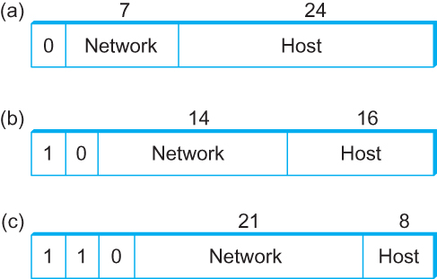
Back to Addressing
    A 32 bit number in quad-dot notation
    Identifies an Interface
      A host might have several interfaces!!!
    129.82.138.254
    10000001.01010010.10001010.11111110
Notes:
Ndn can help organizing the namespaces
Once that’s done, data discovery and provenance is
Straight forward
Retrieval, transparent failover, and specialized operations
In this work, we take a real access log and try to quantify NDN’s improvements to a climate
workflow

Slide 23

Subnets Revisited
223.1.1.0/24
223.1.2.0/24
Recipe:
Create isolated networks – subnets
No longer need to know
individual Ips – knowing
the subnet is enough
  223.1.1.0/14 → Interface 2
223.1.1.1
223.1.1.2
223.1.2.1
223.1.1.4
223.1.2.9
223.1.2.2
223.1.1.3
223.1.3.27
subnet
223.1.3.1
223.1.3.2
223.1.3.0/24
subnet mask: /24

Slide 24

Subnets (Prefixes) scales the Internet
Addresses are allocated in contiguous prefixes (tntech 149.149.0.0/16)
Routing protocols operate based on prefixes (how do I reach 149.149.0.0/16)?
149.149.5.0/24
149.149.6.0/24
149.149.7.0/24
149.149.0.0/16
.
.
.
.
.
149.160.0.0/16
149.0.0.0/8
Internet
How do I reach
149.0.0.0/8?
Not
How do I reach 149.149.5.0/24
How do I reach 149.149.6.0/24
149.160.0.0/17
149.160.128.0/17

Slide 25
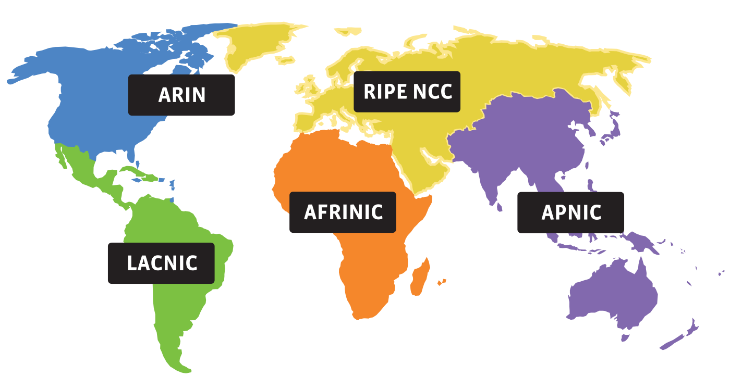
Who gets what prefix?
0. Internet Corporation for Assigned Names and Numbers (ICANN) – Decides which RIRs get what address
1. Regional Internet Registries (RIRs) – Which orgs get what address
2. ISPs – Which customers get which address
Notes:
Ndn can help organizing the namespaces
Once that’s done, data discovery and provenance is
Straight forward
Retrieval, transparent failover, and specialized operations
In this work, we take a real access log and try to quantify NDN’s improvements to a climate
workflow

Slide 26
IPv4 Crisis
We have officially run out of IPv4 addresses
IPv6 to the rescue – use it.
Notes:
Ndn can help organizing the namespaces
Once that’s done, data discovery and provenance is
Straight forward
Retrieval, transparent failover, and specialized operations
In this work, we take a real access log and try to quantify NDN’s improvements to a climate
workflow

Slide 27
How do we talk to the other networks?
Some sort of routing table
- Like your GPS
- Allows you to create paths to other networks
Notes:
Ndn can help organizing the namespaces
Once that’s done, data discovery and provenance is
Straight forward
Retrieval, transparent failover, and specialized operations
In this work, we take a real access log and try to quantify NDN’s improvements to a climate
workflow

Slide 28
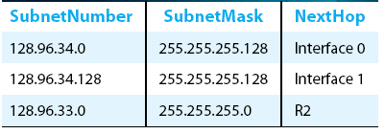
Forwarding vs Routing
Forwarding:
          to select an output port based on destination address and routing table
          Local path
    Routing:
          process by which routing table is built
          End-to-end path
Notes:
Ndn can help organizing the namespaces
Once that’s done, data discovery and provenance is
Straight forward
Retrieval, transparent failover, and specialized operations
In this work, we take a real access log and try to quantify NDN’s improvements to a climate
workflow

Slide 29
Why bother?
5
v
3
w
2
5
Quality of path affects performance
  Longer path = more delay
Balance path usage, avoid congested paths
Deal with failures
u
2
1
z
3
1
2
x
y
1
Notes:
Ndn can help organizing the namespaces
Once that’s done, data discovery and provenance is
Straight forward
Retrieval, transparent failover, and specialized operations
In this work, we take a real access log and try to quantify NDN’s improvements to a climate
workflow

Slide 30
Router architecture overview
Two key router functions:
run routing algorithms/protocol (RIP, OSPF, BGP)
forwarding datagrams from incoming to outgoing link
Control Plane = routing
Vs
Data Plane = forwarding
forwarding tables computed,
pushed to input ports
routing
processor
routing, management
control plane (software)
forwarding data plane (hardware)
high-speed
forwarding
fabric
router input ports
router output ports

Slide 31
Router architecture overview
Two key router functions:
run routing algorithms/protocol (RIP, OSPF, BGP)
forwarding datagrams from incoming to outgoing link
Control Plane = routing
Vs
Data Plane = forwarding
forwarding tables computed,
pushed to input ports
routing
processor
routing, management
control plane (software)
forwarding data plane (hardware)
high-speed
forwarding
fabric
router input ports
router output ports

Slide 32
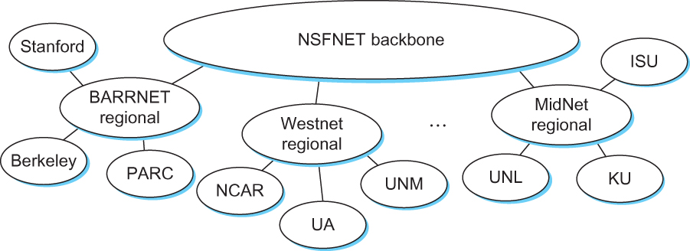
Scaling Routing!
Internet in the 1990s
Notes:
Ndn can help organizing the namespaces
Once that’s done, data discovery and provenance is
Straight forward
Retrieval, transparent failover, and specialized operations
In this work, we take a real access log and try to quantify NDN’s improvements to a climate
workflow

Slide 33
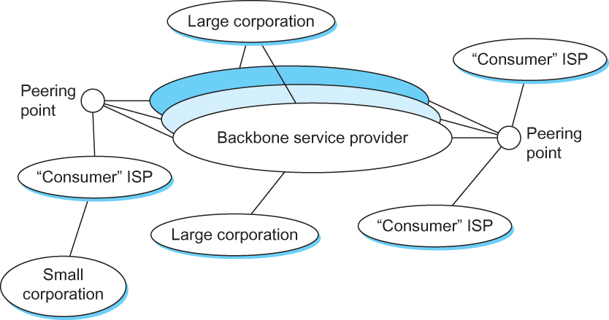
Internet now
Notes:
Ndn can help organizing the namespaces
Once that’s done, data discovery and provenance is
Straight forward
Retrieval, transparent failover, and specialized operations
In this work, we take a real access log and try to quantify NDN’s improvements to a climate
workflow

Slide 34
Hierarchical routing - Policy
scale: with 600 million destinations:
can’t store all dest’s in routing tables!
routing table exchange would swamp links!
administrative autonomy
internet = network of networks
each network admin may want to control routing in its own network

Slide 35
Autonomous systems (ASes)
AS
  A set of routers under a single technical administration
  What happens inside an AS stays within that AS!
    That is, AS decides routing metrics internally
Notes:
Ndn can help organizing the namespaces
Once that’s done, data discovery and provenance is
Straight forward
Retrieval, transparent failover, and specialized operations
In this work, we take a real access log and try to quantify NDN’s improvements to a climate
workflow

Slide 36
BGP-4: Border Gateway Protocol
Assumes the Internet is an arbitrarily interconnected set of AS's.
Local traffic – within the AS
Transit traffic – from AS1 to AS3 via AS2
Three types of AS’s
  Stub AS
  Multihomed AS
  Transit AS

Slide 37
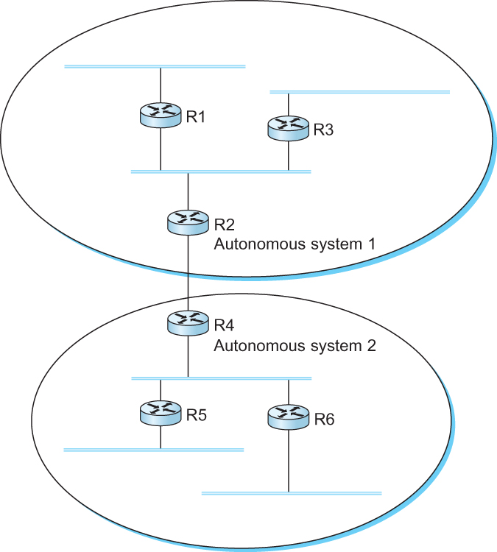
BGP-4: Border Gateway Protocol
IGP
Interior gateway protocol
R7
Stub AS
R3 Will not carry traffic between R2 and R1
R6
Transit AS
R3
Multihomed
AS
R6 Will carry traffic between R2 and R7
R5
Stub AS

Slide 38
BGP - goals
The goal of Inter-domain routing is to find any path to the intended destination that is loop free
  We are concerned with reachability than optimality
  Finding path anywhere close to optimal is considered to be a great achievement
Why?

Slide 39
BGP - Goals
Scalability: Forward any packet destined anywhere in the Internet
  Having a routing table that will provide a match for any valid IP address
Autonomous nature of the domains
  impossible to calculate meaningful costs for a path crossing multiple ASs
  A cost of 1000 is great at provider 1, terrible at provider 2
Issues of trust
  Provider A might be unwilling to believe certain advertisements from provider B

Slide 40
BGP: Path vector protocol
Send the whole path with the routing update
Loops are detected if an AS finds itself in the path
  Reject if so
  Accept otherwise
Add self to the path and advertise to the neighbors
Advantage: No loops, Local decision before advertising

Slide 41
BGP: Path vector protocol
Loop!
Path: AS 223, AS 225, AS 245, AS 7770
Path: AS 223, AS 225, AS 245, AS 7770
AS 7770
AS 223
AS 225
Path: AS 223
Path: AS 223, AS 225
AS 245
Path: AS 223, AS 225, AS 245

Slide 42
Transport layer
So we have created a global network
Two problems:
  How do we turn this host-to-host packet delivery service into a process-to-process communication channel?
  How do we look things up? ← More on this later
Notes:
Ndn can help organizing the namespaces
Once that’s done, data discovery and provenance is
Straight forward
Retrieval, transparent failover, and specialized operations
In this work, we take a real access log and try to quantify NDN’s improvements to a climate
workflow

Slide 43

















Transport services and protocols
application
transport
network
data link
physical
provide logical communication between app processes running on different hosts
transport protocols run in end systems
  send side: breaks app messages into segments, passes to network layer
  rcv side: reassembles segments into messages, passes to app layer
more than one transport protocol available to apps
  Internet: TCP and UDP
logical end-end transport
application
transport
network
data link
physical

Slide 44
Multiplexing/demultiplexing
multiplexing at sender:
handle data from multiple
sockets, add transport header (later used for demultiplexing)
demultiplexing at receiver:
use header info to deliver
received segments to correct
socket
application
application
P1
P2
application
socket
P3
transport
P4
process
transport
network
transport
network
link
network
link
physical
link
physical
physical

Slide 45
Finally – the DNS
Internet’s telephone directory!
Notes:
Ndn can help organizing the namespaces
Once that’s done, data discovery and provenance is
Straight forward
Retrieval, transparent failover, and specialized operations
In this work, we take a real access log and try to quantify NDN’s improvements to a climate
workflow

Slide 46

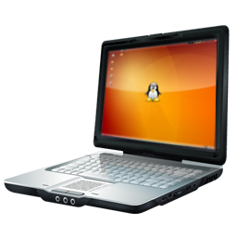
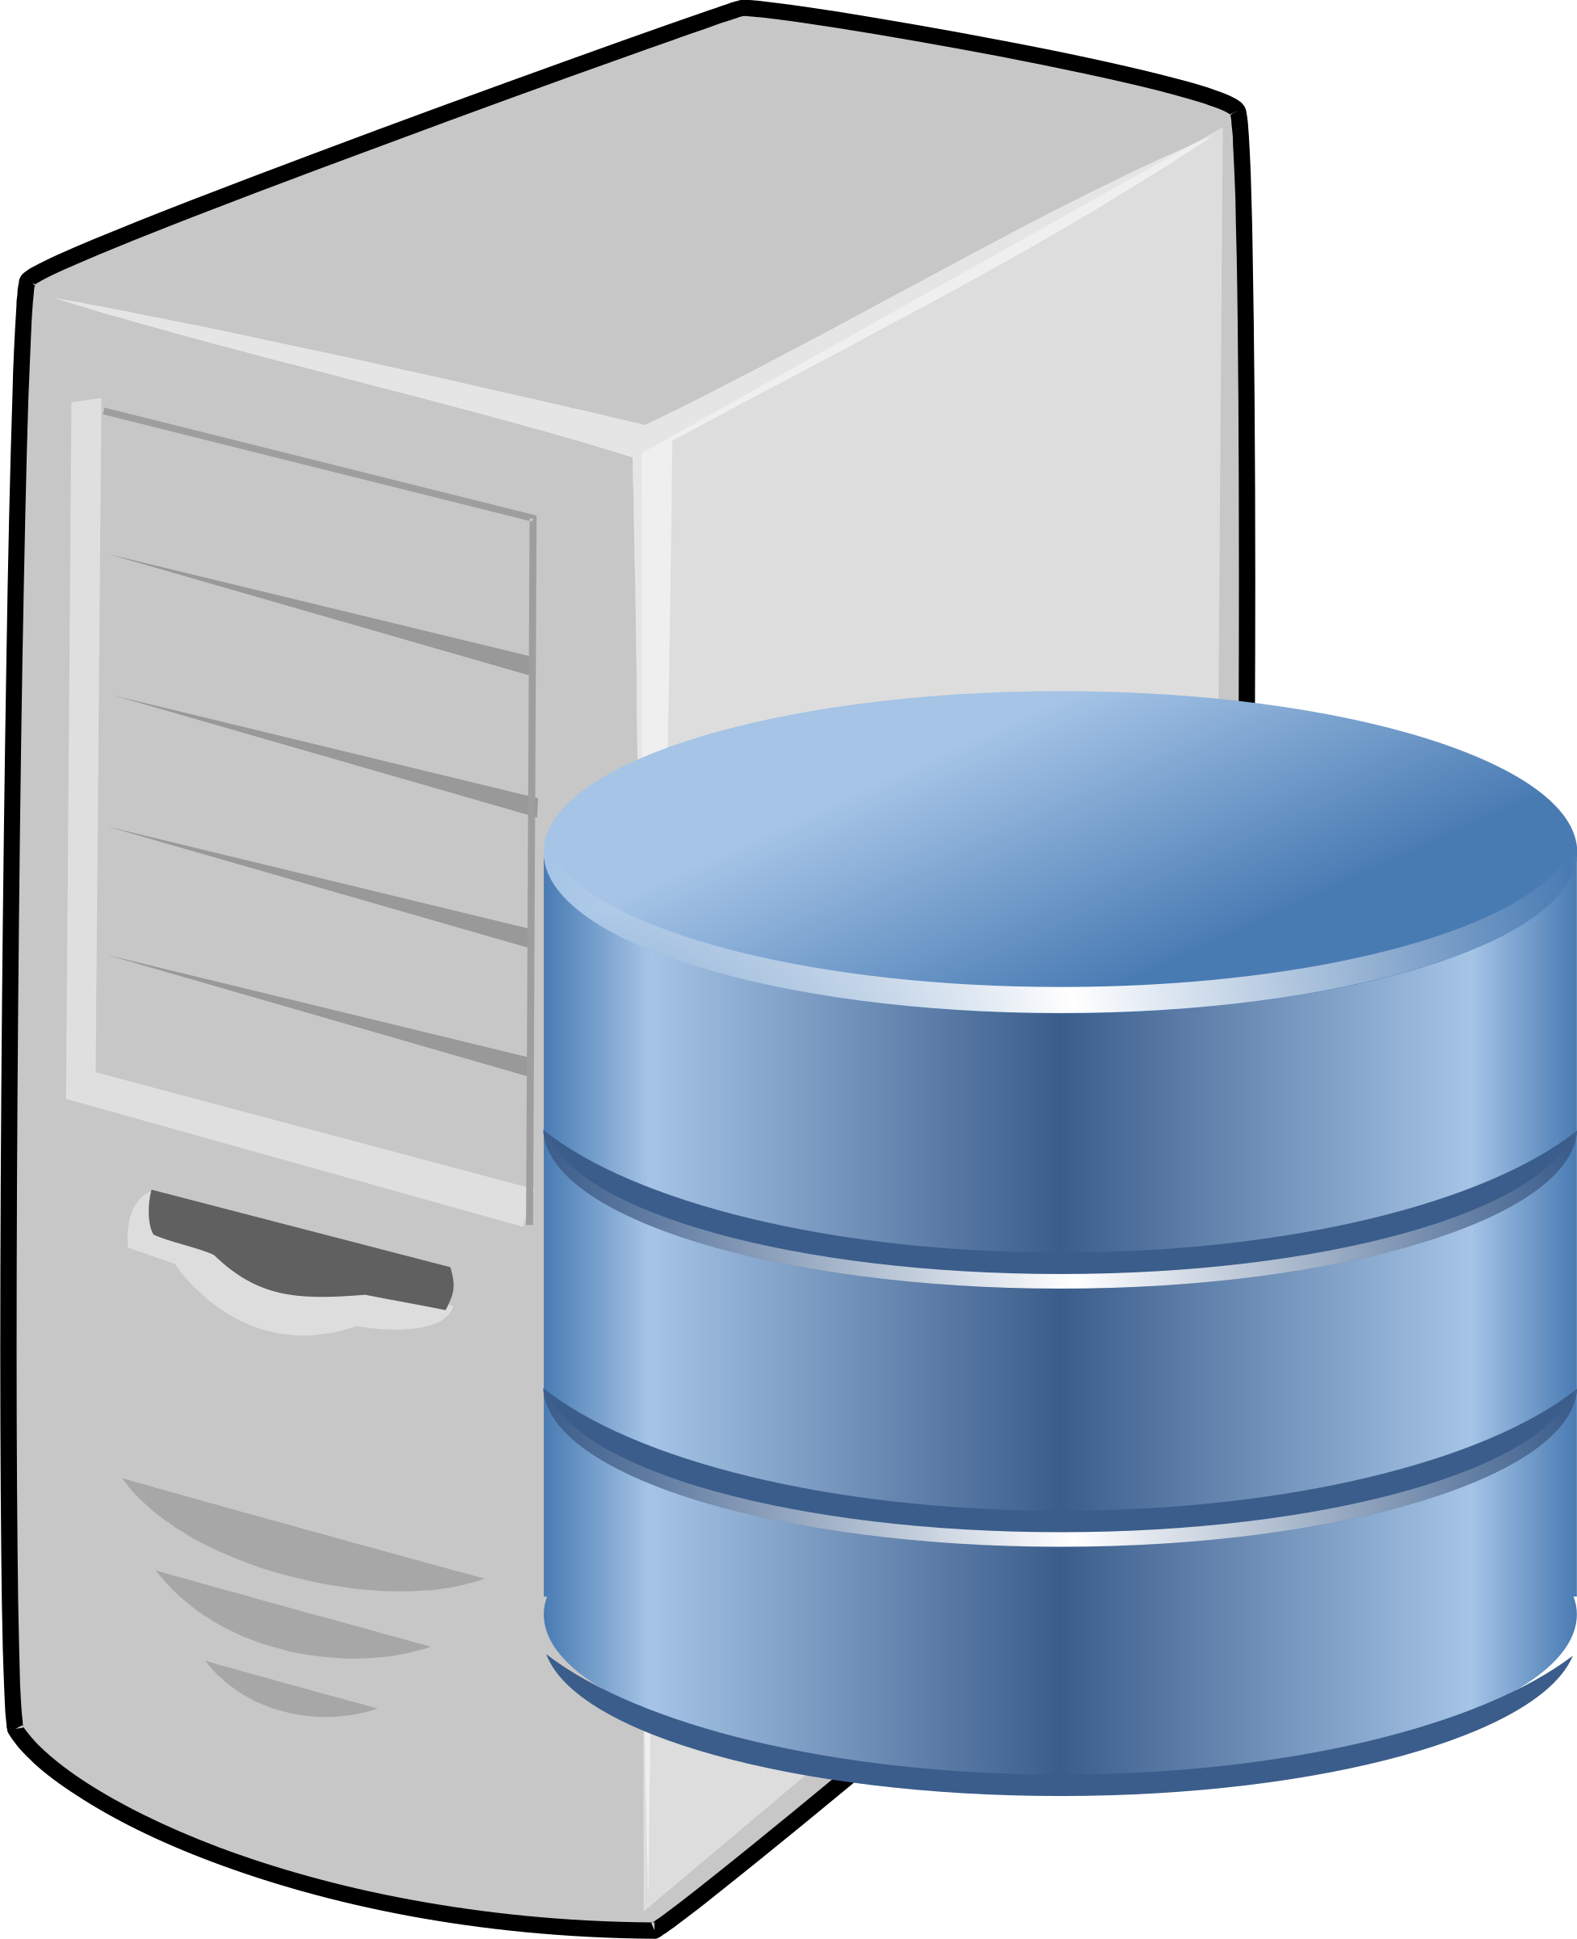

IP Based Communication
google.com
216.58.217.46
GET google.com/index.html
Lookup google.com
216.58.217.46
Get Data
google.com
216.58.217.49
Notes:
Mention interest aggregation
Caching

Slide 47
DNS – IP to Name
People: Good with names
Machines: Good with numbers
https://cat-bounce.com/ → 208.113.161.95
DNS maps IP addresses to human readable names.

Slide 48
DNS: a distributed, hierarchical database
Root DNS Servers
…
…
com DNS servers
org DNS servers
edu DNS servers
yahoo.com
DNS servers
pbs.org
DNS servers
poly.edu
DNS servers
umass.edu
DNS servers
amazon.com
DNS servers
client wants IP for www.amazon.com;
client queries root server to find com DNS server
client queries .com DNS server to get amazon.com DNS server
client queries amazon.com DNS server to get IP address for www.amazon.com

Slide 49
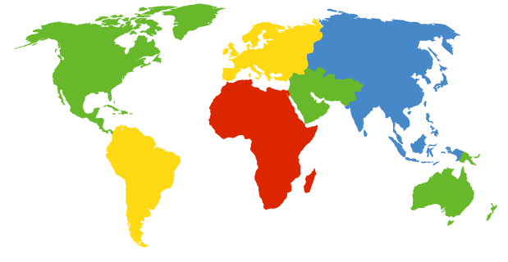
DNS: root name servers
contacted by local name server that can not resolve name
root name server:
  contacts authoritative name server if name mapping not known
  gets mapping
  returns mapping to local name server
c. Cogent, Herndon, VA (5 other sites)
d. U Maryland College Park, MD
h. ARL Aberdeen, MD
j. Verisign, Dulles VA (69 other sites )
k. RIPE London (17 other sites)
i. Netnod, Stockholm (37 other sites)
e. NASA Mt View, CA
f. Internet Software C.
Palo Alto, CA (and 48 other sites)
m. WIDE Tokyo
(5 other sites)
13 root name “servers” worldwide
a. Verisign, Los Angeles CA
(5 other sites)
b. USC-ISI Marina del Rey, CA
l. ICANN Los Angeles, CA
(41 other sites)
g. US DoD Columbus, OH (5 other sites)

Slide 50
Topics covered in this Lecture
Where the Internet came from
Design decisions
Mechanisms that drive it
Problems
Where do we go from here?
Notes:
Ndn can help organizing the namespaces
Once that’s done, data discovery and provenance is
Straight forward
Retrieval, transparent failover, and specialized operations
In this work, we take a real access log and try to quantify NDN’s improvements to a climate
workflow

Slide 51
Where do things break?
Link layer
– whale broke my fiber. Solar radiation. Your microwave.
- Also, TCP/IP is point to point – so you can’t do effective broadcast/multicast – even though your link layer is broadcast by nature.

Slide 52
Where do things break?
TCP/IP Layers
– Mobility!
- TCP pseudo header – connections are end-to-end!
- Multipath routing
- Content reuse

Slide 53
Where do things break?
Security
- No built-in security mechanisms
– DDoS
- Spam and Phishing
- Social engineering
- Insecure communication
- Password
- Human errors

Slide 54
DNS Poisoining
DDoS attacks
Bombard root servers with traffic
Bombard TLD servers
  Potentially more dangerous
Man-in-middle
  Intercept queries
DNS poisoning
  Send bogus replies to DNS server, which caches
Redirect attacks
Send queries with spoofed source address: target IP
Requires amplification

Slide 55
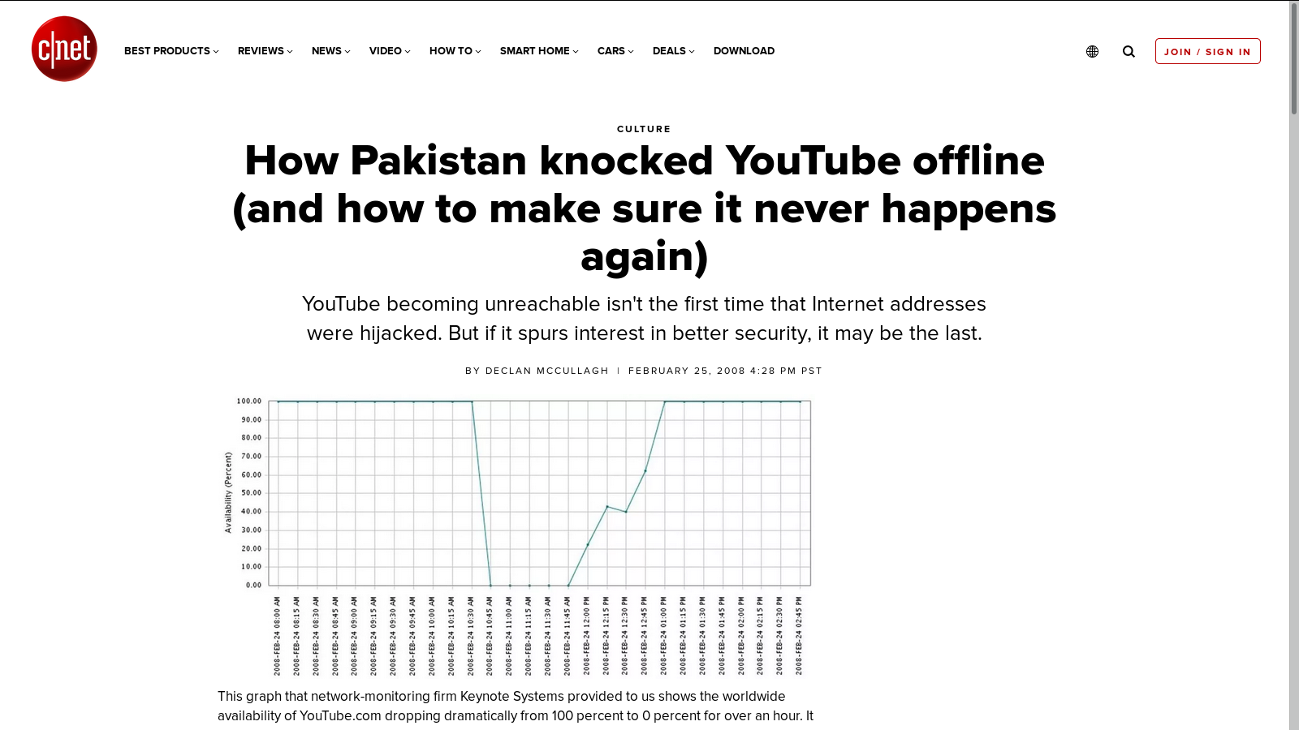
BGP: Security problems
Anyone can advertise
anything!!!

Slide 56
So What’s next?
How do we create protocols that interconnects new devices?
Clouds.
Edge Devices.
IoT.
Vehicular networks.

Slide 57
So What’s next?
The goal of this class – explore what I just presented in a lot more details.
Explore how do we create protocols that interconnects new devices?
CDNs.
Clouds.
Edge Devices.
IoT.
Vehicular networks.

Slide 58
References
A Brief History of the Internet - Barry M. Leiner, Vinton G. Cerf,
David D. Clark, Robert E. Kahn, Leonard Kleinrock, Daniel C. Lynch,
Jon Postel, Larry G. Roberts, Stephen Wolff
https://arxiv.org/html/cs/9901011
Vint Cerf: Re-Thinking the Internet -
https://www.youtube.com/watch?v=hagxPPoMGjw

