Slide 1


Slide 2

Content Delivery Networks
Rajat Bhattarai
10/04/2021

Slide 3
Overview
Problem Statement
CDN Basics
CDN Example: Akamai
Netflix Multi-CDN Architecture
Netflix's Open Connect
Open Connect Deployment in the USA and Brazil
Research Question: Does caching inside ISPs and IXPs like in Netflix's Open Connect improve Quality of Experience solving scalability and cost issues of current CDNs?

Slide 4




Problem Statement
Static HTML Page,
Images and Videos
Flash Crowd Problem for Popular Websites
Request load overwhelms site's infrastructure
Can lead to crash and consequently lost revenue or negative customer impression
Previously, only one server
Scalability issues
Reliability issues
Performance issues
Dynamic
Server
Fig. 1: How a website works?

Slide 5
Solutions
Static HTML Page,
Images and Videos
Dynamic
Local Clustering [1]
Improves fault-tolerance and scalability to some extent
But,
Requires load balancer which is still single point of failure
Data centre and ISP failure can make cluster inaccessible
Web Proxy Cache [1]
Just serves previously requested content
Does not work for dynamic websites
Server
Server
Server
Load Balancer
Fig. 2: Local Clustering

Slide 6
CDN as a Solution
Static HTML Page,
Images and Videos
Replicate content caches around different geographies
Advantages
Reduce demand on site's infrastructure
Reduce latency and increase service resilience (Greater Quality of Experience)
Customized data according to device and location
Dynamic
Server
Edge Server
Edge Server
Edge Server
Content Caches
Fig. 3: How a CDN enabled website works?

Slide 7
CDN Providers
Akamai, Amazon, Limelight, Fastly, Level 3 and so on provide service to content providers all over the world
Have servers all around the world
Located inside service provider networks and the internet exchange points
Major Content Providers like Google, Facebook, Netflix have built their own CDN infrastructures
Google – Google Global Cache
Netflix – Open Connect
Facebook – Facebook Content Distribution Network (FBCDN)

Slide 8


How CDN works?
First request
If the content is not in the cache or cache entry has expired, edge server makes request to origin server.
When the edge server receives the response from the origin server, it stores the content in cache.
GET /foo.png
GET /foo.png
foo.png
foo.png
User
Edge Server
Origin Server
Second request
GET /foo.png
foo.png
User
Edge Server
Origin Server
Fig. 4: How CDN works?

Slide 9
Mapping clients to servers
CDNs redirect end users to the optimal edge server
Best server can change over time
Based on attributes like client location, network conditions, load of server, and so on
CDNs Require
Server Selection Mechanism
Server Redirection Mechanism
DNS Based
Anycast

Slide 10
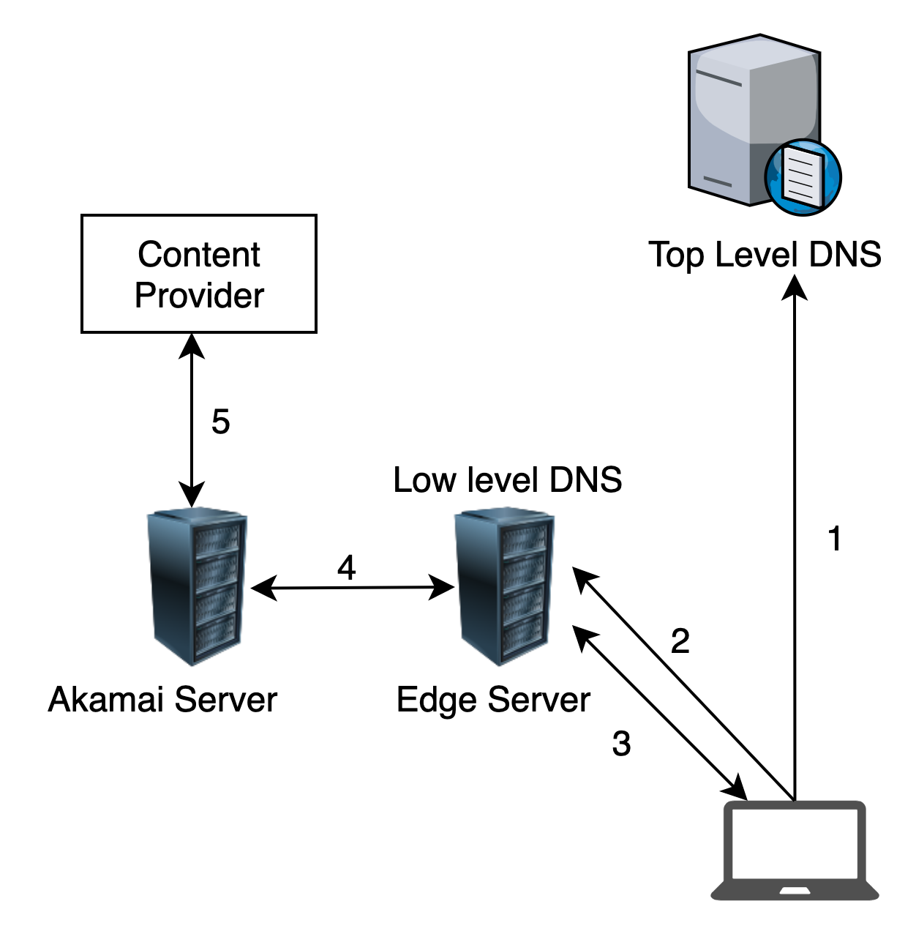
DNS Redirection
Advantages
Uses existing, scalable DNS
Limitations
Lots of DNS round-trip time
CDN authoritative DNS server responds to the IP address of resolvers and not that of actual client
Full control to the CDN provider
User
Fig. 5: DNS redirection
www.fox.com. 510 IN CNAME www.fox-rma.com.edgesuite.net.
www.fox-rma.com.edgesuite.net. 5139 IN CNAME a2047.w7.akamai.net.
a2047.w7.akamai.net. 4 IN A 23.62.96.128
a2047.w7.akamai.net. 4 IN A 23.62.96.144
a2047.w7.akamai.net. 4 IN A 23.62.96.193
a2047.w7.akamai.net. 4 IN A 23.62.96.162

Slide 11
Anycast Redirection
Same IP address for multiple servers
Advantages
Simple Management
Uses BGP Best Path
Less DNS lookup time
Limitations
Loses other server selection flexibility like server load
BGP path may not be optimal
120.10.0.0/16
AS8
Edge server
AS1
AS10
AS20
120.10.0.0/16
User
Edge server
Fig. 6: Anycast redirection

Slide 12
CDN Example: Akamai
Launched in 1999
Only delivered web objects at the start, now can distribute dynamically generated pages and applications
2002: More than 12000 servers in over 100 networks
Present: 325,000 servers in more than 135 countries and 1435 networks
Directs clients' requests to the [1]
nearest (lower round trip and low packet loss)
available server (less load and more bandwidth capacity)
likely to have the requested content

Slide 13
Akamai Infrastructure
Automatic Network Control [1]
Dynamic, fault-tolerant DNS system
Resolves host names using the following criteria
Service requested
Server health: must be up and running without errors
Server load: should be available for additional requests
Network condition: sufficient bandwidth, client must reach with minimum loss
Client location
Content requested
No. | Steps
1 and 2 | Client HTTP content request, resolves edge server's name
3 | Request issued to edge server
4 and 5 | Edge server requests content from appropriate source, satisfies request and logs completion
Fig. 7: Servicing a client with Akamai

Slide 14
Akamai Infrastructure (cont.)
Akamai agents communicate with border router, BGP routers as peers to determine network topology
Combines this information with live network statistics like traceroute data to provide detailed view of network structure and quality measures for different mappings
Network Monitoring [1]
DNS based load balancing
Each content server reports its load to monitoring application
The application aggregates and publishes load report to local DNS
If server load exceeds threshold, DNS server assigns to additional servers
Simulating end-user behavior by downloading web objects and measuring the failure rate to monitor health
Traffic analyzer application for customers

Slide 15
Akamai Services [1]
Static Content
HTML pages, images, executables, PDF documents
Lifetime from zero to infinite
Dynamic Content
Cannot actually cache dynamic content
Edge Side Includes Technology (ESI)
Integrates Extensible Stylesheet Language Transformation(XSLT) engine to process XML
Break dynamic pages into fragments with independent cacheability
Streaming Media
Supports live and on demand media in Microsoft Windows Media, Real and Apple's Quicktime formats

Slide 16
Technical Challenges [1]
System Scalability
Adding more servers makes monitoring and controlling challenging
Monitoring network conditions across many locations
Reacting Quickly to the network conditions
Isolating customer so that they cannot negatively affect each other
System Reliability
Many components that could fail leading to Outage
Failures must be detected and corrected along with handing out new routes for users
Software Deployment and Platform Management
Upgrade software periodically on entire network

Slide 17
Technical Challenges (contd. ) [1]
Content Visibility and Control for customers
Cache Consistency
Cache all the cacheables using TTLs
Lifetime Control
Authentication and Authorization – protected content
Edge server must contain authorization features or relay tokens to origin server
Integrity Control – content integrity checks
Should not server wrong content to wrong customers
Visibility into access patterns – log details to customers
Customers require log data of their applications even though machines running applications can change from time to time
Billing – make billing infrastructure

Slide 18
Netflix: Case study
Leading provider of on-demand video streaming all over the world over 190 countries
29.7% of the peak downstream traffic in US in 2011 [2]
209 million global paid subscribers, 79 million in the US and Canada [6]
Too big for internet?
Sends more data than entire global internet can support
Petabytes of Data
Large-scale, fast-growing video streaming
Used multi-CDN initially for content delivery before moving to Open Connect

Slide 19
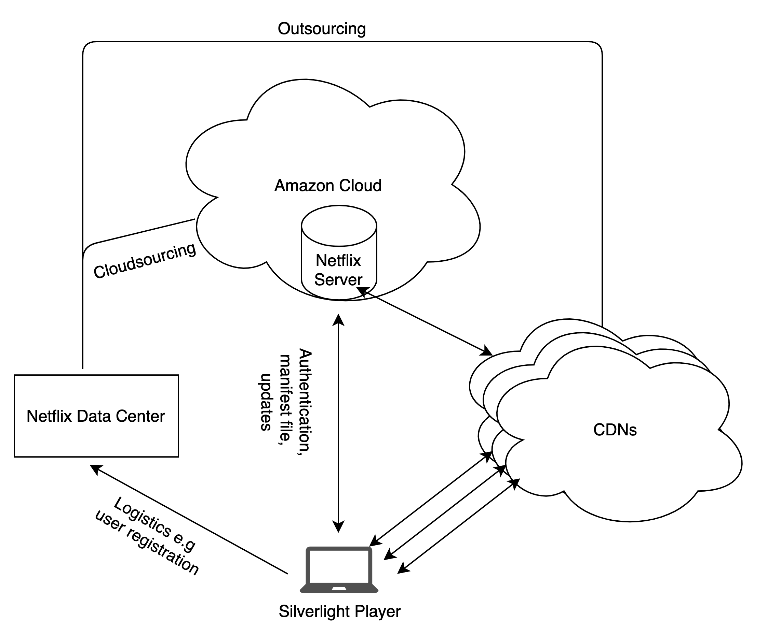
Netflix Multi-CDN Architecture [2]
Hostname | Organization
www.netflix.com | Netflix
signup.netflix.com | Amazon
movies.netflix.com | Amazon
agmoviecontrol.netflix.com | Amazon
Nflix.i.87f50a04.x.lcdn.nflximg.com | Level 3
Netflix-753.vo.llnwd.net | Limelight
Netflix753.as.nflximg.com.edgesuite.net | Akamai
EC2, S3, to SDB and VPC
Fig. 8: Netflix multi-CDN architecture

Slide 20
Multi-CDN Architecture (cont.)
Netflix Data center only for new user registration and capturing payment information
Amazon cloud handles content ingestion, log recording, DRM, CDN routing, authentication
Uses three CDNs: Akamai, Limelight, Level-3
Silverlight Player to download, decode and play video in browser
DASH (Dynamic Streaming over HTTP) protocol for streaming
Each video encoded at different quality levels divided into small chunks
Client requests one chunk at a time
Rate determination algorithm to determine quality of next chunk

Slide 21
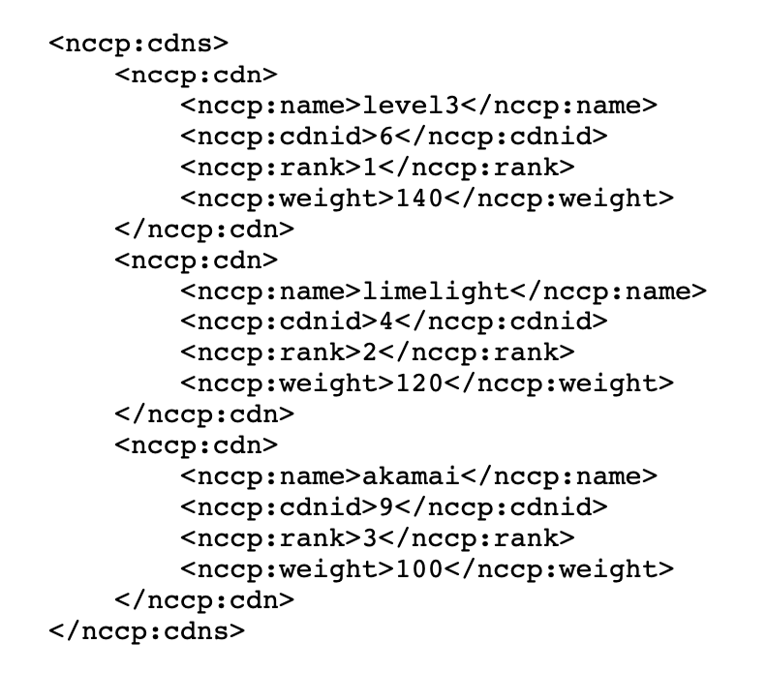
Video Playback Process
1. Silverlight player download and User authentication
2. Netflix Manifest File
Controls streaming, client specific
Provides DASH metadata in XML
Transferred through SSL
Contains key information like list of CDNs, location of trickplay data, video/audio chunk URLs for multiple quality levels, etc.
Fig. 9: CDN List in manifest file

Slide 22
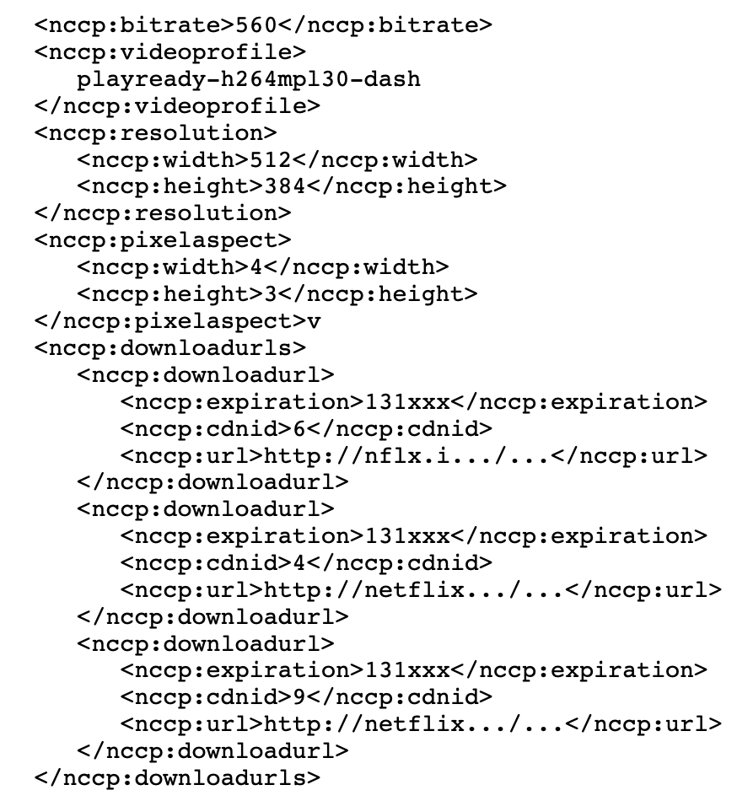
Video Playback Process (cont.)
3. Tickplay
pause, rewind, forward and random seek
Thumbnail images, interval, urls of trickplay file, multiple resolutions
4. Audio and video chunk download
Player buffer fills first and then periodic download
5. User Experience Reporting
After playback starts, player communicates periodically with the control server agmoviecontrol.netflix.com
Fig. 10: URL List in manifest file for download

Slide 23
CDN Selection Strategy [2]
Netflix CDN ranking tied to each user account and remains unchanged over many days
Client stays with same CDN as long as possible even if it has to degrade quality level of the playback
Independent of network conditions
Other CDNs serve as backup and used only if current CDN server cannot support even lowest video quality
Limitations
Does not exploit multi-CDN capabilities
Simultaneous download from multiple CDNs
Measurement based CDN selection
Unlucky users
Video viewing quality might suffer even other CDN can provide

Slide 24
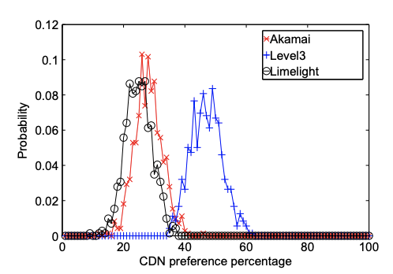
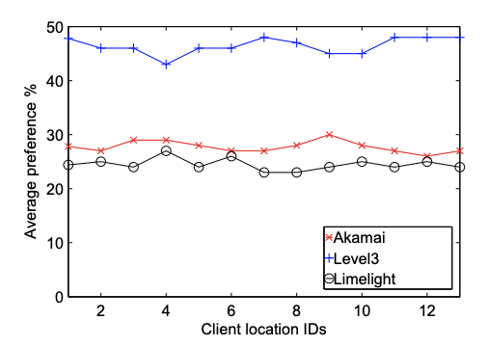
Comparison with Hulu [3]
Another leading provider of video streaming services in the US
Architecture very similar to Netflix
Uses same 3 CDNs
Uses only one CDN server throughout the duration of a video and switches to next for another video
Random selection, Gaussian Distribution
Independent of network conditions
Other CDNs serve as backup and used only if current CDN server cannot support even lowest video quality like in Netflix
Fig. 11: CDN preference distribution [3]
Fig. 12: CDN preference over geographic regions [3]

Slide 25
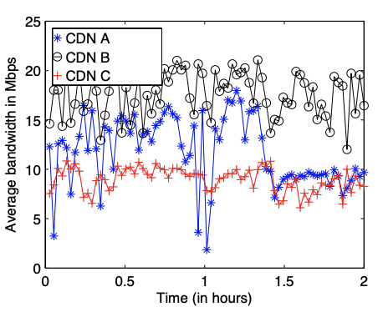
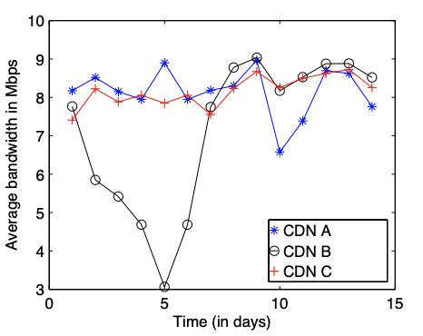
Better Approach [2, 3]
Find out the highest bandwidth client can receive if the best CDN is used at any given time and use the best CDN(Measurement based CDN selection)
12% improvement over static CDN selection[2]
Use multiple CDNs simultaneously
Download 3 different chunks in parallel from 3 CDNs
more than 50% improvement over best CDN
Fig. 13: Instanteous Bandwidth for three CDNs at a site [2]
Fig. 14: One Day Average Bandwidth for three CDNs at a site [2]

Slide 26
Problems of Multi-CDN Architecture
High Cost
Requires multiple contract with each CDN provider
Quality of Service also dependent upon transit agreement between each CDN provider and Network Service Provider
Scalability to geographical regions dependent upon the scalability of each CDN provider
No Interoperability of CDNs among providers

Slide 27
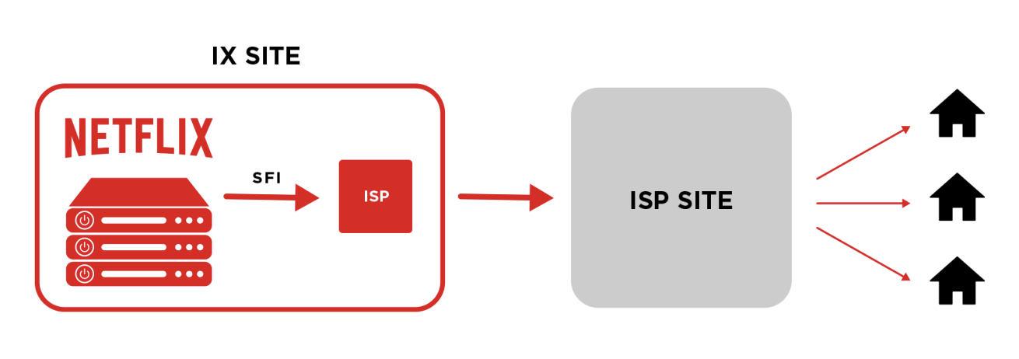
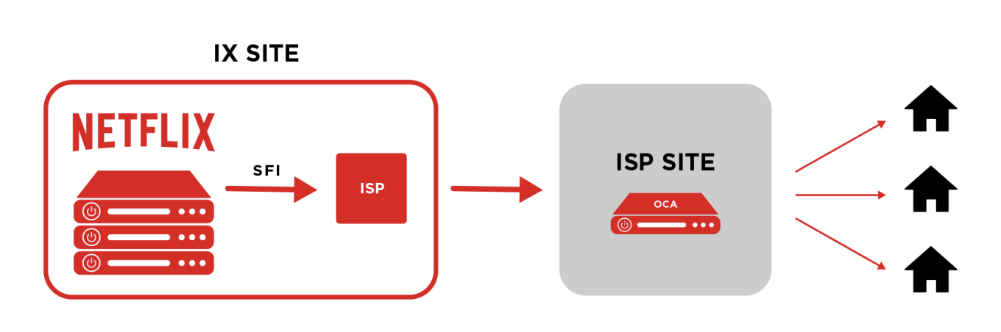
Netflix's Open Connect
CDN customized for Netflix
Deploys cache, Open Connect Appliances (OCAs) within internet exchange points (referred to as IXs or IXPs) or within ISPs
Settlement-free interconnection (SFI) for peering to Open Connect operations team and other ISPs
Reasons
Directly work with ISPs because Netflix takes significant portion of overall traffic of every ISPs
Customized CDN solution to design directed cache
Fig. 15: Deployment inside IXP
Fig. 16: Deployment inside ISP

Slide 28
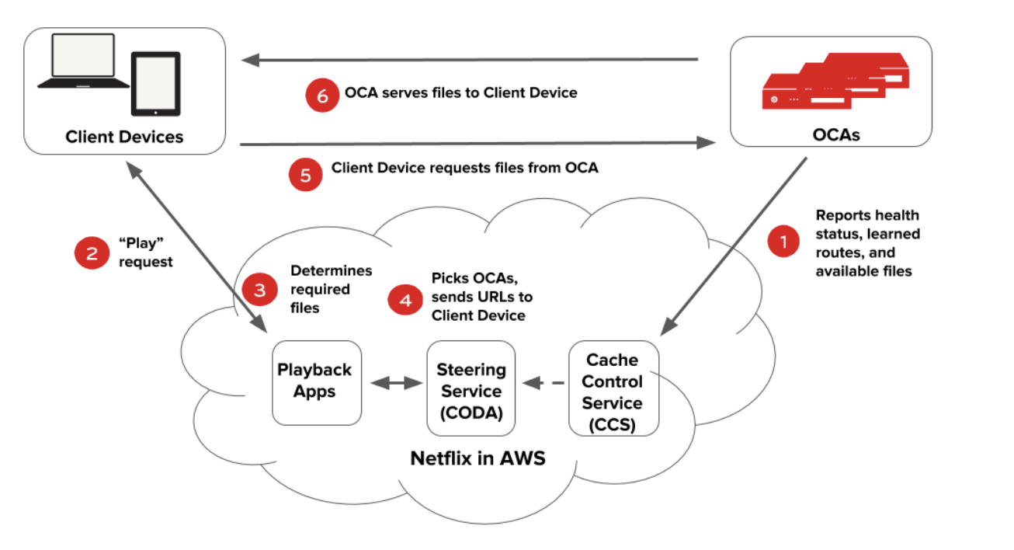
Playback Process with OCAs [6]
Fig. 17: Netflix playback process with OCAs

Slide 29

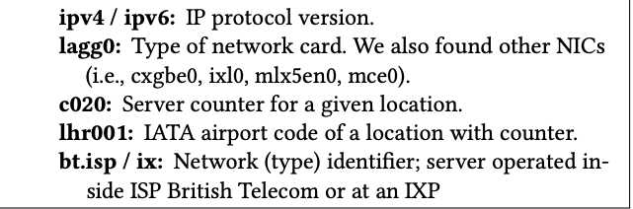
OCA Selection [4, 7]
When client requests a file, main application logic sends 3 domain names of content servers based on
Longest Match
the most-specific route to the client’s prefix
Shortest AS path
Lowest MED
The appliance that receives the route to the client’s netblock with the lowest multi-exit discriminator (MED)
Geolocation
Based on client IPs, comparing it to the latitude and longitude of nearby OCAs
Netflix Server names
Components of Server name

Slide 30
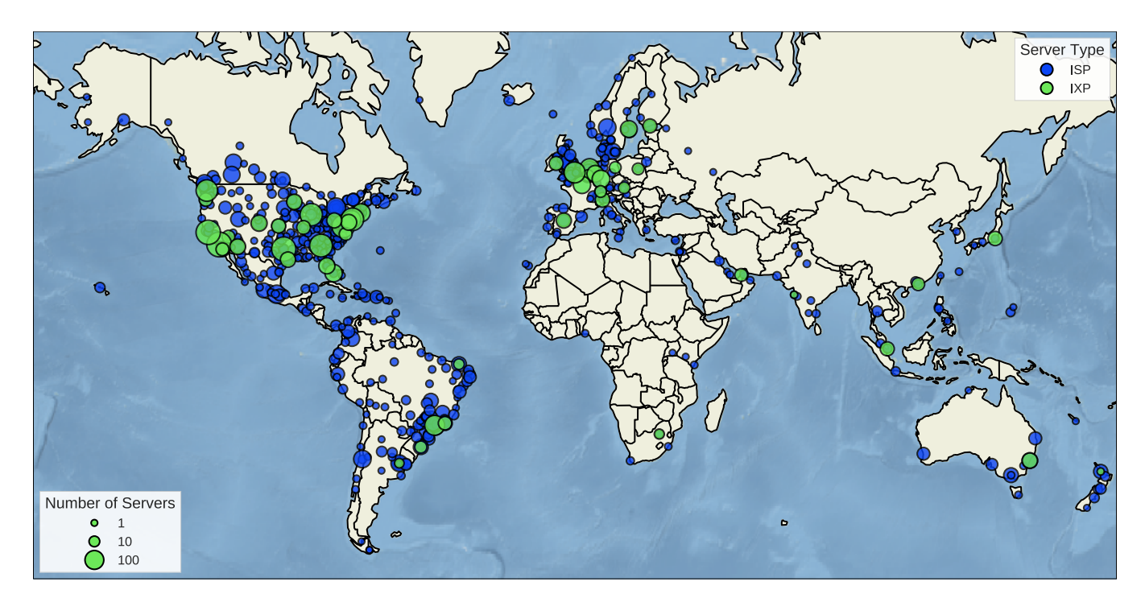
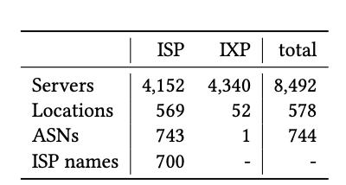
Deployment Worldwide [4]
Fig. 18: Netflix Server Deployment

Slide 31
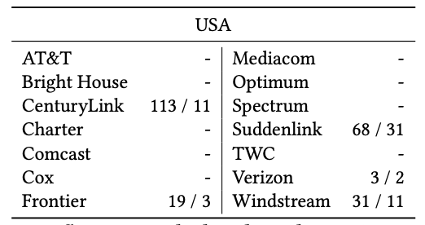
Deployment in the USA [4]
Largest server Deployment
3246 IXP servers across 24 IXPs
1007 ISP servers across 205 ISPs
IXP has up to 350 servers
ISP has up to 14 servers
Deployment at ISPs complements geographical reach of IXP deployment
Four major ISPs AT&T, Comcast, Time Warner and Verizon) refused to deploy
About money, who should pay?
Fig. 19: Netflix servers deployed inside ISPs

Slide 32
Deployment in the USA (contd.)
Netflix ISP Speed Index shows similar performance for ISPs with and without server deployment
Deploying server inside ISPs does not automatically imply better performance
Available IXPs are sufficient for Netflix in USA
IXPs are not very large enough in USA to require deployment in ISPs

Slide 33
Deployment in the Brazil [4]
Second largest server deployment
188 servers across IXPs at 4 locations only (São Paulo, Rio de Janeiro, and Porto Alegre, Fortaleza)
713 servers across 187 ISPs at 58 locations
Unlike USA, servers primarily located inside ISPs
IXPs in Brazil have small number of peers and lack content providers
Developing internet infrastructure
Netflix Speed Index show much lower bandwidth figures compared to other Netflix markets
Deployment inside ISPs necessary

Slide 34
Open Connect Advantages
Content delivery without operating on backbone internet
IXPs and ISPs self-sufficient for serving local customers (Internet Flattening)
Prefetching to populate content reduces transit traffic
Proves large-scale traffic delivery possible from edge locations
No need for datacenters
Reduces bandwidth demand at public internet and help save cost for ISPs
More control over quality of delivery

Slide 35
Challenges
Convincing ISPs and IXPs
Some ISPs themselves provide content
Limited space in ISP datacenters
power, cooling, and colocation costs
Who should pay who?
Strategic placements of caches
Caches inside IXPs are cost effective and require a smaller number of agreements but not always feasible
Not a solution for companies with less traffic
Cost of developing and managing caching appliances

Slide 36
Revisiting Hypothesis
Research Question: Does caching inside ISPs like in Netflix's Open Connect improve Quality of Experience solving scalability and cost issues of current CDNs?
Yes
Netflix gets more control over content delivery and serves content from ISPs and IXPs directly decreasing latency greatly that increases QoE
Open Connect Appliances can be deployed at any ISPs around the world which provides easy and fast scalability
No longer needs to pay for costs of CDN provider. Only transit cost is paid to some broadband provider like Comcast. Reduces overall cost of delivery.

Slide 37
Future Works on CDN
Convergence of Edge Computing and CDN
Bring Computing to edge servers
Which content to cache?
Machine learning for caching mechanism (popularity prediction)
Convergence of NDN and CDN
Use NDN on current CDNs, improve request routing

Slide 38
References
[1] J. Dilley, B. Maggs, J. Parikh, H. Prokop, R. Sitaraman and B. Weihl, "Globally distributed content delivery," in IEEE Internet Computing, vol. 6, no. 5, pp. 50-58, Sept.-Oct. 2002, doi: 10.1109/MIC.2002.1036038.
[2] V. K. Adhikari et al., "Unreeling netflix: Understanding and improving multi-CDN movie delivery," 2012 Proceedings IEEE INFOCOM, 2012, pp. 1620-1628, doi: 10.1109/INFCOM.2012.6195531.
[3] V. K. Adhikari et al., "Measurement Study of Netflix, Hulu, and a Tale of Three CDNs," in IEEE/ACM Transactions on Networking, vol. 23, no. 6, pp. 1984-1997, Dec. 2015, doi: 10.1109/TNET.2014.2354262.
[4] Böttger, Timm, Felix Cuadrado, Gareth Tyson, Ignacio Castro, and Steve Uhlig. 2016. “Open Connect Everywhere: A Glimpse at the Internet Ecosystem through the Lens of the Netflix CDN.” ARXIV Working Paper. https://arxiv.org/abs/1606.05519.
[5] https://www.insiderintelligence.com/insights/netflix-subscribers/
[6] https://openconnect.netflix.com/Open-Connect-Overview.pdf
[7] https://blog.apnic.net/2018/06/20/netflix-content-distribution-through-open-connect/

