Slide 1
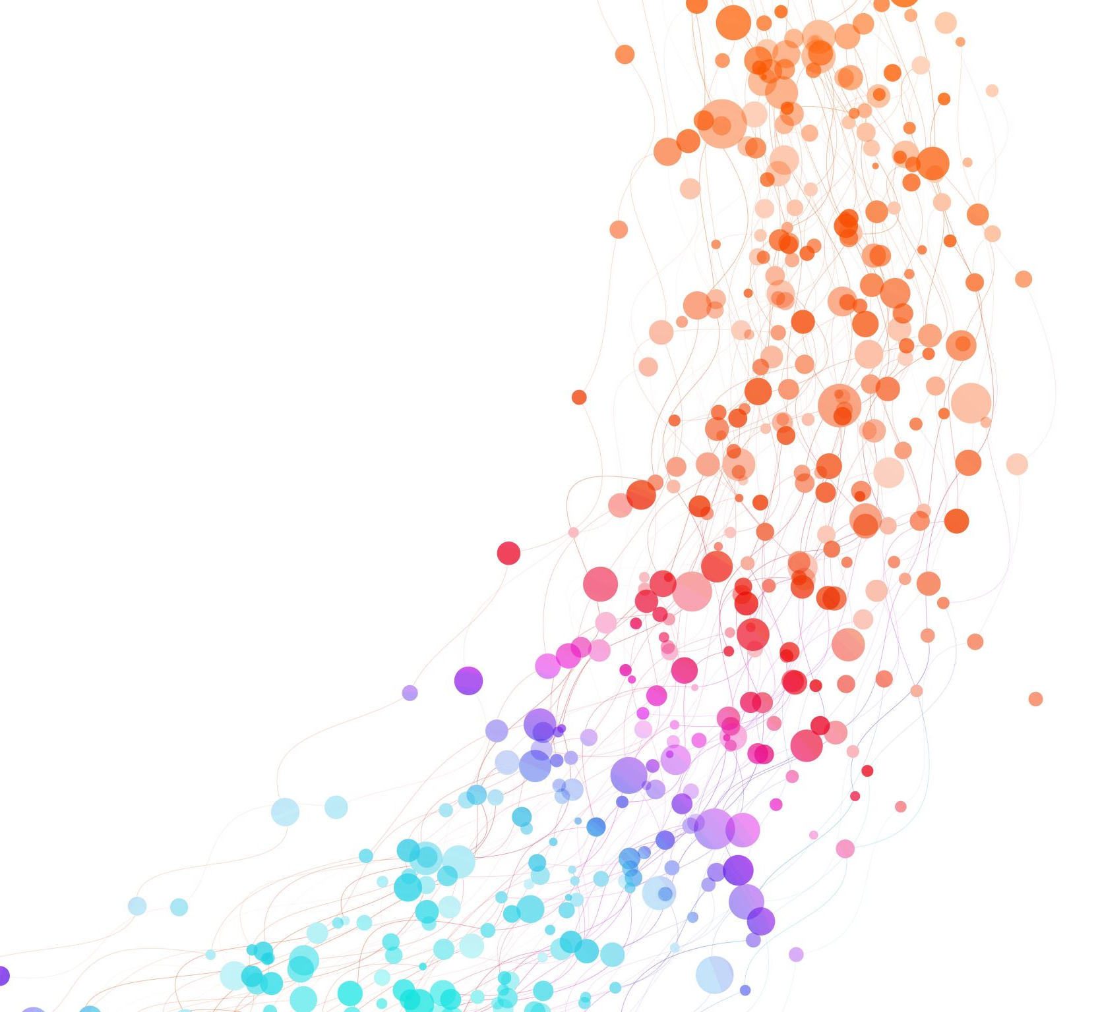
NDN For CDN
Sankalpa Timilsina

Slide 2
Overview
Recap of CDN Basics
Recap of NDN Basics
Comparison on CDN and NDN
NDN for CDN
Background and related work
Experiments
Evaluation

Slide 3
Research Question
Can the deployment of NDN over CDN be potentially beneficial to content providers and users and/or what could be the possible disadvantages?

Slide 4
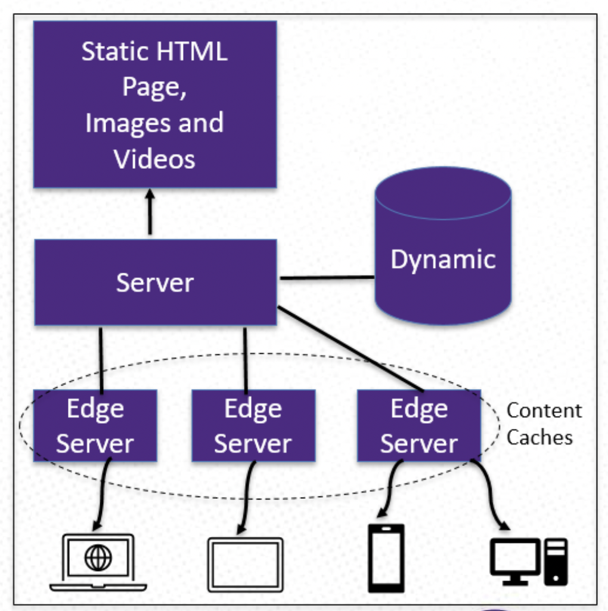
Recap of CDN Basics
Replicate content caches around different geographies
If the content is not in cache or cache entry, edge server makes request to origin server
When the edge server receives the response from origin server, it stores the content in cache

Slide 5
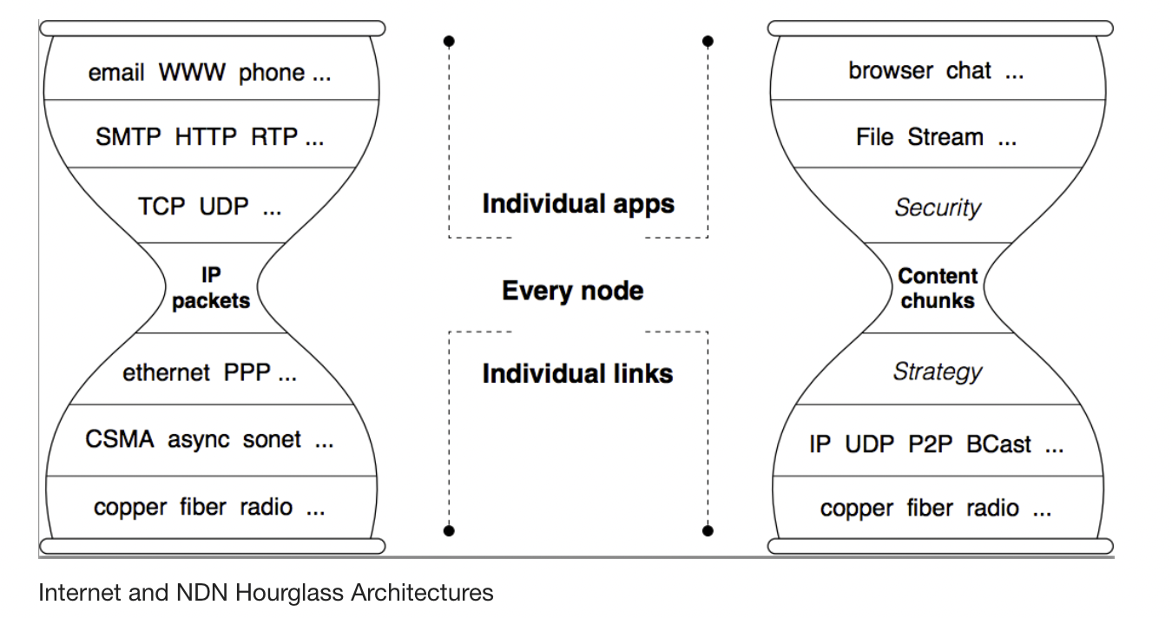
Recap of NDN Basics
The Internet designed as a communication network where the name in its packets were communication endpoints
Recent growth in e-commerce, digital media, etc. has resulted in the Internet primarily being used as a distribution network
Distribution networks are fundamentally more general than communication networks and solving distribution problems with a communications network is complex and error prone.

Slide 6
Recap of NDN Basics
NDN retains the Internet’s hourglass architecture but evolves the thin waist to allow the creation of completely general distribution networks
The basic idea is removing the restriction that packets can only name communication endpoints
NDN’s minimal functionality includes support for consumer-driven data delivery, built-in data security, and use of in-network memory.

Slide 7
Recap of NDN Basics
The consumer-driven data delivery is realized through setting up packet forwarding state.
Forwarding state provides support for scaling data dissemination (multicast delivery and content distribution), balancing data flows for congestion control, retrieving data via multiple paths, and facilitating delay-tolerant communications.

Slide 8

Comparison on CDN and NDN
Protocol Overhead
CDN Case:
The protocol overhead is the ratio of the total bytes transmitted to content bytes received. In other words, protocol overhead can be expressed as a percentage of non-application bytes (like protocol) divided by the total number of bytes in the message.
CDN adopts TCP on the transport, introducing an overhead of 20 bytes for the TCP header, and 12 bytes for the optional header fields, and IP on the network layer, introducing another 20 bytes for the IP header. The MTU of the ethernet is generally 1500 bytes and Ethernet frame size is 1514 bytes. So, the lower bound of TCP/IP protocol overhead is 4.56%.

Slide 9
Comparison on CDN and NDN
NDN Case: 1. In order to be compatible to today's infrastructure, NDN can be used on top of TCP/IP. In CCNx, a software implementation of NDN, the default packet contains a maximum payload of 4096 bytes, a header of maximum 550 bytes and the interest packet segment with sizes from approximate 150 to 250 bytes.
2. Thus, transmitting a NDN packet needs 4 Ethernet frames, causing the total overhead to be about 23.6%.
3. The overhead is caused by retransmission of lost packets, which is more expensive in NDN, due to large 4096 bytes chunk payload.

Slide 10
Comparison on NDN and CDN
Robustness CDN CASE:
The topology and deployment of CDN are static which is connection-based.
That's to say, in a fixed area, users are redirected to accessing a certain edge node server.
If the server broke down, the network of the area would collapse.
Additionally, as possessing numerous edge nodes, the CDNs still face network congestion threat in massive access.

Slide 11
Comparison on NDN ad CDN
NDN CASE: (Robustness)
1. By contrast in NDNs, each node is equal serving as a source server, a router, a client, even a cache.
2. Anyone breaking down doesn't affect the whole network at all.
3. Furthermore, NDN nodes are able to choose the best way to fetch content to avoid the network congestion efficiency.

Slide 12
Comparison on NDN and CDN
Security
CDN CASE:
1. DNS control scheduling and private data centers guarantee CDNs from being attacked, which is accompanied with huge cost.
2. But, trust in content is easily misplaced by untrustworthy loation and connection information.
3. Moreover, the CDNs still face DoS attacks.

Slide 13
Comparison on NDN and CDN
NDN Case: (Security)
1. In NDNs, packets are signature signed and encoded. And its design principles remarkably improve the security of transmitting and routing, such as:
All the packets including route messages have to be signed, preventing forging and tempering
Multipath routing reduces the prefix hijacked, therefore, routers can check the abnormalities caused by prefix and attempt to retrieve data from other paths
2. This separation of data security and network transmission reduces the difficulty of management

Slide 14
Comparison on NDN and CDN
Cost
CDN Case:
1. Most of CDN nodes are different, in the aspects of source site, proxy cache server, load balancing, DNS, which complicates configuration as well as implementation of network services.
2. Thus each node server should be configured independently.

Slide 15
Comparison on NDN and CDN
NDN CASE: (Cost)
1. All over the nodes of NDN, including client, are equal, that is, each node can have multiple roles at the same time
2. Thus configuring only one node server and a system is formed through migrating.
3. The only difference among NDN nodes lies in the hardware, eg, the size of CS is larger than others.
In conclusion:
The deployment cost of CDN is much higher than that of NDN

Slide 16
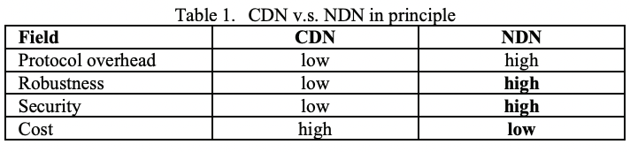
Comparison on NDN and CDN

Slide 17
NDN For CDN
NDN supports content distribution without requiring an overlay service to bridge the gap between network services and application needs
Therefore, it can realize content distribution at large scale with an arguably simpler system design
Radical changes in Internet usage have created a big gap between what the network provides (i.e., transport service) and what applications want (i.e., contents)
The current Internet is an enormous transport network moving bits from one endpoint to another and requires applications to provide the addresses of the endpoints

Slide 18
NDN For CDN: How CDN was realized?
Such a network has no sense of what content has been requested
Thus, a machine might relay the traffic for the same files over and over without knowing how much burden it could remove from the network by simply caching the files
A content network understands what content has been solicited and tries to retrieve it from anywhere in the network, whether a cache or the origin (a.k.a. content producer).
To realize content networks within TCP/IP architecture with minimal changes to the current Internet, content delivery networks (CDNs) — massive distributed caching overlay networks — have been deployed.

Slide 19
NDN for CDN: Problems with CDN
As the scale increases, CDNs are also confronting challenges such as :
system complexity,
Cost,
and content security.

Slide 20
NDN For CDN: NDN as a solution
NDN offers a network architecture that directly supports content distribution without requiring a CDN overlay to bridge the gap between network services and application needs
As we looked in the comparison section, this will also benefit us in terms of data security, robustness, scalability and cost.
In other words, NDN might be able to provide large-scale content distribution with less system complexity and resource footprint.

Slide 21
Background
NDN Stateful forwarding plane
The NDN forwarding plane comes with an in-band measurement, so each node can monitor the content retrieval performance and tune its forwarding decisions while retrieving the content
Forwarding decision carried out by the forwarding strategy
Forwarding plane can detect routing loops natively and choose a different interface (i.e., next-hop) if a loop happens
As a result, an NDN node can retrieve a few chunks of a content from different interfaces simultaneously without causing a permanent loop in the network

Slide 22
Background
5. It evaluates the performance that each interface offers by combining several metrics such as round-trip time and/or the number of timeouts
6. This process can repeat several times during content retrieval to refine the ranking and adapt to network changes
7. The node then might remember the interface ranking to properly forward future requests for the same content

Slide 23
Experiments
Experiment 1: Named Data Networking for Content Delivery Workflows[1]
Content distribution over HTTP is looked using Apache Traffic Server (ATS), an open-source, high performance caching software that can act both as reverse and forward proxy
For looking at content distribution over NDN, the standard NDN software such as ndntools (producer/consumer tools) and NDN forwarding daemon (NFD) are used
VMs on GCPs are used to create nodes for the topology

Slide 24
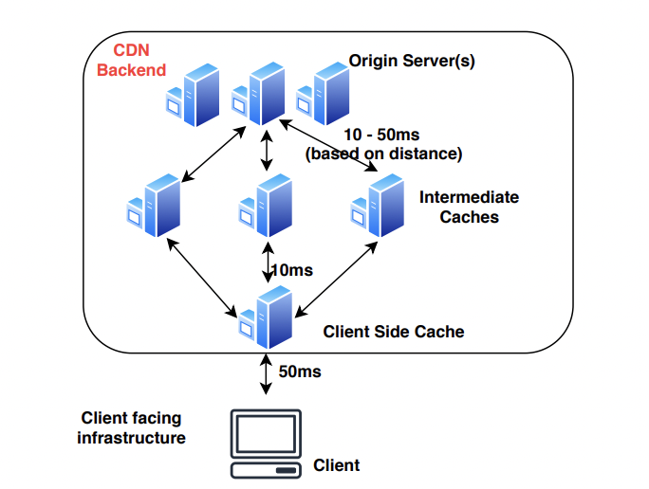
Methodology
Experiment 1: Named Data Networking for Content Delivery Workflows[1]
The client represents a device that requests content from the CDN
The client side cache can be deployed near the users to reduce latency and traffic volume
Any request that can not be served from the client side cache comes to intermediate caches
These caches typically work as a reverse proxy, download the data from the origin, and caches it for future usage

Slide 25
Methodology contd...
Experiment 1: Named Data Networking for Content Delivery Workflows[1]
ATS is configured on the client-side cache to act as a forward proxy - it simply forwards the requests of the clients to the server-side caches and caches the return data
The intermediate caches are configured as reverse proxies to the origin server
They receive the requests from the client-side cache, check if data is available in their local caches, and bring the data from the origin server before returning the data to the requesting entity

Slide 26
Methodology contd..
For the HTTP experiments, Apache Web Server was used on the origin server as the content producer
On the intermediate caching nodes, HTTP caching was utilized with sizes set to 2-4GB.
For the NDN experiments, data was published from the origin server using ndnputchunks, a standard ndn tool. The intermediate caches were either disabled or set to a large number (2- 4GB) depending on the experiment.

Slide 27
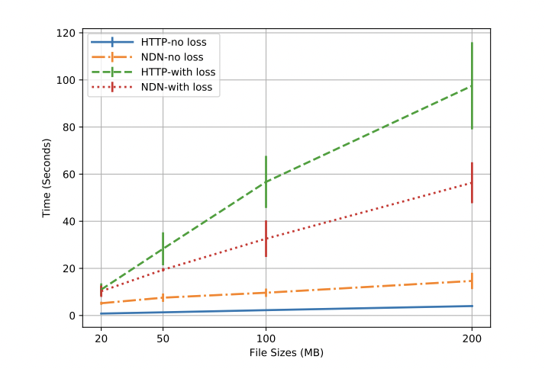
Evaluation
A. Goodput
HTTP/ TCP is faster without any loss.
In the presence of loss NDN performs better. The loss in this experiment was set to 0.08% on the access link and 0.01% on the other two links for a total of 0.1% loss

Slide 28
Evaluation
B. Time To First Byte (TTFB)
TTFB is consistently lower for NDN compared to HTTP, with and without caching
Specifically, HTTP TTFBs are about 100 ms and 230 ms with and without caching, while NDN TTFBs are about 50 ms and 135 ms with and without caching, respectively
The reason for that is that HTTP runs on top of TCP that performs a handshake to establish a connection before retrieving any data.
NDN can directly fetch data without requiring a connection, resulting in lower TTFB values

Slide 29
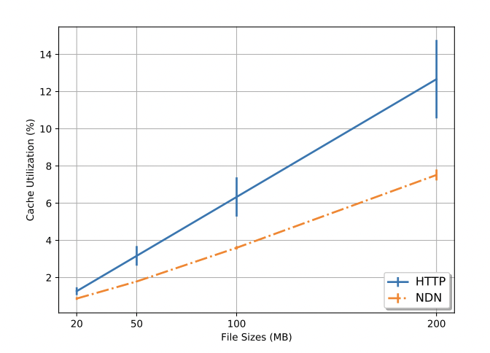
Evaluation
C. Cache Utilization
Maintaining a lower cache utilization per object across the system allows the CDNs to fit more content in the caches, speeds up delivery of a diverse set of content
If a piece of content is retrieved through one upstream cache and later the system uses another upstream, the content is now cached at two places. The effective cache utilization by this content is then (2×content size)/total cache size .

Slide 30
Evaluation
C. Cache Utilization
With NDN, the caching granularity is packets. If half of the content is fetched from upstream cache one and the rest from upstream cache two, the utilization remains at (content size/total cache size)

Slide 31
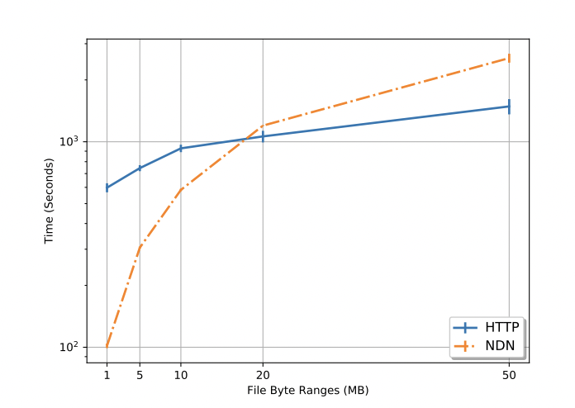
Evaluation
D. Partial Data Retrieval from Cache
The x-axis shows the byte ranges requested over HTTP and NDN
ATS either needs to fetch the full file or send the request to the origin server before serving a byte range request
NDN can reuse content chunks that are already present in the cache

Slide 32
Evaluation
D. Partial Data Retrieval from Cache
With ATS, there are two ways to accomplish this. By default, the requests bypass the ATS caches and are directly forwarded to the origin server.
Configuring ATS this way can negate origin shielding
The other way is by bringing in the whole file in the cache from the origin server and then serve the byte range requests from there

Slide 33
Evaluation
D. Partial Data Retrieval from Cache
This approach is also problematic since requesting a small byte range from a large file will bring in the whole file into ATS’s cache, reducing cache utilization
NDN creates smaller chunks from a larger content object. For example, a large file (e.g., /data file) would be chunked into n data packets, where the packets will have names like /data file/segment=1, /data file/segment=2,.../data file/segment=3

Slide 34
Evaluation
D. Partial Data Retrieval from Cache
These segments are individually cached in the intermediate caches. An application asking for segments 1 to 10 can retrieve them from the cache without bringing the whole file in or going to the origin server
When partial data is cached, NDN can serve the subsequent requests from the cache - request for any content that is not in the cache to the origin server

Slide 35
Evaluation
D. Partial Data Retrieval from Cache
As a result, NDN offers resiliency against both the scenarios in ATS where a user can potentially bypass the caches and reach the origin server or force ATS to bring in a large file
NDN is consistently faster than HTTP for a lower volume of data
However, as the size of the byte range increases, NDN becomes slower compared to HTTP since it is not optimized for performance

Slide 36
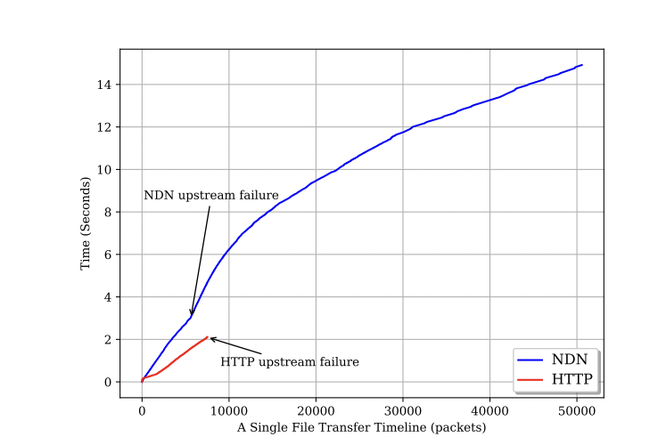
Evaluation
E. Transparent Failover
NDN’s hop by hop forwarding transparently switches routes when upstreams fail
On the contrary, ATS connections are broken when upstream failure happens, throws away already retrieved content, and forces the client to restart the transfer.

Slide 37
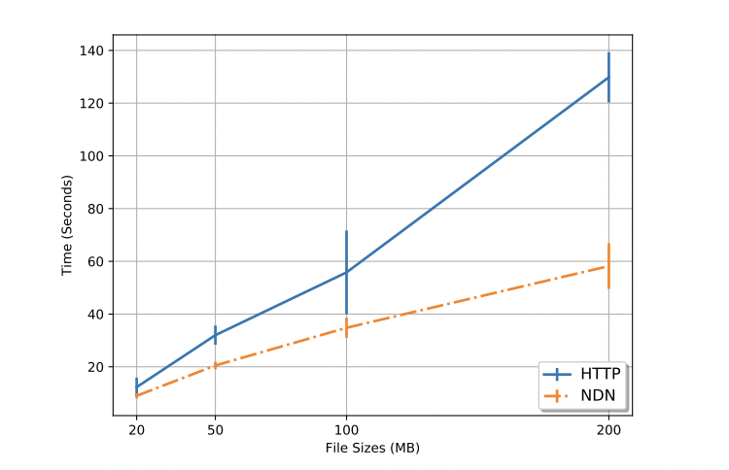
Evaluation
F. Automatically switch to the better path
Figure shows NDN and HTTP performance with upstream performance degradation with different file sizes
This experiment uses multiple upstreams
As the upstream detoriates, NDN moves to a better path while ATS sticks to the original path
The effect is more prominent as the file size increases

Slide 38
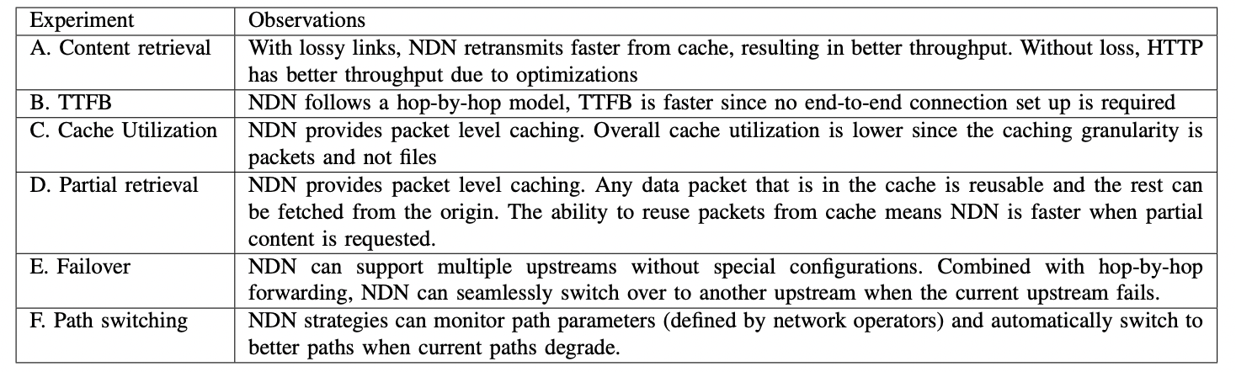
Evaluation: Summary

Slide 39
Revisiting Research Question
Can the deployment of NDN over CDN be potentially beneficial to content providers and users and/or what could be the possible disadvantages?
In my view, it is a both Yes and No. Yes, because we can see from the experiments that we can definitely benefit in terms of better content security, TTFB, cache utilization, failover, path switching etc.
No because NDN is still a lot immature in terms of performance optimizations. We could see previously that HTTP performs better without loss for larger file sizes due to better optimizations and maturity.
As a future direction, there are still questions like multithreaded forwarding in terms of performance for software like NFD (Named data networking forwarding daemon) to mature more and be a better fit for CDNs.

