Slide 1


IoT Networking
Anthony Palmer

Slide 2
Research Question
“Is there a more secure network architecture for IoT than what is currently in use?”

Slide 3


Overview
Issues in IoT Networking
Privacy preservation
Key management protocol
Named Data Networking
Software Defined Networking

Slide 4
Influences in IoT Networking Challenges [2]
IoT devices are fundamentally different from devices that the network was originally designed for
Constrained power budget
Limited computational resources
Operate in adverse environments
Intermittent connectivity
IoT often deploys multiple forms of communication simultaneously
Different scopes
Different security properties
Different costs
Little to no user interface

Slide 5
Major Problems in IoT Networking
Complex solutions for simple communication needs
Limitations of channel-based and session-based security
Poor integration of local communication

Slide 6
Complex Solutions to Simple Communication Needs
IoT applications often center around data retrieval and actuation control
Complexities exist even in basic communications over IP
Due to communication diversity and resource constraints
Must do one of the following to integrate all needed elements:
Develop local, application-layer middleware to manage interoperability
Push all data to cloud services

Slide 7
Limitations of Channel-Based and Session-Based Security
IoT includes many security-sensitive applications
This includes the areas of personal privacy, safety, vandalism, and corporate espionage
Security approaches from standard internet applications don’t fit
Channel- and session-based semantics considered weak across heterogeneous environment
Every different stack would require its own forms of security
Securing a channel or session does not help with identity expression outside of IP address
Also doesn’t manage data origin, doesn’t express trust relationships among communication elements, and doesn’t handle key distribution.

Slide 8
Poor Integration of Local Communication
Local communication is a tenet of IoT
Many applications require devices in the same location to work in harmony
Responsibility of network layer to provide efficient support for direct communication
IP-based solutions limited in local networking
Application support for local communications often requires DNS and middleware bootstrapping to bridge between names and addresses
Applications on IP’s host-to-host communication do not leverage broadcast nature of wireless media used in IoT communications
Must carefully configure systems to allow for multicast
IoT environments often involve multiple overlapping local communication domains

Slide 9
Security Strategies

Slide 10
Strategies in the Current Architecture
Privacy protection
User Authenticated Key Management Protocol

Slide 11
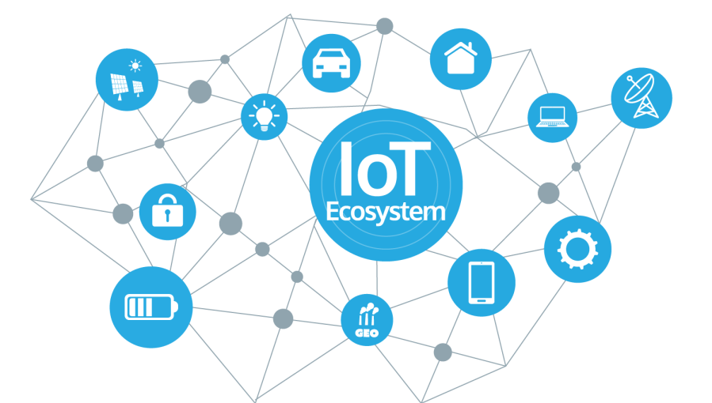
Privacy Preservation
[3] explores IoT network risks and experiments with security techniques
Inexpensive home automation network
Used for attack and defense studies
Focus on privacy preservation in home automation networks
Integral to achieving the promise of IoT

Slide 12
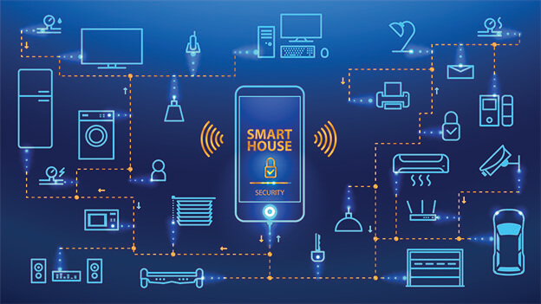
Why Use A Smart Home?
Large variety of sensor applications
Thermostat, door locks, cameras, etc.
Variety provides for wide range of possible attacks
Minimal cost (COTS)
Provides insight into other IoT applications
Industrial systems, automobiles, etc.

Slide 13
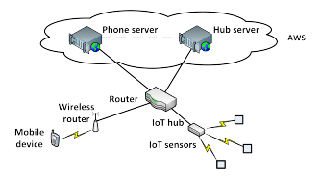
Network Architecture
SmartThingsTM hub and several SmartThings sensors comprise the IoT portion of the architecture

Slide 14
Network Traffic Analysis
Packets captured via tcpdump
IoT hub establishes TCP connection with server, builds SSL connection
Hub periodically checks in with server (ping)

Slide 15
Privacy Preserving Techniques
Conceal location information
Manipulate event reporting

Slide 16
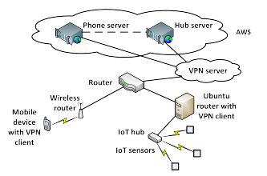
Location Concealment
Architecture with added VPN for concealment

Slide 17
VPN Setup
Two VPNs set up
VPN in New York City (NYC) using OpenVPN
Second VPN in San Francisco (SFO) for validation
NYC was successful in masking the true hub IP address
VPN overlay did not cause any failures in SmartThings network
SFO further validated preservation of functionality

Slide 18
VPN Shortcomings
Delay
Significant delay in keepalive (KA) message send and acknowledgement:
Without VPN: 0.778ms
NYC: 13.97ms
SFO: 155.23ms
Lack of notification for momentary loss
Two open/close tests with VPN switch in the middle
No report of server being inactive
Momentary loss followed by appearance at different IP address significant
Could indicate man-in-the-middle attack

Slide 19
Manipulation of Event Reporting
Timing and frequency of sensor events reveals information about private behavior and daily patterns
Three classes of event manipulation techniques
Delaying events
Inserting events
Dropping events

Slide 20
Baseline
Open/close testing at 30 second intervals
Initial TTL of 50 for open event, 100 for closed
SSL encryption led to indistinguishable packets
Event notifications from hub: 109 bytes
Selective manipulation not possible
Packets looked same across all sensors, couldn’t determine individual device packets

Slide 21
Delaying Events
Modified open/close
Drop TCP used to drop all packets between hub and server after close
Packets arrived after rule removal with timestamps reflecting drop time
Conditional actions also delayed as result

Slide 22
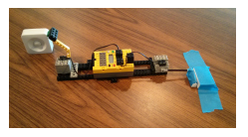
Inserting Events
Used LEGO MINDSTORMS robot to periodically trigger open/close sensors
False events filtered at the application level
Reconstructs true behavior
Confuses adversary
Can also plant dummy sensors so user knows what to ignore

Slide 23
Dropping Events
Drop TCP packets until hub’s buffer is full
Maintain intermittent connectivity
Make it look like connectivity issues in home network to observer
Less interesting for privacy protection, but could be utilized by attackers
Disrupt event reporting, prevent actions from happening

Slide 24
Key Management Protocol
[4] discusses the design of a lightweight three-factor remote user authentication scheme for Hierarchical IoT Networks (HIoTN)
HIoTN has need for direct real-time data access
Called User Authenticated Key Management Protocol (UAKMP)
Three factors:
User smart card
Password
Personal biometrics

Slide 25
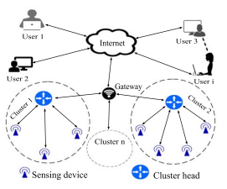
Network Model

Slide 26
UAKMP Phases
Offline sensing node registration
User registration
User login
Authentication and key agreement
Password and biometric update
New sensing node deployment

Slide 27
Phase Breakdown
Offline sensing node registration:
Gateway node preloads necessary info in each deployed sensor node’s memory
Happens prior to deployment
Gateway node originates information
Identity
Temporal credential
User registration:
User registers themselves at gateway node to access sensing nodes
Gateway node generates smart card for user, transmits it to them

Slide 28
Phase Breakdown
Login phase:
Gateway node acts as bridge between user and sensor node
User must send login request to gateway node to access info
Authentication and key agreement:
Gateway node generates authentication request to desired sensor node
Accomplished via the sensor node’s cluster head
Two types of mutual authentications:
Between user and gateway node
Between gateway node and sensor node
User and sensor node generate shared session key for future secure communications

Slide 29
Phase Breakdown
Password and biometric update:
User may need to update password and/or biometrics for security reasons
New sensing node deployment:
Nodes may become compromised
Physically by adversary
Battery power exhausted
Need to be able to deploy new nodes and replace existing ones as needed

Slide 30
Formal Security Analysis
Focused on adversary attempting to break SK security
Utilizes real-or-random model
Randomly generated responses
Performed semantically, but successfully

Slide 31
Informal Security Analysis
Stolen Smart Card Attack
ID and password still protected, preventing access
Privileged-Insider Attack
Privileged-insider user tries to retrieve credentials of legitimate user from smart card
Still need user biometrics and password (three-factor)
User Impersonation Attack
Still need biometrics, so this fails
Five other informal attacks analyzed (node impersonation, node capture, bypass, etc.)

Slide 32
Formal Security Verification with AVISPA
Simulation study using AVISPA
Automated Validation of Internet Security Protocols and Applications
Push-button tool for automated validation
Integrated with four back-ends
Three verifications performed:
Executability checking on nontrivial specifications
Replay attack checking
Dolev-Yao threat model checking
All three verifications satisfied with short check times
Means replay and man-in-the-middle attacks are protected against

Slide 33
Drawbacks to UAKMP
Highly semantic and theoretical
Not deployed in a fully-realized environment
Authors look to do so in the future
Components designed to fit simulation, but still not used in production
Both of the prior papers only patch the current network

Slide 34
Different Network Architectures

Slide 35
New Proposed Architectures
Named Data Networking (NDN) in IoT
Software Defined Networking (SDN) in IoT

Slide 36
Named Data Networking in IoT
[2] proposes the use of NDN in an IoT space
Current host-to-host communications difficult in highly heterogeneous environment
Multiple interfaces
Various security regimes
Must communicate locally and globally
NDN allows developers to work with devices and data directly

Slide 37
Named Data Networking
Proposed future internet architecture
Part of the field of Information Centric Networking (ICN)
Shifts focus from hosts to data
NDN disseminates named data at the network level
Forwards names with application semantics
Data secured at time of production
NDN allows for naming of things in IoT
Ex. Calling a smart bulb by name instead of denoting it by an IP address

Slide 38
Use Cases [2]
Smart homes
Already discussed in [3]
Personal health and wellness applications
Systems on Chips (SoCs) in wearable devices
Utilize machine learning to decipher meaningful patterns
Monitor physical activity, body temperature, heart rate, etc.
Precision agriculture industry
Improve productivity and yield
Ex. Fujitsu uses IoT devices to control greenhouses

Slide 39
Basic Protocol
Named Data Retrieval is the core of NDN
“Thin waist” of communication is now Data packets
User sends Interest packet with name of desired data
NDN network uses name to retrieve data, sent in Data packet
Hierarchical name structure
Components can define scope of data, app-specific semantics, and unique identifiers
Naming structure of NDN matches well with that of IoT
Ex. An Interest packet could use the name “/LivingRoom/Temperature” to retrieve the temperature in the living room of a smart home

Slide 40
Strengths of NDN in IoT
Data-centric security
Name-based forwarding
In-network storage

Slide 41
Data-Centric Security
NDN directly secures data at the network layer
Each Data packet signed at production
Binds name of payload and data
Receivers can validate a Data packet no matter where or how they received it
Only authorized parties can access data
Combines with hierarchical name structure to make strong security measures

Slide 42
Data-Centric Security
NDN developers currently working on a broader range of application security
Asymmetric RSA and ECDSA signatures
HMACs and hash chains for typical IoT messages (lightweight approaches)
Focus on data security rather than channel security is a building block for meeting IoT security requirements
Independent of specific communication technology
Allows for heterogeneous network transversal without compromising security
Allows for intermediate caching without need for node trust

Slide 43
Name-Based Forwarding
NDN forwards packets based on their names, not IP addresses
Works well for IoT as it allows for the naming of things
At each hop, NDN forwarder checks for Data that matches the Interest in its storage
Uses matched Data packet to satisfy Interest packet
If no match is found, check Pending Interest Table (PIT), which holds recent Interests
If same Interest has been recently forwarded, aggregate identical Interests
Otherwise, record Interest in PIT, look up Interest in forwarding table, and propagate according to forwarding strategy
Return Data packet by following the PIT trail of forwarders

Slide 44
In-Network Storage
Data-centric security allows for in-network storage (caching) without security concerns
NDN routers cache forwarded Data packets as possible
Enables efficient data dissemination
Allows for local recovery
Persistent data repositories can also be used for long-term managed data storage

Slide 45
How NDN Combines with IoT
Naming things, devices, and their data
Bootstrapping and discovery of unnamed nodes
Schematizing trust
Data packets carry name and signer’s name
Name-based access control
NAC utilizes additional access control namespace
Data aggregation

Slide 46
NDN Implementations in IoT
NDN-BMS
Designs and implements NDN-based building management system for facility personnel
Prototype deployed at UCLA
NDN-IoT
Dev toolkit for smart home networks running on Raspberry Pi
NDN over Arduino
Uses special version of NDN library called NDN-CPP Lite developed by authors
NDN-ACE
Access control framework on constrained IoT devices

Slide 47
SDN-Based Architecture for IoT
[1] presents a Software Defined Networking (SDN)-based architecture
Allows for networking with or without infrastructure
Called an SDN domain
Includes wired network, wireless network, and Ad-Hoc networks
Second architecture proposed to include sensor networks in domain
Authors interconnect these domains and discuss how to enhance security without compromising security of individual domain
Also propose new secure and distributed architecture for IoT

Slide 48
Software Defined Networking
New paradigm for innovation in networking research and development
Control and data planes decoupled
Network intelligence and state centralized
Controller connects to switch through OpenFlow channel
Manages switch via OpenFlow Protocol
Can add, update, and delete flow entries
SDN enables quick responses to security threats, granular traffic filtering, and deployment of dynamic security policies

Slide 49
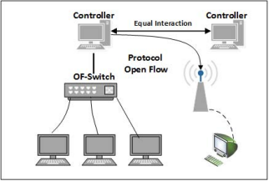
SDN Architecture
Equal interaction means all controllers have read/write access to the switch, which means they have to synchronize in order not to step on each other’s feet

Slide 50
SDN Architecture
SDN provides a programmatic interface inside the controller
Allows network control operations to:
Run on top of one or more server platforms with higher performances
Use vendor-independent hardware
Use an open operating system
Communicate with other operating systems or control platforms using standard protocols

Slide 51
SDN for Ad-Hoc Networks
Authors propose a Multiple SDN Controller architecture for ad-hoc networks
Ad-hoc networks connect devices directly without routers
Ad-hoc network nodes are viewed as a combination of
Legacy interfaces (physical layer)
Programmable layer (SDN-compatible virtual switch and SDN controller)
Operating system and applications (OS layer)

Slide 52
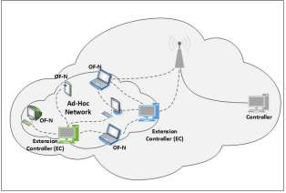
SDN for Ad-Hoc Networks
All legacy interfaces connected to virtual switch, which is controlled by SDN controller
Nodes will connect to each other through embedded SDN-compatible switch
Compatible with SDN legacy network, allowing for design of extended network

Slide 53
SDN Architecture for IoT
Traditional network elements are not designed for high scalability, traffic, or mobility
The authors look to adapt two primary elements to IoT:
SDN domain
SDN domain interconnection

Slide 54
SDN Domain in IoT
In an IoT network, devices can’t have an embedded SDN compatible switch or controller like mentioned previously
Solution: Connect each device to a neighbor node with SDN compatibility
This is because many sensor nodes are low-resource
Each domain has its SDN controller to control all traffic in its domain

Slide 55
SDN Domain Interconnection
In an architecture with multiple domains, we assume each domain has at least one SDN controller
Controller manages only device in its domain
Domain represents enterprise network or datacenter
Heterogeneity is a must in SDN for IoT
To achieve this large-scale interconnectivity, the root (or border) controller is introduced
Routing functions and security rules distributed across border controllers
Border controllers act as a connection point to other border controllers

Slide 56
Distributed SDN Security
The authors designed an extended secure SDN-based architecture for IoT
Controller manages security of a single domain
This is extended to multiple controllers in regard to available resources
Extend distributed control by interconnecting all domains via border controllers
To secure network access and resources:
SDN controllers must authenticate network devices
Once OpenFlow secure connection is established, controller blocks user’s active ports
Prevents other traffic from reaching user
Controller authorizes only user’s authentication traffic
Appropriate flows will be pushed after authorization

Slide 57
Distributed SDN Security
Concept of the security grid is to extend concept of domain to multiple domains
SDN controllers act as security guards at the edge of the extended domain
Ensures network safety
Safety connections funneled through SDN controllers
Security controllers in every domain would prevent users from opening unauthorized new services
Communication ports must be requested via SDN controller
Extended SDN controllers periodically monitor and check flow table entries of software switches (user-side)

Slide 58
Conclusion
Current IoT networks have issues with security, among other things
Network architecture not designed for IoT
Poor local communication in IP scheme
Hard to implement even simple communications
Channel and session security doesn’t fit with IoT
Patchwork solutions help but don’t fully remedy the issue
A network redesign can be conducive to a more secure IoT environment

Slide 59
References
O. Flauzac, C. González, A. Hachani and F. Nolot, "SDN Based Architecture for IoT and Improvement of the Security," 2015 IEEE 29th International Conference on Advanced Information Networking and Applications Workshops, 2015, pp. 688-693, doi: 10.1109/WAINA.2015.110.
W. Shang et al., "Named Data Networking of Things (Invited Paper)," 2016 IEEE First International Conference on Internet-of-Things Design and Implementation (IoTDI), 2016, pp. 117-128, doi: 10.1109/IoTDI.2015.44.
M. R. Schurgot, D. A. Shinberg and L. G. Greenwald, "Experiments with security and privacy in IoT networks," 2015 IEEE 16th International Symposium on A World of Wireless, Mobile and Multimedia Networks (WoWMoM), 2015, pp. 1-6, doi: 10.1109/WoWMoM.2015.7158207.
M. Wazid, A. K. Das, V. Odelu, N. Kumar, M. Conti and M. Jo, "Design of Secure User Authenticated Key Management Protocol for Generic IoT Networks," in IEEE Internet of Things Journal, vol. 5, no. 1, pp. 269-282, Feb. 2018, doi: 10.1109/JIOT.2017.2780232.

