Slide 1
Networking for the cloud
M Rayhan Ahmed Mithu

Slide 2
Outline
Research question
Overview of cloud computing (CC)
Network architecture of CC
Security aspects
Open issues
Migrating to the cloud

Slide 3
Research question
Moving to the cloud, why it is a challenge? What are the critical processes to migrate to cloud?

Slide 4
Cloud Computing

Slide 5
What is cloud computing?[1]
Its a model that provides convenient and on-demand access to configurable computer resources such as neworks, servers, storage, applications and services to the end users with minimal management effort and interaction with the service providers (NIST).

Slide 6
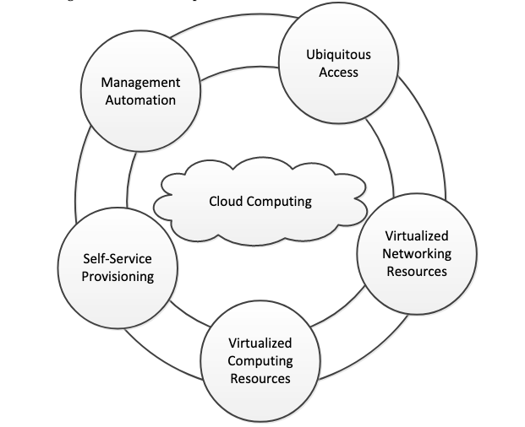
Foundations of CC [1]

Slide 7
CC service models [1]
Software as a Service (Saas)
Platform as a Service (Paas)
Infrastructure as a Service (Iaas)

Slide 8
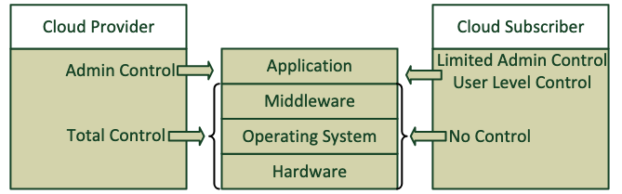
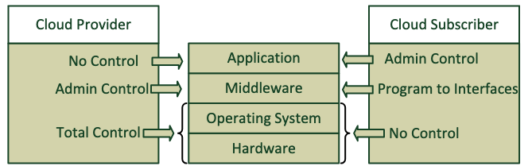
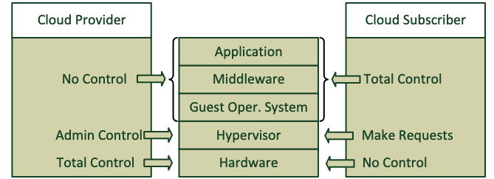
Control comparison of different models [1]
SaaS
PaaS
IaaS

Slide 9
Network architecture [1]
Reliable communications
Reliable link protocol (FCoE)
Avoid losing frames (IEEE 802.1Qbb)
Avoid transmission loss (IEEE 802.1Qau)
Congestion exposure mechanism
Efficient communications
Shortest Path Bridging (SPB)
Transparent Interconnect of Lots of Links - TRILL
Enhanced OSPF and BGP
Virtual networking
Software Defined Network (SDN)
Elastic allocation, federation and interoperability

Slide 10
Future network trends [1]
Solve tradeoff between resource allocation and fault tolerance
Resource sharing
Metrics to assess performance and energy efficiency
SDN could help to study fully collaborative, peer-to-peer and pervasive web scenarios
Cooperation in Cloud Computing
Mobile Cloud Computing and Network Functions Virtualization;
inter-Cloud Computing architectures
Internet of Things

Slide 11
Security Aspects [1]
Up to date security patches
Data isolation
Authentication and trust mechanisms
Secure connection (VPN)
Identify threats

Slide 12
Security Aspects (Model specific) [1]
SaaS - inherits security drawbacks of web services
PaaS - isolation between tenants and efficient resource usage
IaaS - security of networking, virtualization and physical resources
Security risks of emerging model Data as a service.

Slide 13
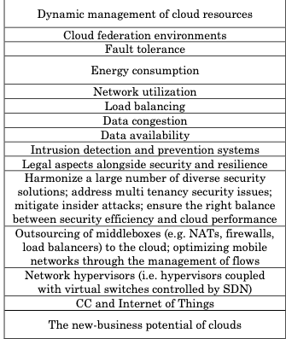
Open Issues [1]

Slide 14
Cloud adoption factors [2]
Virtualization
Security and privacy
Interoperability
Service-level agreement
Organizational context

Slide 15
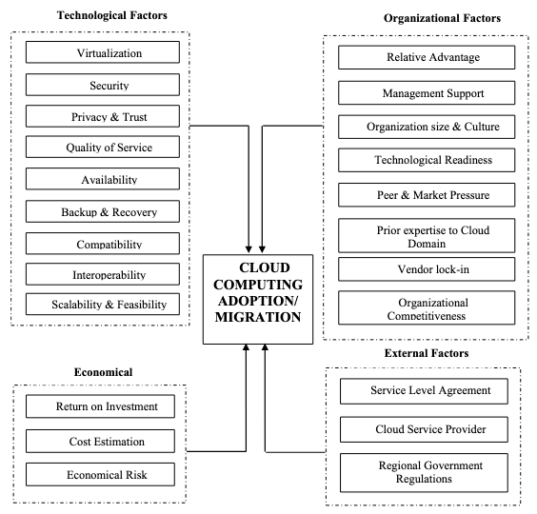
Cloud adoption/migration framework [2]

Slide 16
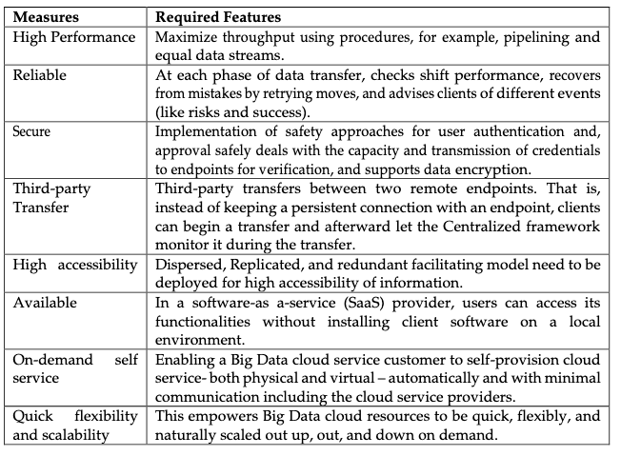
Required measures for migration [3]

Slide 17
Opportunities advantages of migration [3]
Adaptable IT resources
Cost-saving solutions
Security features
Manage incomings and outgoings
Develop new skillsets
Organizational development

Slide 18
Challenges of migration [2,3]
Choosing the right vendor
Trust in cloud security
Departmental downsizing
Lack of supplementary resources
Lack of prior knowledge could result in failure

Slide 19
Critical process of migration [4]
Plan phase
Design phase
Enable phase

Slide 20
Plan Phase [4]
Analyse context
Analyse requirements
Identify system
Define plan

Slide 21
Design phase [4]
Design cloud solution
Choose platform
Identify incompatibilities
Design principles

Slide 22
Enable phase [4]
Resolve incompatibilities
Encrypt/Decrypt entities
Deploy system components
Configure network
Isolate tennant
Rebalance system
Enable elasticity
Deploy system
Test system

Slide 23
Conclusion
Cloud computing offers a lot
There are still open issues and concerns
Migrating requires in depth analysis

Slide 24
Questions?

Slide 25
Reference
Moura, J. and Hutchison, D., 2016. Review and analysis of networking challenges in cloud computing. Journal of Network and Computer Applications, 60, pp.113-129.
Amin, R., Vadlamudi, S. and Rahaman, M.M., 2021. Opportunities and challenges of data migration in cloud. Engineering International, 9(1), pp.41-50.
Shuaib, M., Samad, A., Alam, S. and Siddiqui, S.T., 2019. Why adopting cloud is still a challenge?—A review on issues and challenges for cloud migration in organizations. Ambient Communications and Computer Systems, pp.387-399.
Gholami, M.F., Daneshgar, F., Beydoun, G. and Rabhi, F., 2017. Challenges in migrating legacy software systems to the cloud—an empirical study. Information Systems, 67, pp.100-113.

