Slide 1
CSC4200/5200 – Computer Networking
Routing - Continued
Instructor: Susmit Shannigrahi
sshannigrahi@tntech.edu
GTA: dereddick42@students.tntech.edu

Slide 2

Apps (HTTP)
Data
Apps (HTTP)
Segments
Transport (TCP/UDP)
Transport (TCP/UDP)
Network (IP)
Packets
Network (IP)
Link (Ethernet)
Frames
Link (Ethernet)
Ethernet Interface
Ethernet Interface
Bits (1010001)

Slide 3

Forwarding vs Routing
Forwarding:
          to select an output port based on destination address and routing table
          Local path
    Routing:
          process by which routing table is built
          End-to-end path
Notes:
Ndn can help organizing the namespaces
Once that’s done, data discovery and provenance is
Straight forward
Retrieval, transparent failover, and specialized operations
In this work, we take a real access log and try to quantify NDN’s improvements to a climate
workflow

Slide 4
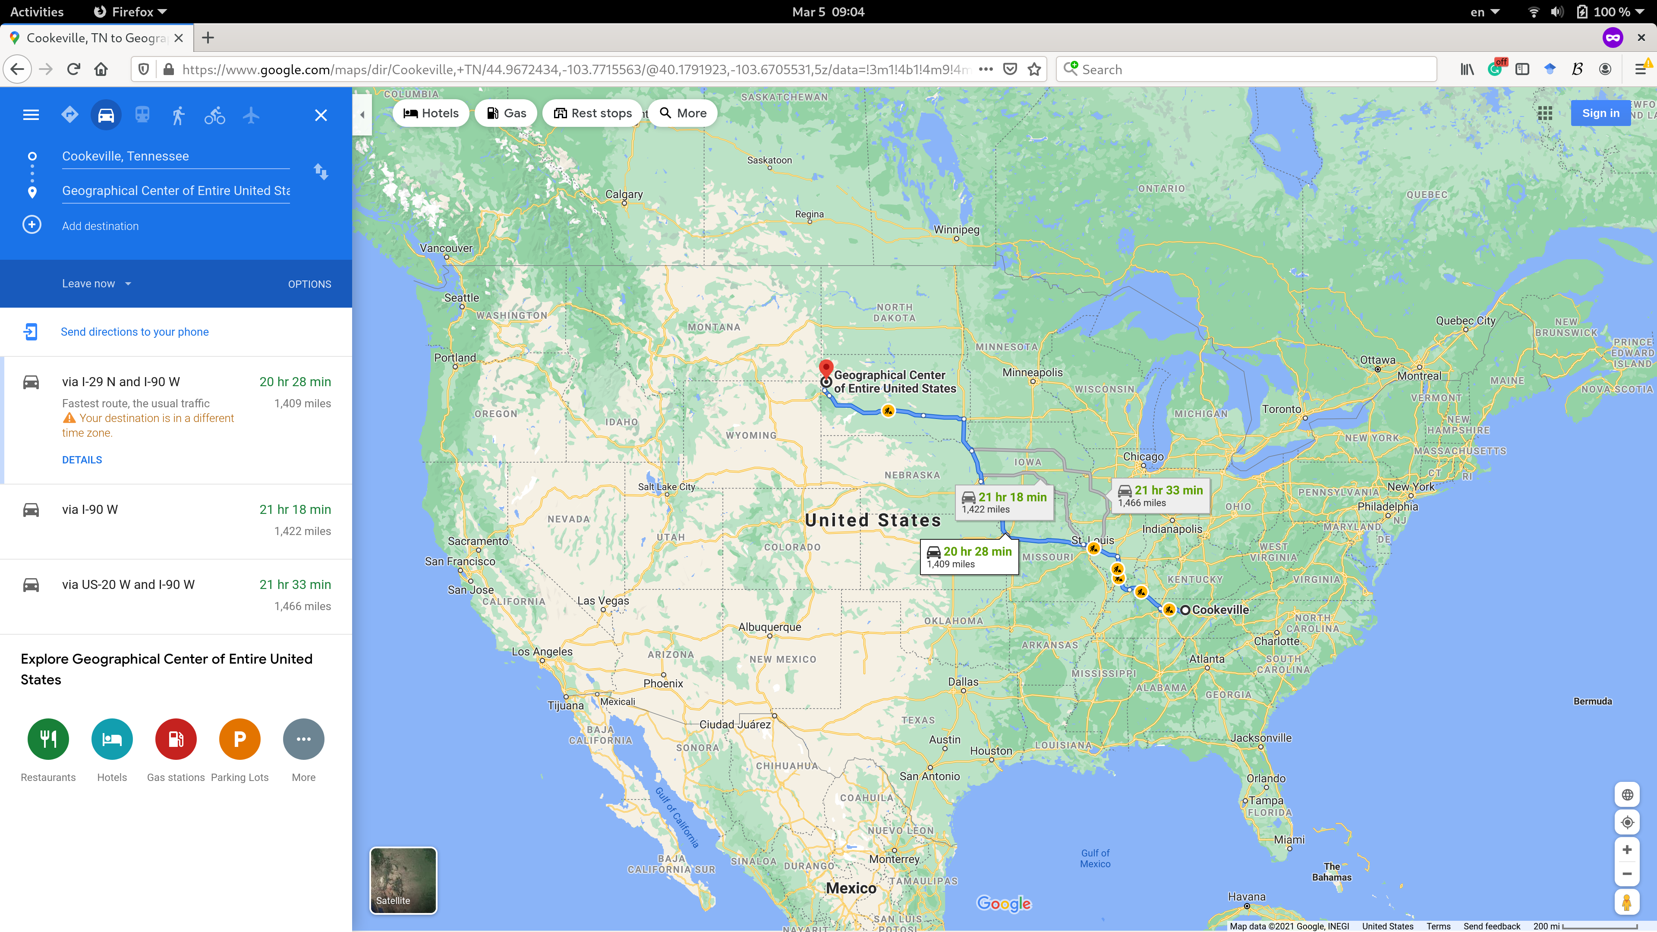
Routing = Navigation
Notes:
Ndn can help organizing the namespaces
Once that’s done, data discovery and provenance is
Straight forward
Retrieval, transparent failover, and specialized operations
In this work, we take a real access log and try to quantify NDN’s improvements to a climate
workflow

Slide 5
Why bother?
5
v
3
w
2
5
Quality of path affects performance
  Longer path = more delay
Balance path usage, avoid congested paths
Deal with failures
u
2
1
z
3
1
2
x
y
1
Notes:
Ndn can help organizing the namespaces
Once that’s done, data discovery and provenance is
Straight forward
Retrieval, transparent failover, and specialized operations
In this work, we take a real access log and try to quantify NDN’s improvements to a climate
workflow

Slide 6
Router architecture overview
Two key router functions:
run routing algorithms/protocol (RIP, OSPF, BGP)
forwarding datagrams from incoming to outgoing link
Control Plane = routing
Vs
Data Plane = forwarding
forwarding tables computed,
pushed to input ports
routing
processor
routing, management
control plane (software)
forwarding data plane (hardware)
high-speed
forwarding
fabric
router input ports
router output ports

Slide 7
Graph abstraction
5
v
3
w
2
5
u
2
1
z
3
1
2
x
y
1
graph: G = (N,E)
N = set of routers = { u, v, w, x, y, z }
E = set of links ={ (u,v), (u,x), (v,x), (v,w), (x,w), (x,y), (w,y), (w,z), (y,z) }
X→ Z
Cost (x,v,w,z) = cost(x,v) + cost (v, w) + cost(w,z) = 10
Cost (x,w,z) = cost(x,w) + cost(w,z) = 8
Cost(x, y, z) = ?
Objective → find the lowest cost path between all nodes

Slide 8
Dijkstra’s Shortest-Path Algorithm
5
Given a graph (network) with link costs
Find the lowest cost paths to all nodes
Iterative
  After n iterations, you will find least cost path to n nodes
S = Least cost paths already known, initially source node {U}
D(v): current cost of path from source(U) to node V
  Initially, D(v) = c(u,v) for all nodes v adjacent to u
  D(v) = ∞ for all other nodes
  Update D(v) as we go
v
3
w
2
5
u
2
1
z
3
1
x
2
1
y

Slide 9
Dijsktra’s Algorithm
1 Initialization:
2 N' = {u}
3 for all nodes v
4 if v adjacent to u
5 then D(v) = c(u,v)
6 else D(v) = ∞
7
8 Loop
9 find w not in N' such that D(w) is a minimum
10 add w to N'
11 update D(v) for all v adjacent to w and not in N' :
12 D(v) = min( D(v), D(w) + c(w,v) )
13 /* new cost to v is either old cost to v or known
14 shortest path cost to w plus cost from w to v */
15 until all nodes in N'

Slide 10
Dijkstra’s algorithm: example
D(v)
p(v)
D(w)
p(w)
D(x)
p(x)
D(y)
p(y)
D(z)
p(z)
Step
N'
0
u
7,u
3,u
5,u
∞
∞
1
uw
6,w
5,u
11,w
∞
2
uwx
6,w
11,w
14,x
uwxv
10,v
14,x
x
3
9
4
uwxvy
12,y
5
uwxvyz
5
7
4
8
notes:
construct shortest path tree by tracing predecessor nodes
ties can exist (can be broken arbitrarily)
u
3
w
y
z
2
3
7
4
v
Kurose/ross

Slide 11
Dijkstra’s algorithm: another example
Step
0
1
2
3
4
5
N'
u
ux
uxy
uxyv
uxyvw
uxyvwz
D(v),p(v)
2,u
2,u
2,u
D(w),p(w)
5,u
4,x
3,y
3,y
D(x),p(x)
1,u
D(y),p(y)
∞
2,x
D(z),p(z)
∞
∞
4,y
4,y
4,y
5
v
3
w
2
5
u
2
1
z
3
1
2
x
y
1
Network Layer
4-<number>

Slide 12
Dijsktra’s → Link State Routing
5
Each node keeps track of adjacent links (neighbors)
Each router broadcasts it’s state (network map)
Each router runs Dijkstra’s algorithm
(finds the shortest path)
Each router has complete picture of the network
Example: Open Shortest Path First (OSPF)
v
3
w
2
5
u
2
1
z
3
1
x
2
1
y

Slide 13
OSPF – Open Shortest Path First
SPF – another name for Link State Routing
Each node creates an update packet - link-state packet (LSP)
  The ID of the node that created the LSP (U)
  A list of directly connected neighbors and the cost of the link ((V, 2), (X, 1), (W, 5))
A sequence number (1122)
A time to live for this packet (16)
LSP → ({U}, {(V, 2), (X, 1), (W, 5)}, {1122}, {16})
5
v
3
w
2
5
u
2
1
z
3
1
x
2
1
y

Slide 14
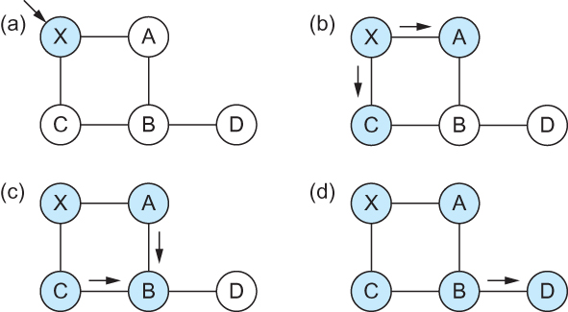
OSPF – controlled flooding
Flooding of link-state packets. (a) LSP arrives at node X; (b) X floods LSP to A and C; (c) A and C flood LSP to B (but not X); (d) flooding is complete

Slide 15
Link State Routing – controlled flooding
Flood when topology changes or link goes down
  Detected by periodic hello messages
  If message missed → link down
Refresh and flood periodically
Problems?
  High computational cost
  Reliable flooding may not be reliable

Slide 16




Tying it all together in the network layer
SRC | 2.2.2.2
DST | 5.5.5.5
SRC | bbbb
DST | dddd
Decapsulate IP packet
L1H1
2.2.2.2
Ether: cccc
SRC | 2.2.2.2
DST | 5.5.5.5
SRC | 2.2.2.2
DST | 5.5.5.5
Youtube
5.5.5.5
Ether: dddd
ARP: WHO HAS 5.5.5.5?
youtube: I do! Ethernet address: dddd
Iface 1:
2.2.2.1
Ether: aaaa
Iface 2:
5.5.5.1
Ether: bbbb
DHCP
server
SRC | 2.2.2.2
DST | 5.5.5.5
Routing Table
5.5.5.0/8 | IF: 2
2.2.2.0/8 | IF: 1
We are populating this!!!

Slide 17
Reading Assignment
Network as a graph:
  https://book.systemsapproach.org/internetworking/routing.html#network-as-a-graph
  Approximately 5 minutes
Link state:
  https://book.systemsapproach.org/internetworking/routing.html#link-state-ospf
  Approximately 20 minutes
Notes:
Ndn can help organizing the namespaces
Once that’s done, data discovery and provenance is
Straight forward
Retrieval, transparent failover, and specialized operations
In this work, we take a real access log and try to quantify NDN’s improvements to a climate
workflow

