Slide 1
CSC4200/5200 – Computer Networking
Global Internet
Instructor: Susmit Shannigrahi
sshannigrahi@tntech.edu
GTA: dereddick42@students.tntech.edu

Slide 2

Apps (HTTP)
Data
Apps (HTTP)
Segments
Transport (TCP/UDP)
Transport (TCP/UDP)
Network (IP)
Packets
Network (IP)
Link (Ethernet)
Frames
Link (Ethernet)
Ethernet Interface
Ethernet Interface
Bits (1010001)

Slide 3
Logistics
PA2 will post tomorrow – due March 31st.
Those who asked for PA1 extension – email me the code.
Homework2 will post next week.
Second exam – end of March.
Notes:
Ndn can help organizing the namespaces
Once that’s done, data discovery and provenance is
Straight forward
Retrieval, transparent failover, and specialized operations
In this work, we take a real access log and try to quantify NDN’s improvements to a climate
workflow

Slide 4

Back to Addressing
    A 32 bit number in quad-dot notation
    Identifies an Interface
      A host might have several interfaces!!!
    129.82.138.254
    10000001.01010010.10001010.11111110
Notes:
Ndn can help organizing the namespaces
Once that’s done, data discovery and provenance is
Straight forward
Retrieval, transparent failover, and specialized operations
In this work, we take a real access log and try to quantify NDN’s improvements to a climate
workflow

Slide 5

Subnets Revisited
223.1.1.0/24
223.1.2.0/24
Recipe:
Create isolated networks – subnets
No longer need to know
individual Ips – knowing
the subnet is enough
  223.1.1.0/14 → Interface 2
223.1.1.1
223.1.1.2
223.1.2.1
223.1.1.4
223.1.2.9
223.1.2.2
223.1.1.3
223.1.3.27
subnet
223.1.3.1
223.1.3.2
223.1.3.0/24
subnet mask: /24

Slide 6
Subnets – Class based
Originally – only rigid boundaries
  Class A – 5.0.0.0/8 - 0*
  Class B – 149.149.0.0/16 - 10*
  Class C – 129.82.138.0/14 - 110*
  Class D – 224.0.0.0 – 1110*
  Class E - reserved

Slide 7
Subnets – Classless CIDR
No rigid boundaries
  129.82.138.0/25
  10000001.01010010.10001010.10000000

Slide 8

Subnets (Prefixes) scales the Internet
Addresses are allocated in contiguous prefixes (tntech 149.149.0.0/16)
Routing protocols operate based on prefixes (how do I reach 149.149.0.0/16)?
149.149.5.0/24
149.149.6.0/24
149.149.7.0/24
149.149.0.0/16
.
.
.
.
.
149.160.0.0/16
149.0.0.0/8
Internet
How do I reach
149.0.0.0/8?
Not
How do I reach 149.149.5.0/24
How do I reach 149.149.6.0/24
149.160.0.0/17
149.160.128.0/17

Slide 9
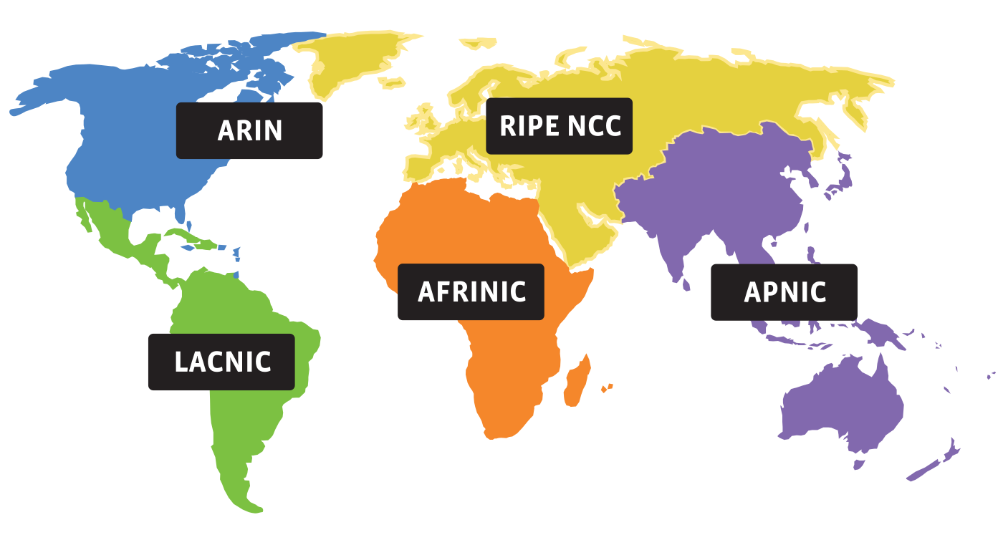
Who gets what prefix?
0. Internet Corporation for Assigned Names and Numbers (ICANN) – Decides which RIRs get what address
1. Regional Internet Registries (RIRs) – Which orgs get what address
2. ISPs – Which customers get which address
Notes:
Ndn can help organizing the namespaces
Once that’s done, data discovery and provenance is
Straight forward
Retrieval, transparent failover, and specialized operations
In this work, we take a real access log and try to quantify NDN’s improvements to a climate
workflow

Slide 10
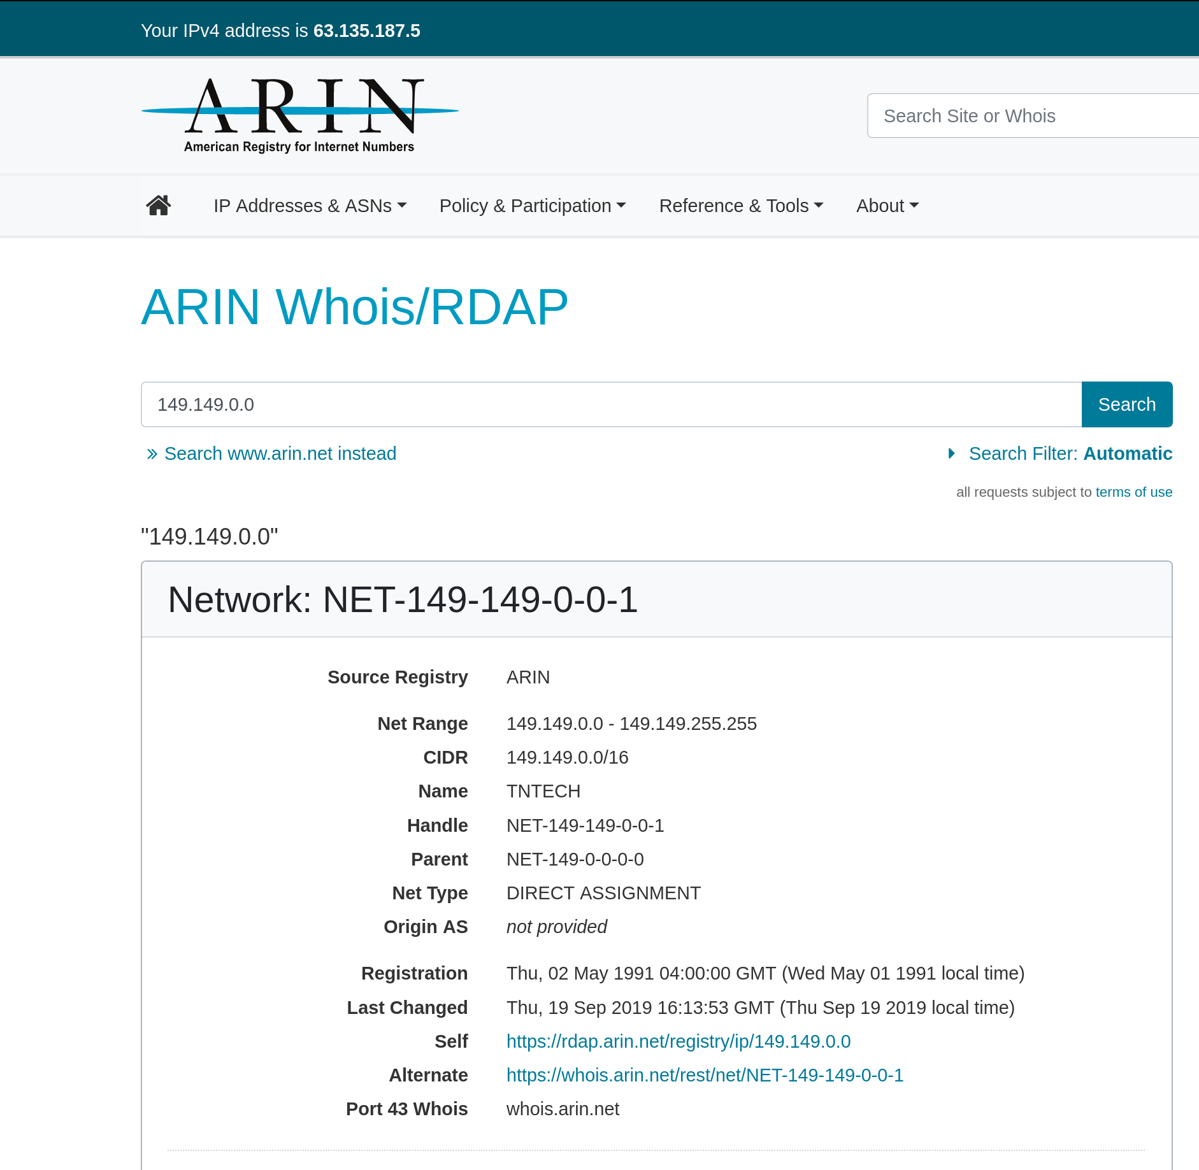
How do you know who has a prefix? “whois”
$ whois tntech.edu
Domain Name: TNTECH.EDU
Registrant:
Tennessee Technological University
Information Technology Service
1010 N. Peachtree Street
Cookeville, TN 38505
USA
Domain record activated: 09-Sep-1992
Domain record last updated: 26-Sep-2019
Domain expires: 31-Jul-2020

Slide 11
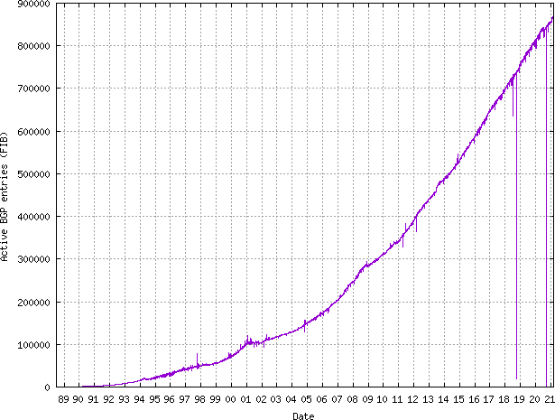
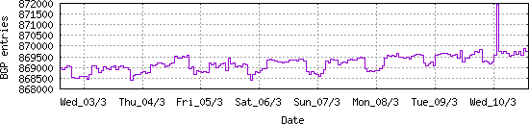
How many prefixes are there?
https://www.cidr-report.org/
100K in 2001 → 800K in 2019

Slide 12
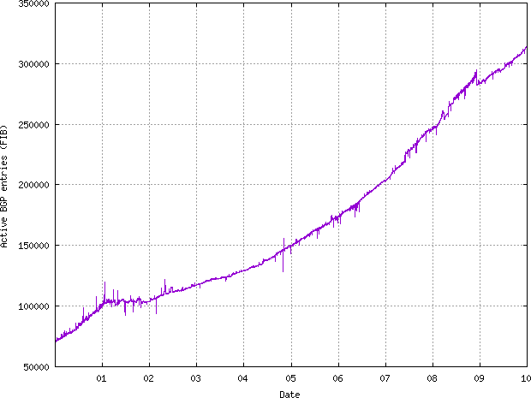
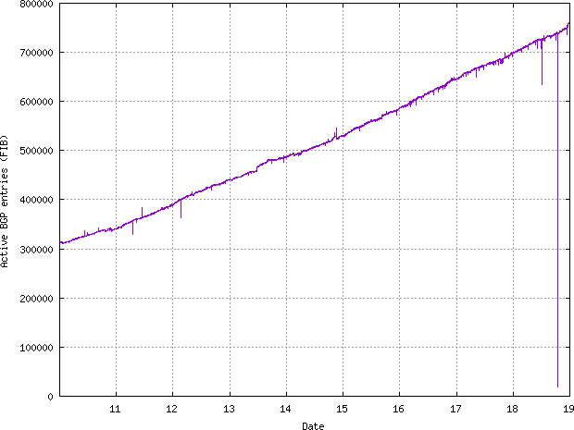
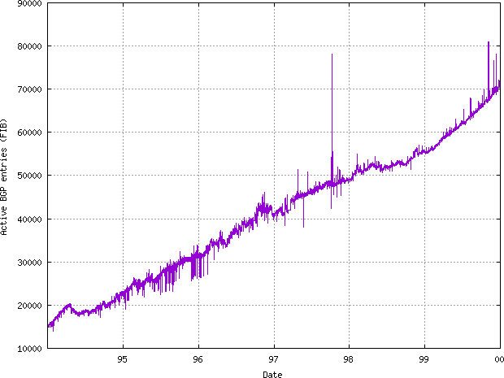
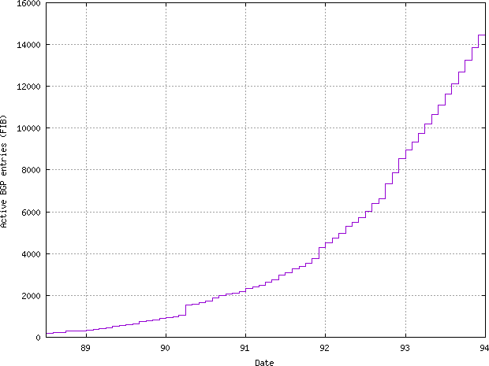
Bit of history – how the Internet evolved
‘88-’94 - 0 → 14000
‘94-’00 – 90000 – Linear growth
’00-’10 – up to 300,000
’10-’19 – up to 800,000

Slide 13
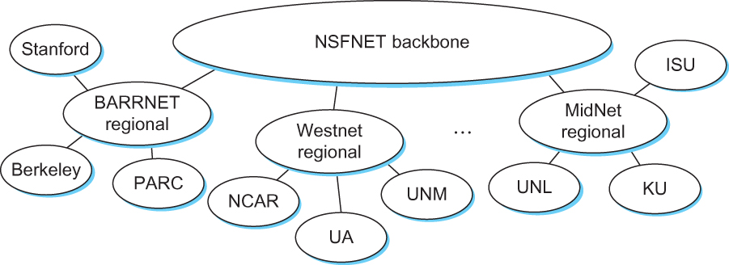
Internet in the 1990s
Notes:
Ndn can help organizing the namespaces
Once that’s done, data discovery and provenance is
Straight forward
Retrieval, transparent failover, and specialized operations
In this work, we take a real access log and try to quantify NDN’s improvements to a climate
workflow

Slide 14
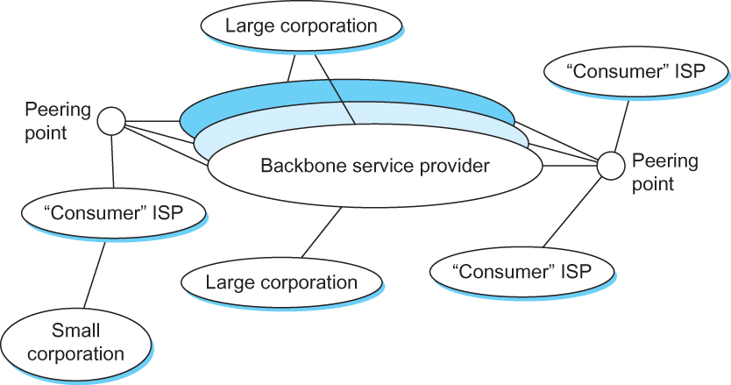
Internet now
Notes:
Ndn can help organizing the namespaces
Once that’s done, data discovery and provenance is
Straight forward
Retrieval, transparent failover, and specialized operations
In this work, we take a real access log and try to quantify NDN’s improvements to a climate
workflow

Slide 15
Hierarchical routing - Policy
scale: with 600 million destinations:
can’t store all dest’s in routing tables!
routing table exchange would swamp links!
administrative autonomy
internet = network of networks
each network admin may want to control routing in its own network

Slide 16
Autonomous systems (ASes)
AS
  A set of routers under a single technical administration
  Uses IGP within the AS to route packets
  Uses BGP between Ases to route packets
What happens inside an AS stays within that AS!
  That is, AS decides routing metrics internally
Notes:
Ndn can help organizing the namespaces
Once that’s done, data discovery and provenance is
Straight forward
Retrieval, transparent failover, and specialized operations
In this work, we take a real access log and try to quantify NDN’s improvements to a climate
workflow

Slide 17
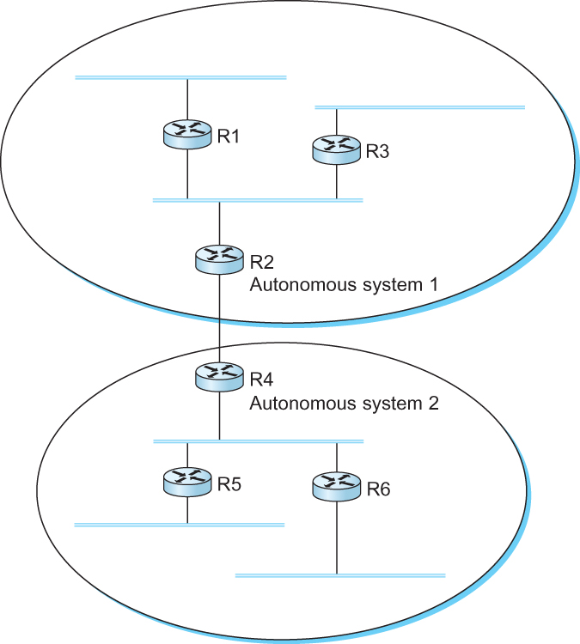
Interdomain Routing
IGP
Interior gateway protocol
IGP
Interior gateway protocol
BGP
Border gateway protocol
IGP
Interior gateway protocol
IGP
Interior gateway protocol
A network with four autonomous systems

Slide 18
BGP-4: Border Gateway Protocol
Assumes the Internet is an arbitrarily interconnected set of AS's.
Local traffic – within the AS
Transit traffic – from AS1 to AS3 via AS2
Three types of AS’s
  Stub AS
  Multihomed AS
  Transit AS

Slide 19
BGP-4: Border Gateway Protocol
IGP
Interior gateway protocol
R7
Stub AS
R3 Will not carry traffic between R2 and R1
R6
Transit AS
R3
Multihomed
AS
R6 Will carry traffic between R2 and R7
R5
Stub AS

Slide 20
BGP: Which routing protocol?
Link state?
Does not scale
you can have loops
exposes routing costs to others
Distance vector?
Slow to converge, count-to-infinity
No universal metrics

Slide 21
BGP - goals
The goal of Inter-domain routing is to find any path to the intended destination that is loop free
  We are concerned with reachability than optimality
  Finding path anywhere close to optimal is considered to be a great achievement
Why?

Slide 22
BGP - Goals
Scalability: Forward any packet destined anywhere in the Internet
  Having a routing table that will provide a match for any valid IP address
Autonomous nature of the domains
  impossible to calculate meaningful costs for a path crossing multiple ASs
  A cost of 1000 is great at provider 1, terrible at provider 2
Issues of trust
  Provider A might be unwilling to believe certain advertisements from provider B

Slide 23
BGP: Path vector protocol
Send the whole path with the routing update
Loops are detected if an AS finds itself in the path
  Reject if so
  Accept otherwise
Add self to the path and advertise to the neighbors
Advantage: No loops, Local decision before advertizing

Slide 24
BGP: Path vector protocol
Send the whole path with the routing update
Loops are detected if an AS finds itself in the path
  Reject if so
  Accept otherwise
Add self to the path and advertise to the neighbors
Advantage: No loops, Local decision before advertising

Slide 25
BGP: Path vector protocol
Loop!
Path: AS 223, AS 225, AS 245, AS 7770
Path: AS 223, AS 225, AS 245, AS 7770
AS 7770
AS 223
AS 225
Path: AS 223
Path: AS 223, AS 225
AS 245
Path: AS 223, AS 225, AS 245

Slide 26
BGP: Interconnections
Uses TCP port 179 to connect to peers
Arbitrary connections between AS’s
Advantages:
  Much simpler, no periodic update
  Valid as long as TCP connection is valid (or withdrawn)
  Incremental update (only a portion of the routing table)
Disadvantages:
  No security
  Congestion control on routing messages

Slide 27
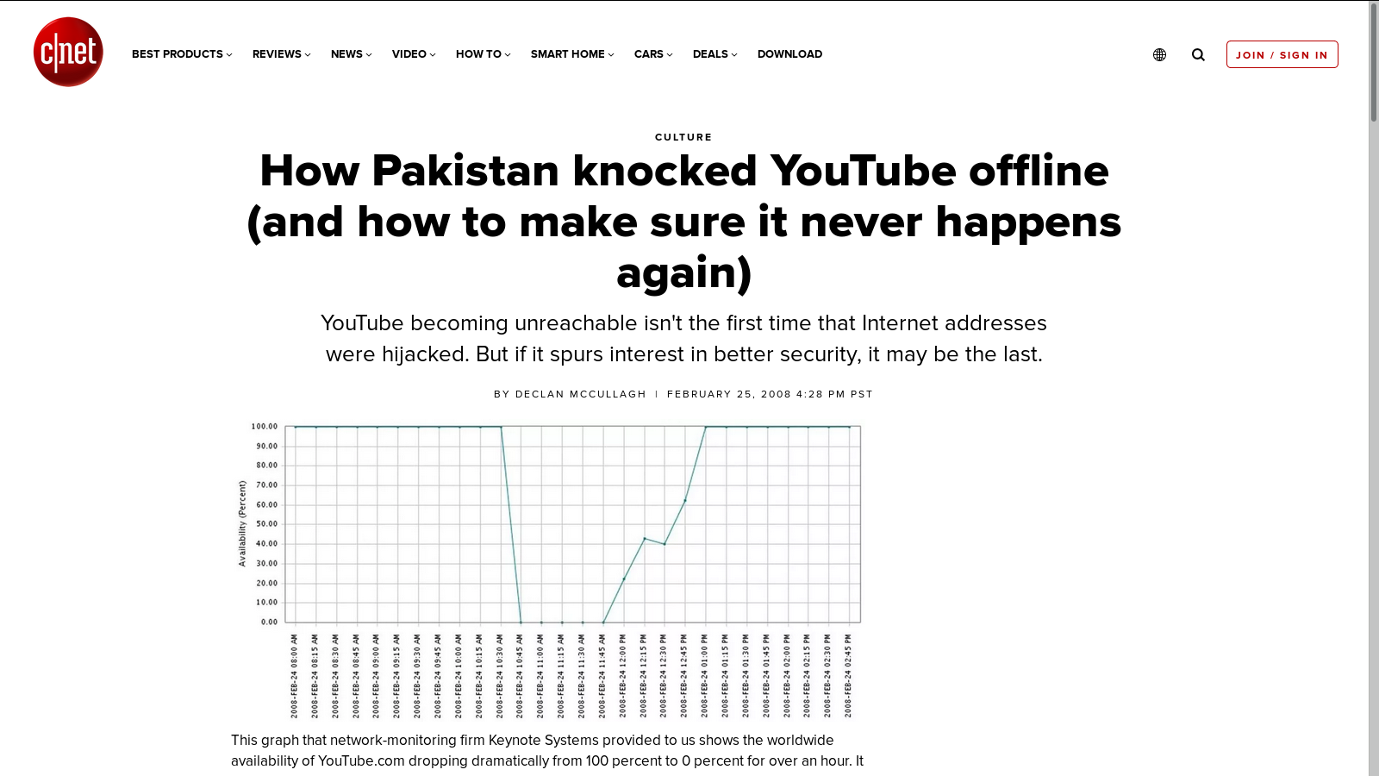
BGP: Security problems
Anyone can advertise
anything!!!

Slide 28
BGP: Hop by Hop model
You can only tell others what you are using
  But you control what you say
BGP advertises only to peers
  Tell them what you are using
  Hop-by-hop model

Slide 29
BGP: Allows for policy
Capable of enforcing various policies
  AS2 → Don’t use AS1 to get to AS3
Not part of BGP – configuration information that controls propagation of paths

Slide 30
Reading Assignments
Scaling to billions:
  https://book.systemsapproach.org/scaling/problem.html#problem-scaling-to-billions
    ~2 minutes read
Global Internet
  https://book.systemsapproach.org/scaling/global.html#global-internet
  Skip the routing areas section
  Read until “Common AS Relationships and Policies”
  ~40 minutes

Slide 31
Next steps
Notes:
Ndn can help organizing the namespaces
Once that’s done, data discovery and provenance is
Straight forward
Retrieval, transparent failover, and specialized operations
In this work, we take a real access log and try to quantify NDN’s improvements to a climate
workflow

