Slide 1
CSC4200/5200 – Computer Networking
BGP - Continued
Instructor: Susmit Shannigrahi
sshannigrahi@tntech.edu
GTA: dereddick42@students.tntech.edu

Slide 2

Apps (HTTP)
Data
Apps (HTTP)
Segments
Transport (TCP/UDP)
Transport (TCP/UDP)
Network (IP)
Packets
Network (IP)
Link (Ethernet)
Frames
Link (Ethernet)
Ethernet Interface
Ethernet Interface
Bits (1010001)

Slide 3
So far...
Routing
How do we scale routing?
Notes:
Ndn can help organizing the namespaces
Once that’s done, data discovery and provenance is
Straight forward
Retrieval, transparent failover, and specialized operations
In this work, we take a real access log and try to quantify NDN’s improvements to a climate
workflow

Slide 4
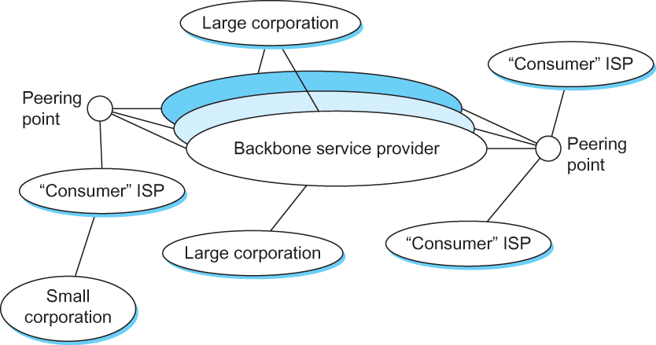
Internet now
Notes:
Ndn can help organizing the namespaces
Once that’s done, data discovery and provenance is
Straight forward
Retrieval, transparent failover, and specialized operations
In this work, we take a real access log and try to quantify NDN’s improvements to a climate
workflow

Slide 5
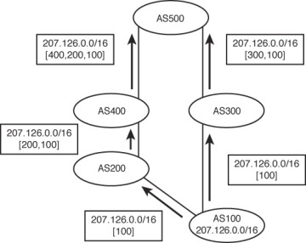
BGP Attribute – AS PATH
Each hop adds ASN to the path
-Only externally
http://www.ciscopress.com/articles/article.asp?p=2738462&seqNum=2

Slide 6
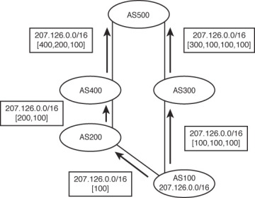
BGP Attribute – AS PATH
AS100 trying to influence path selection at AS500
- Append multiple path
http://www.ciscopress.com/articles/article.asp?p=2738462&seqNum=2

Slide 7
BGP Attribute – Local Preference
How do you load balance between
two links using BGP?
AS1
At A:
129.82.138.0/17 → 10
129.82.138.128/17 → 5
At C:
129.82.138.0/17 → 5
129.82.138.128/17 → 10
AS2
129.82.138.0/16
a
b
c
d
http://www.ciscopress.com/articles/article.asp?p=2738462&seqNum=2

Slide 8
BGP Attribute – Local Preference
How does AS1 prefer a-b over c-d?
Higher preference wins!
AS1
AS2
129.82.134.0/16
a
b
c
d
http://www.ciscopress.com/articles/article.asp?p=2738462&seqNum=2

Slide 9
BGP Attribute – MED (Multi exit discriminator
AS1 and AS2 has two paths
between them
AS1 tells AS2 it’s MED for
influencing AS2’s path selection
Lower cost wins
AS1
AS2
129.82.134.0/16
a
b
c
d

Slide 10
BGP Attribute – MED
How would AS1 make AS2 send
129.82.138.0/17 over a-b
and
129.82.138.128/17 over c-d?
AS1
AS2
129.82.138.0/16
AS1 tells AS2
129.82.138.0/17 MED 5 via a
129.82.138.128/17 MED 10 via a
129.82.138.0/17 MED 10 via c
129.82.138.128/17 MED 5 via c
a
b
c
d

Slide 11
BGP Attribute – MED
Typically used in provider/subscriber
Not between peers – why?
One AS may force the other to carry traffic
for it
NYC
AS1
AS2
129.82.138.0/16
a
b
c
d
LAX

Slide 12
Local Pref vs MED
LOC_PREF → Internal – you tell your routers which route to use
MED → External – you tell you neighbors which route you prefer
Neighbor is an autonomous system, so it can ignore you

Slide 13
BGP Attribute - Community
Put anything you want – between Ases, not known publicly
COMMUNITY: 17:210 17:13 4195:10 416:13 45:1103

Slide 14

Internal vs External BGP
BGP between R2 and R4
What is between R1, R2, and R3?
R1
R2
R4
a
b
AS1
R3

Slide 15
Internal vs External BGP
BGP between R2 and R4
What is between R1, R2, and R3?
IBGP (Internal)
Different rules:
If you learn from outside, advertise
If you learn from inside, don’t
R1
R2
R4
a
b
AS1
R3
R2 can tell R3 and R1 about R4
R2 can not tell R1 about prefixes from R2 -loop!
IBGP must be a mesh!

Slide 16


BGP vs IP routers
Next hop | Announcing AS| Target Prefix| Path
203.189.128.233 | 23673 | 149.149.0.0/16 | 23673 1299
R2
R4
a
b
203.189.128.233
BGP tells you which IP router to use

Slide 17
BGP Decision process
Next hop | Announcing AS| Target Prefix| Path | LOCAL_PREF | MED| Next Hop Cost
203.189.128.233 | 23673 | 149.149.0.0/16 | 23673 1299 | 10 | 5| 100
203.189.128.233 | 23673 | 149.149.0.0/16 | 23673 1299 | 100 | 50| 10
149.149.0.0/16
R2
R4
a
b
203.189.128.233

Slide 18
BGP Decision process
Next hop | Announcing AS| Target Prefix| Path | LOCAL_PREF | MED| Next Hop Cost
203.189.128.233 | 23673 | 149.149.0.0/16 | 23673 1299 | 10 | 5| 100
203.189.128.233 | 23673 | 149.149.0.0/16 | 23673 1299 | 100 | 50| 10
R5
ADJ- RIB-IN
c
149.149.0.0/16
149.149.0.0/16
R4
a
R2
b
203.189.128.233

Slide 19
BGP Decision process
At ADJ-RIB-IN calculate degree of preference until one route for
each destination remains!!
  select route with highest LOCAL-PREF
  Select route with shortest AS-PATH
  Select route with lowest MED
  Select route with smallest NEXT-HOP cost
  Select route learned from E-BGP peer with lowest ID
  Select route learned from I-BGP peer with lowest ID
Install selected route in LOC-RIB
Update ADJ-RIB-OUT, notify peers
  You can only send what is in LOC-RIB (or a subset of it)

Slide 20
BGP
1 will prefer 2 over 3
1 will not accept traffic from 3
2 will prefer path to 3 via 1
3 will utilize both paths
AS1
AS2
a
b
c
d
AS3

Slide 21
Apps (HTTP)
Data
Apps (HTTP)
Segments
Transport (TCP/UDP)
Transport (TCP/UDP)
Network (IP)
Packets
Network (IP)
Link (Ethernet)
Frames
Link (Ethernet)
Ethernet Interface
Ethernet Interface
Bits (1010001)

