Slide 1
CSC4200/5200 – Computer Networking
Transport layer protocols
Instructor: Susmit Shannigrahi
sshannigrahi@tntech.edu

Slide 2

Apps (HTTP)
Data
Apps (HTTP)
Segments
Transport (TCP/UDP)
Transport (TCP/UDP)
Network (IP)
Packets
Network (IP)
Link (Ethernet)
Frames
Link (Ethernet)
Ethernet Interface
Ethernet Interface
Bits (1010001)

Slide 3
What is transport layer?
Problem: How to turn this host-to-host packet delivery service into a process-to-process communication channel?
Notes:
Ndn can help organizing the namespaces
Once that’s done, data discovery and provenance is
Straight forward
Retrieval, transparent failover, and specialized operations
In this work, we take a real access log and try to quantify NDN’s improvements to a climate
workflow

Slide 4

















Transport services and protocols
application
transport
network
data link
physical
provide logical communication between app processes running on different hosts
transport protocols run in end systems
  send side: breaks app messages into segments, passes to network layer
  rcv side: reassembles segments into messages, passes to app layer
more than one transport protocol available to apps
  Internet: TCP and UDP
logical end-end transport
application
transport
network
data link
physical

Slide 5
Transport Layer
Our goals:
understand principles behind transport layer services:
  multiplexing, demultiplexing
  reliable data transfer
  flow control
  congestion control
learn about Internet transport layer protocols:
  UDP: connectionless transport
  TCP: connection-oriented reliable transport
  TCP congestion control
3-<number>

Slide 6
Transport vs. network layer
network layer: logical communication between hosts
transport layer: logical communication between processes
  relies on, enhances, network layer services
3-<number>

Slide 7
Internet transport-layer protocols
Reliable, in-order delivery (TCP)
  congestion control
  flow control
  connection setup
unreliable, unordered delivery: UDP
  no-frills extension of “best-effort” IP
services not available:
  delay guarantees
  bandwidth guarantees
application
transport
network
data link
physical
network
data link
physical
network
data link
physical
network
data link
physical
network
data link
physical
logical end-end transport
network
data link
physical
network
data link
physical
network
data link
physical
application
transport
network
data link
physical

Slide 8

Multiplexing/demultiplexing
multiplexing at sender:
handle data from multiple
sockets, add transport header (later used for demultiplexing)
demultiplexing at receiver:
use header info to deliver
received segments to correct
socket
application
application
P1
P2
application
socket
P3
transport
P4
process
transport
network
transport
network
link
network
link
physical
link
physical
physical

Slide 9
How demultiplexing works
host receives IP datagrams
  each datagram has source IP address, destination IP address
  each datagram carries one transport-layer segment
  each segment has source, destination port number
host uses IP addresses & port numbers to direct segment to appropriate socket
32 bits
source port #
dest port #
other header fields
application
data
(payload)
TCP/UDP segment format
3-<number>

Slide 10
UDP: User Datagram Protocol
Lightweight communication
  Avoid overhead and delays of ordered delivery
  Send messages to and receive them from a socket
connectionless:
  no handshaking between UDP sender, receiver
  each UDP segment handled independently of others

Slide 11
UDP: segment header
length, in bytes of UDP segment, including header
32 bits
source port #
dest port #
length
checksum
Why would anyone use UDP?
no connection establishment (which can add delay)
simple: no connection state at sender, receiver
small header size
no congestion control: UDP can blast away as fast as desired
application
data
(payload)
UDP segment format

Slide 12

Who uses UDP?
Multimedia applications
  Sending a lost frame is not worth it
  By the time the packet is retransmitted,
  it’s too late
DNS
  Small query
  Connection establishment might be an overkill

Slide 13

Principles of reliable data transfer
important in application, transport, link layers
  top-10 list of important networking topics!

Slide 14
TCP – Transmission Control Protocol
point-to-point:
  one sender, one receiver
reliable, in-order byte steam:
  no “message boundaries”
pipelined:
  TCP congestion and flow control set window size
full duplex data:
  bi-directional data flow in same connection
  MSS: maximum segment size
connection-oriented:
  handshaking (exchange of control msgs) inits sender, receiver state before data exchange
flow controlled:
  sender will not overwhelm receiver

Slide 15
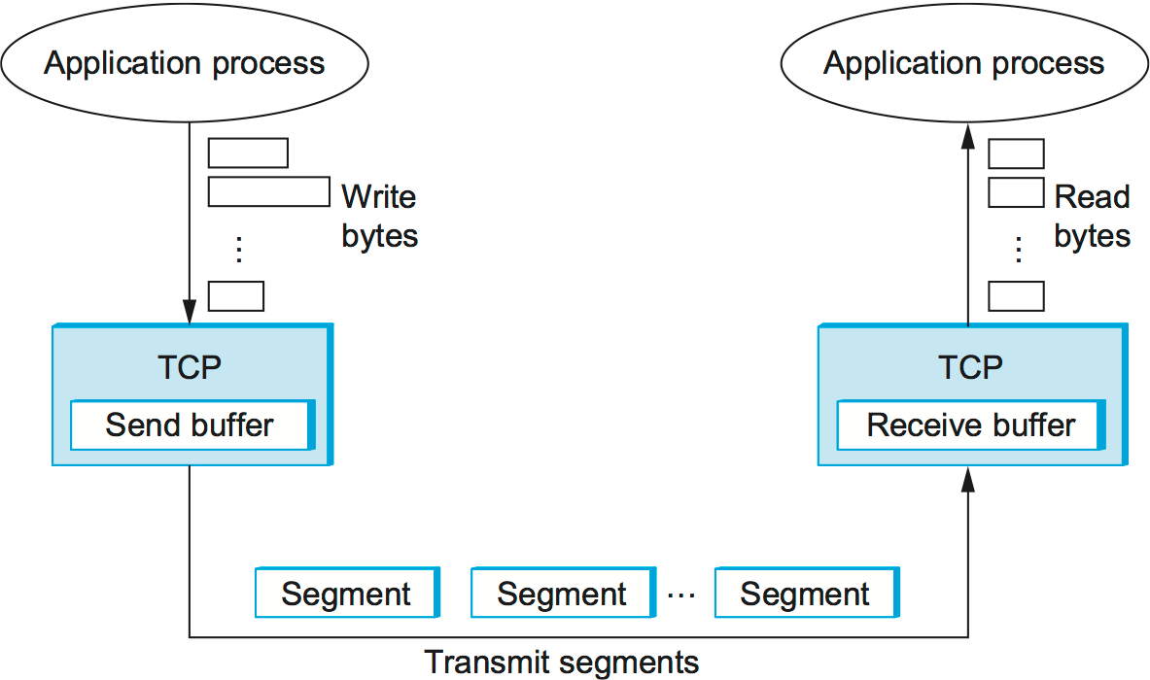
TCP – Transmission Control Protocol

Slide 16
TCP – Transmission Control Protocol
segment
Host 1
1 2 3 4 5 6 7 8
Host 2
1 2 3 4 5 6 7 8

Slide 17
TCP Segment
IP
header
IP Data
TCP header
TCP segment
IP → No more than MTU (1500 Bytes)
TCP header → 20 bytes
TCP segment → 1460 bytes
Why?

Slide 18

TCP Header
SYN
FIN
RST
PSH
URG
ACK
TCP Header Format

Slide 19

TCP Three-way Handshake
Timeline for three-way handshake algorithm

Slide 20
TCP – Transmission Control Protocol
point-to-point:
  one sender, one receiver
reliable, in-order byte steam:
  no “message boundaries”
pipelined:
  TCP congestion and flow control set window size
full duplex data:
  bi-directional data flow in same connection
  MSS: maximum segment size
connection-oriented:
  handshaking (exchange of control msgs) inits sender, receiver state before data exchange
flow controlled:
  sender will not overwhelm receiver

Slide 21
Reading Assignments
UDP:
  https://book.systemsapproach.org/e2e/udp.html#simple-demultiplexor-udp
  About 15 minutes
TCP
  https://book.systemsapproach.org/e2e/tcp.html#reliable-byte-stream-tcp
  End-to-End Issues, Segment Format, Connection Establishment and Termination

