Slide 1
CSC4200/5200 – Computer Networking
Global internet and transport layer recap
Instructor: Susmit Shannigrahi
sshannigrahi@tntech.edu
GTA: dereddick42@students.tntech.edu

Slide 2

Apps (HTTP)
Data
Apps (HTTP)
Segments
Transport (TCP/UDP)
Transport (TCP/UDP)
Network (IP)
Packets
Network (IP)
Link (Ethernet)
Frames
Link (Ethernet)
Ethernet Interface
Ethernet Interface
Bits (1010001)

Slide 3
A Number of Logistical Updates
PA3 groups – let me know by tomorrow or I will create groups at random
All slides uploaded.
Grading rubric for PA2 and PA3 has posted
Homework 4 has posted, due in a week
PA3 demo, December 6th, Tech Pride Room, 8AM -9:30AM
  Make a poster, do a live demo, or screencast
Final December 9th – Location/Time – Library 112, 1:00PM - 3:00PM Monday, December 9

Slide 4
Recap of Global Internet, TCP/IP
What is an Autonomous system? Why do we need ASes?

Slide 5
Autonomous systems (ASes)
AS
  A set of routers under a single technical administration
  Uses IGP within the AS to route packets
  Uses BGP between Ases to route packets
What happens inside an AS stays within that AS!
  That is, AS decides routing metrics internally
Notes:
Ndn can help organizing the namespaces
Once that’s done, data discovery and provenance is
Straight forward
Retrieval, transparent failover, and specialized operations
In this work, we take a real access log and try to quantify NDN’s improvements to a climate
workflow

Slide 6
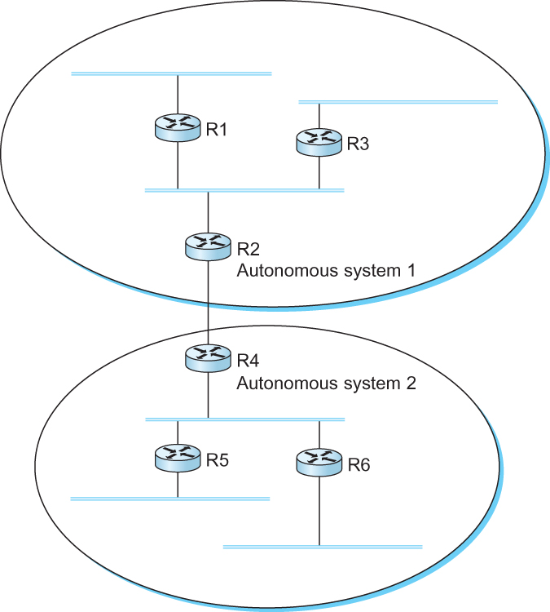
Recap of Global Internet, TCP/IP
Difference between Intra-AS and Inter-AS routing?

Slide 7
Interdomain Routing
IGP
Interior gateway protocol
IGP
Interior gateway protocol
BGP
Border gateway protocol
IGP
Interior gateway protocol
IGP
Interior gateway protocol
A network with four autonomous systems

Slide 8
Recap of Global Internet, TCP/IP
What are the three types of ASes in BGP?

Slide 9
BGP-4: Border Gateway Protocol
IGP
Interior gateway protocol
R7
Stub AS
R3 Will not carry traffic between R2 and R1
R6
Transit AS
R3
Multihomed
AS
R6 Will carry traffic between R2 and R7
R5
Stub AS

Slide 10
Recap of Global Internet, TCP/IP
Which of the following are the goals of BGP?
Loop free path
Optimal path
Multiple paths to the same destination
All paths to a destination

Slide 11
BGP - goals
The goal of Inter-domain routing is to find any path to the intended destination that is loop free
  We are concerned with reachability than optimality
  Finding path anywhere close to optimal is considered to be a great achievement
Why?

Slide 12
Recap of Global Internet, TCP/IP
What is the protocol used by BGP?
Path vector protocol
Distance vector protocol
Link state protocol
RIP
Flooding

Slide 13
BGP: Path vector protocol
Loop!
Path: AS 223, AS 225, AS 245, AS 7770
Path: AS 223, AS 225, AS 245, AS 7770
AS 7770
AS 223
AS 225
Path: AS 223
Path: AS 223, AS 225
AS 245
Path: AS 223, AS 225, AS 245

Slide 14
Recap of Global Internet, TCP/IP
At which layer is BGP?
Network
Transport
Physical
Application

Slide 15
Recap of Global Internet, TCP/IP
How does BGP announce a route to an AS?

Slide 16
BGP Attributes - AS_PATH
AS 100
1.0.0.0/8
AS 200
2.0.0.0/8
AS 300
2.0.0.0/8 Path = 300, 200
1.0.0.0/8 Path = 300, 200, 100
AS 400

Slide 17
Recap of Global Internet, TCP/IP
How does BGP announce a route to an AS?

Slide 18
Recap of Global Internet, TCP/IP
What are the three tables and what do they do?
RIB-Local
Prefix, Next Hop, Path
129.82.138.0/24, 192.20.2.1 , AS100
149.149.0.0/16, 149.149.0.1, AS200
150.150.0.0/17, 192.20.1.1, AS50, AS100
ADJ-
RIB-OUT
Input
From peer
ADJ-
RIB-IN
Output
to peer

Slide 19
Recap of Global Internet, TCP/IP
How does BGP enforce policies?
Attributes -
Local Preference, MED, Path Length

Slide 20
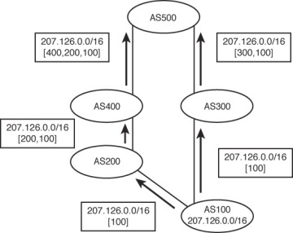
BGP Attribute – AS PATH
Each hop adds ASN to the path
-Only externally
http://www.ciscopress.com/articles/article.asp?p=2738462&seqNum=2

Slide 21
Recap of Global Internet, TCP/IP
Local Preference vs MED

Slide 22
BGP Attribute – Local Preference
How do you load balance between
two links using BGP?
AS1
At A:
129.82.138.0/17 → 10
129.82.138.128/17 → 5
At C:
129.82.138.0/17 → 5
129.82.138.128/17 → 10
AS2
129.82.138.0/16
a
b
c
d
http://www.ciscopress.com/articles/article.asp?p=2738462&seqNum=2

Slide 23
BGP Attribute – MED (Multi exit discriminator
AS1 and AS2 has two paths
between them
AS1 tells AS2 it’s MED for
influencing AS2’s path selection
Lower cost wins
AS1
AS2
129.82.134.0/16
a
b
c
d

Slide 24



How does BGP relate to IP?
Next hop | Announcing AS| Target Prefix| Path
203.189.128.233 | 23673 | 149.149.0.0/16 | 23673 1299
R2
R4
a
b
203.189.128.233
BGP tells you which IP router to use

Slide 25
BGP Decision process
At ADJ-RIB-IN calculate degree of preference until one route for
each destination remains!!
  select route with highest LOCAL-PREF
  Select route with shortest AS-PATH
  Select route with lowest MED
  Select route with smallest NEXT-HOP cost
  Select route learned from E-BGP peer with lowest ID
  Select route learned from I-BGP peer with lowest ID
Install selected route in LOC-RIB
Update ADJ-RIB-OUT, notify peers
  You can only send what is in LOC-RIB (or a subset of it)

Slide 26
Transport vs. network layer
network layer: logical communication between hosts
transport layer: logical communication between processes
  relies on, enhances, network layer services
3-<number>

Slide 27

Multiplexing/demultiplexing
multiplexing at sender:
handle data from multiple
sockets, add transport header (later used for demultiplexing)
demultiplexing at receiver:
use header info to deliver
received segments to correct
socket
application
application
P1
P2
application
socket
P3
transport
P4
process
transport
network
transport
network
link
network
link
physical
link
physical
physical

Slide 28
Transport protocols
What are the two types of Transport protocols?
If you had to write your own transport protocol, what functionality would you implement?

Slide 29

TCP vs UDP
length, in bytes of UDP segment, including header
32 bits
source port #
dest port #
length
checksum
application
data
(payload)
UDP segment format

Slide 30
TCP vs UDP
Which is connection oriented and which is connection less?
If there is no connection, how does UDP know where to return packets?

Slide 31

TCP Three-way Handshake
The idea is to tell each other
The ISNs
SYN → Client tells server that
it wants to open a connection,
Client’s ISN = x
SYN+ ACK → Server tells
Client → Okay → Server’s ISN
= y, ACK = CLSeq + 1
Why increment by 1?
Timeline for three-way handshake algorithm

Slide 32
How long should the sender wait?
Receiver
Sender
For TCP, timeout is a function
of RTT
Keep a running estimate of RTTs
by watching the ACKs
EstimatedRTT = (1 – α) • EstimatedRTT
+ α • SampleRTT
Alpha is generally 0.125
Timeout = 2* EstimatedRTT
Packet
Timeout
ACK
Retransmit

Slide 33

Sliding Window Revisited
Sending Side
LastByteAcked ≤ LastByteSent
LastByteSent ≤ LastByteWritten
Receiving Side
LastByteRead < NextByteExpected
NextByteExpected ≤ LastByteRcvd + 1
Relationship between TCP send buffer (a) and receive buffer (b).

Slide 34

TCP Fast Retransmission
Timeouts are wasteful
Triple duplicate ACKs
Retransmits before timeout

Slide 35
TCP: closing a connection
client state
server state
ESTAB
ESTAB
clientSocket.close()
FIN_WAIT_1
can no longer
send but can
receive data
FINbit=1, seq=x
CLOSE_WAIT
ACKbit=1; ACKnum=x+1
can still
send data
FIN_WAIT_2
wait for server
close
LAST_ACK
FINbit=1, seq=y
TIMED_WAIT
can no longer
send data
ACKbit=1; ACKnum=y+1
timed wait
for 2*max
segment lifetime
CLOSED
CLOSED
Transport Layer
3-<number>

Slide 36
TCP Flow Control vs Congestion Control
Flow control - between sender and receiver
Congestion control – In the network!
FC – Save the receiver
CC – Save the network! ← Literally (Congestive collapse 1986→ 1987/1988)

Slide 37

Queuing Disciplines
Fair Queuing
Round-robin service of four flows at a router

Slide 38
Metrics: Throughput vs Delay
High throughput –
Throughput: measured performance of a system –E.g., number of bits/second of data that get through
Low delay –
Delay: time required to deliver a packet or message –E.g., number of ms to deliver a packet •
These two metrics are sometimes at odds –
  More packets = more queuing
Transport Layer
3-<number>

Slide 39
Min Max Fair queuing
Assume n clients
Channel capacity C
Give c/n to each client
  If C1 does not want c/n
  Divide the excess capacity equally among others
  So everyone else gets c/n + (c/n – c1)/n-1
  Repeat for C2 and others

Slide 40
TCP Congestion Control
What is the basic idea?
additively increase window size …
…. until loss occurs (then cut window in half)
AIMD saw tooth
behavior: probing
for bandwidth
cwnd: TCP sender
congestion window size
time

Slide 41
Congestion control - How much to increase and decrease?
approach: sender increases transmission rate (window size), probing for usable bandwidth, until loss occurs
  additive increase: increase cwnd by 1 MSS every RTT until loss detected
  multiplicative decrease: cut cwnd in half after loss
additively increase window size …
…. until loss occurs (then cut window in half)
AIMD saw tooth
behavior: probing
for bandwidth
cwnd: TCP sender
congestion window size
time

Slide 42
TCP Slow Start
Host A
Host B
Why not use a large number of segments?
one segment
RTT
two segments
four segments
time

Slide 43
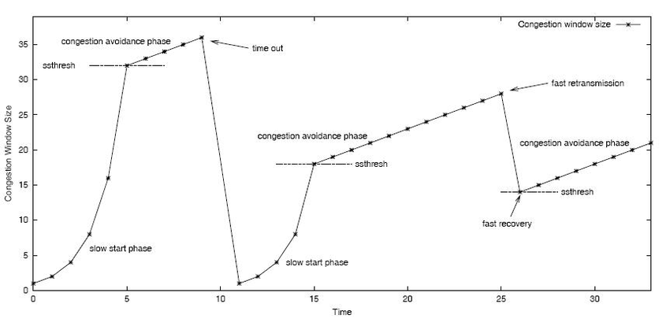
TCP Slow Start and congestion avoidance
How to set
ssthresh?
Initially – Randomly
high
Later – adjusted as
congestion happens
Why cut in half? Why not
Start from the previous value?
https://www.researchgate.net/figure/3-TCP-slow-start-phase-and-congestion-avoidance-phase_fig3_225731524

Slide 44

TCP Throughput
TCP average throughput as a function of window size and RTT?
Ignore slow start, assume long TCP flow
Let W be the window size
Throughput = W/RTT
After loss, throughput = W/2*RTT
Average throughput = 0.75W/RTT
Throughput = (1.22*MSS)*(RTT/sqrt(Loss)) ← Magic formula
What is the loss rate to maximize 100Gbps pipe with
9000 bytes segments and 100ms RTT? Hint – must be very very low

Slide 45
Next steps: TCP Delay
We will briefly touch on TCP delay in the next class
Start with applications!

Slide 46
Apps (HTTP)
Data
Apps (HTTP)
Segments
Transport (TCP/UDP)
Transport (TCP/UDP)
Network (IP)
Packets
Network (IP)
Link (Ethernet)
Frames
Link (Ethernet)
Ethernet Interface
Ethernet Interface
Bits (1010001)

