Slide 1
CSC4200/5200 – Computer Networking
Network Security - Continued
Instructor: Susmit Shannigrahi
sshannigrahi@tntech.edu
GTA: dereddick42@students.tntech.edu

Slide 2
Security Roadmap
What is network security?
Principles of cryptography
Message integrity
Authentication
Securing TCP connections: SSL
Network layer security: IPsec
Operational security: firewalls and IDS
Network Security

Slide 3
What is network security?
confidentiality: only sender, intended receiver should “understand” message contents
  sender encrypts message
  receiver decrypts message
authentication: sender, receiver want to confirm identity of each other
message integrity: sender, receiver want to ensure message not altered (in transit, or afterwards) without detection
access and availability: services must be accessible and available to users

Slide 4



Friends and enemies: Alice, Bob, Trudy
Bob and Alice want to communicate “securely”
Trudy may intercept, delete, add messages
Alice
Bob
channel
data, control messages
secure
sender
s
data
secure
receiver
data
Trudy

Slide 5
Some example problems
  eavesdrop: intercept messages
  actively insert messages into connection
  impersonation: can fake (spoof) source address in packet (or any field in packet)
  hijacking: “take over” ongoing connection by removing sender or receiver, inserting himself in place
  denial of service: prevent service from being used by others (e.g., by overloading resources)

Slide 6
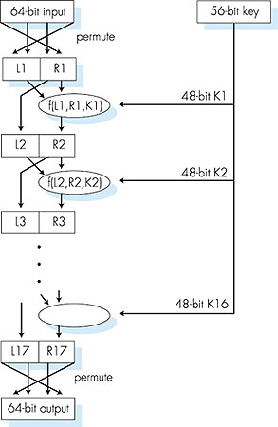
Symmetric key crypto: DES
DES operation
initial permutation
16 identical “rounds” of function application, each using different 48 bits of key
final permutation

Slide 7

Public key cryptography
+
Bob’s public
key
K
B
K
-
Bob’s private
key
B
plaintext
message, m
encryption
algorithm
ciphertext
decryption
algorithm
plaintext
message
+
K (m)
-
+
B
m = K (K (m))
B
B

Slide 8
Roadmap
What is network security?
Principles of cryptography
Message integrity
Authentication
Securing TCP connections: SSL
Network layer security: IPsec
Operational security: firewalls and IDS

Slide 9
Authentication
Goal: Bob wants Alice to “prove” her identity to him
Protocol ap1.0: Alice says “I am Alice”
“I am Alice”
Failure scenario??
Network Security

Slide 10
Authentication
Goal: Bob wants Alice to “prove” her identity to him
Protocol ap1.0: Alice says “I am Alice”
in a network,
Bob can not “see” Alice, so Trudy simply declares
herself to be Alice
“I am Alice”
Network Security

Slide 11
Authentication: another try
Protocol ap2.0: Alice says “I am Alice” in an IP packet
containing her source IP address
Alice’s
IP address
“I am Alice”
Failure scenario??
Network Security

Slide 12
Authentication: another try
Protocol ap2.0: Alice says “I am Alice” in an IP packet
containing her source IP address
Trudy can create
a packet “spoofing”
Alice’s address
Alice’s
IP address
“I am Alice”
Network Security

Slide 13
Authentication: another try
Protocol ap3.0: Alice says “I am Alice” and sends her
secret password to “prove” it.
Alice’s
IP addr
Alice’s
password
“I’m Alice”
Failure scenario??
Alice’s
IP addr
OK
Network Security

Slide 14

Authentication: another try
Protocol ap3.0: Alice says “I am Alice” and sends her
secret password to “prove” it.
Alice’s
IP addr
Alice’s
password
“I’m Alice”
playback attack: Trudy records Alice’s packet
and later
plays it back to Bob
Alice’s
IP addr
OK
Alice’s
IP addr
Alice’s
password
“I’m Alice”
Network Security

Slide 15
Authentication: yet another try
Protocol ap3.1: Alice says “I am Alice” and sends her
encrypted secret password to “prove” it.
Alice’s
IP addr
encrypted
password
“I’m Alice”
Failure scenario??
Alice’s
IP addr
OK
Network Security

Slide 16
Authentication: yet another try
Protocol ap3.1: Alice says “I am Alice” and sends her
encrypted secret password to “prove” it.
Alice’s
IP addr
encrypted
password
“I’m Alice”
record
and
playback
still works!
Alice’s
IP addr
OK
Alice’s
IP addr
encrypted
password
“I’m Alice”
Network Security

Slide 17
Authentication: yet another try
Goal: avoid playback attack
nonce: number (R) used only once-in-a-lifetime
ap4.0: to prove Alice “live”, Bob sends Alice nonce, R. Alice
must return R, encrypted with shared secret key
“I am Alice”
R
K (R)
Alice is live, and only Alice knows key to encrypt nonce, so it must be Alice!
A-B
Failures, drawbacks?
Network Security

Slide 18
Authentication: ap5.0
ap4.0 requires shared symmetric key
can we authenticate using public key techniques?
ap5.0: use nonce, public key cryptography
“I am Alice”
Bob computes
R
+
-
-
K
(K (R)) = R
K (R)
A
A
A
and knows only Alice could have the private key, that encrypted R such that
“send me your public key”
+
K
A
+
-
K
(K (R)) = R
A
A
Network Security

Slide 19
ap5.0: security hole
man (or woman) in the middle attack: Trudy poses as Alice (to Bob) and as Bob (to Alice)
I am Alice
I am Alice
R
-
K (R)
T
R
-
Send me your public key
K (R)
+
A
K
T
Send me your public key
+
K
A
+
K (m)
Trudy gets
T
-
+
+
m = K (K (m))
K (m)
T
T
-
A
sends m to Alice encrypted with Alice’s public key
+
m = K (K (m))
A
A
Network Security

Slide 20
ap5.0: security hole
man (or woman) in the middle attack: Trudy poses as Alice (to Bob) and as Bob (to Alice)
difficult to detect:
Bob receives everything that Alice sends, and vice versa.
problem is that Trudy receives all messages as well!
Network Security

Slide 21
Roadmap
What is network security?
Principles of cryptography
Message integrity
Authentication
Securing TCP connections: SSL
Network layer security: IPsec
Operational security: firewalls and IDS

Slide 22
SSL: Secure Sockets Layer
widely deployed security protocol
  supported by almost all browsers, web servers
  https
  billions $/year over SSL
mechanisms: [Woo 1994], implementation: Netscape
variation -TLS: transport layer security, RFC 2246
provides
  confidentiality
  integrity
  authentication
original goals:
  Web e-commerce transactions
  encryption (especially credit-card numbers)
  Web-server authentication
  optional client authentication
  minimum hassle in doing business with new merchant
available to all TCP applications
  secure socket interface
Network Security

Slide 23
SSL and TCP/IP
Application
Application
SSL
TCP
TCP
IP
IP
normal application
application with SSL
SSL provides application programming interface (API) to applications
C and Java SSL libraries/classes readily available
Network Security

Slide 24

Could do something like PGP:
-
K_{A}
.
.
-
-
K_{A}(H(m))
K_{S}
m
H( )
K_{A}( )
.
+
K_{S}( )
m
+
Internet
.
+
K_{S}
K_{B}( )
+
K_{B}(K_{S} )
+
K_{B}
but want to send byte streams & interactive data
want set of secret keys for entire connection
want certificate exchange as part of protocol: handshake phase
Network Security

Slide 25
Real SSL: handshake (1)
Purpose
server authentication
negotiation: agree on crypto algorithms
establish keys
client authentication (optional)
Network Security

Slide 26
Real SSL: handshake (2)
client sends list of algorithms it supports, along with client nonce
server chooses algorithms from list; sends back: choice + certificate + server nonce
client verifies certificate, extracts server’s public key, generates pre_master_secret, encrypts with server’s public key, sends to server
client and server independently compute encryption and MAC keys from pre_master_secret and nonces
client sends a MAC of all the handshake messages
server sends a MAC of all the handshake messages
Network Security

Slide 27
Real SSL connection
handshake: ClientHello
handshake: ServerHello
handshake: Certificate
handshake: ServerHelloDone
handshake: ClientKeyExchange
ChangeCipherSpec
everything
henceforth
is encrypted
handshake: Finished
ChangeCipherSpec
handshake: Finished
application_data
application_data
Alert: warning, close_notify
TCP FIN follows
Network Security

Slide 28
SSL record protocol
data
data
fragment
MAC
data
fragment
MAC
record
header
encrypted
data and MAC
record
header
encrypted
data and MAC
record header: content type; version; length
MAC: includes sequence number, MAC key M_{x}
fragment: each SSL fragment 2¹⁴ bytes (~16 Kbytes)
Network Security

Slide 29
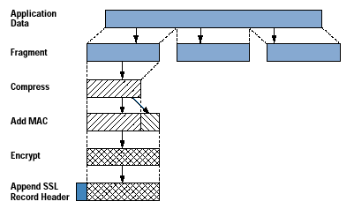
Application and SSL
Cisco.com

Slide 30
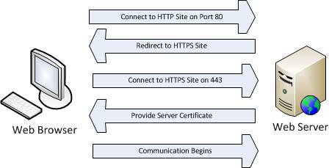
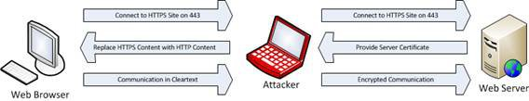
SSL and HTTPS
http://techgenix.com/understanding-man-in-the-middle-attacks-arp-part4/

Slide 31
Roadmap
What is network security?
Principles of cryptography
Message integrity
Authentication
Securing TCP connections: SSL
Network layer security: VPN and IPsec
Operational security: firewalls and IDS

Slide 32
What is network-layer confidentiality ?
between two network entities:
sending entity encrypts datagram payload, payload could be:
  TCP or UDP segment, ICMP message, OSPF message ….
all data sent from one entity to other would be hidden:
  web pages, e-mail, P2P file transfers, TCP SYN packets …
“blanket coverage”
Network Security

Slide 33
Virtual Private Networks (VPNs)
motivation:
institutions often want private networks for security.
  costly: separate routers, links, DNS infrastructure.
VPN: institution’s inter-office traffic is sent over public Internet instead
  encrypted before entering public Internet
  logically separate from other traffic
Network Security

Slide 34



Virtual Private Networks (VPNs)
public
Internet
IP
header
laptop
w/ IPsec
IPsec
header
Secure
payload
Secure
payload
IP
header
IPsec
header
salesperson
in hotel
IPsec
header
IP
header
Secure
payload
router w/
IPv4 and IPsec
router w/
IPv4 and IPsec
payload
IP
header
IP
header
payload
branch office
headquarters
Network Security

Slide 35
IPsec services
data integrity
origin authentication
replay attack prevention
confidentiality
two protocols providing different service models:
  AH
  ESP
Network Security

Slide 36
IPsec transport mode
IPsec
IPsec
IPsec datagram emitted and received by end-system
protects upper level protocols
Network Security

Slide 37
IPsec – tunneling mode
IPsec
IPsec
IPsec
IPsec
edge routers IPsec-aware
hosts IPsec-aware
Network Security

Slide 38
Two IPsec protocols
Authentication Header (AH) protocol
  provides source authentication & data integrity but not confidentiality
Encapsulation Security Protocol (ESP)
  provides source authentication, data integrity, and confidentiality
  more widely used than AH
Network Security

Slide 39
Four combinations are possible!
Host mode with AH | Host mode with ESP
Tunnel mode with AH | Tunnel mode with ESP
most common and
most important
Network Security

Slide 40
IPsec datagram
focus for now on tunnel mode with ESP
“enchilada” authenticated
encrypted
new IP
header
ESP
hdr
original
IP hdr
Original IP
datagram payload
ESP
trl
ESP
auth
SPI
Seq
#
padding
pad
length
next
header
Network Security

Slide 41
What happens?
headquarters
Internet
branch office
200.168.1.100
193.68.2.23
R1
security association
R2
172.16.1/24
172.16.2/24
“enchilada” authenticated
encrypted
new IP
header
ESP
hdr
original
IP hdr
Original IP
datagram payload
ESP
trl
ESP
auth
SPI
Seq
#
padding
pad
length
next
header
Network Security

Slide 42
Roadmap
What is network security?
Principles of cryptography
Message integrity
Authentication
Securing TCP connections: SSL
Network layer security: VPN and IPsec
Operational security: firewalls and IDS

Slide 43


Firewalls
firewall
isolates organization’s internal net from larger Internet, allowing some packets to pass, blocking others
administered
network
public
Internet
trusted “good guys”
untrusted “bad guys”
firewall
Network Security

Slide 44
Firewalls: why
prevent denial of service attacks:
  SYN flooding: attacker establishes many bogus TCP connections, no resources left for “real” connections
prevent illegal modification/access of internal data
  e.g., attacker replaces CIA’s homepage with something else
allow only authorized access to inside network
  set of authenticated users/hosts
three types of firewalls:
  stateless packet filters
  stateful packet filters
  application gateways
Network Security

Slide 45
Stateless packet filtering
Should arriving packet be allowed in? Departing packet let out?
internal network connected to Internet via router firewall
router filters packet-by-packet, decision to forward/drop packet based on:
  source IP address, destination IP address
  TCP/UDP source and destination port numbers
  ICMP message type
  TCP SYN and ACK bits
Network Security

Slide 46
Stateless packet filtering: example
example 1: block incoming and outgoing datagrams with IP protocol field = 17 and with either source or dest port = 23
  result: all incoming, outgoing UDP flows and telnet connections are blocked
example 2: block inbound TCP segments with ACK=0.
  result: prevents external clients from making TCP connections with internal clients, but allows internal clients to connect to outside.
Network Security

Slide 47
Stateless packet filtering: more examples
Policy | Firewall Setting
No outside Web access. | Drop all outgoing packets to any IP address, port 80
No incoming TCP connections, except those for institution’s public Web server only. | Drop all incoming TCP SYN packets to any IP except 130.207.244.203, port 80
Prevent Web-radios from eating up the available bandwidth. | Drop all incoming UDP packets - except DNS and router broadcasts.
Prevent your network from being used for a smurf DoS attack. | Drop all ICMP packets going to a “broadcast” address (e.g. 130.207.255.255).
Prevent your network from being tracerouted | Drop all outgoing ICMP TTL expired traffic
Network Security

Slide 48
Access Control Lists
ACL: table of rules, applied top to bottom to incoming packets: (action, condition) pairs
action | source address | dest address | protocol | source port | dest port | flag bit
allow | 222.22/16 | outside of 222.22/16 | TCP | > 1023 | 80 | any
allow | outside of 222.22/16 | 222.22/16 | TCP | 80 | > 1023 | ACK
allow | 222.22/16 | outside of 222.22/16 | UDP | > 1023 | 53 | ---
allow | outside of 222.22/16 | 222.22/16 | UDP | 53 | > 1023 | ----
deny | all | all | all | all | all | all
Network Security

Slide 49
Stateful packet filtering
stateless packet filter: heavy handed tool
  admits packets that “make no sense,” e.g., dest port = 80, ACK bit set, even though no TCP connection established:
action | source address | dest address | protocol | source port | dest port | flag bit
allow | outside of 222.22/16 | 222.22/16 | TCP | 80 | > 1023 | ACK
stateful packet filter: track status of every TCP connection
  track connection setup (SYN), teardown (FIN): determine whether incoming, outgoing packets “makes sense”
  timeout inactive connections at firewall: no longer admit packets
Network Security

Slide 50
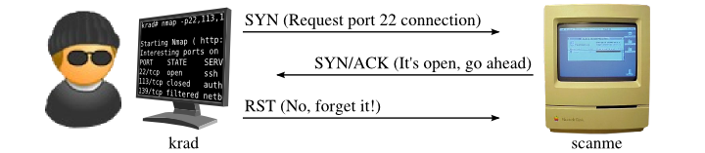
Stateless packet filtering: problems
If network security interests you: https://nmap.org/book/

Slide 51
Stateful packet filtering
ACL augmented to indicate need to check connection state table before admitting packet
action | source address | dest address | proto | source port | dest port | flag bit | check conxion
allow | 222.22/16 | outside of 222.22/16 | TCP | > 1023 | 80 | any
allow | outside of 222.22/16 | 222.22/16 | TCP | 80 | > 1023 | ACK | x
allow | 222.22/16 | outside of 222.22/16 | UDP | > 1023 | 53 | ---
allow | outside of 222.22/16 | 222.22/16 | UDP | 53 | > 1023 | ---- | x
deny | all | all | all | all | all | all
Network Security

Slide 52

Application gateways
gateway-to-remote
host telnet session
host-to-gateway
telnet session
filters packets on application data as well as on IP/TCP/UDP fields.
example: allow select internal users to telnet outside.
application
gateway
router and filter
1. require all telnet users to telnet through gateway.
2. for authorized users, gateway sets up telnet connection to dest host. Gateway relays data between 2 connections
3. router filter blocks all telnet connections not originating from gateway.
Network Security

Slide 53
Application gateways
filter packets on application data as well as on IP/TCP/UDP fields.
example: allow select internal users to telnet outside
host-to-gateway
telnet session
application
gateway
router and filter
gateway-to-remote
host telnet session
1. require all telnet users to telnet through gateway.
2. for authorized users, gateway sets up telnet connection to dest host. Gateway relays data between 2 connections
3. router filter blocks all telnet connections not originating from gateway.
Network Security

Slide 54
Limitations of firewalls, gateways
IP spoofing: router can’t know if data “really” comes from claimed source
if multiple app’s. need special treatment, each has own app. gateway
client software must know how to contact gateway.
  e.g., must set IP address of proxy in Web browser
filters often use all or nothing policy for UDP
tradeoff: degree of communication with outside world, level of security
many highly protected sites still suffer from attacks
Network Security

Slide 55
Intrusion detection systems
packet filtering:
  operates on TCP/IP headers only
  no correlation check among sessions
IDS: intrusion detection system
  deep packet inspection: look at packet contents (e.g., check character strings in packet against database of known virus, attack strings)
  examine correlation among multiple packets
    port scanning
    network mapping
    DoS attack
Network Security

Slide 56
Intrusion detection systems
multiple IDSs: different types of checking at different locations
firewall
internal
network
Internet
IDS
sensors
Web
server
DNS
server
FTP
server
demilitarized
zone
Network Security

Slide 57
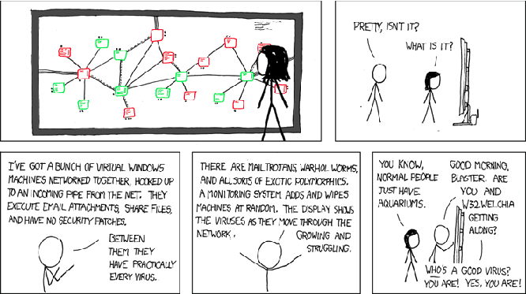
Honeypots
mechanism set to detect, deflect unauthorized use of systems.

Slide 58
Network Security (summary)
basic techniques…...
  cryptography (symmetric and public)
  message integrity
  end-point authentication
…. used in many different security scenarios
  secure email
  secure transport (SSL)
  IP sec
  802.11
operational security: firewalls and IDS
Network Security

