Slide 1
CSC4200/5200 – Computer Networking
NAT, Routing
Instructor: Susmit Shannigrahi
sshannigrahi@tntech.edu
GTA: dereddick42@students.tntech.edu

Slide 2

Apps (HTTP)
Data
Apps (HTTP)
Segments
Transport (TCP/UDP)
Transport (TCP/UDP)
Network (IP)
Packets
Network (IP)
Link (Ethernet)
Frames
Link (Ethernet)
Ethernet Interface
Ethernet Interface
Bits (1010001)

Slide 3
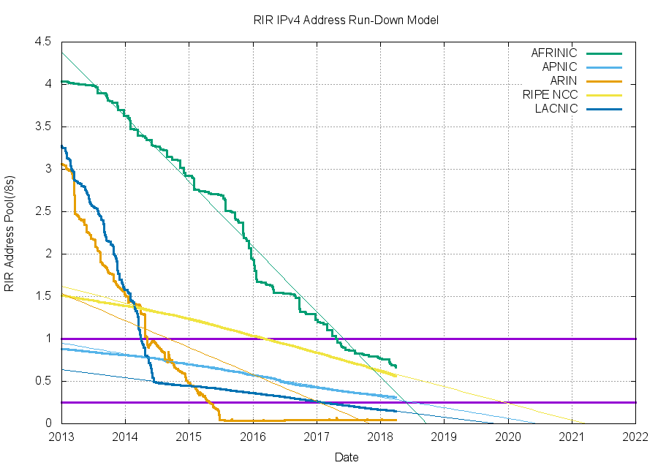
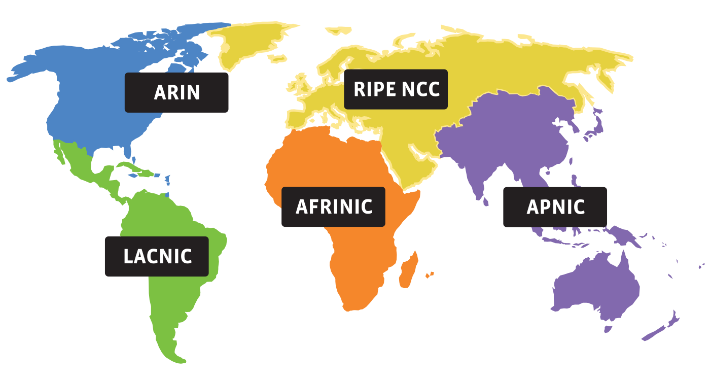
Address shortage
IPv4 – 32 bits – Around 4 billion
Notes:
Ndn can help organizing the namespaces
Once that’s done, data discovery and provenance is
Straight forward
Retrieval, transparent failover, and specialized operations
In this work, we take a real access log and try to quantify NDN’s improvements to a climate
workflow

Slide 4
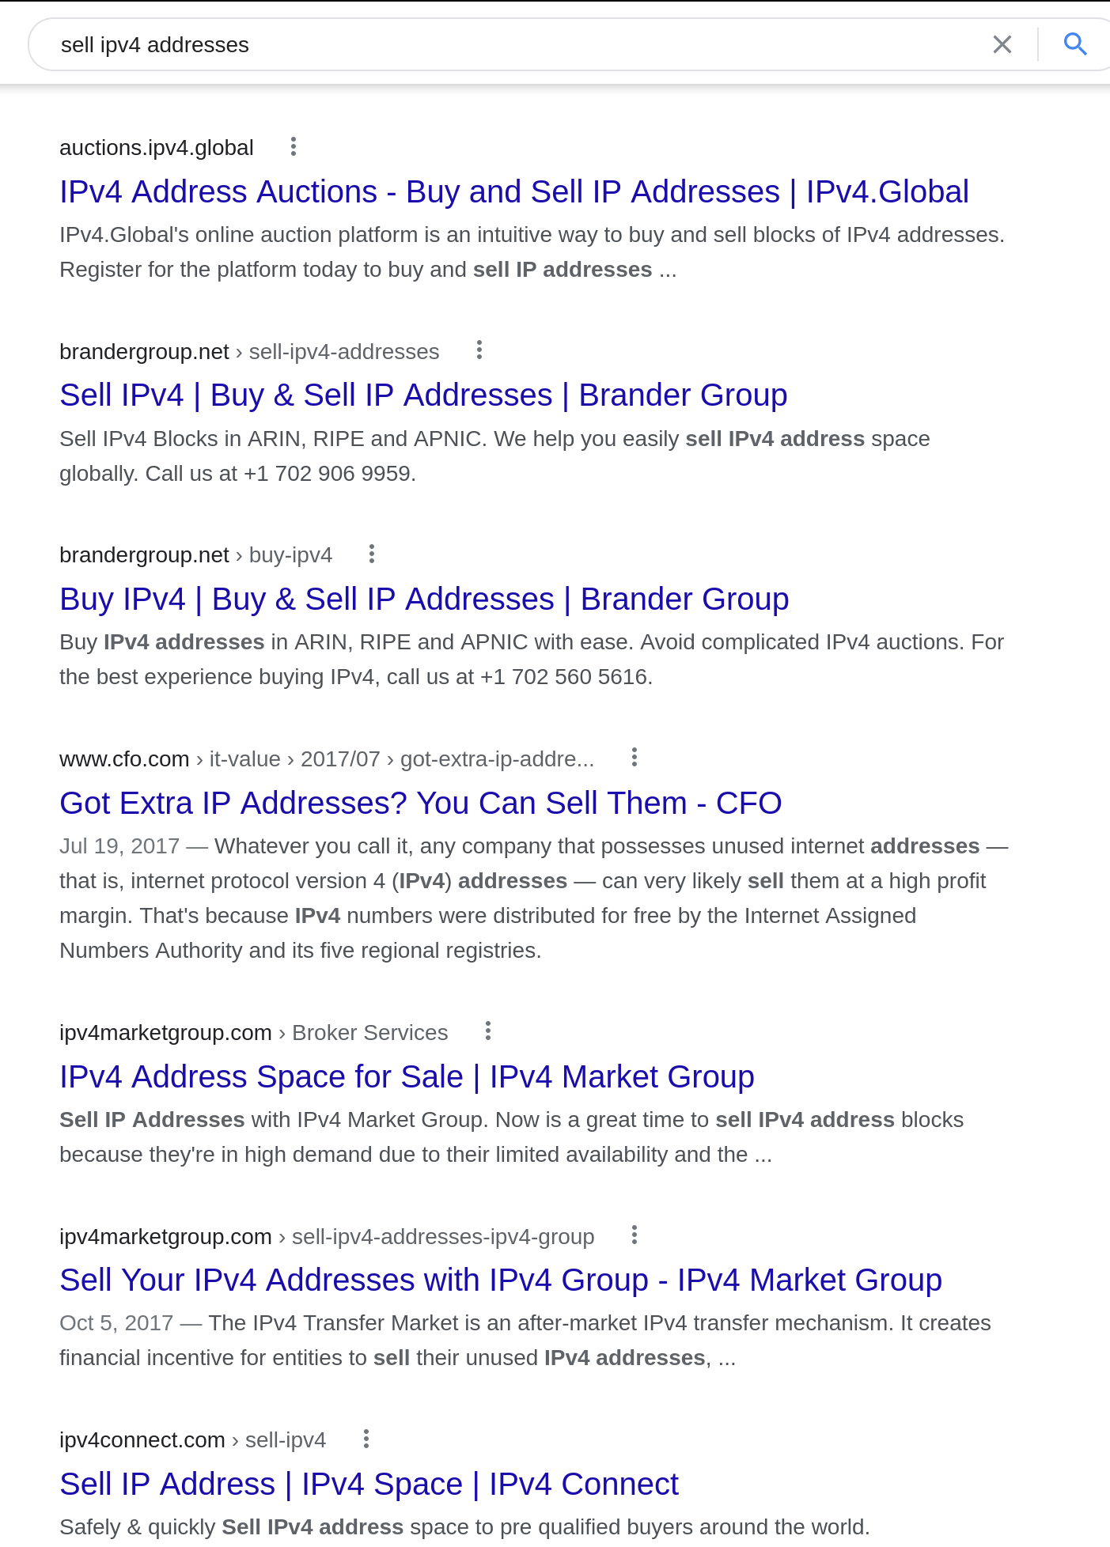
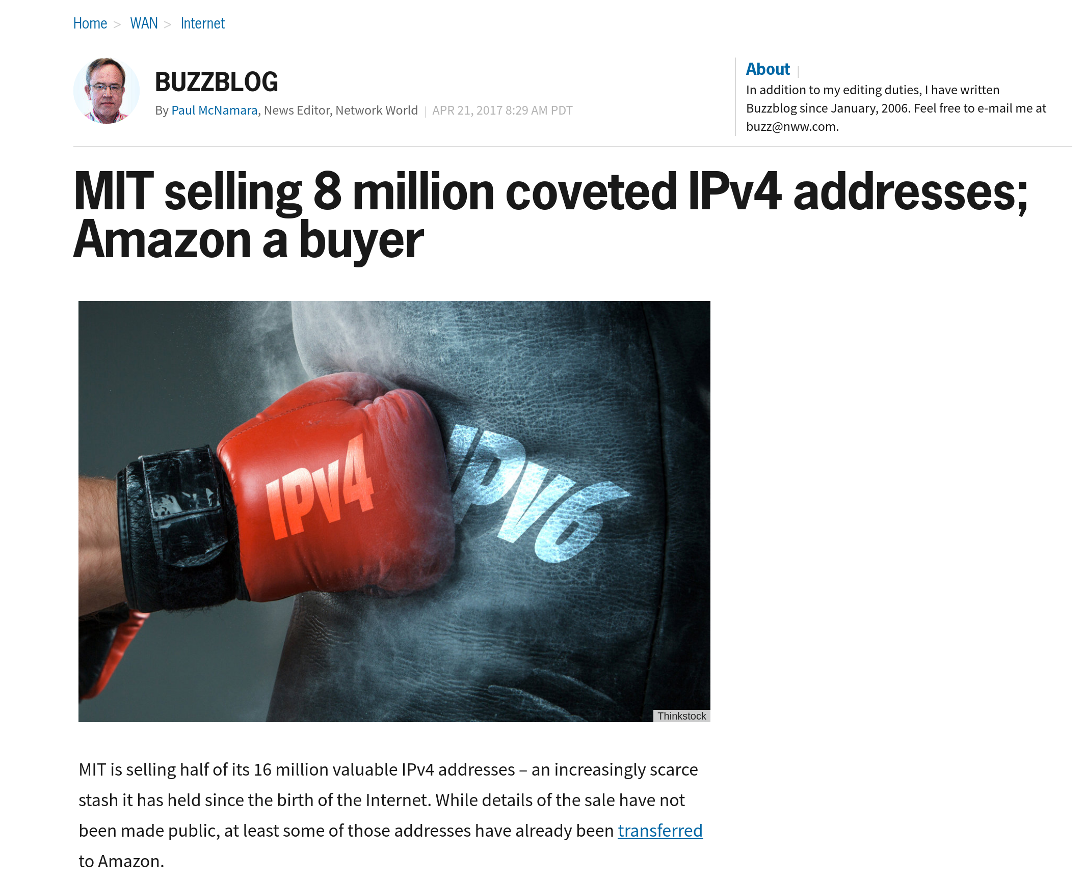
Solution?

Slide 5

NAT: network address translation
rest of
Internet
local network
(e.g., home network)
10.0.0/24
10.0.0.1
10.0.0.4
10.0.0.2
138.76.29.7
10.0.0.3
datagrams with source or
destination in this network
have 10.0.0/24 address for
source, destination (as usual)
Notes:
Ndn can help organizing the namespaces
Once that’s done, data discovery and provenance is
Straight forward
Retrieval, transparent failover, and specialized operations
In this work, we take a real access log and try to quantify NDN’s improvements to a climate
workflow

Slide 6
NAT: Network Address Translation
rest of
Internet
local network
(e.g., home network)
10.0.0/24
10.0.0.1
10.0.0.4
10.0.0.2
138.76.29.7
10.0.0.3
datagrams with source or
destination in this network
have 10.0.0/24 address for
source, destination (as usual)
Notes:
Ndn can help organizing the namespaces
Once that’s done, data discovery and provenance is
Straight forward
Retrieval, transparent failover, and specialized operations
In this work, we take a real access log and try to quantify NDN’s improvements to a climate
workflow

Slide 7
NAT: network address translation
NAT translation table
WAN side addr LAN side addr
2: NAT router
changes datagram
source addr from
10.0.0.1, 3345 to
138.76.29.7, 5001,
updates table
1: host 10.0.0.1
sends datagram to
128.119.40.186, 80
138.76.29.7, 5001 10.0.0.1, 3345
…… ……
S: 10.0.0.1, 3345
D: 128.119.40.186, 80
10.0.0.1
1
2
S: 138.76.29.7, 5001
D: 128.119.40.186, 80
10.0.0.4
10.0.0.2
138.76.29.7
S: 128.119.40.186, 80
D: 10.0.0.1, 3345
4
S: 128.119.40.186, 80
D: 138.76.29.7, 5001
3
4: NAT router
changes datagram
dest addr from
138.76.29.7, 5001 to 10.0.0.1, 3345
10.0.0.3
3: reply arrives
dest. address:
138.76.29.7, 5001
Kurose/Ross

Slide 8
NAT
One IP address for all devices
  Addresses the address space problem
Can change local addresses without involving the ISP
NAT traversal problem
  Is a server is behind NAT, how does
  the client talk to it?
10.0.0.1
client
?
10.0.0.4
138.76.29.7
NAT
router
Notes:
Ndn can help organizing the namespaces
Once that’s done, data discovery and provenance is
Straight forward
Retrieval, transparent failover, and specialized operations
In this work, we take a real access log and try to quantify NDN’s improvements to a climate
workflow

Slide 9
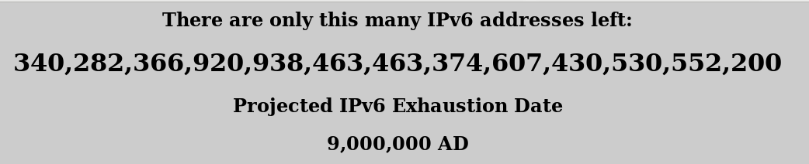
Address shortage – Better solution? IPv6
https://samsclass.info/ipv6/exhaustion-2016.htm
IPv6 – 128 bits
Notes:
Ndn can help organizing the namespaces
Once that’s done, data discovery and provenance is
Straight forward
Retrieval, transparent failover, and specialized operations
In this work, we take a real access log and try to quantify NDN’s improvements to a climate
workflow

Slide 10
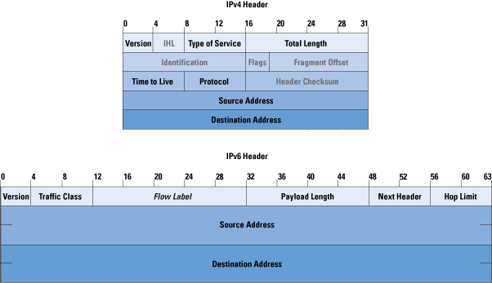
Address shortage – Better solution? IPv6
https://samsclass.info/ipv6/exhaustion-2016.htm
IPv4 – 128 bits
Notes:
Ndn can help organizing the namespaces
Once that’s done, data discovery and provenance is
Straight forward
Retrieval, transparent failover, and specialized operations
In this work, we take a real access log and try to quantify NDN’s improvements to a climate
workflow

Slide 11



Address shortage – Better solution?
Get rid of the Addresses!
Next generation of the Internet
You don’t care about the hosts anyway
  For most part
Why not ask for content directly?
  Information Centric Networking (ICN)
ICN
(name based forwarding)
Interest
(/google/index.html)
Data
(/google)
Notes:
Ndn can help organizing the namespaces
Once that’s done, data discovery and provenance is
Straight forward
Retrieval, transparent failover, and specialized operations
In this work, we take a real access log and try to quantify NDN’s improvements to a climate
workflow

Slide 12
ICMP: Internet Control Message Protocol
Errors in network:
  Router does not know how to forward a packet
  Packet is broken
IP is best effort
  Can silently drop packets
How would be ever know something is wrong?
  Feedback about the problem
  ICMP

Slide 13
ICMP: Internet Control Message Protocol
Used for
  error reporting: unreachable host, network, port, protocol
  echo request/reply (used by ping)
Application at network-layer
  ICMP msgs carried in IP datagrams
  Essentially at application layer
  Considered part of IP
Type Code description
0 0 echo reply (ping)
3 0 dest. network unreachable
3 1 dest host unreachable
3 2 dest protocol unreachable
3 3 dest port unreachable
3 6 dest network unknown
3 7 dest host unknown
4 0 source quench (congestion
control - not used)
8 0 echo request (ping)
9 0 route advertisement
10 0 router discovery
11 0 TTL expired
12 0 bad IP header
Network Layer
4-<number>

Slide 14
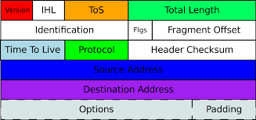
ICMP and Time to Live
Each time a host sends a packet it sets the TTL field
Each router that forwards it decrements the number
When TTL reaches 0, send a time exceeded message
TTL=3
TTL=1
TTL=2
TTL=0

Slide 15
Traceroute and ICMP
source sends series of UDP segments to dest
  first set has TTL =1
  second set has TTL=2, etc.
  unlikely port number
when nth set of datagrams arrives to nth router:
  router discards datagrams
  and sends source ICMP messages (type 11, code 0)
  ICMP messages includes name of router & IP address
when ICMP messages arrives, source records RTTs
stopping criteria:
UDP segment eventually arrives at destination host
destination returns ICMP “port unreachable” message (type 3, code 3)
source stops
3 probes
3 probes
3 probes

Slide 16
Ping and ICMP
source sends an ICMP echo message
Destination sends an ICMP echo reply
ICMP echo message
ICMP echo reply

Slide 17

Forwarding vs Routing
Forwarding:
          to select an output port based on destination address and routing table
          Local path
    Routing:
          process by which routing table is built
          End-to-end path
Notes:
Ndn can help organizing the namespaces
Once that’s done, data discovery and provenance is
Straight forward
Retrieval, transparent failover, and specialized operations
In this work, we take a real access log and try to quantify NDN’s improvements to a climate
workflow

Slide 18
Why bother?
5
v
3
w
2
5
Quality of path affects performance
  Longer path = more delay
Balance path usage, avoid congested paths
Deal with failures
u
2
1
z
3
1
2
x
y
1
Notes:
Ndn can help organizing the namespaces
Once that’s done, data discovery and provenance is
Straight forward
Retrieval, transparent failover, and specialized operations
In this work, we take a real access log and try to quantify NDN’s improvements to a climate
workflow

Slide 19
Router architecture overview
Two key router functions:
run routing algorithms/protocol (RIP, OSPF, BGP)
forwarding datagrams from incoming to outgoing link
Control Plane = routing
Vs
Data Plane = forwarding
forwarding tables computed,
pushed to input ports
routing
processor
routing, management
control plane (software)
forwarding data plane (hardware)
high-speed
forwarding
fabric
router input ports
router output ports

Slide 20
Graph abstraction
5
v
3
w
2
5
u
2
1
z
3
1
2
x
y
1
graph: G = (N,E)
N = set of routers = { u, v, w, x, y, z }
E = set of links ={ (u,v), (u,x), (v,x), (v,w), (x,w), (x,y), (w,y), (w,z), (y,z) }
X→ Z
Cost (x,v,w,z) = cost(x,v) + cost (v, w) + cost(w,z) = 10
Cost (x,w,z) = cost(x,w) + cost(w,z) = 8
Cost(x, y, z) = ?
Objective → find the lowest cost path between all nodes

Slide 21
Dijkstra’s Shortest-Path Algorithm
5
Given a graph (network) with link costs
Find the lowest cost paths to all nodes
Iterative
  After n iterations, you will find least cost path to n nodes
S = Least cost paths already known, initially source node {U}
D(v): current cost of path from source(U) to node V
  Initially, D(v) = c(u,v) for all nodes v adjacent to u
  D(v) = ∞ for all other nodes
  Update D(v) as we go
v
3
w
2
5
u
2
1
z
3
1
x
2
1
y

Slide 22
Dijsktra’s Algorithm
1 Initialization:
2 N' = {u}
3 for all nodes v
4 if v adjacent to u
5 then D(v) = c(u,v)
6 else D(v) = ∞
7
8 Loop
9 find w not in N' such that D(w) is a minimum
10 add w to N'
11 update D(v) for all v adjacent to w and not in N' :
12 D(v) = min( D(v), D(w) + c(w,v) )
13 /* new cost to v is either old cost to v or known
14 shortest path cost to w plus cost from w to v */
15 until all nodes in N'

Slide 23
Dijkstra’s algorithm: example
D(v)
p(v)
D(w)
p(w)
D(x)
p(x)
D(y)
p(y)
D(z)
p(z)
Step
N'
0
u
7,u
3,u
5,u
∞
∞
1
uw
6,w
5,u
11,w
∞
2
uwx
6,w
11,w
14,x
uwxv
10,v
14,x
x
3
9
4
uwxvy
12,y
5
uwxvyz
5
7
4
8
notes:
construct shortest path tree by tracing predecessor nodes
ties can exist (can be broken arbitrarily)
u
3
w
y
z
2
3
7
4
v
Kurose/ross

Slide 24
Dijkstra’s algorithm: another example
Step
0
1
2
3
4
5
N'
u
ux
uxy
uxyv
uxyvw
uxyvwz
D(v),p(v)
2,u
2,u
2,u
D(w),p(w)
5,u
4,x
3,y
3,y
D(x),p(x)
1,u
D(y),p(y)
∞
2,x
D(z),p(z)
∞
∞
4,y
4,y
4,y
5
v
3
w
2
5
u
2
1
z
3
1
2
x
y
1
Network Layer
4-<number>

Slide 25
Dijsktra’s → Link State Routing
5
Each node keeps track of adjacent links
Each router broadcasts it’s state
Each router runs Dijkstra’s algorithm
Each router has complete picture of the network
Example: Open Shortest Path First (OSPF)
v
3
w
2
5
u
2
1
z
3
1
x
2
1
y

Slide 26
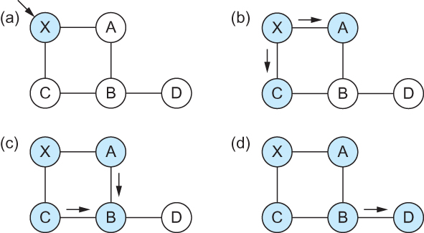
Link State Routing – controlled flooding
Flooding of link-state packets. (a) LSP arrives at node X; (b) X floods LSP to A and C; (c) A and C flood LSP to B (but not X); (d) flooding is complete

Slide 27
Link State Routing – controlled flooding
Flood when topology changes or link goes down
  Detected by periodic hello messages
  If message missed → link down
Refresh and flood periodically
Problems?
  High computational cost
  Reliable flooding may not be reliable

Slide 28
Apps (HTTP)
Data
Apps (HTTP)
Segments
Transport (TCP/UDP)
Transport (TCP/UDP)
Network (IP)
Packets
Network (IP)
Link (Ethernet)
Frames
Link (Ethernet)
Ethernet Interface
Ethernet Interface
Bits (1010001)

Slide 29
Next Steps
Reading Assignment:
https://book.systemsapproach.org/internetworking/basic-ip.html#error-reporting-icmp
About 10 minutes
Notes:
Ndn can help organizing the namespaces
Once that’s done, data discovery and provenance is
Straight forward
Retrieval, transparent failover, and specialized operations
In this work, we take a real access log and try to quantify NDN’s improvements to a climate
workflow

