Slide 1
CSC4200/5200 – Computer Networking
Network FUNDAMENTALS
Instructor: Susmit Shannigrahi
sshannigrahi@tntech.edu

Slide 2
Chapter 1: Fundamentals
Networking is ubiquitous
  What did you use it for today?
First things first:
  Terminology
  Basic tools
  What does it take to build an Internet?
Notes:
Ndn can help organizing the namespaces
Once that’s done, data discovery and provenance is
Straight forward
Retrieval, transparent failover, and specialized operations
In this work, we take a real access log and try to quantify NDN’s improvements to a climate
workflow

Slide 3
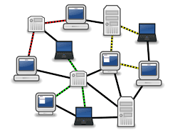
Links, Nodes, Network, Internet
You can view the network as a graph
Each device (a phone, a computer) is a node
Each connection is a link
  Wires = real links
  Bluetooth, Radio, Infrared = virtual links
Nodes + links = a network
  Many connected networks = Internet
Notes:
Ndn can help organizing the namespaces
Once that’s done, data discovery and provenance is
Straight forward
Retrieval, transparent failover, and specialized operations
In this work, we take a real access log and try to quantify NDN’s improvements to a climate
workflow

Slide 4
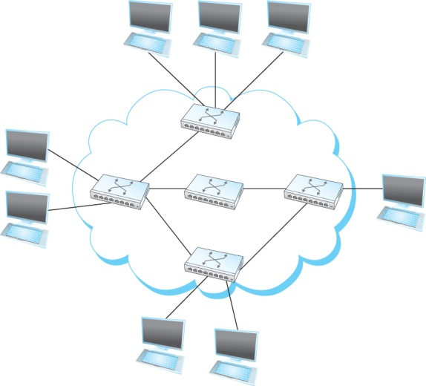
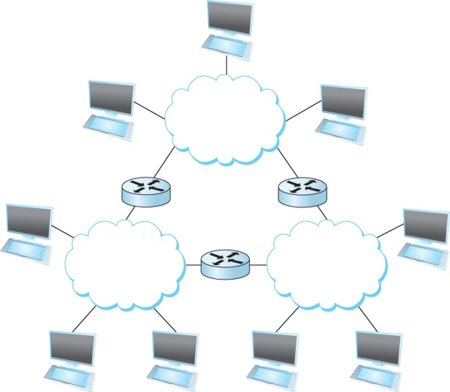
A Network and the Internet
Notes:
Ndn can help organizing the namespaces
Once that’s done, data discovery and provenance is
Straight forward
Retrieval, transparent failover, and specialized operations
In this work, we take a real access log and try to quantify NDN’s improvements to a climate
workflow

Slide 5
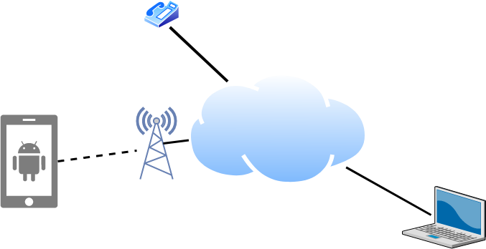
Links, Nodes, Routers, Switches
Notes:
Ndn can help organizing the namespaces
Once that’s done, data discovery and provenance is
Straight forward
Retrieval, transparent failover, and specialized operations
In this work, we take a real access log and try to quantify NDN’s improvements to a climate
workflow

Slide 6
Client and Server
My laptop with a browser = client
  It requests a service
  Email, chat, video, youtube
A node running a program that serves the requests = server
  Runs a service
  Chat, video, messaging
A node can both be a client and a server
Notes:
Ndn can help organizing the namespaces
Once that’s done, data discovery and provenance is
Straight forward
Retrieval, transparent failover, and specialized operations
In this work, we take a real access log and try to quantify NDN’s improvements to a climate
workflow

Slide 7
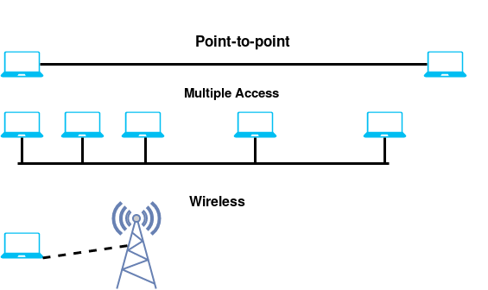
Connectivity
Point-to-Point
Multiple access
Wireless
Notes:
Ndn can help organizing the namespaces
Once that’s done, data discovery and provenance is
Straight forward
Retrieval, transparent failover, and specialized operations
In this work, we take a real access log and try to quantify NDN’s improvements to a climate
workflow

Slide 8
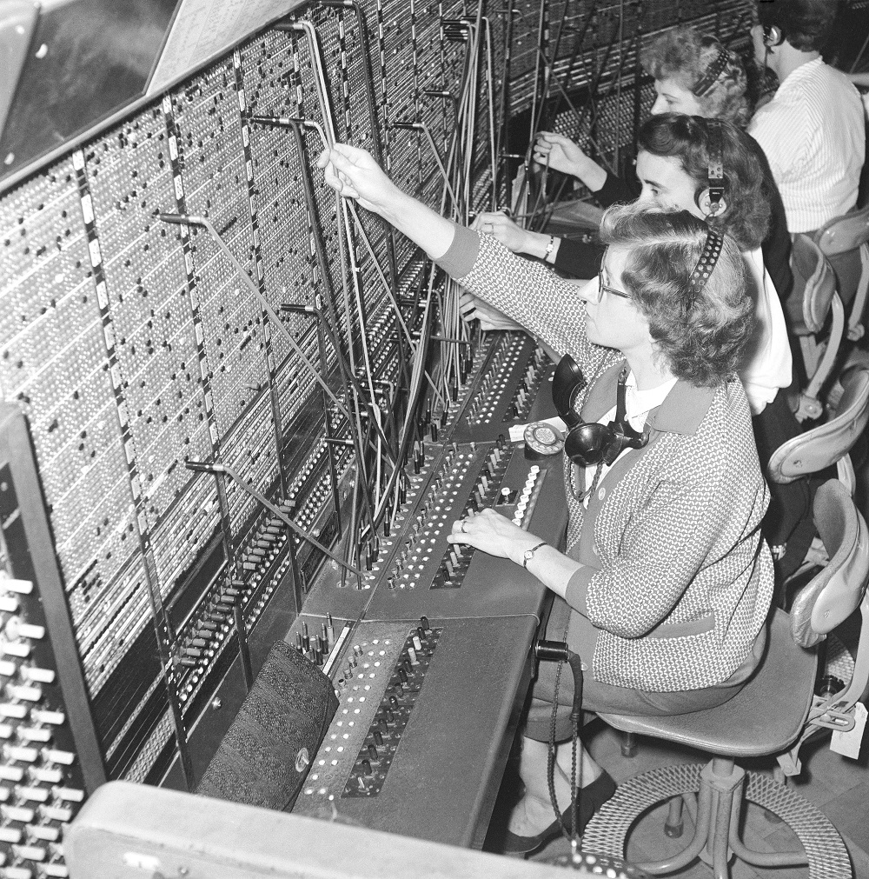


Circuit Switching – Old telephone networks
Operator, get me the navy
Build physical wire:
  Guaranteed resources
  Great for voice
Why change a working system?
Notes:
Ndn can help organizing the namespaces
Once that’s done, data discovery and provenance is
Straight forward
Retrieval, transparent failover, and specialized operations
In this work, we take a real access log and try to quantify NDN’s improvements to a climate
workflow

Slide 9
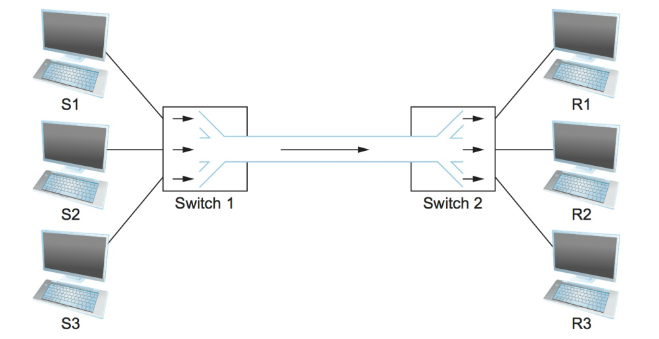
Circuit Switching
What are the problems?
Notes:
Ndn can help organizing the namespaces
Once that’s done, data discovery and provenance is
Straight forward
Retrieval, transparent failover, and specialized operations
In this work, we take a real access log and try to quantify NDN’s improvements to a climate
workflow

Slide 10
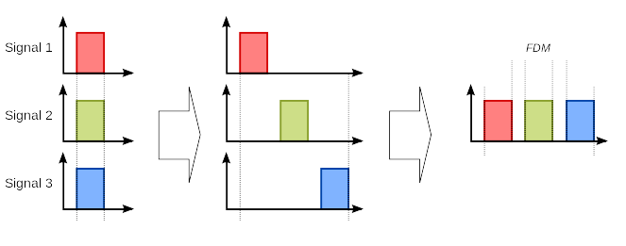
Frequency Division Multiplexing for Circuit Switching
wikipedia
Notes:
Ndn can help organizing the namespaces
Once that’s done, data discovery and provenance is
Straight forward
Retrieval, transparent failover, and specialized operations
In this work, we take a real access log and try to quantify NDN’s improvements to a climate
workflow

Slide 11
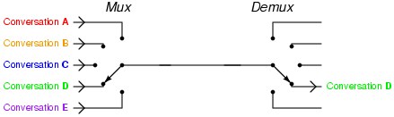
Time Division Multiplexing for Circuit Switching
wikipedia
Notes:
Ndn can help organizing the namespaces
Once that’s done, data discovery and provenance is
Straight forward
Retrieval, transparent failover, and specialized operations
In this work, we take a real access log and try to quantify NDN’s improvements to a climate
workflow

Slide 12
Circuit Switching – TDM and FDM
Problems solved? Or do they still exist?
Notes:
Ndn can help organizing the namespaces
Once that’s done, data discovery and provenance is
Straight forward
Retrieval, transparent failover, and specialized operations
In this work, we take a real access log and try to quantify NDN’s improvements to a climate
workflow

Slide 13
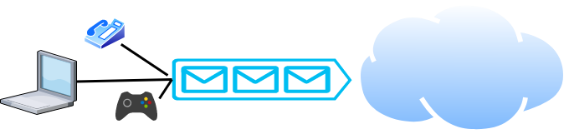
Packet Switching
Packets are low level components
Multiple kind of traffic with different requirements
  Gaming vs Phone
Dumb network – How do you ensure quality of service?
End points must be smart
Notes:
Ndn can help organizing the namespaces
Once that’s done, data discovery and provenance is
Straight forward
Retrieval, transparent failover, and specialized operations
In this work, we take a real access log and try to quantify NDN’s improvements to a climate
workflow

Slide 14
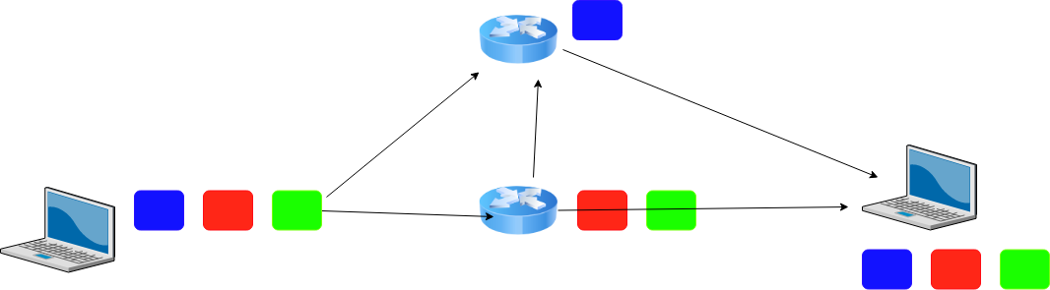
Packet Switching

Slide 15
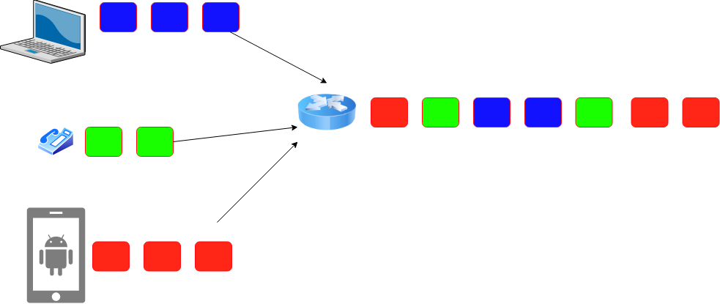
Statistical Multiplexing for Packet Switching
Ensures that slots will not be wasted
Introduces queuing delay
What actions can you take when queue becomes full? There may be many choices.
  Your choice would have profound implications on performance
  Drop packets, tell the sender to slow down, direct to another routers

Slide 16
How many users can you support?
1Mbps link
  Users are active 10% of the time
  10 Simultaneous users = full capacity
Circuit switching = 10 users
Packet switching with 35 users -> Probability of 10 sim. Users < 0.0004
https://math.stackexchange.com/questions/918861/probability-problem-in-networking

Slide 17
Circuit vs Packet Switching
Circuit Switching
Dedicated resource divided among participants
Requires setup, guaranteed performance (unless the link breaks)
Packet Switching
Shared resource
Use small chunks of data (packets), send as soon as possible
Store-and-forward packets

Slide 18
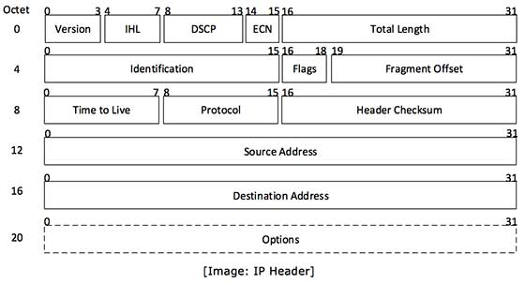
But What is a Packet?
Self-contained data unit
Has two parts (generally)
  Control information
  Payload
How do we transmit “Hello World?”
How do we transmit a dictionary?

Slide 19
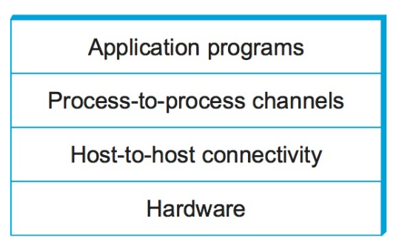
Network Architecture
What are the requirements from a network?
Architecture = High-level blueprint
  Protocols = Building blocks of the architecture
  Layering = Break down the problem in smaller pieces

Slide 20
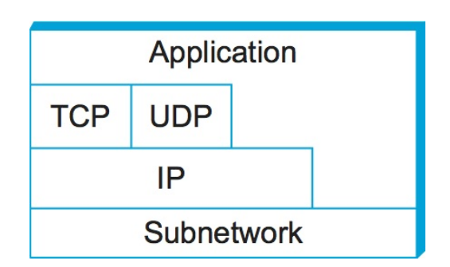
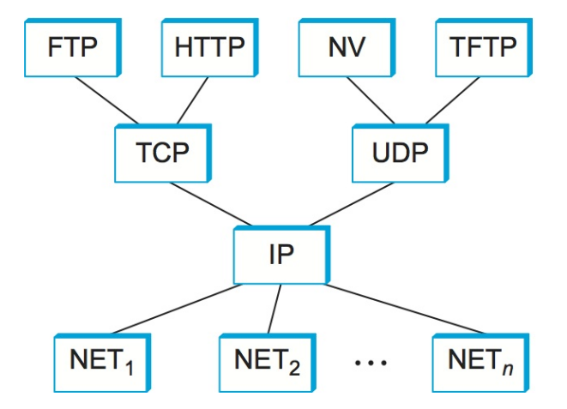
Network Layers
Use Service
Export Service
Makes it easier to divide functionality
Hides implementation details
Few other reasons?

Slide 21


IP Suite
We reject kings, presidents, and voting. We believe in rough consensus
and running code. (David Clark, IETF, July 1992)
wikipedia

Slide 22
Reading Assignment
Read the overview of Chapter 1 - “Problem: Building a Network”
    https://book.systemsapproach.org/foundation/problem.html#problem-building-a-network
    About 5 minutes
Read Chapter 1.2
  https://book.systemsapproach.org/foundation/architecture.html#architecture
  About 45 minutes
Reach Chapter 1.3
  https://book.systemsapproach.org/foundation/architecture.html#architecture
  About 45 minutes

