Slide 1
CSC4200/5200 – Computer Networking
Congestion Control
Instructor: Susmit Shannigrahi
sshannigrahi@tntech.edu
GTA: dereddick42@students.tntech.edu

Slide 2

Apps (HTTP)
Data
Apps (HTTP)
Segments
Transport (TCP/UDP)
Transport (TCP/UDP)
Network (IP)
Packets
Network (IP)
Link (Ethernet)
Frames
Link (Ethernet)
Ethernet Interface
Ethernet Interface
Bits (1010001)

Slide 3

TCP flow control
receiver “advertises” free buffer space in the header
sender limits amount of unacked (“in-flight”) data to receiver’s rwnd value
guarantees receive buffer will not overflow
Transport Layer
3-<number>

Slide 4

Congestion Control
Transport Layer
3-<number>

Slide 5
Principles of congestion control
congestion:
informally: “too many sources sending too much data too fast for network to handle”
different from flow control!
manifestations:
  lost packets (buffer overflow at routers)
  long delays (queueing in router buffers)
a top-10 problem!
Transport Layer
3-<number>

Slide 6

Congestion: scenario 1
original data: λ_{in}
throughput: λ_{out}
three senders, two receivers
one router, infinite buffers
output link capacity: R
The router can only transmit one –... and either buffer or drop the other
If many packets arrive,
Buffer overflow
Host A
unlimited shared output link buffers
Host B

Slide 7
Causes/costs of congestion: scenario 2
one router, finite buffers
sender retransmission of timed-out packet
  application-layer input = application-layer output: λ_{in} = λ_{out}
  transport-layer input includes retransmissions : λ_{in} λ_{in}
‘
λ_{in} : original data
λ'_{in}: original data, plus retransmitted data
λ_{out}
Host A
finite shared output link buffers
Host B
Transport Layer
3-<number>

Slide 8
Metrics: Throughput vs Delay
High throughput –
Throughput: measured performance of a system –E.g., number of bits/second of data that get through
Low delay –
Delay: time required to deliver a packet or message –E.g., number of ms to deliver a packet •
These two metrics are sometimes at odds –
  More packets = more queuing
Transport Layer
3-<number>

Slide 9

Issues in Resource Allocation
Evaluation Criteria
  Effective Resource Allocation
power of the network.
Power = Throughput/Delay
Ratio of throughput to delay as a function of load
Notes:
The University of Adelaide, School of Computer Science
November 4, 2019
Chapter 2 — Instructions: Language of the Computer

Slide 10
Issues in Resource Allocation
Evaluation Criteria
  Fair Resource Allocation
    The effective utilization of network resources is not the only criterion for judging a resource allocation scheme.
    We want to be “fair”
    Equal share of bandwidth
But, what if the flows traverse different paths?
Open problem, often determined by economics
Notes:
The University of Adelaide, School of Computer Science
November 4, 2019
Chapter 2 — Instructions: Language of the Computer

Slide 11

Queuing Disciplines
Router
Simplest – FIFO
and drop tail
(a) FIFO queuing; (b) tail drop at a FIFO queue.
What are the problems?

Slide 12
Defining Fairness: Flows
“fair” to whom? – Should be Fair to a Flow
What is a flow?
Combination of <Src IP, Src Port, Dst IP, Dst Port>

Slide 13
Fair Queuing
Fair Queuing
  FIFO does not discriminate between different traffic sources, or
  it does not separate packets according to the flow to which they belong.
  Fair queuing (FQ) maintains a separate queue for each flow

Slide 14

Queuing Disciplines
Fair Queuing
Round-robin service of four flows at a router

Slide 15
Min Max Fair queuing
Assume n clients
Channel capacity C
Give c/n to each client
  If C1 does not want c/n
  Divide the excess capacity equally among others
  So everyone else gets c/n + (c/n – c1)/n-1
  Repeat for C2 and others

Slide 16
TCP Congestion Control
Each source determines available capacity
Max many packets is allowed to have in transit - window
Congestion window = # of unacked bytes
MaxSendWindow = min(congestion window, receiver window)
How do you change congestion window?
  Decrease on losing a packet (back off)
  Increase on successful send

Slide 17
How much to increase and decrease?
Additive Increase, Multiplicative Decrease (AIMD)

Slide 18
How much to increase and decrease?
approach: sender increases transmission rate (window size), probing for usable bandwidth, until loss occurs
  additive increase: increase cwnd by 1 MSS every RTT until loss detected
  multiplicative decrease: cut cwnd in half after loss
additively increase window size …
…. until loss occurs (then cut window in half)
AIMD saw tooth
behavior: probing
for bandwidth
cwnd: TCP sender
congestion window size
time

Slide 19
TCP Slow Start
Host A
Host B
when connection begins, increase rate exponentially until first loss event:
  initially cwnd = 1 MSS
  double cwnd every RTT
  done by incrementing cwnd for every ACK received
summary: initial rate is slow but ramps up exponentially fast
one segment
RTT
two segments
four segments
time

Slide 20
TCP Slow Start
Host A
Host B
Why not start with a
large window?
Why not increase one by one?
one segment
RTT
two segments
four segments
time

Slide 21
TCP: detecting, reacting to loss
loss indicated by timeout:
  cwnd set to 1 MSS;
  window then grows exponentially (as in slow start) to threshold, then grows linearly
loss indicated by 3 duplicate ACKs: TCP RENO
  dup ACKs indicate network capable of delivering some segments
  cwnd is cut in half window then grows linearly
TCP Tahoe always sets cwnd to 1 (timeout or 3 duplicate acks)

Slide 22
TCP:Two types of loss
Triple duplicate ack
  Do a multiplicative decrease, keep going
Timeout
  Reset CWND to 1
  Take advantage of

Slide 23
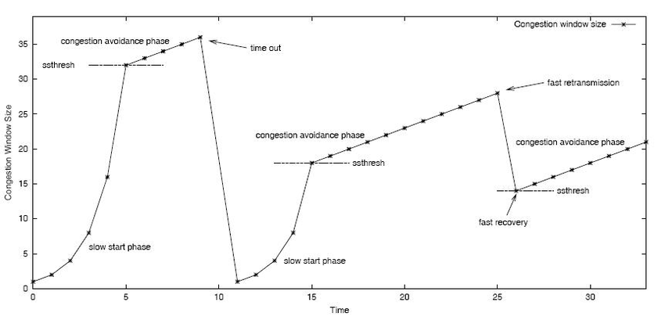
TCP Slow Start and congestion avoidance
How to set
ssthresh?
Initially – Randomly
high
Later – adjusted as
congestion happens
https://www.researchgate.net/figure/3-TCP-slow-start-phase-and-congestion-avoidance-phase_fig3_225731524

Slide 24
TCP Congestion Summary
CWND < Threshold → Slow Start, Exponential increase
CWND > Threshold → Congestion Avoidance, Linear increase
Triple Duplicate ACK → Threshold = CWND/2, CWND = CWND/2
Timeout → Threshold = CWND/2, CWDN = 1 (or 3)

Slide 25
TCP Throughput
TCP average throughput as a function of window size and RTT?
Ignore slow start, assume long TCP flow
Let W be the window size
Throughput = W/RTT
After loss, throughput = W/2*RTT
Average throughput = 0.75W/RTT

Slide 26
Problems with Fast Links
Consider the high speed link:
9000 byte segments
100ms RTT
100Gbps/second throughput
Throughput = 0.75W/RTT
So, WindowSize (w) = Throughput * RTT / 0.75
W = 1,481,481,444 segments

Slide 27
Problems with Fast Links
TCP assumes all losses are due to congestion
Throughput = (1.22*MSS)*(RTT/sqrt(Loss))
What is the loss rate to maximize 100Gbps pipe with
9000 bytes segments and 100ms RTT? Hint – must be very very low
https://www.switch.ch/network/tools/tcp_throughput/

