Slide 1
CSC4200/5200 – Computer Networking
Networked applications
Instructor: Susmit Shannigrahi
sshannigrahi@tntech.edu
GTA: dereddick42@students.tntech.edu

Slide 2

Apps (HTTP)
Data
Apps (HTTP)
Segments
Transport (TCP/UDP)
Transport (TCP/UDP)
Network (IP)
Packets
Network (IP)
Link (Ethernet)
Frames
Link (Ethernet)
Ethernet Interface
Ethernet Interface
Bits (1010001)

Slide 3
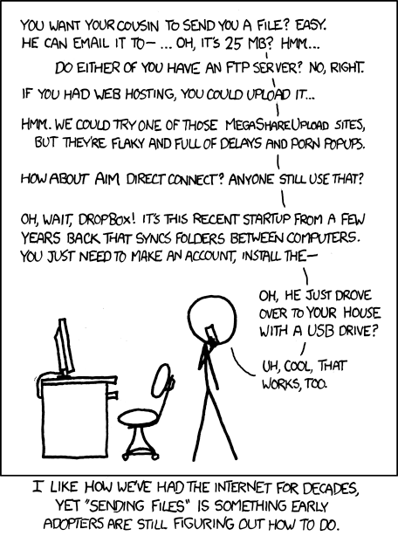
How do you send the cat picture?
Write your own cat picture transfer app
In an email
Upload to a webserver and download using FTP
Upload to dropbox/AWS/Google cloud
Use a bit-torrent like protocol
Use a CDN
And many other ways….
https://xkcd.com/949/
Notes:
Ndn can help organizing the namespaces
Once that’s done, data discovery and provenance is
Straight forward
Retrieval, transparent failover, and specialized operations
In this work, we take a real access log and try to quantify NDN’s improvements to a climate
workflow

Slide 4

















Creating a network app
application
transport
network
data link
physical
write programs that:
run on (different) end systems
communicate over network
e.g., web server software communicates with browser software
no need to write software for network-core devices
network-core devices do not run user applications
applications on end systems allows for rapid app development, propagation
application
transport
network
data link
physical
application
transport
network
data link
physical

Slide 5
Creating a network app
application
transport
network
data link
physical
write programs that:
run on (different) end systems
communicate over network
e.g., web server software communicates with browser software
no need to write software for network-core devices
network-core devices do not run user applications
applications on end systems allows for rapid app development, propagation
application
transport
network
data link
physical
application
transport
network
data link
physical

Slide 6
Application architectures
possible structure of applications:
client-server
peer-to-peer (P2P)

Slide 7
Client-server architecture
server:
always-on host
permanent IP address
data centers for scaling
clients:
communicate with server
may be intermittently connected
may have dynamic IP addresses
do not communicate directly with each other
client/server

Slide 8
P2P architecture
no always-on server
arbitrary end systems directly communicate
Services between peers
  self scalability
peers are intermittently connected and change IP addresses
  complex management
peer-peer

Slide 9
Example of each?
Client server ?
P2P?

Slide 10

Sockets
process sends/receives messages to/from its socket
socket analogous to door
  sending process shoves message out door
  sending process relies on transport infrastructure on other side of door to deliver message to socket at receiving process
application
socket
application
controlled by
app developer
process
process
transport
transport
network
network
controlled
by OS
link
Internet
link
physical
physical

Slide 11
App-layer protocol defines
types of messages exchanged,
  e.g., request, response
message syntax:
  what fields in messages & how fields are delineated
message semantics
  meaning of information in fields
rules for when and how processes send & respond to messages
open protocols:
defined in RFCs
allows for interoperability
e.g., HTTP, SMTP
proprietary protocols:
e.g., Skype

Slide 12
What transport service does an app need?
data integrity
some apps (e.g., file transfer, web transactions) require 100% reliable data transfer
throughput
some apps (e.g., multimedia) require minimum amount of throughput to be “effective”
timing
some apps require low delay to be “effective”
security
encryption, data integrity, …

Slide 13
Transport service requirements: common apps
application
file transfer
e-mail
Web documents
real-time audio/video
stored audio/video
interactive games
text messaging
data loss
no loss
no loss
no loss
loss-tolerant
loss-tolerant
loss-tolerant
no loss
throughput
elastic
elastic
elastic
audio: 5kbps-1Mbps
video:10kbps-5Mbps
same as above
few kbps up
elastic
time sensitive
no
no
no
yes, 100’s msec
yes, few secs
yes, 100’s msec
yes and no

Slide 14
Securing Data - Application Layer Function
TCP & UDP
no encryption
cleartext passwds sent into socket traverse Internet in cleartext
SSL
provides encrypted TCP connection
data integrity
end-point authentication
SSL is at app layer
Apps use SSL libraries, which “talk” to TCP
SSL socket API
  cleartext passwds sent into socket traverse Internet encrypted
  More on this later.

Slide 15
Web and HTTP
web page consists of objects
object can be HTML file, JPEG image, Java applet, audio file,…
web page consists of base HTML-file which includes several referenced objects
each object is addressable by a URL, e.g.,
www.someschool.edu/someDept/pic.gif
host name
path name

Slide 16
Web vs Internet?
http://info.cern.ch/
http://info.cern.ch/hypertext/WWW/TheProject.html

Slide 17

HTTP overview
HTTP - hypertext transfer protocol
Web’s application layer protocol
client/server model
  client: browser that requests, receives, (using HTTP protocol) and “displays” Web objects
  server: Web server sends (using HTTP protocol) objects in response to requests
PC running
Firefox browser
HTTP request
HTTP response
HTTP request
server
running
Apache Web
server
HTTP response
iphone running
Safari browser

Slide 18
HTTP overview (continued)
uses TCP:
client initiates TCP connection (creates socket) to server, port 80
server accepts TCP connection from client
HTTP messages (application-layer protocol messages) exchanged between browser (HTTP client) and Web server (HTTP server)
TCP connection closed
HTTP is “stateless”
server maintains no information about past client requests
Applications may make it almost “stateful”

Slide 19
HTTP connections (Remember it uses TCP)
non-persistent HTTP
at most one object sent over TCP connection
  connection then closed
downloading multiple objects required multiple connections
persistent HTTP
multiple objects can be sent over single TCP connection between client, server

Slide 20
HTTP request message
two types of HTTP messages: request, response
HTTP request message:
  ASCII (human-readable format)
carriage return character
request line
(GET, POST,
HEAD commands)
line-feed character
GET /index.html HTTP/1.1\r\n
Host: www-net.cs.umass.edu\r\n
User-Agent: Firefox/3.6.10\r\n
Accept: text/html,application/xhtml+xml\r\n
Accept-Language: en-us,en;q=0.5\r\n
Accept-Encoding: gzip,deflate\r\n
Accept-Charset: ISO-8859-1,utf-8;q=0.7\r\n
Keep-Alive: 115\r\n
Connection: keep-alive\r\n
\r\n
header
lines
carriage return,
line feed at start
of line indicates
end of header lines

Slide 21
HTTP response message
status line
(protocol
status code
status phrase)
HTTP/1.1 200 OK\r\n
Date: Sun, 26 Sep 2010 20:09:20 GMT\r\n
Server: Apache/2.0.52 (CentOS)\r\n
Last-Modified: Tue, 30 Oct 2007 17:00:02 GMT\r\n
ETag: "17dc6-a5c-bf716880"\r\n
Accept-Ranges: bytes\r\n
Content-Length: 2652\r\n
Keep-Alive: timeout=10, max=100\r\n
Connection: Keep-Alive\r\n
Content-Type: text/html; charset=ISO-8859-1\r\n
\r\n
data data data data data ...
header
lines
data, e.g.,
requested
HTML file

Slide 22
HTTP response status codes
status code appears in 1st line in server-to-client response message.
some sample codes:
200 OK
  request succeeded, requested object later in this msg
301 Moved Permanently
  requested object moved, new location specified later in this msg (Location:)
400 Bad Request
  request msg not understood by server
404 Not Found
  requested document not found on this server
505 HTTP Version Not Supported

Slide 23
Cookies: keeping “state”
client
server
ebay 8734
usual http request msg
Amazon server
creates ID
1678 for user
cookie file
usual http response
set-cookie: 1678
backend
database
create
entry
ebay 8734
amazon 1678
usual http request msg
cookie: 1678
cookie-
specific
action
access
usual http response msg
one week later:
access
ebay 8734
amazon 1678
usual http request msg
cookie: 1678
cookie-
specific
action
usual http response msg

Slide 24
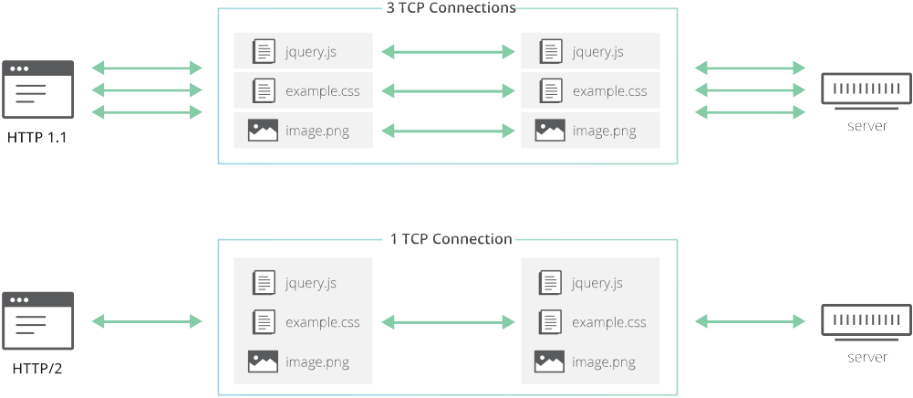
HTTP 1 vs 2
https://blog.cloudflare.com/the-road-to-quic/

Slide 25
HTTP 2 Head-of-the-line Blocking
Shared connection = Shared loss
https://blog.cloudflare.com/the-road-to-quic/

Slide 26

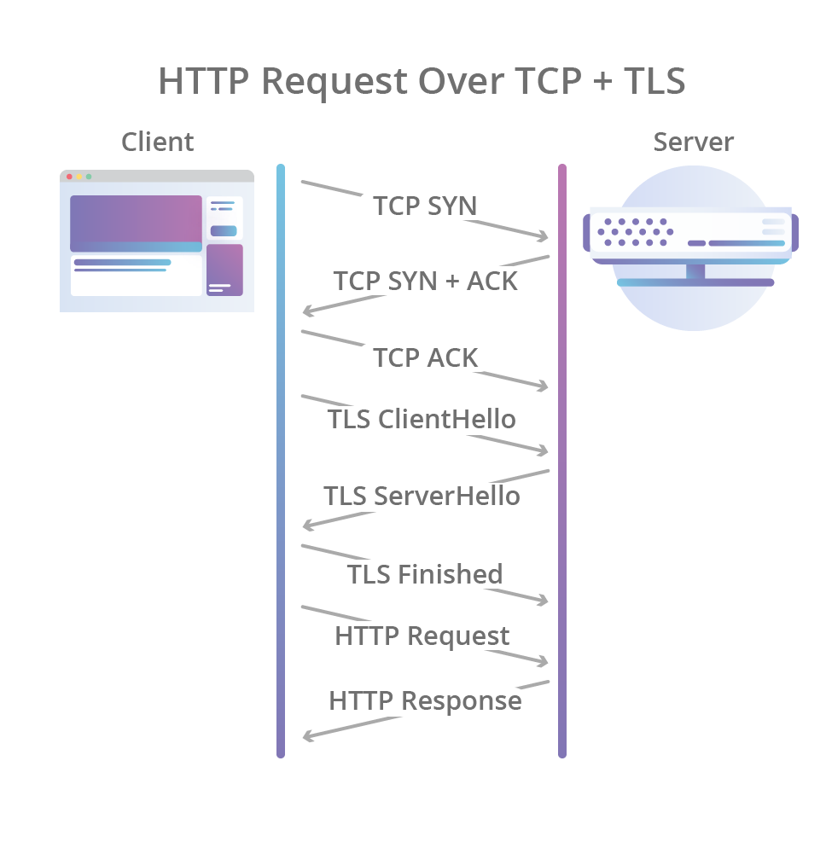
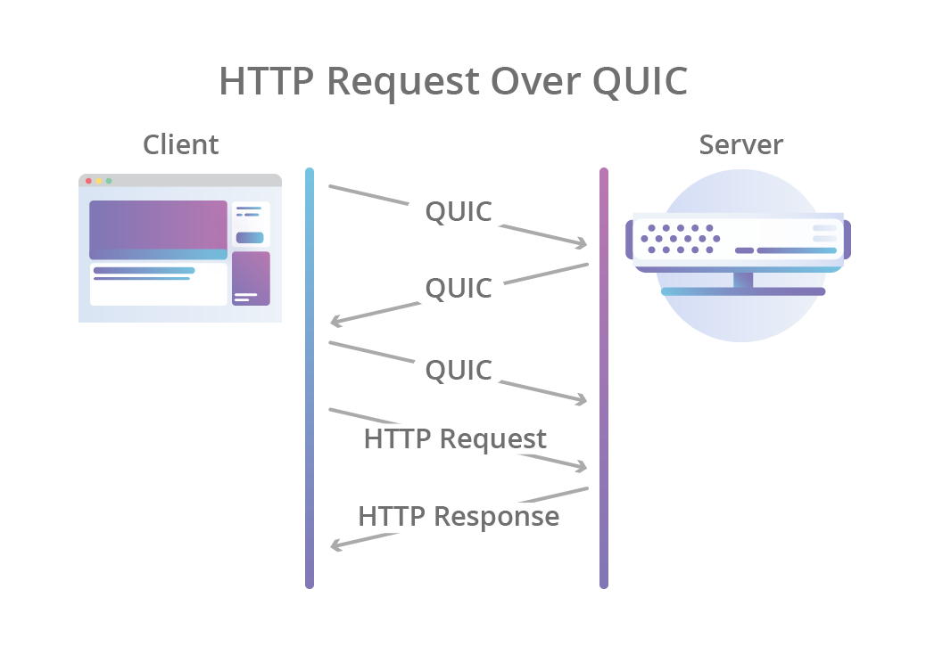
QUIC
https://blog.cloudflare.com/the-road-to-quic/

Slide 27
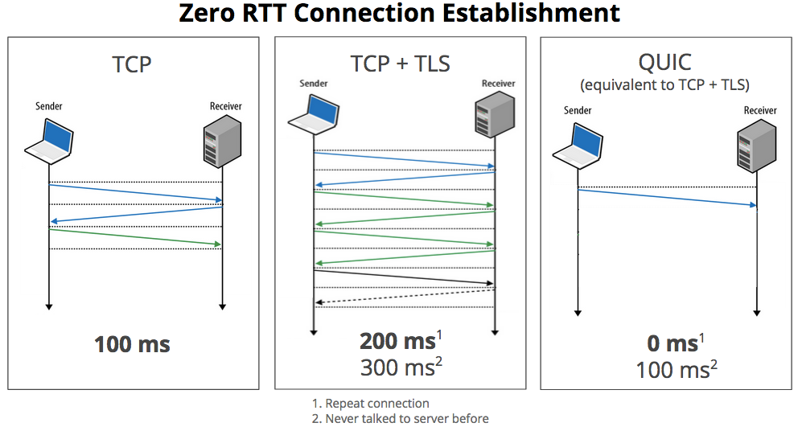
QUIC is Quick(er)
https://blog.chromium.org/2015/04/a-quic-update-on-googles-experimental.html

Slide 28
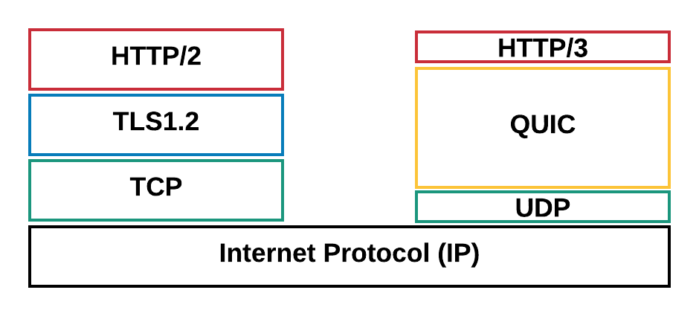
HTTP 2/TCP vs HTTP 3/QUIC
1. Faster connection establishment
2. No HoL blocking
3. Multiplexing connections with ability to differentiate
4. Connection migration
https://eng.uber.com/employing-quic-protocol/

Slide 29
Next Steps
DNS and Email
P2P - bittorrent

Slide 30
Apps (HTTP)
Data
Apps (HTTP)
Segments
Transport (TCP/UDP)
Transport (TCP/UDP)
Network (IP)
Packets
Network (IP)
Link (Ethernet)
Frames
Link (Ethernet)
Ethernet Interface
Ethernet Interface
Bits (1010001)

