Slide 1
CSC4200/5200 – Computer Networking
SoFtware Defined networking
Instructor: Susmit Shannigrahi
sshannigrahi@tntech.edu
GTA: dereddick42@students.tntech.edu

Slide 2
Data VS Control Plane
Data plane is (mostly) in the hardware -
  Forward packets
Control plane
  How do we tell routers how to forward packets?
  BGP?
  How do you change something when network
  changes?

Slide 3
Data and Control Plane together
Problems?
  No separate channel
  Expensive
  Hard to change

Slide 4
What is SDN?
Software-defined networking (SDN) provides abstraction for
  Configuration, security, and forwarding
SDN makes the network
  Directly programmable
  Agile: administrator can change the network
  Centrally managed: network management is logically centralized.
  Vendor-neutral

Slide 5
Simple Example: Access Control
Source: Scott Shenker, UC Berkeley
What
Abstract Network
Model
Global
Network View
How
Notes:
What is access control?

Slide 6
Software Defined Networks
Source: Scott Shenker, UC Berkeley
Specifies behavior
Control Program
Abstract Network Model
Compiles to topology
Network Virtualization
Global Network View
Transmits to switches
Network OS

Slide 7
What Does This Picture Mean?
Source: Scott Shenker, UC Berkeley
Write a simple program to configure a simple model
  Configuration merely a way to specify what you want
Examples
  ACLs: who can talk to who
  Isolation: who can hear my broadcasts
  Routing: only specify routing to the degree you care
    Some flows over satellite, others over landline
  TE: specify in terms of quality of service, not routes
Virtualization layer “compiles” these requirements
  Produces suitable configuration of actual network devices
NOS then transmits these settings to physical boxes

Slide 8
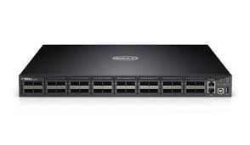
What is SDN?
Control Plane
Data Plane
Very high queuing delay
Control Plane
Data Plane
Control Plane
Data Plane

Slide 9
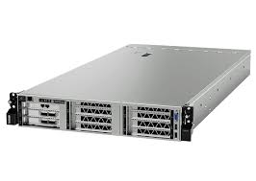
What is SDN?
Controller
Control Plane
Data Plane
Bypass
Very high queuing delay
Control Plane
Data Plane
Control Plane
Data Plane

