Slide 1
CSC4200/5200 – Computer Networking
Internetworking
Instructor: Susmit Shannigrahi
sshannigrahi@tntech.edu
GTA: dereddick42@students.tntech.edu

Slide 2
Midterm! Midterm! Midterm! (Chapter 1 – 4)
October 11th (In less than a month!)
  90 minutes – 1:15PM – 2:30PM
  If you have a conflict, let me know NOW!
  Location – TBD
Closed book, no laptop, phone, or calculator!
One cheat sheet allowed (one letter paper – any note you want)
Only from the book and lecture notes, no programming questions
Notes:
Ndn can help organizing the namespaces
Once that’s done, data discovery and provenance is
Straight forward
Retrieval, transparent failover, and specialized operations
In this work, we take a real access log and try to quantify NDN’s improvements to a climate
workflow

Slide 3
Project groups
Let me know by 09/20, Friday.
  If I don’t hear from you by Friday, you will be assigned to a random group!
Notes:
Ndn can help organizing the namespaces
Once that’s done, data discovery and provenance is
Straight forward
Retrieval, transparent failover, and specialized operations
In this work, we take a real access log and try to quantify NDN’s improvements to a climate
workflow

Slide 4
Midterm! Midterm! Midterm! (Chapter 1 – 4)
What do I study?
  Think about the fundamentals
    Why this protocols are designed this way?
      Why not use bit correction on Ethernet frames?
      Why use CSMA/CA for wireless and not CSMA/CD?
    What will happen if I change this aspect of the protocol?
      What will happen if we make the sliding window infinite?
    Simple calculations
      Calculate the total delay of a link
    Study the homeworks!
Notes:
Ndn can help organizing the namespaces
Once that’s done, data discovery and provenance is
Straight forward
Retrieval, transparent failover, and specialized operations
In this work, we take a real access log and try to quantify NDN’s improvements to a climate
workflow

Slide 5

Apps (HTTP)
Data
Apps (HTTP)
Segments
Transport (TCP/UDP)
Transport (TCP/UDP)
Network (IP)
Packets
Network (IP)
Link (Ethernet)
Frames
Link (Ethernet)
Ethernet Interface
Ethernet Interface
Bits (1010001)

Slide 6
So far...
we saw how to build a local network
How do we interconnect different types of networks to build a large global network?
Notes:
Ndn can help organizing the namespaces
Once that’s done, data discovery and provenance is
Straight forward
Retrieval, transparent failover, and specialized operations
In this work, we take a real access log and try to quantify NDN’s improvements to a climate
workflow

Slide 7
















Why another layer?
application
transport
network
data link
physical
network
data link
physical
network
data link
physical
network
data link
physical
network
data link
physical
network
data link
physical
network
data link
physical
network
data link
physical
network
data link
physical
network
data link
physical
application
transport
network
data link
physical
network
data link
physical
network
data link
physical
Kurose -Ross
Notes:
Ndn can help organizing the namespaces
Once that’s done, data discovery and provenance is
Straight forward
Retrieval, transparent failover, and specialized operations
In this work, we take a real access log and try to quantify NDN’s improvements to a climate
workflow

Slide 8

Switching
Switch
  A mechanism to interconnect
  links to form a large network
  Forward frames
  Separate the collision domains
  Filter packets between LANs
  Connects two or more LAN segments - Bridging
LAN 1
Collision domain 1
LAN 2
Collision domain 2
Notes:
Ndn can help organizing the namespaces
Once that’s done, data discovery and provenance is
Straight forward
Retrieval, transparent failover, and specialized operations
In this work, we take a real access log and try to quantify NDN’s improvements to a climate
workflow

Slide 9
Switches are
Self learning!
No configuration needed
Send frames to needed segments
How do they construct such a
table?
LAN 1
Collision domain 1
LAN 2
Collision domain 2
Notes:
Ndn can help organizing the namespaces
Once that’s done, data discovery and provenance is
Straight forward
Retrieval, transparent failover, and specialized operations
In this work, we take a real access log and try to quantify NDN’s improvements to a climate
workflow

Slide 10
Switches are self learning!
Inspect the source MAC address
  What is a mac address?
Associate mac address and incoming interface
Store this association for later use, (for some time)
  aging-timer
Notes:
Ndn can help organizing the namespaces
Once that’s done, data discovery and provenance is
Straight forward
Retrieval, transparent failover, and specialized operations
In this work, we take a real access log and try to quantify NDN’s improvements to a climate
workflow

Slide 11

Switching Table
To decide how to forward a packet, a switch consults a forwarding table
Destination, Port
-------------------------------------
A 3
B 0
C 3
D 3
E 2
F 1
G 0
H 0
Forwarding Table for Switch 2
Notes:
Ndn can help organizing the namespaces
Once that’s done, data discovery and provenance is
Straight forward
Retrieval, transparent failover, and specialized operations
In this work, we take a real access log and try to quantify NDN’s improvements to a climate
workflow

Slide 12
Switching Table
Unknown destination → send out on all Interfaces (flooding)
  Skip the incoming interface
Destination, Port
-------------------------------------
A 3
B 0
C 3
D 3
E 2
F 1
G 0
H 0
Forwarding Table for Switch 2
Notes:
Ndn can help organizing the namespaces
Once that’s done, data discovery and provenance is
Straight forward
Retrieval, transparent failover, and specialized operations
In this work, we take a real access log and try to quantify NDN’s improvements to a climate
workflow

Slide 13
Switching Table Algorithm
Create the table first!
  For each packet
    If destination address in arriving segment
      Drop
    If destination is in another segment
      Forward
    If destination unknown
      Flood!
Notes:
Ndn can help organizing the namespaces
Once that’s done, data discovery and provenance is
Straight forward
Retrieval, transparent failover, and specialized operations
In this work, we take a real access log and try to quantify NDN’s improvements to a climate
workflow

Slide 14
Switching Table Algorithm
Send frame from C to F
Switch 1 →
  Notes C is on Interface 3
  Floods
Switch 2 →
  Notes C is on Interface 3
  Floods
Host F replies
  Switch 2 notes F is on Interface 1
  Sends back over Interface 3
Switch 1 notes F is on Interface 1
  Sends back over Interface 3
  Host c receives frame
Notes:
Ndn can help organizing the namespaces
Once that’s done, data discovery and provenance is
Straight forward
Retrieval, transparent failover, and specialized operations
In this work, we take a real access log and try to quantify NDN’s improvements to a climate
workflow

Slide 15
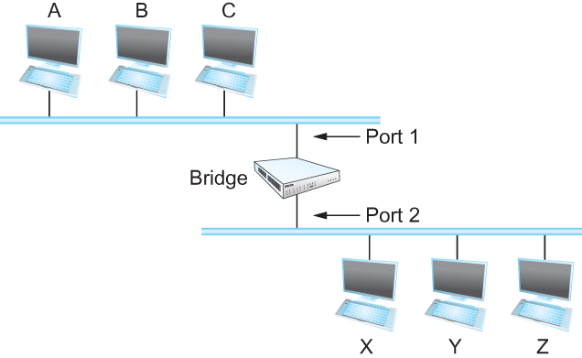
Bridges
Bridges and LAN Switches
    Class of switches that is used to forward packets between shared-media LANs such as Ethernets
  Known as LAN switches
  Referred to as Bridges
Suppose you have a pair of Ethernets that you want to interconnect
  One approach is put a repeater in between them, physical limitations
An alternative would be to put a node between the two Ethernets and have the node forward frames from one Ethernet to the other
  This node is called a Bridge
  A collection of LANs connected by one or more bridges is usually said to form an Extended LAN
Notes:
Ndn can help organizing the namespaces
Once that’s done, data discovery and provenance is
Straight forward
Retrieval, transparent failover, and specialized operations
In this work, we take a real access log and try to quantify NDN’s improvements to a climate
workflow

Slide 16
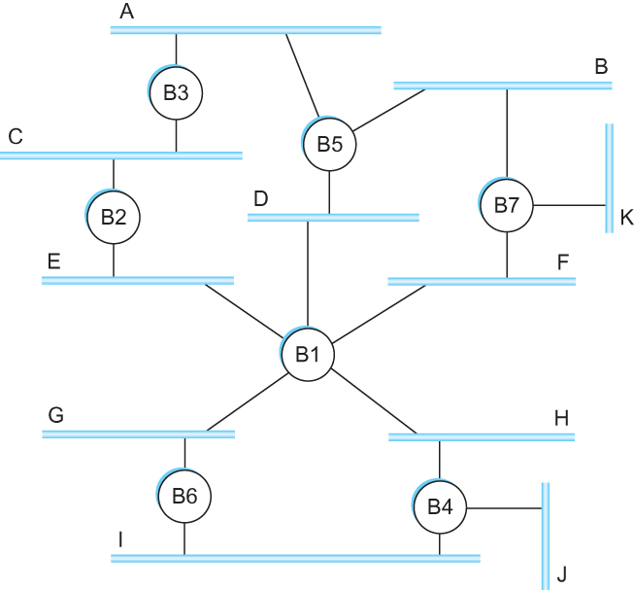
Flooding over bridges causes forwarding loops
Spot the loop
Why?
Notes:
Ndn can help organizing the namespaces
Once that’s done, data discovery and provenance is
Straight forward
Retrieval, transparent failover, and specialized operations
In this work, we take a real access log and try to quantify NDN’s improvements to a climate
workflow

Slide 17
Loop
Spot the loop
Why?
Notes:
Ndn can help organizing the namespaces
Once that’s done, data discovery and provenance is
Straight forward
Retrieval, transparent failover, and specialized operations
In this work, we take a real access log and try to quantify NDN’s improvements to a climate
workflow

Slide 18
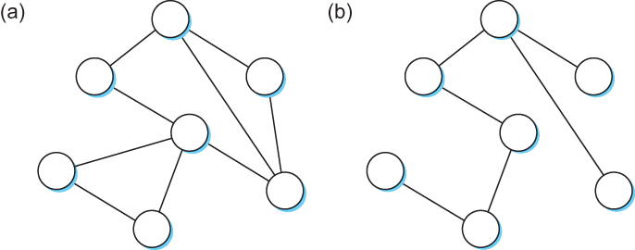
Solution? Spanning Tree
Think of the extended LAN as being represented by a graph that possibly has loops (cycles)
A spanning tree is a sub-graph of this graph that covers all the vertices but contains no cycles
Spanning tree keeps all the vertices of the original graph but throws out some of the edges
Example of (a) a cyclic graph; (b) a corresponding spanning tree.
Notes:
Ndn can help organizing the namespaces
Once that’s done, data discovery and provenance is
Straight forward
Retrieval, transparent failover, and specialized operations
In this work, we take a real access log and try to quantify NDN’s improvements to a climate
workflow

Slide 19
Next Steps
How to construct a spanning tree!
Virtual LANs
IP
Notes:
Ndn can help organizing the namespaces
Once that’s done, data discovery and provenance is
Straight forward
Retrieval, transparent failover, and specialized operations
In this work, we take a real access log and try to quantify NDN’s improvements to a climate
workflow

Slide 20
Link Layer Recap – All this for a cat picture
Apps (HTTP)
Data
Apps (HTTP)
Segments
Transport (TCP/UDP)
Transport (TCP/UDP)
Network (IP)
Packets
Network (IP)
Link (Ethernet)
Frames
Link (Ethernet)
Ethernet Interface
Ethernet Interface
Bits (1010001)

