Slide 1
CSC4200/5200 – COMPUTER NETWORKING
INTERNET PROTOCOL (IP)
Instructor: Susmit Shannigrahi
sshannigrahi@tntech.edu

Slide 2

Apps (HTTP)
Data
Apps (HTTP)
Segments
Transport (TCP/UDP)
Transport (TCP/UDP)
Network (IP)
Packets
Network (IP)
Link (Ethernet)
Frames
Link (Ethernet)
Ethernet Interface
Ethernet Interface
Bits (1010001)

Slide 3
Exam
Sept 28th
If you have a conflict, let me know NOW!
Location – iLearn
Open book – but you may not have time to look things up.
Only from the book and lecture notes, no programming questions
Notes:
Ndn can help organizing the namespaces
Once that’s done, data discovery and provenance is
Straight forward
Retrieval, transparent failover, and specialized operations
In this work, we take a real access log and try to quantify NDN’s improvements to a climate
workflow

Slide 4
So far...
We are forwarding packets between different LANs
Spanning tree algorithm for preventing loops
Notes:
Ndn can help organizing the namespaces
Once that’s done, data discovery and provenance is
Straight forward
Retrieval, transparent failover, and specialized operations
In this work, we take a real access log and try to quantify NDN’s improvements to a climate
workflow

Slide 5
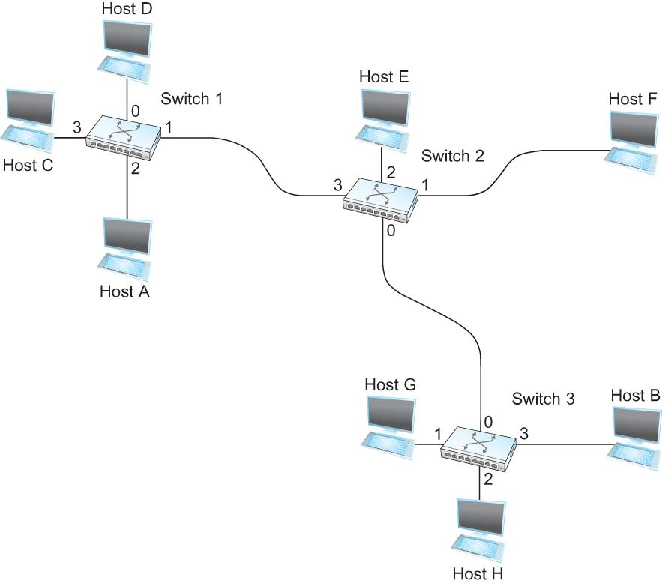
Switching
Switch
A mechanism to interconnect
links to form a large network
Forward frames
Separate the collision domains
Filter packets between LANs
Connects two or more LAN segments - Bridging
LAN 1
Collision domain 1
LAN 2
Collision domain 2
Notes:
Ndn can help organizing the namespaces
Once that’s done, data discovery and provenance is
Straight forward
Retrieval, transparent failover, and specialized operations
In this work, we take a real access log and try to quantify NDN’s improvements to a climate
workflow

Slide 6
How do we create a spanning tree?
1
Message (Y, d, X) - (to, distance, from)
4 thinks it’s the root
Sends (4, 0, 4) to 3 and 5
Receives (3,0,3) from 3
Sets it to as the root since 3 < 4
Receives (3,1,5) from 5
Sees that this is a longer path to 3
2 hops vs direct path (1 hop)
Removes 4-5 link from the tree
Does not scale!
2
7
3
6
4
5
Notes:
Ndn can help organizing the namespaces
Once that’s done, data discovery and provenance is
Straight forward
Retrieval, transparent failover, and specialized operations
In this work, we take a real access log and try to quantify NDN’s improvements to a climate
workflow

Slide 7
ATM (Carries Cells, not Money)
ATM (Asynchronous Transfer Mode)
Connection-oriented packet-switched network
Packets are called cells
5 byte header + 48 byte payload
Fixed length packets are easier to switch in hardware
Why?
Notes:
Ndn can help organizing the namespaces
Once that’s done, data discovery and provenance is
Straight forward
Retrieval, transparent failover, and specialized operations
In this work, we take a real access log and try to quantify NDN’s improvements to a climate
workflow

Slide 8
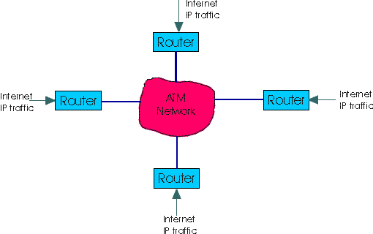
ATM (Carries Cells, not Money)
ATM (Asynchronous Transfer Mode)
Connection-oriented packet-switched network
Packets are called cells
5 byte header + 48 byte payload
Fixed length packets are easier to switch in hardware
Simpler to design
Enables parallelism
Still used in long distance private links
kurose/ross
Notes:
Ndn can help organizing the namespaces
Once that’s done, data discovery and provenance is
Straight forward
Retrieval, transparent failover, and specialized operations
In this work, we take a real access log and try to quantify NDN’s improvements to a climate
workflow

Slide 9
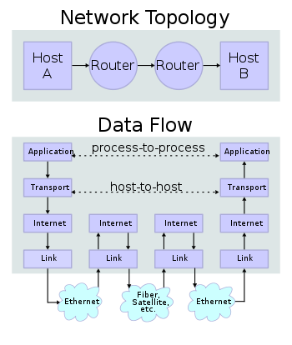
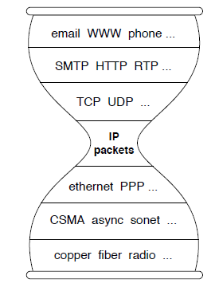
IP Suite – From the First Lecture
wikipedia

Slide 10
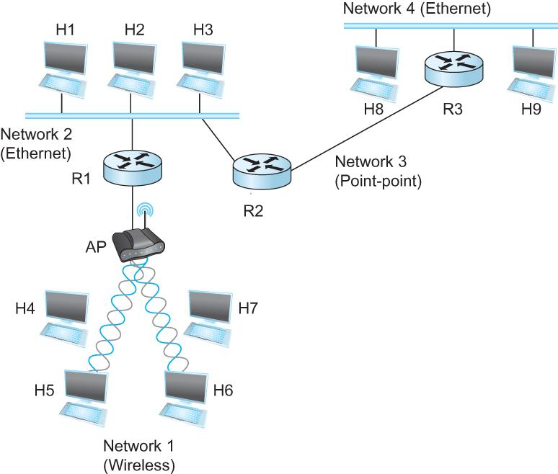
Internet Protocol (IP)
What is an internetwork?
An arbitrary collection of networks interconnected to provide some sort of host-host to packet delivery service
Notes:
Ndn can help organizing the namespaces
Once that’s done, data discovery and provenance is
Straight forward
Retrieval, transparent failover, and specialized operations
In this work, we take a real access log and try to quantify NDN’s improvements to a climate
workflow

Slide 11
But that’s what switches are for – No?
Switches create networks, Routers connect different networks.
Typically switches are at Layer 2, Routers are at Layer 3
Switches forward FRAMES, Routers forward PACKETS
Apps (HTTP)
Transport (TCP/UDP)
Network (IP)
Link (Ethernet)
Notes:
Ndn can help organizing the namespaces
Once that’s done, data discovery and provenance is
Straight forward
Retrieval, transparent failover, and specialized operations
In this work, we take a real access log and try to quantify NDN’s improvements to a climate
workflow

Slide 12
But that’s what switches are for – No?
This room → Point-to-point link
This room + next room → Switch
This room + next room + foundation hall → Switches with VLAN
This university + Internet → Router
Good for conceptualization - not always as simple
Notes:
Ndn can help organizing the namespaces
Once that’s done, data discovery and provenance is
Straight forward
Retrieval, transparent failover, and specialized operations
In this work, we take a real access log and try to quantify NDN’s improvements to a climate
workflow

Slide 13
Every device has a MAC – Why do we need another address?
Ethernet (MAC) addresses are flat
Not the only link layer
Not related to network topology
Remember – we are still connecting to hosts!
How do we go from: 52:54:00:86:38:14 to tntech?
Other reasons?
Apps (HTTP)
Transport (TCP/UDP)
Network (IP Address)
Link (MAC Address)
Notes:
Ndn can help organizing the namespaces
Once that’s done, data discovery and provenance is
Straight forward
Retrieval, transparent failover, and specialized operations
In this work, we take a real access log and try to quantify NDN’s improvements to a climate
workflow

Slide 14
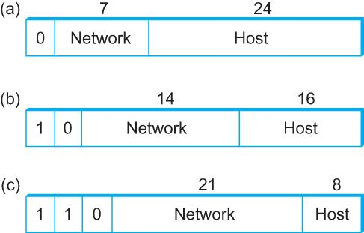
Global Address in IP – Each node has an unique address
A 32 bit number in quad-dot notation
Identifies an Interface
A host might have several interfaces!!!
129.82.138.254 10000001.01010010.10001010.11111110
Notes:
Ndn can help organizing the namespaces
Once that’s done, data discovery and provenance is
Straight forward
Retrieval, transparent failover, and specialized operations
In this work, we take a real access log and try to quantify NDN’s improvements to a climate
workflow

Slide 15
IP allows the network to scale!
What if addresses were arbitrary?
5.1.6.7
1.1.2.2
1.1.2.1
1.1.2.1 | Interface 3 1.1.2.2 | Interface 2
…..
Notes:
Ndn can help organizing the namespaces
Once that’s done, data discovery and provenance is
Straight forward
Retrieval, transparent failover, and specialized operations
In this work, we take a real access log and try to quantify NDN’s improvements to a climate
workflow

Slide 16
Solution - Group hosts
What if addresses were arbitrary?
1.1.2.1
5.1.6.7
1.1.2.2
1.1.*.* | Interface 3
Notes:
Ndn can help organizing the namespaces
Once that’s done, data discovery and provenance is
Straight forward
Retrieval, transparent failover, and specialized operations
In this work, we take a real access log and try to quantify NDN’s improvements to a climate
workflow

Slide 17
IP addresses are in Network + Host
1.1.2.1 →
1.1 → Network part
2.1 → host part
Each octet can range from 1- 255
Hierarchical address
1.1.2.1
5.1.6.7
1.1.2.2
1.1.*.* | Interface 3
129.82.138.254 10000001.01010010.10001010.11111110
Network part (24 bits). Host part(8 bits)
Notes:
Ndn can help organizing the namespaces
Once that’s done, data discovery and provenance is
Straight forward
Retrieval, transparent failover, and specialized operations
In this work, we take a real access log and try to quantify NDN’s improvements to a climate
workflow

Slide 18
How do we know host vs network → Subnetting
1.1.2.1
5.1.6.7
129.82.138.254 (Address) 10000001.01010010.10001010.11111110
11111111.11111111. 11111111.00000000
255.255.255.0 (Subnet mask)
1.1.2.2
1.1.*.* | Interface 3
Notes:
Ndn can help organizing the namespaces
Once that’s done, data discovery and provenance is
Straight forward
Retrieval, transparent failover, and specialized operations
In this work, we take a real access log and try to quantify NDN’s improvements to a climate
workflow

Slide 19
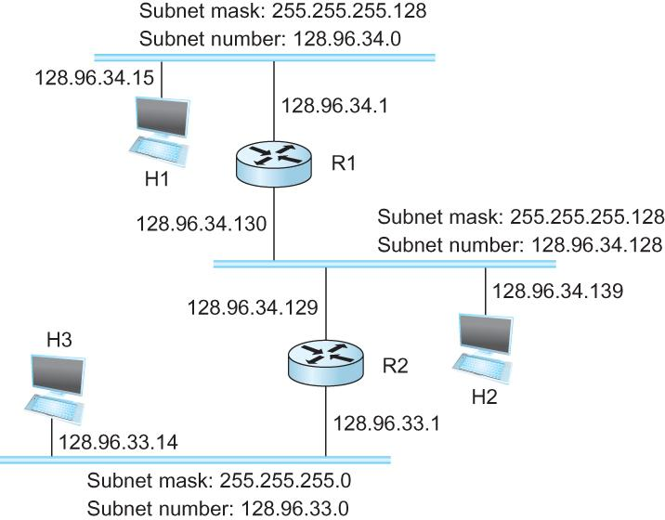
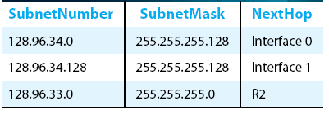
Subnetting
Forwarding Table at Router R1
Notes:
Ndn can help organizing the namespaces
Once that’s done, data discovery and provenance is
Straight forward
Retrieval, transparent failover, and specialized operations
In this work, we take a real access log and try to quantify NDN’s improvements to a climate
workflow

Slide 20
Subnetting
Three classes:
Class A: 129.0.0.0/8
Class B: 129.82.0.0/16
Class C: 129.82.2.0/14
Notes:
Ndn can help organizing the namespaces
Once that’s done, data discovery and provenance is
Straight forward
Retrieval, transparent failover, and specialized operations
In this work, we take a real access log and try to quantify NDN’s improvements to a climate
workflow

Slide 21
Well, not really!
CIDR: Classless Interdomain routing
subnet portion of address of arbitrary length
address format: a.b.c.d/x, where x is # bits in subnet portion of address
129.82.13.0/23
More flexible
Notes:
Ndn can help organizing the namespaces
Once that’s done, data discovery and provenance is
Straight forward
Retrieval, transparent failover, and specialized operations
In this work, we take a real access log and try to quantify NDN’s improvements to a climate
workflow

Slide 22
Now routers can operate on Network address!!!!
129.82.138.252
149.149.2.254
129.82.138.254 (Address)
10000001.01010010.10001010.11111110
11111111.11111111. 11111111.00000000
255.255.255.0 (Subnet mask) 129.82.138.254 + 255.255.255.0 → 129.82.138.0/24
129.82.138.253
129.82.138.0/24 | Interface 2
149.149.2.254/24| Iface 3
Notes:
Ndn can help organizing the namespaces
Once that’s done, data discovery and provenance is
Straight forward
Retrieval, transparent failover, and specialized operations
In this work, we take a real access log and try to quantify NDN’s improvements to a climate
workflow

Slide 23
Address management is localized
129.82.138.252
149.149.2.254
129.82.138.253
129.82.138.251
No coordination needed for adding 129.82.138.251
No routing update needs to go out
129.82.138.0/24 | Interface 2
149.149.2.254/24| Iface 3
Notes:
Ndn can help organizing the namespaces
Once that’s done, data discovery and provenance is
Straight forward
Retrieval, transparent failover, and specialized operations
In this work, we take a real access log and try to quantify NDN’s improvements to a climate
workflow

Slide 24
Address management can be automated
129.82.138.252
149.149.2.254
129.82.138.253
129.82.138.251
ARP:
Map IP address to MAC address DHCP:
Learn IP address, gateway, DNS
More on these later.
129.82.138.0/24 | Interface 2
149.149.2.254/24| Iface 3
Notes:
Ndn can help organizing the namespaces
Once that’s done, data discovery and provenance is
Straight forward
Retrieval, transparent failover, and specialized operations
In this work, we take a real access log and try to quantify NDN’s improvements to a climate
workflow

Slide 25
You have an address – Send data now. IP service model
Packet Delivery Model
Connectionless model for data delivery
Best-effort delivery (unreliable service)
packets are lost
packets are delivered out of order
duplicate copies of a packet are delivered
packets can be delayed for a long time
Global Addressing Scheme
Provides a way to identify all hosts in the network
Notes:
Ndn can help organizing the namespaces
Once that’s done, data discovery and provenance is
Straight forward
Retrieval, transparent failover, and specialized operations
In this work, we take a real access log and try to quantify NDN’s improvements to a climate
workflow

Slide 26
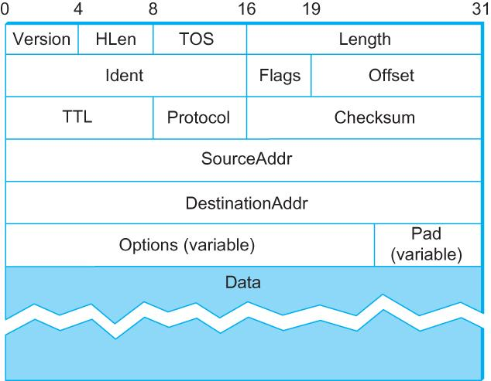
IP Packet
Version (4): 4
Hlen (4): number of 32-bit words in header
TOS (8): type of service (not widely used)
Length (16): number of bytes in this datagram
Ident (16): used by fragmentation
Flags/Offset (16): used by fragmentation
TTL (8): number of hops this datagram has traveled
Protocol (8): demux key (TCP=6, UDP=17)
Checksum (16): of the header only
DestAddr & SrcAddr (32)
Notes:
Ndn can help organizing the namespaces
Once that’s done, data discovery and provenance is
Straight forward
Retrieval, transparent failover, and specialized operations
In this work, we take a real access log and try to quantify NDN’s improvements to a climate
workflow

Slide 27
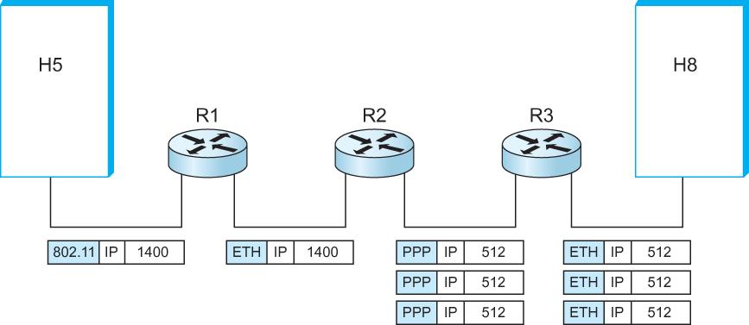
IP Fragmentation and Reassembly
Underlying Layer 2 limitations
Ethernet 1500
PPP 512
Break packets into smaller chunk and reassemble later
Notes:
Ndn can help organizing the namespaces
Once that’s done, data discovery and provenance is
Straight forward
Retrieval, transparent failover, and specialized operations
In this work, we take a real access log and try to quantify NDN’s improvements to a climate
workflow

Slide 28
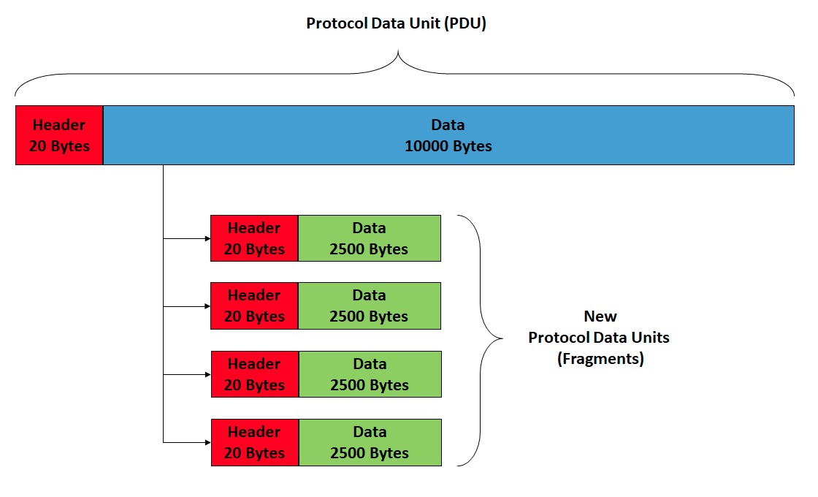
IP Fragmentation and Reassembly
wikipedia
Notes:
Ndn can help organizing the namespaces
Once that’s done, data discovery and provenance is
Straight forward
Retrieval, transparent failover, and specialized operations
In this work, we take a real access log and try to quantify NDN’s improvements to a climate
workflow

Slide 29
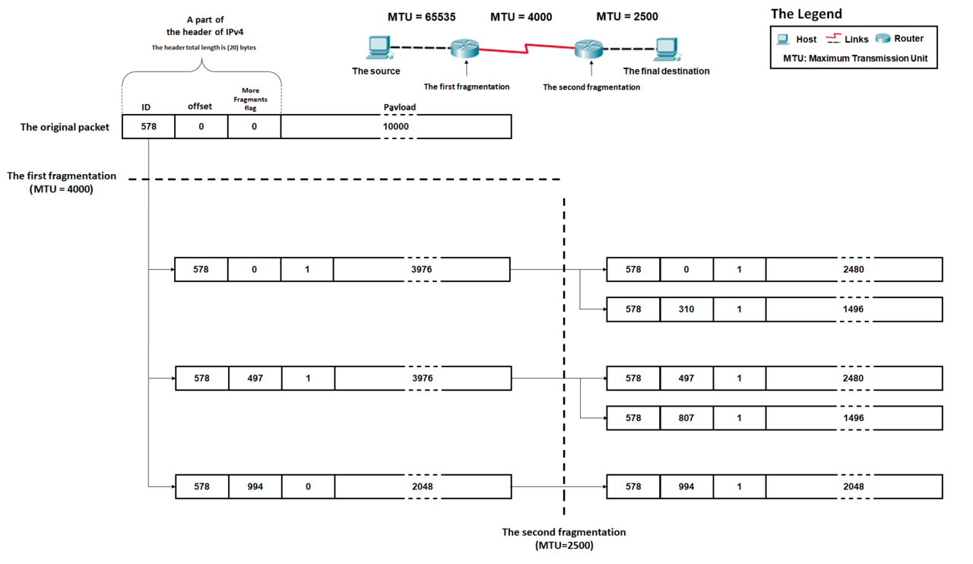
IP Fragmentation and Reassembly
Offset 3976/8
wikipedia
Notes:
Ndn can help organizing the namespaces
Once that’s done, data discovery and provenance is
Straight forward
Retrieval, transparent failover, and specialized operations
In this work, we take a real access log and try to quantify NDN’s improvements to a climate
workflow

Slide 30
IP Fragmentation and Reassembly
Underlying Layer 2 limitations
Ethernet 1500
PPP 512
Break packets into smaller chunk and reassemble later
Notes:
Ndn can help organizing the namespaces
Once that’s done, data discovery and provenance is
Straight forward
Retrieval, transparent failover, and specialized operations
In this work, we take a real access log and try to quantify NDN’s improvements to a climate
workflow

Slide 31
Reading Assignments
Internetworking:
CHAPTER 3.1 Basic Internetworking:
Chapter 3.2
Notes:
Ndn can help organizing the namespaces
Once that’s done, data discovery and provenance is
Straight forward
Retrieval, transparent failover, and specialized operations
In this work, we take a real access log and try to quantify NDN’s improvements to a climate
workflow

