Slide 1
CSC4200/5200 – Computer Networking
Network performance basics
Instructor: Susmit Shannigrahi
sshannigrahi@tntech.edu

Slide 2
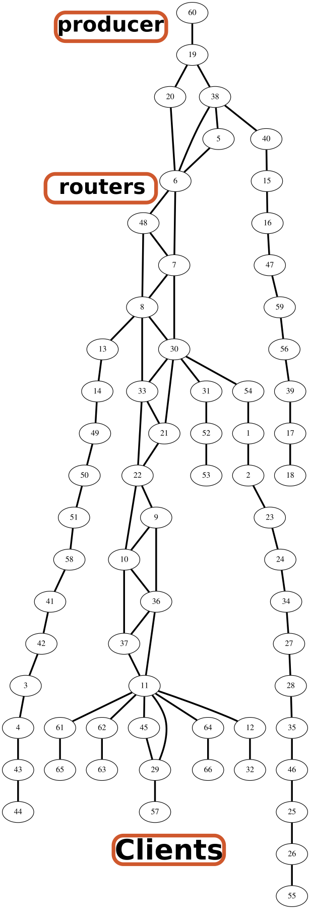
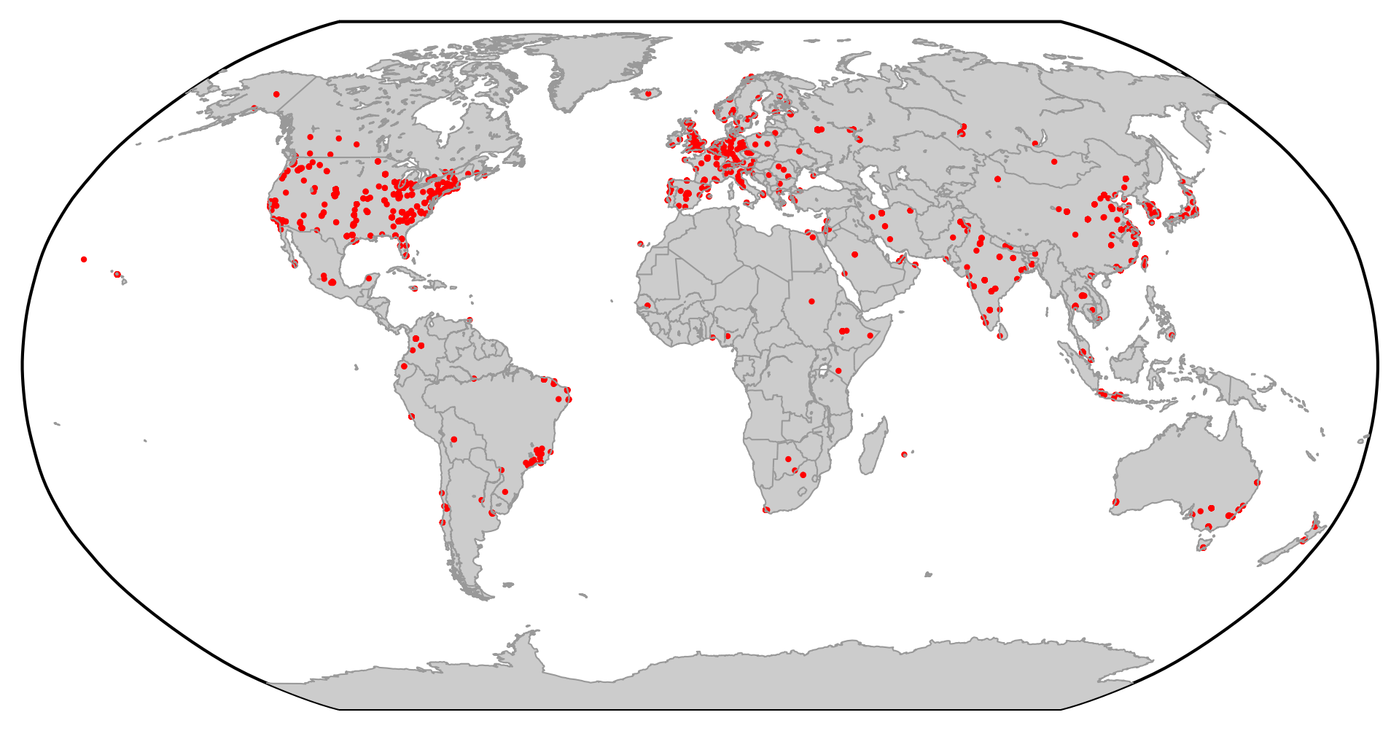
Recap – Network = Graph (Nodes + Links)
Notes:
Ndn can help organizing the namespaces
Once that’s done, data discovery and provenance is
Straight forward
Retrieval, transparent failover, and specialized operations
In this work, we take a real access log and try to quantify NDN’s improvements to a climate
workflow

Slide 3
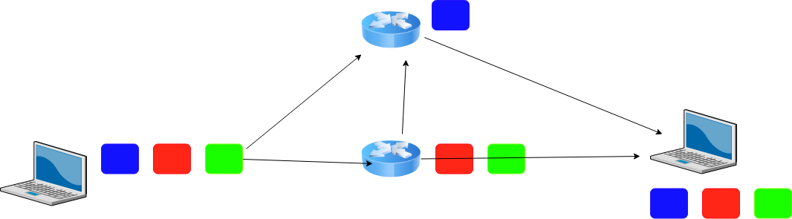
Packet Switching on the Internet

Slide 4
Performance – Terminology
Bits = b
Bytes = B
Kilobytes = KB (1024 Bytes or 1000Bytes)
Megabytes = MB (1024KB or 1000KB)
Ask ECE folks = 1000, 1Mbps = 1000*1000Bps
Ask CS folks = 1024, 1MB = 1024*1024Bytes
Notes:
Ndn can help organizing the namespaces
Once that’s done, data discovery and provenance is
Straight forward
Retrieval, transparent failover, and specialized operations
In this work, we take a real access log and try to quantify NDN’s improvements to a climate
workflow

Slide 5
Performance Basics - Bandwidth and Latency
Bandwidth = Size of the network pipe
Latency = Delay in sending packets
Throughput = How fast your can send data, function of both bandwidth and latency (and other things)
Notes:
Ndn can help organizing the namespaces
Once that’s done, data discovery and provenance is
Straight forward
Retrieval, transparent failover, and specialized operations
In this work, we take a real access log and try to quantify NDN’s improvements to a climate
workflow

Slide 6
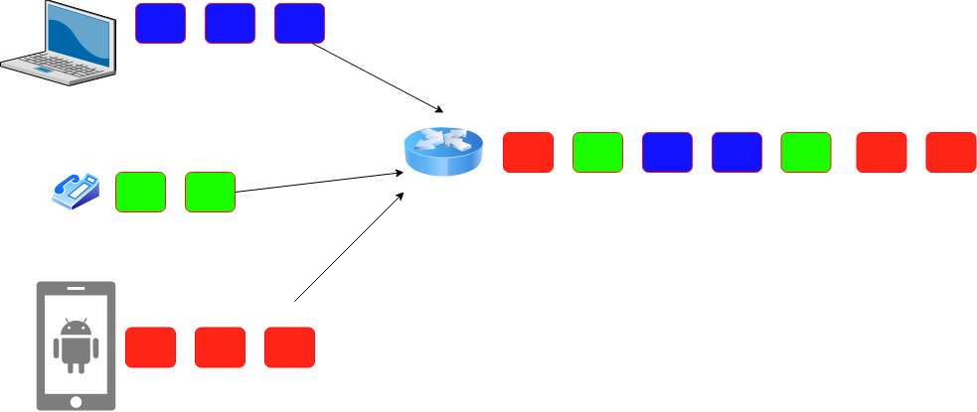
Performance - Latency
Latency = Propagation Delay + Transmission Delay + Queuing Delay
Propagation = Distance/Speed Of Light (in Copper or Fiber)
Transmit = Size/Bandwidth
How long to “put it on the wire?” (Transmission)
How long to traverse
the link? (Propagation)
How long to queue? (queuing)
Notes:
Ndn can help organizing the namespaces
Once that’s done, data discovery and provenance is
Straight forward
Retrieval, transparent failover, and specialized operations
In this work, we take a real access log and try to quantify NDN’s improvements to a climate
workflow

Slide 7
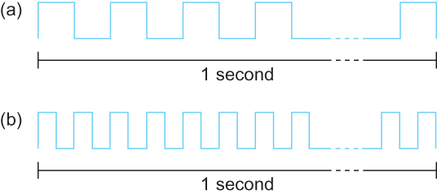
Performance – Bandwidth - bits/second
Bits transmitted at a particular bandwidth can be regarded as having some width:
(a) bits transmitted at 1Mbps (each bit 1 μs wide);
(b) bits transmitted at 2Mbps (each bit 0.5 μs wide).
Packets are made of bits – each bit need some time to be processed at the router. This is transmission delay!
Notes:
Ndn can help organizing the namespaces
Once that’s done, data discovery and provenance is
Straight forward
Retrieval, transparent failover, and specialized operations
In this work, we take a real access log and try to quantify NDN’s improvements to a climate
workflow

Slide 8

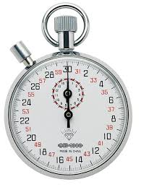
Propagation delay
Packets are made of bits. All bits must make it the next router before it can be forwarded.
Propagation delay = 50ms (time it takes for a bit to go from A to B)
Transmission delay = 1 ms (time it takes for each bit to be converted into signal)
A
B
50ms
10110...
50ms
t0
1
0
1
1
0
1
0
1
1
0
t50
50ms
t1
t51
50ms
t2
t52
50ms
t3
t53
50ms
t5
t55

Slide 9


Performance – Queuing Delay
R: link bandwidth (bps)
L: packet length (bits)
A: Average packet arrival rate
Traffic delay = AL/R
AL/R ~ 1
AL/R ~ 0
Everyone in the front has to be serviced first!!!!!
Notes:
Ndn can help organizing the namespaces
Once that’s done, data discovery and provenance is
Straight forward
Retrieval, transparent failover, and specialized operations
In this work, we take a real access log and try to quantify NDN’s improvements to a climate
workflow

Slide 10
Performance – Example
Breakout
Calculate the total time required to transfer a 1000-KB file using 1KB packets. Assuming bandwidth is 1.5 Mbps, the RTT of 50 ms, an initial 2 × RTT of “handshaking” before any data is sent.
Delay = Handshake + Transmission + Propagation + Queuing
Delay = 2*50ms + (1000*1024*8)/(1.5*1000*1000) second + 50/2ms + 0 = 5.586seconds
Propagation delay = First bit from sender to receiver
Transmission delay = All bits on the wire
Notes:
Delay = 2*50ms + (1000*1024*8)/(1.5*1000*1000) second + 50/2ms + 0 = 5.586seconds
Propagation delay = First bit from sender to receiver
Transmission delay = All bits on the wire

Slide 11
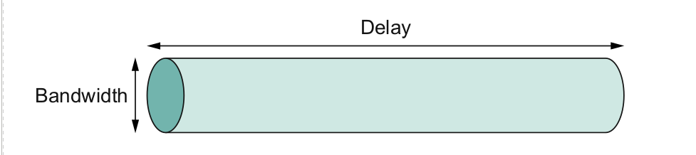
Bandwidth x Delay Product
Capacity of a network pipe = Bandwidth (bits) x Two way Delay (Seconds) (a.k.a RTT or Round Trip Delay)
This is the amount of bits that a pipe can hold!
Notes:
Ndn can help organizing the namespaces
Once that’s done, data discovery and provenance is
Straight forward
Retrieval, transparent failover, and specialized operations
In this work, we take a real access log and try to quantify NDN’s improvements to a climate
workflow

Slide 12
Bandwidth x Delay Product - Example
Bandwidth = 50Mbps Latency = 100ms
Bandwidth x Delay = 50x10⁶x100x10⁻³ ⁼ 5x10⁶ bits = 625 kilobytes
Notes:
Ndn can help organizing the namespaces
Once that’s done, data discovery and provenance is
Straight forward
Retrieval, transparent failover, and specialized operations
In this work, we take a real access log and try to quantify NDN’s improvements to a climate
workflow

Slide 13
Bandwidth x Delay - Some more examples
Bandwidth = 54Mbps (Wireless G)
RTT = 1ms
How much data can the pipe hold?
BxD = 54x10⁶x1x10⁻³
Notes:
Ndn can help organizing the namespaces
Once that’s done, data discovery and provenance is
Straight forward
Retrieval, transparent failover, and specialized operations
In this work, we take a real access log and try to quantify NDN’s improvements to a climate
workflow

Slide 14
Bandwidth x Delay – Mars Rover
https://mars.nasa.gov/msl/mission/communications/ https://www.youtube.com/watch?v=NGgzq8eXZOQ
Breakout:
- Bit rate of curiosity: 32000bits/second - Delay = 14 minutes each way - BxD = 32000*14*60*2
Notes:
Ndn can help organizing the namespaces
Once that’s done, data discovery and provenance is
Straight forward
Retrieval, transparent failover, and specialized operations
In this work, we take a real access log and try to quantify NDN’s improvements to a climate
workflow

Slide 15
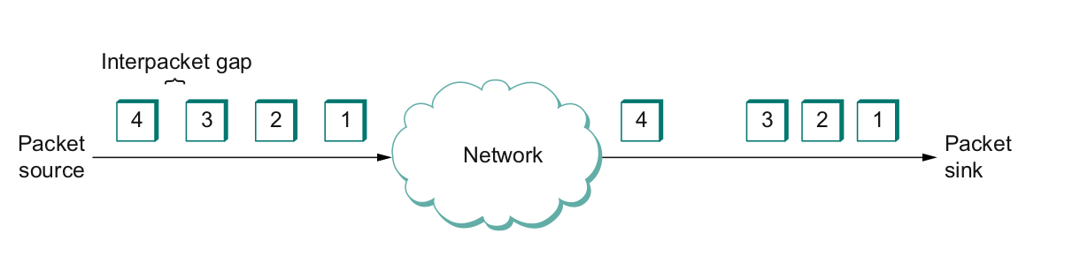
And one more thing - Jitter
Also called Interpacket gap
why does it happen (which artifact of packet switching?)
why is it important (think video applications)?
How do you solve this?
Notes:
Ndn can help organizing the namespaces
Once that’s done, data discovery and provenance is
Straight forward
Retrieval, transparent failover, and specialized operations
In this work, we take a real access log and try to quantify NDN’s improvements to a climate
workflow

Slide 16
Performance – Example
Calculate the total time required to transfer a 1000-KB file in the following case, assuming bandwidth is 1.5 Mbps, an RTT of 50 ms, a packet size of 1 KB data, and an initial 2 × RTT of “handshaking” before data is sent. (Peterson-Davie Exercise 3, Chapter 1)
Delay = Handshake + Transmission + Propagation + Queuing Delay = 2*50ms + (1000*1024*8)/(1.5*1000*1000) second + 50/2ms + 0 = 5.586seconds
Propagation delay = First bit from sender to receiver
Notes:
Ndn can help organizing the namespaces
Once that’s done, data discovery and provenance is
Straight forward
Retrieval, transparent failover, and specialized operations
In this work, we take a real access log and try to quantify NDN’s improvements to a climate
workflow

Slide 17
Performance – Example
Calculate the total time required to transfer a 1.5-MB file in the following cases, assuming an RTT of 80 ms, bandwidth= 10Mbps, a packet size of 1 KB data, and an initial 2 × RTT of “handshaking” before data is sent:
Delay = Handshake + Transmission + Propagation + Queuing
Propagation delay = First bit from sender to receiver
Notes:
Ndn can help organizing the namespaces
Once that’s done, data discovery and provenance is
Straight forward
Retrieval, transparent failover, and specialized operations
In this work, we take a real access log and try to quantify NDN’s improvements to a climate
workflow

Slide 18
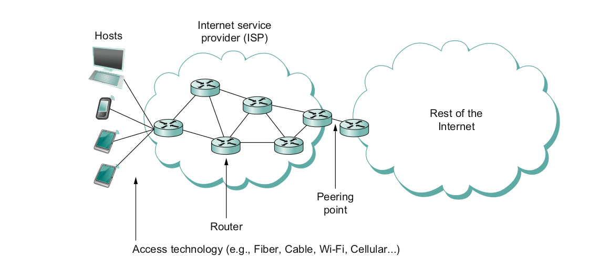
What does it take to create a link?
Common abstractions
Why?

Slide 19
Reading Assignment
Read Section 1.5:
https://book.systemsapproach.org/foundation/performance.html#performance
~30Mins

Slide 20
Apps (HTTP)
Data
Apps (HTTP)
Segments
Transport (TCP/UDP)
Transport (TCP/UDP)
Network (IP)
Packets
Network (IP)
Link (Ethernet)
Frames
Link (Ethernet)
Ethernet Interface
Ethernet Interface
Bits (1010001)

