Slide 1
CSC4200/5200 – Computer Networking
Network FUNDAMENTALS
Instructor: Susmit Shannigrahi
sshannigrahi@tntech.edu

Slide 2
Chapter 1: Fundamentals
Networking is ubiquitous
What did you use it for today?
First things first:
Terminology
Basic tools
What does it take to build an Internet?
Notes:
Ndn can help organizing the namespaces
Once that’s done, data discovery and provenance is
Straight forward
Retrieval, transparent failover, and specialized operations
In this work, we take a real access log and try to quantify NDN’s improvements to a climate
workflow

Slide 3
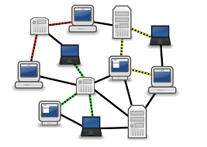
Links, Nodes, Network, Internet
You can view the network as a graph
Each device (a phone, a computer) is a node
Each connection is a link
Wires = real links
Bluetooth, Radio, Infrared = virtual links
Nodes + links = a network
Many connected networks = Internet
Notes:
Ndn can help organizing the namespaces
Once that’s done, data discovery and provenance is
Straight forward
Retrieval, transparent failover, and specialized operations
In this work, we take a real access log and try to quantify NDN’s improvements to a climate
workflow

Slide 4
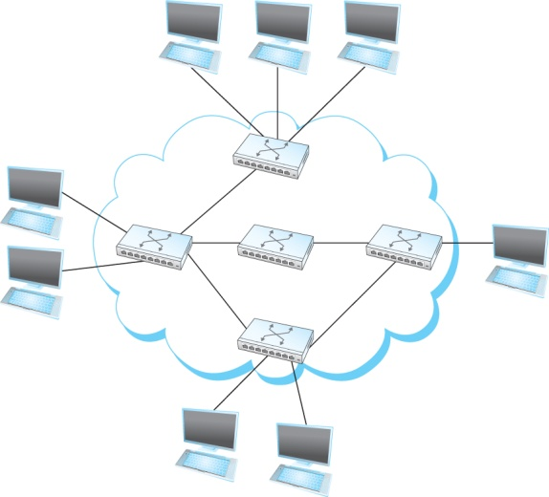
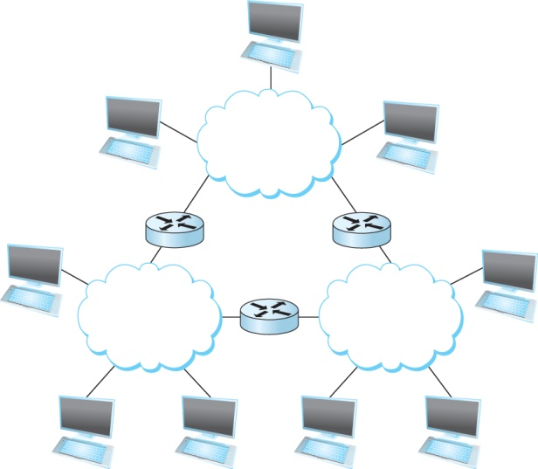
A Network and the Internet
Notes:
Ndn can help organizing the namespaces
Once that’s done, data discovery and provenance is
Straight forward
Retrieval, transparent failover, and specialized operations
In this work, we take a real access log and try to quantify NDN’s improvements to a climate
workflow

Slide 5
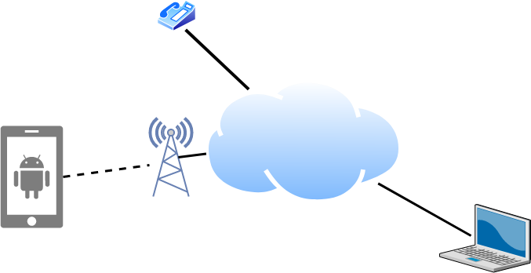
Links, Nodes, Routers, Switches
Notes:
Ndn can help organizing the namespaces
Once that’s done, data discovery and provenance is
Straight forward
Retrieval, transparent failover, and specialized operations
In this work, we take a real access log and try to quantify NDN’s improvements to a climate
workflow

Slide 6
Client and Server
My laptop with a browser = client
It requests a service
Email, chat, video, youtube
A node running a program that serves the requests = server
Runs a service
Chat, video, messaging
A node can both be a client and a server
Notes:
Ndn can help organizing the namespaces
Once that’s done, data discovery and provenance is
Straight forward
Retrieval, transparent failover, and specialized operations
In this work, we take a real access log and try to quantify NDN’s improvements to a climate
workflow

Slide 7
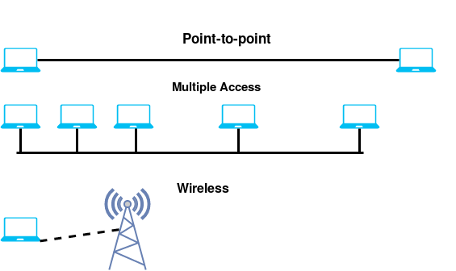
Connectivity
Point-to-Point
Multiple access
Wireless
Notes:
Ndn can help organizing the namespaces
Once that’s done, data discovery and provenance is
Straight forward
Retrieval, transparent failover, and specialized operations
In this work, we take a real access log and try to quantify NDN’s improvements to a climate
workflow

Slide 8
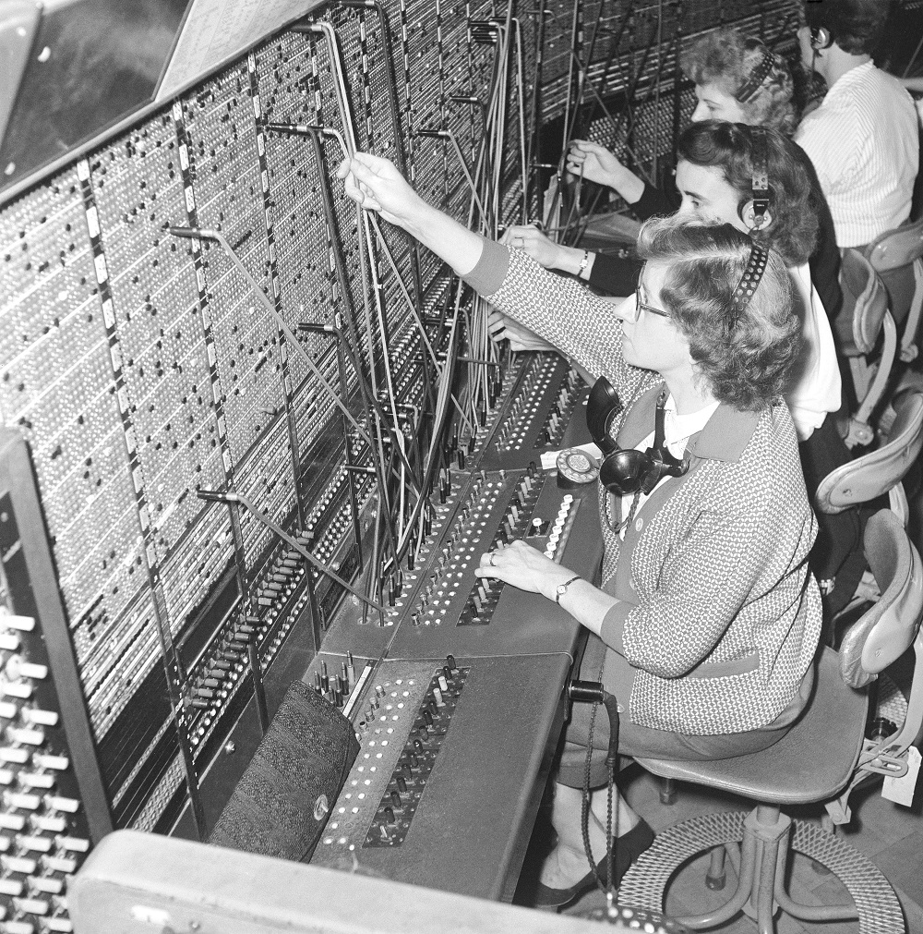


Circuit Switching – Old telephone networks
Operator, get me the navy
Build physical wire:
Guaranteed resources
Great for voice
Why change a working system?
Notes:
Ndn can help organizing the namespaces
Once that’s done, data discovery and provenance is
Straight forward
Retrieval, transparent failover, and specialized operations
In this work, we take a real access log and try to quantify NDN’s improvements to a climate
workflow

Slide 9
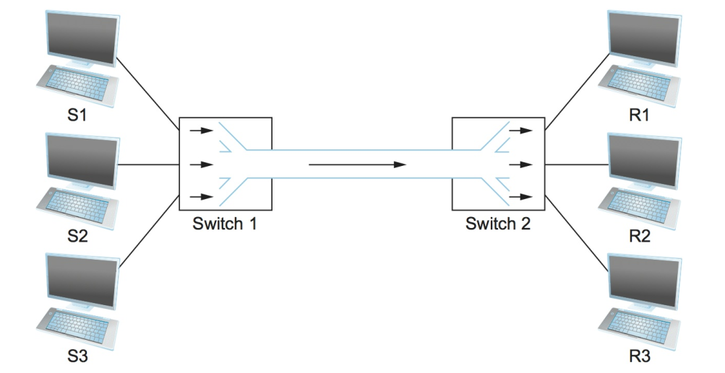
Circuit Switching
What are the problems?
Notes:
Ndn can help organizing the namespaces
Once that’s done, data discovery and provenance is
Straight forward
Retrieval, transparent failover, and specialized operations
In this work, we take a real access log and try to quantify NDN’s improvements to a climate
workflow

Slide 10
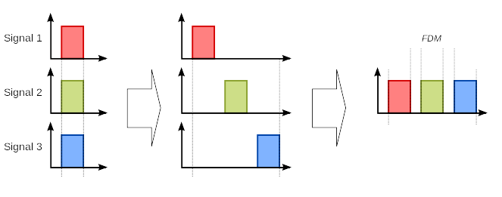
Frequency Division Multiplexing for Circuit Switching
wikipedia
Notes:
Ndn can help organizing the namespaces
Once that’s done, data discovery and provenance is
Straight forward
Retrieval, transparent failover, and specialized operations
In this work, we take a real access log and try to quantify NDN’s improvements to a climate
workflow

Slide 11
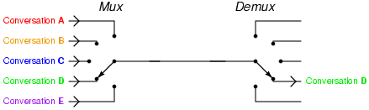
Time Division Multiplexing for Circuit Switching
wikipedia
Notes:
Ndn can help organizing the namespaces
Once that’s done, data discovery and provenance is
Straight forward
Retrieval, transparent failover, and specialized operations
In this work, we take a real access log and try to quantify NDN’s improvements to a climate
workflow

Slide 12
Circuit Switching – TDM and FDM
Problems solved? Or do they still exist?
Notes:
Ndn can help organizing the namespaces
Once that’s done, data discovery and provenance is
Straight forward
Retrieval, transparent failover, and specialized operations
In this work, we take a real access log and try to quantify NDN’s improvements to a climate
workflow

Slide 13
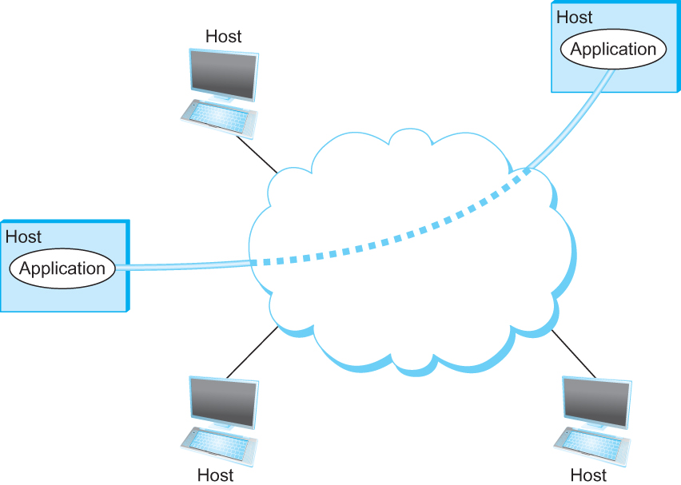
Support for Common Services
Logical Channels
Application-to-Application communication path or a pipe
Process communicating over an abstract channel

Slide 14
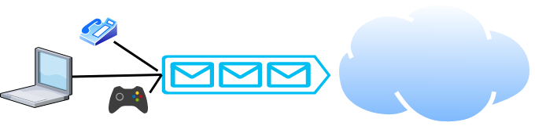
Packet Switching
Packets are low level components
Multiple kind of traffic with different requirements
Gaming vs Phone
Dumb network – How do you ensure quality of service?
End points must be smart
Notes:
Ndn can help organizing the namespaces
Once that’s done, data discovery and provenance is
Straight forward
Retrieval, transparent failover, and specialized operations
In this work, we take a real access log and try to quantify NDN’s improvements to a climate
workflow

Slide 15
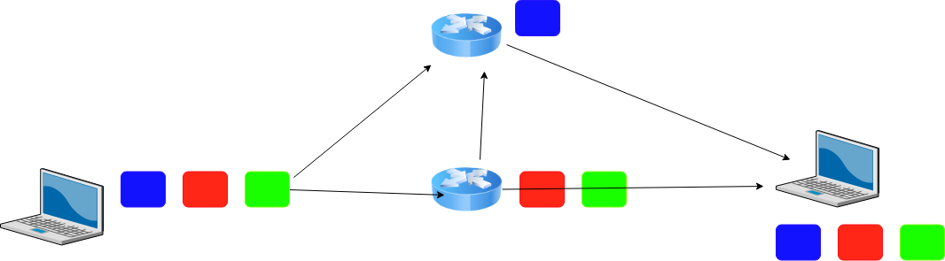
Packet Switching
Analogy?

Slide 16
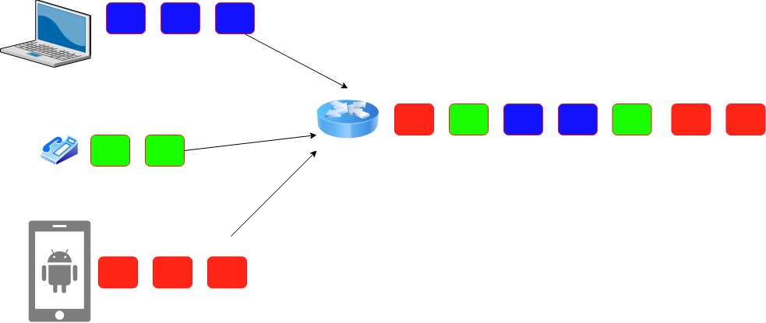
Statistical Multiplexing for Packet Switching
Ensures that slots will not be wasted
Introduces queuing delay
What actions can you take when queue becomes full? There may be many choices.
Your choice would have profound implications on performance
Drop packets, tell the sender to slow down, direct to another routers

Slide 17
How many users can you support?
1Mbps link
Users are active 10% of the time
10 Simultaneous users = full capacity
Circuit switching = 10 users
Packet switching with 35 users -> Probability of 10 sim. Users < 0.0004 https://math.stackexchange.com/questions/918861/probability-problem-in-networking

Slide 18
Circuit vs Packet Switching
Circuit Switching
Dedicated resource divided among participants
Requires setup, guaranteed performance (unless the link breaks)
Packet Switching
Shared resource
Use small chunks of data (packets), send as soon as possible
Store-and-forward packets

Slide 19
Internet Topology Zoo
http://www.topology-zoo.org

Slide 20
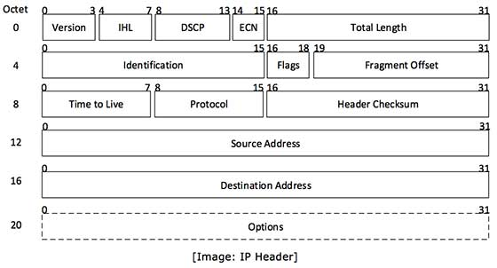
But What is a Packet?
Self-contained data unit
Has two parts (generally)
Control information
Payload
How do we transmit “Hello World?”
How do we transmit a dictionary?

Slide 21
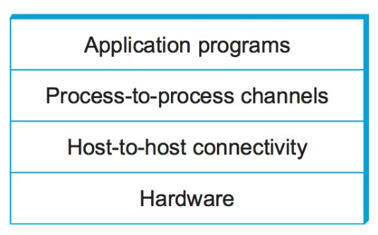
Network Architecture
What are the requirements from a network?
Architecture = High-level blueprint
Protocols = Building blocks of the architecture
Layering = Break down the problem in smaller pieces

Slide 22
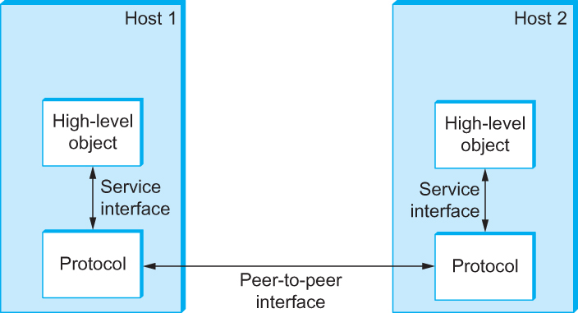
Interfaces
Service and Peer Interfaces

Slide 23
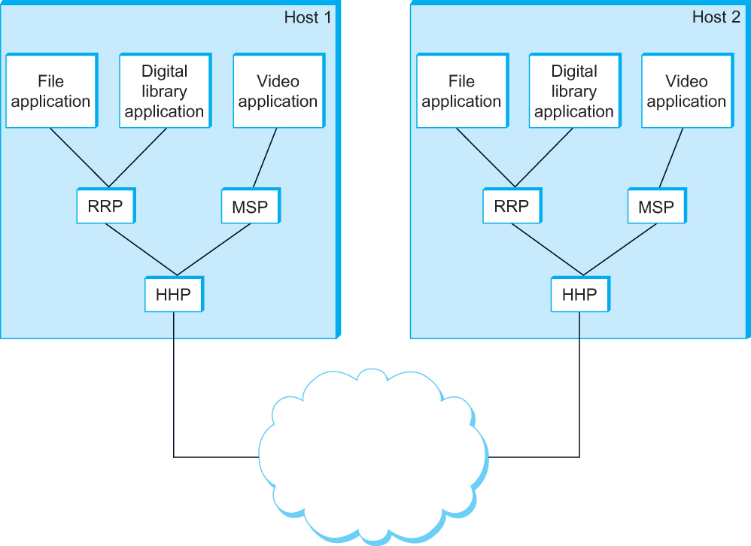
Protocol Graph
Example of a protocol graph
nodes are the protocols and links the “depends-on” relation

Slide 24
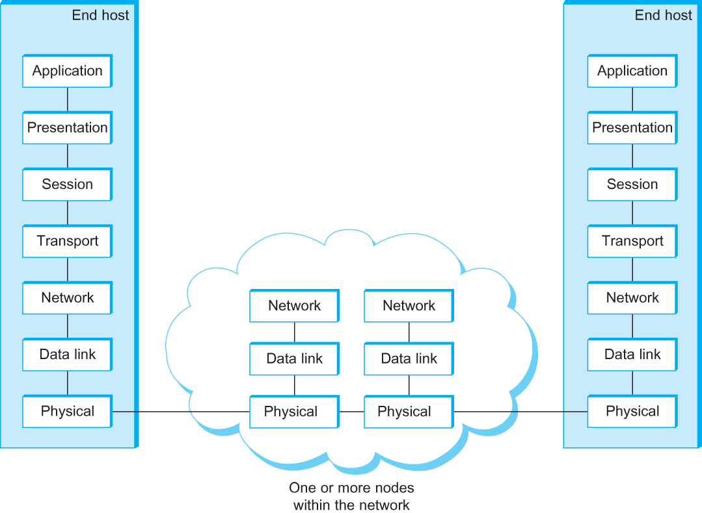
OSI Architecture
The OSI 7-layer Model
OSI – Open Systems Interconnection

Slide 25
Description of Layers
Physical Layer
Handles the transmission of raw bits over a communication link
Data Link Layer
Collects a stream of bits into a larger aggregate called a frame
Network adaptor along with device driver in OS implement the protocol in this layer
Frames are actually delivered to hosts
Network Layer
Handles routing among nodes within a packet-switched network
Unit of data exchanged between nodes in this layer is called a packet
The lower three layers are implemented on all network nodes

Slide 26
Description of Layers
Transport Layer
Implements a process-to-process channel
Unit of data exchanges in this layer is called a message
Session Layer
Provides a name space that is used to tie together the potentially different transport streams that are part of a single application
Presentation Layer
Concerned about the format of data exchanged between peers
Application Layer
Standardize common type of exchanges
The transport layer and the higher layers typically run only on end-hosts and not on the intermediate switches and routers

Slide 27
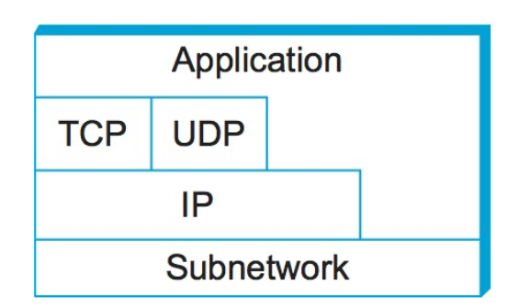
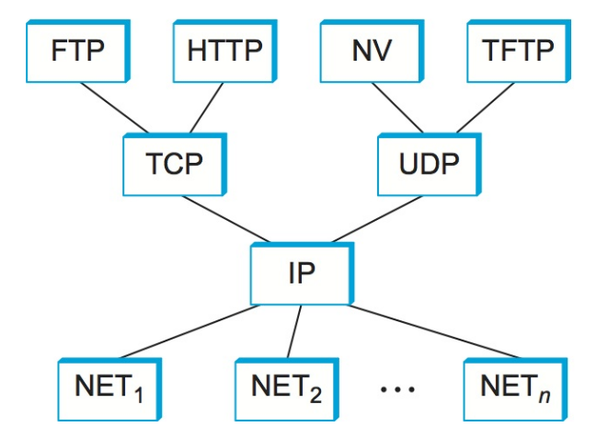
Network Layers
Use Service
Export Service
Makes it easier to divide functionality
Hides implementation details
Few other reasons?

Slide 28
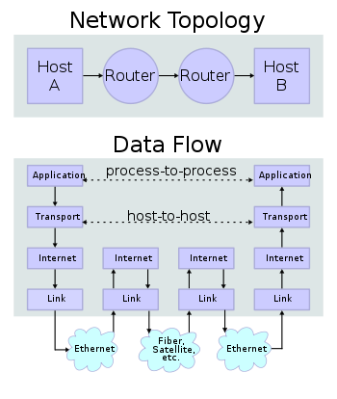
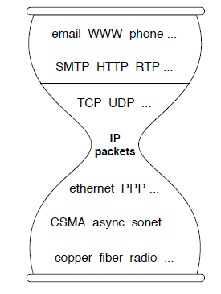
IP Suite
We reject kings, presidents, and voting. We believe in rough consensus
and running code. (David Clark, IETF, July 1992)
wikipedia

Slide 29
Reading Assignment
Read the overview of Chapter 1 - “Problem: Building a Network”
https://book.systemsapproach.org/foundation/problem.html#problem-building-a-network
About 5 minutes
Read Chapter 1.2
https://book.systemsapproach.org/foundation/architecture.html#architecture
About 45 minutes
Reach Chapter 1.3
https://book.systemsapproach.org/foundation/architecture.html#architecture
About 45 minutes

