Slide 1
CSC4200/5200 – Computer Networking
Connecting machines to a network
Instructor: Susmit Shannigrahi
sshannigrahi@tntech.edu

Slide 2

Apps (HTTP)
Data
Apps (HTTP)
Segments
Transport (TCP/UDP)
Transport (TCP/UDP)
Network (IP)
Packets
Network (IP)
Link (Ethernet)
Frames
Link (Ethernet)
Ethernet Interface
Ethernet Interface
Bits (1010001)

Slide 3
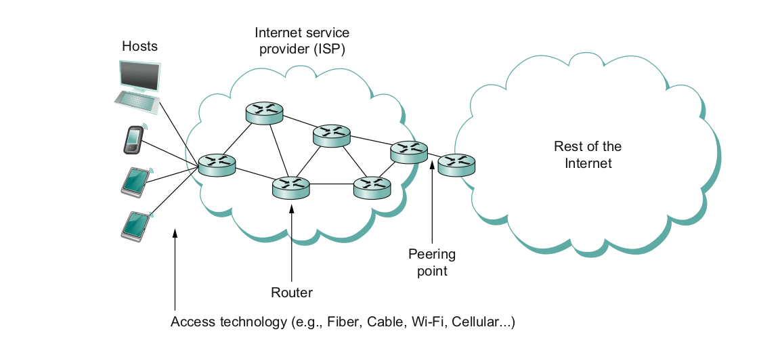
What does it take to create a link?
Common abstractions
Why?

Slide 4
Two Steps to a Link
Create a physical medium between nodes (wire, fiber, air!)
Make it carry bits
Encoding bits so that the other end understands (encoding)
Create bag of bits to create messages (framing)
Detect errors in frames (error detection)
Deal with lost frames (reliable delivery)
Create shared access to link, e.g, WiFi (media access)

Slide 5
Step 1 - Create the Physical Link

Slide 6
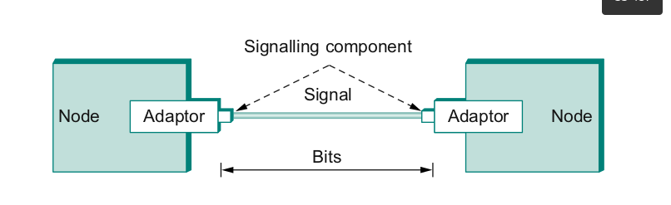
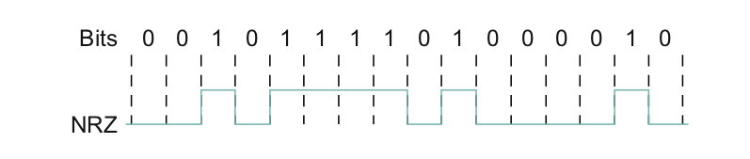
Step 2.1 - Encoding
Bit pattern - 0101001
Must encode it into electrical signals and then decode it on the other end!

Slide 7
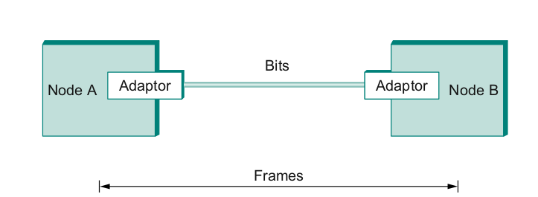
Step 2.2 – Create Frames – bag of bits
Bits - between adaptors
Frames – between hosts (two computers want to exchange messages)
The job of an adaptor is to find frames in a bit sequence
Frames are link layer protocols
Notes:
Ndn can help organizing the namespaces
Once that’s done, data discovery and provenance is
Straight forward
Retrieval, transparent failover, and specialized operations
In this work, we take a real access log and try to quantify NDN’s improvements to a climate
workflow

Slide 8

Step 2.2 - Framing
Point-to-point
Special start of text character denoted as Flag
0 1 1 1 1 1 1 0
Address, control : default numbers
Protocol for demux : IP / IPX
Payload : negotiated (1500 bytes)
Checksum : for error detection
Notes:
The University of Adelaide, School of Computer Science
6 September 2023
Chapter 2 — Instructions: Language of the Computer
8

Slide 9
Step 2.3 - Error Detection
Bit errors are introduced into frames
Because of electrical interference and thermal noises
Detecting Error
Correction Error
Two approaches when the recipient detects an error
Notify the sender that the message was corrupted, so the sender can send again.
If the error is rare, then the retransmitted message will be error-free
Using some error correct detection and correction algorithm, the receiver reconstructs the message
Notes:
The University of Adelaide, School of Computer Science
6 September 2023
Chapter 2 — Instructions: Language of the Computer
9

Slide 10
Error Detection
Common technique for detecting transmission error
CRC (Cyclic Redundancy Check)
Used in HDLC, DDCMP, CSMA/CD, Token Ring
Other approaches
Two Dimensional Parity (BISYNC)
Checksum (IP)
Notes:
The University of Adelaide, School of Computer Science
6 September 2023
Chapter 2 — Instructions: Language of the Computer
10

Slide 11
Error Detection
Basic Idea of Error Detection
To add redundant information to a frame that can be used to determine if errors have been introduced
0
1
0
1
0
0
0
1
0
1
1
1
Number of 1s
Odd 1s = Parity bit 1
Even 1s = Parity bit 0
Notes:
The University of Adelaide, School of Computer Science
6 September 2023
Chapter 2 — Instructions: Language of the Computer
11

Slide 12
Two-dimensional parity
Two-dimensional parity does a similar calculation
Extra parity byte for the entire frame, in addition to a parity bit for each byte
Two-dimensional parity catches all 1-, 2-, and 3-bit errors and most 4-bit errors
Notes:
The University of Adelaide, School of Computer Science
6 September 2023
Chapter 2 — Instructions: Language of the Computer
12

Slide 13
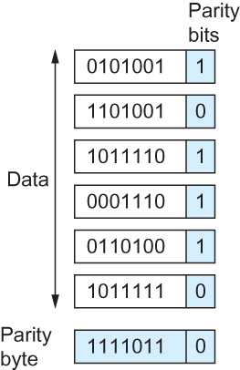
Two-dimensional parity
Number of 1s
Odd 1s = Parity bit 1
Even 1s = Parity bit 0
Do it both horizontally and vertically
Two Dimensional Parity

Slide 14
Internet Checksum Algorithm
Not used at the link level
Add up all the words that are transmitted and then transmit the result of that sum
The result is called the checksum
The receiver performs the same calculation on the received data and compares the result with the received checksum
Notes:
The University of Adelaide, School of Computer Science
6 September 2023
Chapter 2 — Instructions: Language of the Computer
14

Slide 15
Internet Checksum Algorithm
Server Side
1. It treats segment contents as sequence of 16-bit integers.
2. All segments are added. Let's call it sum.
3. Checksum : 1's complement of sum.(In 1's complement all 0s are converted into 1s and all 1s are converted into 0s).
4. Sender puts this checksum value in UDP checksum field. Client Side:
1. Calculate checksum
2. All segments are added and then sum is added with sender's checksum.
3. Check that any 0 bit is presented in checksum. If receiver side checksum contains any 0 then error is detected. So the packet is discarded by receiver.
Notes:
The University of Adelaide, School of Computer Science
6 September 2023
Chapter 2 — Instructions: Language of the Computer
15

Slide 16
Internet Checksum Algorithm (RFC 1071)
Calculate the checksum for 011001100110011001010101010101010000111100001111
Break it into 16 bit integers.
A = 0110011001100110
B = 0101010101010101
------------------------
A+B = 1011101110111011
C = 0000111100001111
------------------------
1100101011001010 (sum of all segments)
0011010100110101 (1’s complement, 1→0, 0→ 1) <= this is the checksum
At receiver:
Add sum of all segments and checksum 1100101011001010
+0011010100110101 ----------------------
1111111111111111
If correct, all 1s!
Notes:
The University of Adelaide, School of Computer Science
6 September 2023
Chapter 2 — Instructions: Language of the Computer
16

Slide 17
Others - Cyclic Redundancy Check (CRC)
Reduce the number of extra bits and maximize protection
N+1 bit message is N degree polynomial
10011010 →
Msg(x)=(1×x⁷)+(0×x⁶)+(0×x⁵)+(1×x⁴)+(1×x³)+(0×x²)+(1×x¹)+(0×x⁰)
Msg(x)=x⁷+x⁴+x³+x¹
Notes:
The University of Adelaide, School of Computer Science
6 September 2023
Chapter 2 — Instructions: Language of the Computer
17

Slide 18
Others - Cyclic Redundancy Check (CRC)
Msg(x)=x⁷+x⁴+x³+x¹
Pick a divisor polynomial (from a table)
C(x) = x³⁺x²+1
Divide M(X) by C(x) → subtract the reminder from M(x)
Gives you M’(X)
You can do this by performing a logical XOR
Send M’(x)and C(x) to the recipient
If the result is 0, you received a good copy
Notes:
The University of Adelaide, School of Computer Science
6 September 2023
Chapter 2 — Instructions: Language of the Computer
18

Slide 19
Others - Cyclic Redundancy Check (CRC)
Msg(x)=x⁷+x⁴+x³+x¹
Pick a divisor polynomial (from a table)
C(x) = x³⁺x²+1
Divide M(X) by C(x) → subtract the reminder from M(x)
Gives you M’(X)
You can do this by performing a logical XOR
Send M’(x)and C(x) to the recipient
If the result is 0, you received a good copy
Notes:
The University of Adelaide, School of Computer Science
6 September 2023
Chapter 2 — Instructions: Language of the Computer
19

Slide 20
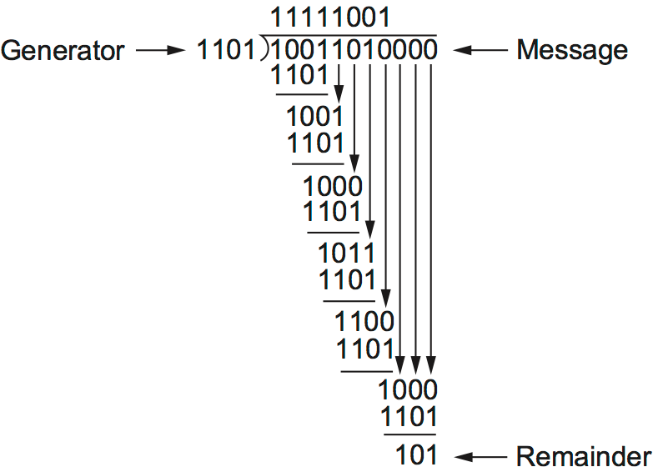
Others - Cyclic Redundancy Check (CRC)
1. Msg(x)=10011010 = x⁷+x⁴+x³+x¹
2. add k zeros at the end of the message, 3 in this case.
10011010000 ← T(x)
3. Pick a c(x) → x³+x²+1.
4. T(x)/c(x) → Reminder 101. 5. Subtract from message and send
Notes:
The University of Adelaide, School of Computer Science
6 September 2023
Chapter 2 — Instructions: Language of the Computer
20

Slide 21
Frames
We are still sending frames between hosts!
Shortcomings of error correction/detection?
Notes:
Ndn can help organizing the namespaces
Once that’s done, data discovery and provenance is
Straight forward
Retrieval, transparent failover, and specialized operations
In this work, we take a real access log and try to quantify NDN’s improvements to a climate
workflow

Slide 22
Step 2.4 - Reliable Delivery
Frames might get lost
Too many bits lost
Clock did not sync properly
Error detected but the report got lost
Can we build links that does not have errors?
Not possible
How about all those error correction stuff we learned?
Can we add them to frames?
We could, but think of the overhead
What happens when the entire frame is lost?
Notes:
Ndn can help organizing the namespaces
Once that’s done, data discovery and provenance is
Straight forward
Retrieval, transparent failover, and specialized operations
In this work, we take a real access log and try to quantify NDN’s improvements to a climate
workflow

Slide 23
Frames – bag of bits
Sending side – encapsulation, add error check bits, flow control
Receiving side – extract frames, check for error, flow control
Notes:
Ndn can help organizing the namespaces
Once that’s done, data discovery and provenance is
Straight forward
Retrieval, transparent failover, and specialized operations
In this work, we take a real access log and try to quantify NDN’s improvements to a climate
workflow

Slide 24
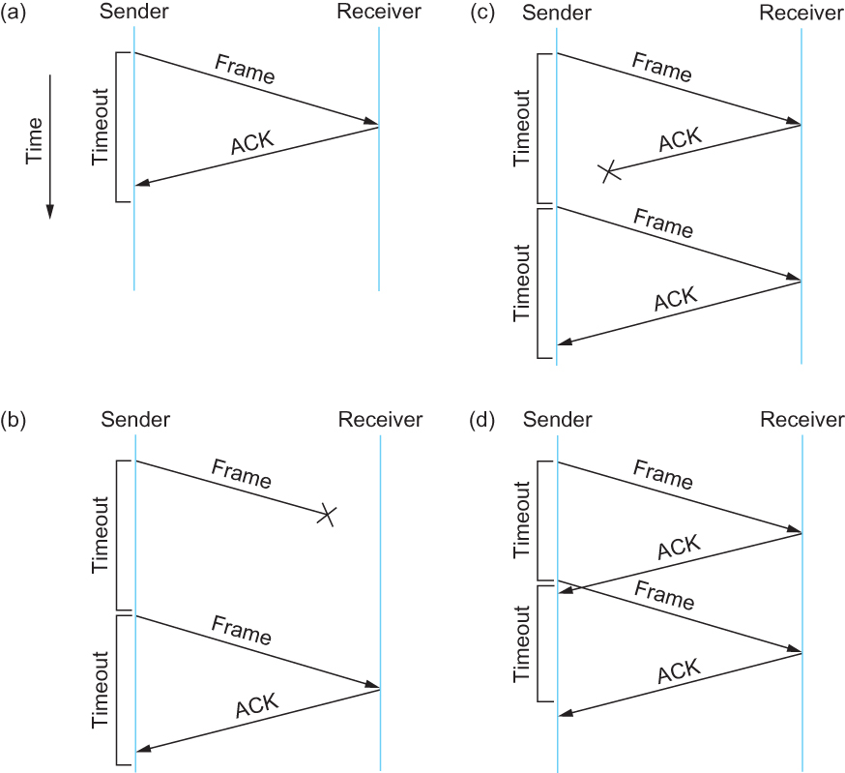
Stop and Wait
Sender sends a frame, sets a timeout (e.g., 1 sec)
Receiver receives the frame,
sends an ACK
Sender
sends the next frame on ACK
retransmits the same frame if timeout happens
Spot the bugs in the protocol
Notes:
Ndn can help organizing the namespaces
Once that’s done, data discovery and provenance is
Straight forward
Retrieval, transparent failover, and specialized operations
In this work, we take a real access log and try to quantify NDN’s improvements to a climate
workflow

Slide 25
Stop and Wait – Bugs (C and D)
Notes:
Ndn can help organizing the namespaces
Once that’s done, data discovery and provenance is
Straight forward
Retrieval, transparent failover, and specialized operations
In this work, we take a real access log and try to quantify NDN’s improvements to a climate
workflow

Slide 26
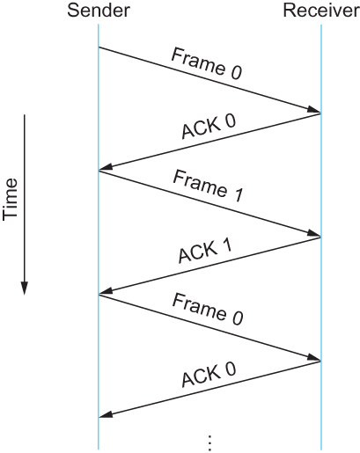
Stop and Wait – How to fix the bug?
Hint: Uniquely identify each packet
Notes:
Ndn can help organizing the namespaces
Once that’s done, data discovery and provenance is
Straight forward
Retrieval, transparent failover, and specialized operations
In this work, we take a real access log and try to quantify NDN’s improvements to a climate
workflow

Slide 27
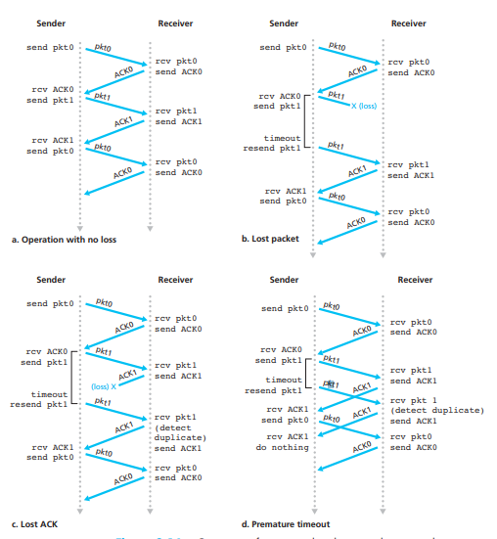
Stop and Wait
v2
Notes:
Ndn can help organizing the namespaces
Once that’s done, data discovery and provenance is
Straight forward
Retrieval, transparent failover, and specialized operations
In this work, we take a real access log and try to quantify NDN’s improvements to a climate
workflow

Slide 28
Stop and Wait - V2 Problems
t1
Sender sets a timeout to wait for an ACK
Too small – retransmissions
Too large – long wait if frames are lost
Solution:
Keep a running average of Round Trip Times
EstimatedRTT = (1 – α) • EstimatedRTT + α • SampleRTT
Timeout = 2*EstimatedRTT
Value of α = 0.125
Where does α come from? RFC 6928 (for now)
t2
Notes:
Ndn can help organizing the namespaces
Once that’s done, data discovery and provenance is
Straight forward
Retrieval, transparent failover, and specialized operations
In this work, we take a real access log and try to quantify NDN’s improvements to a climate
workflow

Slide 29
Stop and Wait – How to fix the bug?
Hint: Uniquely identify each packet
Notes:
Ndn can help organizing the namespaces
Once that’s done, data discovery and provenance is
Straight forward
Retrieval, transparent failover, and specialized operations
In this work, we take a real access log and try to quantify NDN’s improvements to a climate
workflow

Slide 30
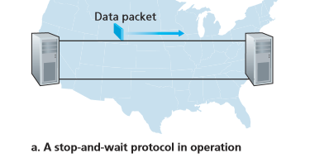
Stop and Wait – How does it perform?
Bandwidth (R)= 1Gbps
Packet size (L) = 1000 bytes
RTT = 30ms
T_{trans} = L/R = 8000bits/10⁹bits/sec = 8microsecond
T_{prop} = 15ms
Total Delay = 15.008 ms
Kurose/Ross
Notes:
Ndn can help organizing the namespaces
Once that’s done, data discovery and provenance is
Straight forward
Retrieval, transparent failover, and specialized operations
In this work, we take a real access log and try to quantify NDN’s improvements to a climate
workflow

Slide 31
Stop and Wait – How does it perform?
t0
t0+15.008
Sender transmits for only 0.008 ms in 30.008ms
Utilization = 0.008/30.008 = 0.00027
One bit at a time
Worse when loss happens!
ACK
t0+30.008
t0+15.008
Kurose/Ross
Notes:
Ndn can help organizing the namespaces
Once that’s done, data discovery and provenance is
Straight forward
Retrieval, transparent failover, and specialized operations
In this work, we take a real access log and try to quantify NDN’s improvements to a climate
workflow

Slide 32
Apps (HTTP)
Data
Apps (HTTP)
Segments
Transport (TCP/UDP)
Transport (TCP/UDP)
Network (IP)
Packets
Network (IP)
Link (Ethernet)
Frames
Link (Ethernet)
Ethernet Interface
Ethernet Interface
Bits (1010001)

Slide 33
Reading Assignment
Chapter 2.4 –Error detection and CRC-
Until Sliding window
Pay special attention to CRC

