Slide 1
CSC4200/5200 – Computer Networking
Reliable Delivery – part 1
Instructor: Susmit Shannigrahi
sshannigrahi@tntech.edu

Slide 2

Apps (HTTP)
Data
Apps (HTTP)
Segments
Transport (TCP/UDP)
Transport (TCP/UDP)
Network (IP)
Packets
Network (IP)
Link (Ethernet)
Frames
Link (Ethernet)
Ethernet Interface
Ethernet Interface
Bits (1010001)

Slide 3
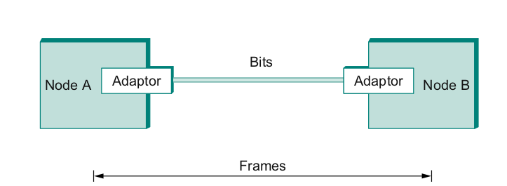
Frames – bag of bits
Sending side – encapsulation, add error check bits, flow control
Receiving side – extract frames, check for error, flow control
Notes:
Ndn can help organizing the namespaces
Once that’s done, data discovery and provenance is
Straight forward
Retrieval, transparent failover, and specialized operations
In this work, we take a real access log and try to quantify NDN’s improvements to a climate
workflow

Slide 4
Two (2.5) Steps to a Link
Create a physical medium between nodes (wire, fiber, air!)
Make it carry bits
Encoding bits so that the other end understands (encoding)
Create bag of bits to create messages (framing)
Detect errors in frames (error detection)
Deal with lost frames (reliable delivery)
Create shared access to link, e.g, WiFi (media access)

Slide 5
Reliable Delivery
Frames might get lost
Too many bits lost
Clock did not sync properly
Error detected but the report got lost
Can we build links that does not have errors?
Not possible
How about all those error correction stuff we learned?
Can we add them to frames?
We could, but think of the overhead
What happens when the entire frame is lost?
Notes:
Ndn can help organizing the namespaces
Once that’s done, data discovery and provenance is
Straight forward
Retrieval, transparent failover, and specialized operations
In this work, we take a real access log and try to quantify NDN’s improvements to a climate
workflow

Slide 6
Frames – bag of bits
Sending side – encapsulation, add error check bits, flow control
Receiving side – extract frames, check for error, flow control
Notes:
Ndn can help organizing the namespaces
Once that’s done, data discovery and provenance is
Straight forward
Retrieval, transparent failover, and specialized operations
In this work, we take a real access log and try to quantify NDN’s improvements to a climate
workflow

Slide 7
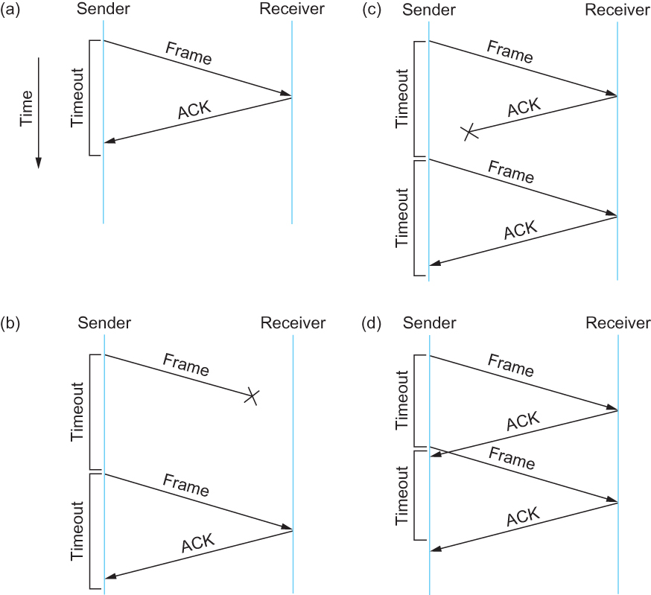
Stop and Wait
Sender sends a frame, sets a timeout (e.g., 1 sec)
Receiver receives the frame,
sends an ACK
Sender
sends the next frame on ACK
retransmits the same frame if timeout happens
Spot the bugs in the protocol
Notes:
Ndn can help organizing the namespaces
Once that’s done, data discovery and provenance is
Straight forward
Retrieval, transparent failover, and specialized operations
In this work, we take a real access log and try to quantify NDN’s improvements to a climate
workflow

Slide 8
Stop and Wait – Bugs (C and D)
Notes:
Ndn can help organizing the namespaces
Once that’s done, data discovery and provenance is
Straight forward
Retrieval, transparent failover, and specialized operations
In this work, we take a real access log and try to quantify NDN’s improvements to a climate
workflow

Slide 9
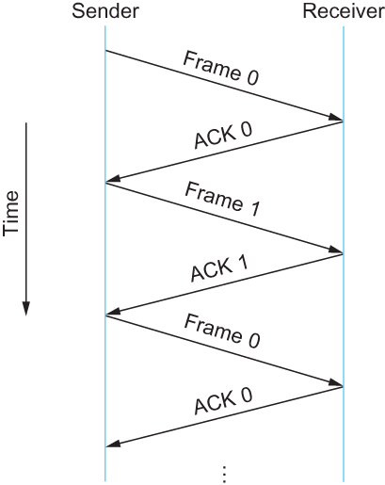
Stop and Wait – How to fix the bug?
Hint: Uniquely identify each packet
1 bit sequence number
- 0 or 1
Alternate between 0 and 1
Notes:
Ndn can help organizing the namespaces
Once that’s done, data discovery and provenance is
Straight forward
Retrieval, transparent failover, and specialized operations
In this work, we take a real access log and try to quantify NDN’s improvements to a climate
workflow

Slide 10
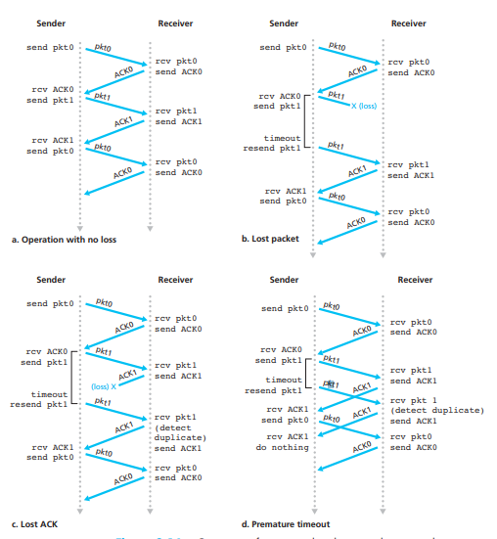
Stop and Wait
v2
Notes:
Ndn can help organizing the namespaces
Once that’s done, data discovery and provenance is
Straight forward
Retrieval, transparent failover, and specialized operations
In this work, we take a real access log and try to quantify NDN’s improvements to a climate
workflow

Slide 11
Stop and Wait - V2 Problems
t1
Sender sets a timeout to wait for an ACK
Too small – retransmissions
Too large – long wait if frames are lost
Solution:
Keep a running average of Round Trip Times
EstimatedRTT = (1 – α) • EstimatedRTT + α • SampleRTT
Timeout = 2*EstimatedRTT
Value of α = 0.125
Where does α come from? RFC 6928 (for now)
t2
Notes:
Ndn can help organizing the namespaces
Once that’s done, data discovery and provenance is
Straight forward
Retrieval, transparent failover, and specialized operations
In this work, we take a real access log and try to quantify NDN’s improvements to a climate
workflow

Slide 12
Stop and Wait – How to fix the bug?
Hint: Uniquely identify each packet
Notes:
Ndn can help organizing the namespaces
Once that’s done, data discovery and provenance is
Straight forward
Retrieval, transparent failover, and specialized operations
In this work, we take a real access log and try to quantify NDN’s improvements to a climate
workflow

Slide 13
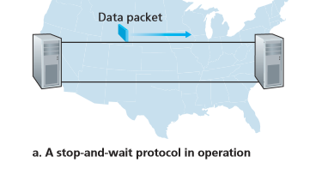
Stop and Wait – How does it perform?
Bandwidth (R)= 1Gbps
Packet size (L) = 1000 bytes
RTT = 30ms
T_{trans} = L/R = 8000bits/10⁹bits/sec = 8microsecond
T_{prop} = 15ms
Total Delay = 15.008 ms
Kurose/Ross
Notes:
Ndn can help organizing the namespaces
Once that’s done, data discovery and provenance is
Straight forward
Retrieval, transparent failover, and specialized operations
In this work, we take a real access log and try to quantify NDN’s improvements to a climate
workflow

Slide 14
Stop and Wait – How does it perform?
t0
t0+15.008
Sender transmits for only 0.008 ms in 30.008ms
Utilization = 0.008/30.008 = 0.00027
One bit at a time
Worse when loss happens!
ACK
t0+30.008
t0+15.008
Kurose/Ross
Notes:
Ndn can help organizing the namespaces
Once that’s done, data discovery and provenance is
Straight forward
Retrieval, transparent failover, and specialized operations
In this work, we take a real access log and try to quantify NDN’s improvements to a climate
workflow

Slide 15
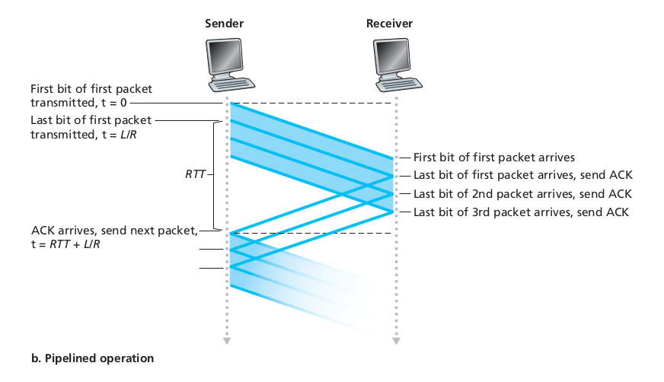
Sliding window to the rescue!
Utilization = 0.008*3/30.008 = 0.00079 (3 times increase)
Notes:
Ndn can help organizing the namespaces
Once that’s done, data discovery and provenance is
Straight forward
Retrieval, transparent failover, and specialized operations
In this work, we take a real access log and try to quantify NDN’s improvements to a climate
workflow

Slide 16
Sliding window to the rescue!
Utilization = 0.008*3/30.008 = 0.00079 (3 times increase)
Notes:
Ndn can help organizing the namespaces
Once that’s done, data discovery and provenance is
Straight forward
Retrieval, transparent failover, and specialized operations
In this work, we take a real access log and try to quantify NDN’s improvements to a climate
workflow

Slide 17
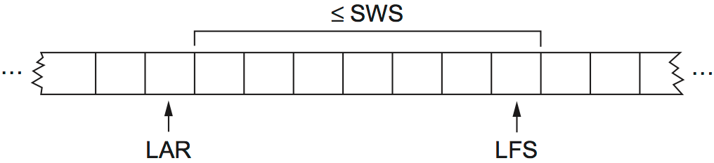
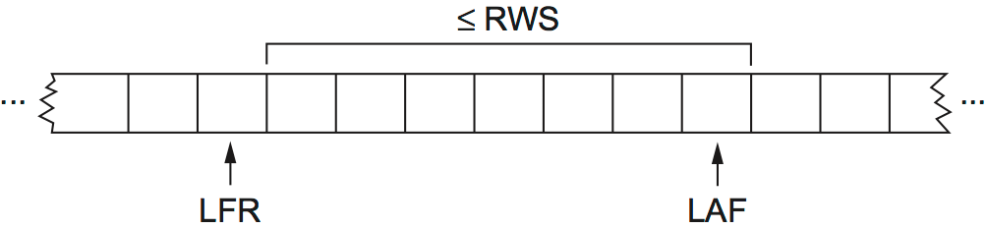
Sliding window – How does this work?
Sliding Window Size
Outstanding requests → SWS
LFS - LAR <= SWS
Last Frame Acked
Last Frame Sent
Sender
Last Frame Received
Last Acceptable Frame
Notes:
Ndn can help organizing the namespaces
Once that’s done, data discovery and provenance is
Straight forward
Retrieval, transparent failover, and specialized operations
In this work, we take a real access log and try to quantify NDN’s improvements to a climate
workflow

Slide 18
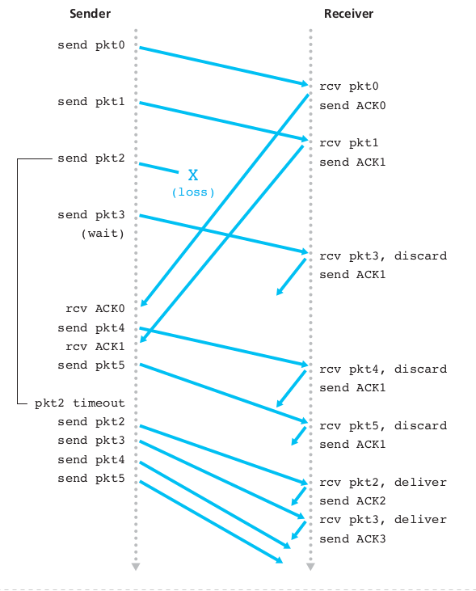
Sliding window -
Go-Back-N
Can transmit N bits before ACK
See the problem?
Can not move forward until all previous packets are acknowledged
Notes:
Ndn can help organizing the namespaces
Once that’s done, data discovery and provenance is
Straight forward
Retrieval, transparent failover, and specialized operations
In this work, we take a real access log and try to quantify NDN’s improvements to a climate
workflow

Slide 19
Sliding Window - Selective Repeat
http://www.exa.unicen.edu.ar/catedras/comdat1/material/Filminas3_Practico3.swf
Receiver:
Individually acks all packets
Buffers packets as necessary
Buffer packets until lost packets are received
Sender:
Resend packets (only) for which ACK not received
Timer for each unACKed packet
Can send only n packets
Notes:
Ndn can help organizing the namespaces
Once that’s done, data discovery and provenance is
Straight forward
Retrieval, transparent failover, and specialized operations
In this work, we take a real access log and try to quantify NDN’s improvements to a climate
workflow

Slide 20
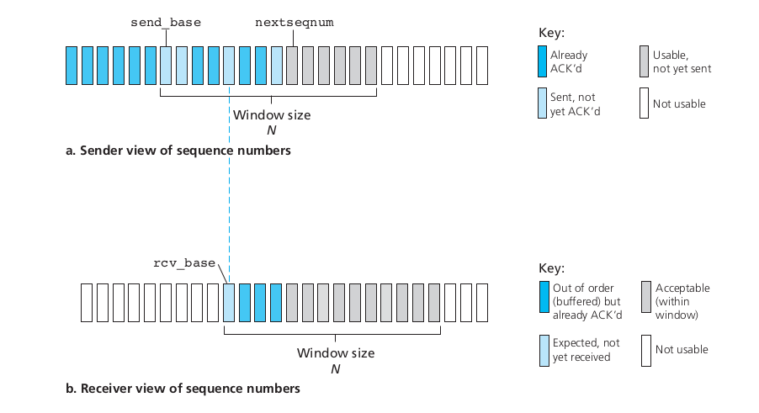
Sliding window - Selective Repeat
Notes:
Ndn can help organizing the namespaces
Once that’s done, data discovery and provenance is
Straight forward
Retrieval, transparent failover, and specialized operations
In this work, we take a real access log and try to quantify NDN’s improvements to a climate
workflow

Slide 21
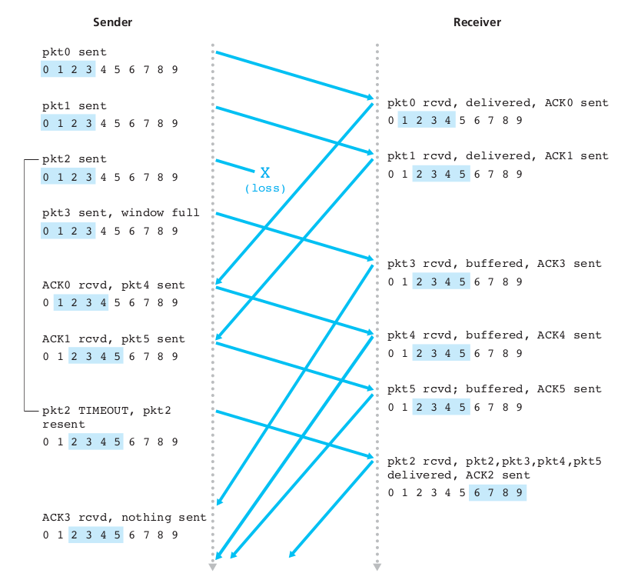
Sliding window - Selective Repeat
Notes:
Ndn can help organizing the namespaces
Once that’s done, data discovery and provenance is
Straight forward
Retrieval, transparent failover, and specialized operations
In this work, we take a real access log and try to quantify NDN’s improvements to a climate
workflow

Slide 22
Sliding window - Selective Repeat - LOSS
Sender:
Data received, if next to-be-sent-packet’s seq # within window, send. Else, buffer or return to application.
Timeout: Each packet has its own timer. resend the packet
ACK received: Mark received, Advance window to next unacked seq # if ack for send_base
Receiver, packet (n)
Sequence between recev_base, recv_base + N - 1, send ack (n)
Out of order: buffer
In-order or closes gap – deliver to application
Packet within <recv_base-N, recv_base -1>, ACK(n)
Otherwise: Ignore
Notes:
Ndn can help organizing the namespaces
Once that’s done, data discovery and provenance is
Straight forward
Retrieval, transparent failover, and specialized operations
In this work, we take a real access log and try to quantify NDN’s improvements to a climate
workflow

Slide 23
Issues with Sliding Window Protocol
When timeout occurs, the amount of data in transit decreases
Since the sender is unable to advance its window
When the packet loss occurs, this scheme is no longer keeping the pipe full
The longer it takes to notice that a packet loss has occurred, the more severe the problem becomes
How to improve this
Negative Acknowledgement (NAK)
Additional Acknowledgement
Selective Acknowledgement (SAK)
Notes:
The University of Adelaide, School of Computer Science
5 September 2023
Chapter 2 — Instructions: Language of the Computer
23

Slide 24
Next Steps
Reading Material:
Chapter 2.5
https://en.wikipedia.org/wiki/Go-Back-N_ARQ
5 minutes

