Slide 1
CSC4200/5200 – Computer Networking
Ethernet and WIFI
Instructor: Susmit Shannigrahi
sshannigrahi@tntech.edu

Slide 2

Apps (HTTP)
Data
Apps (HTTP)
Segments
Transport (TCP/UDP)
Transport (TCP/UDP)
Network (IP)
Packets
Network (IP)
Link (Ethernet)
Frames
Link (Ethernet)
Ethernet Interface
Ethernet Interface
Bits (1010001)

Slide 3
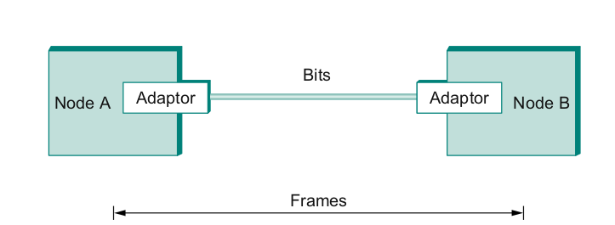
So far...
We have connected two machines using point to point wires
Encoded bits
Sent bits as Frames
Caught and corrected errors
Tuned efficiency and reliability using sliding window
What happens when there are more than two machines?
Notes:
Ndn can help organizing the namespaces
Once that’s done, data discovery and provenance is
Straight forward
Retrieval, transparent failover, and specialized operations
In this work, we take a real access log and try to quantify NDN’s improvements to a climate
workflow

Slide 4
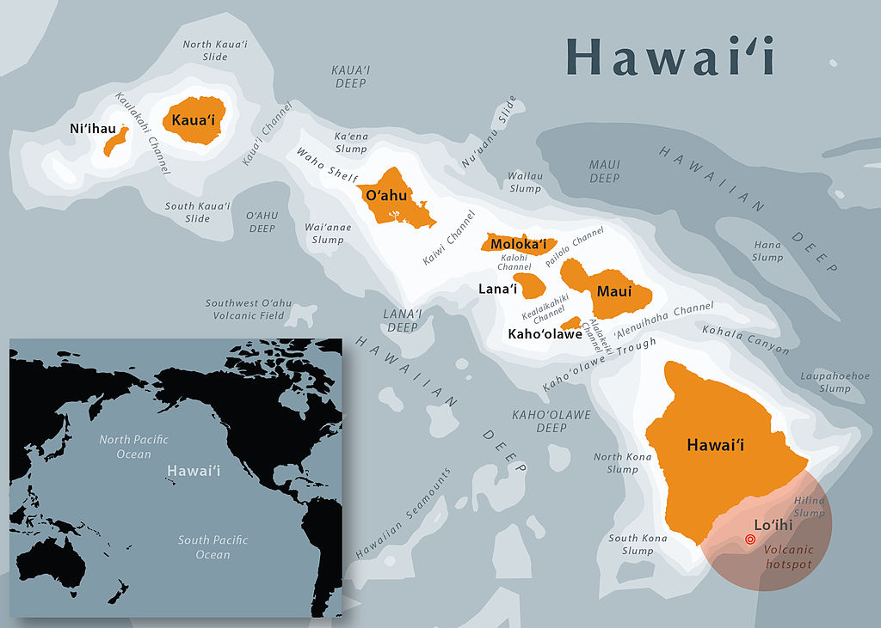
Map of Hawaii
wikipedia
Notes:
Ndn can help organizing the namespaces
Once that’s done, data discovery and provenance is
Straight forward
Retrieval, transparent failover, and specialized operations
In this work, we take a real access log and try to quantify NDN’s improvements to a climate
workflow

Slide 5
AlohaNET
Connect University of Hawaiʻi’s computers using wireless radio to main campus in Oahu
Random access to radio channel
If you have data, send
If you hear someone else, collision! Resend “later”
Fixed frequency channels
Shared medium
Abramson, Norman. "Development of the ALOHANET." IEEE transactions on Information Theory 31.2 (1985): 119-123.
https://www.eng.hawaii.edu/about/history/alohanet/
Notes:
Ndn can help organizing the namespaces
Once that’s done, data discovery and provenance is
Straight forward
Retrieval, transparent failover, and specialized operations
In this work, we take a real access log and try to quantify NDN’s improvements to a climate
workflow

Slide 6
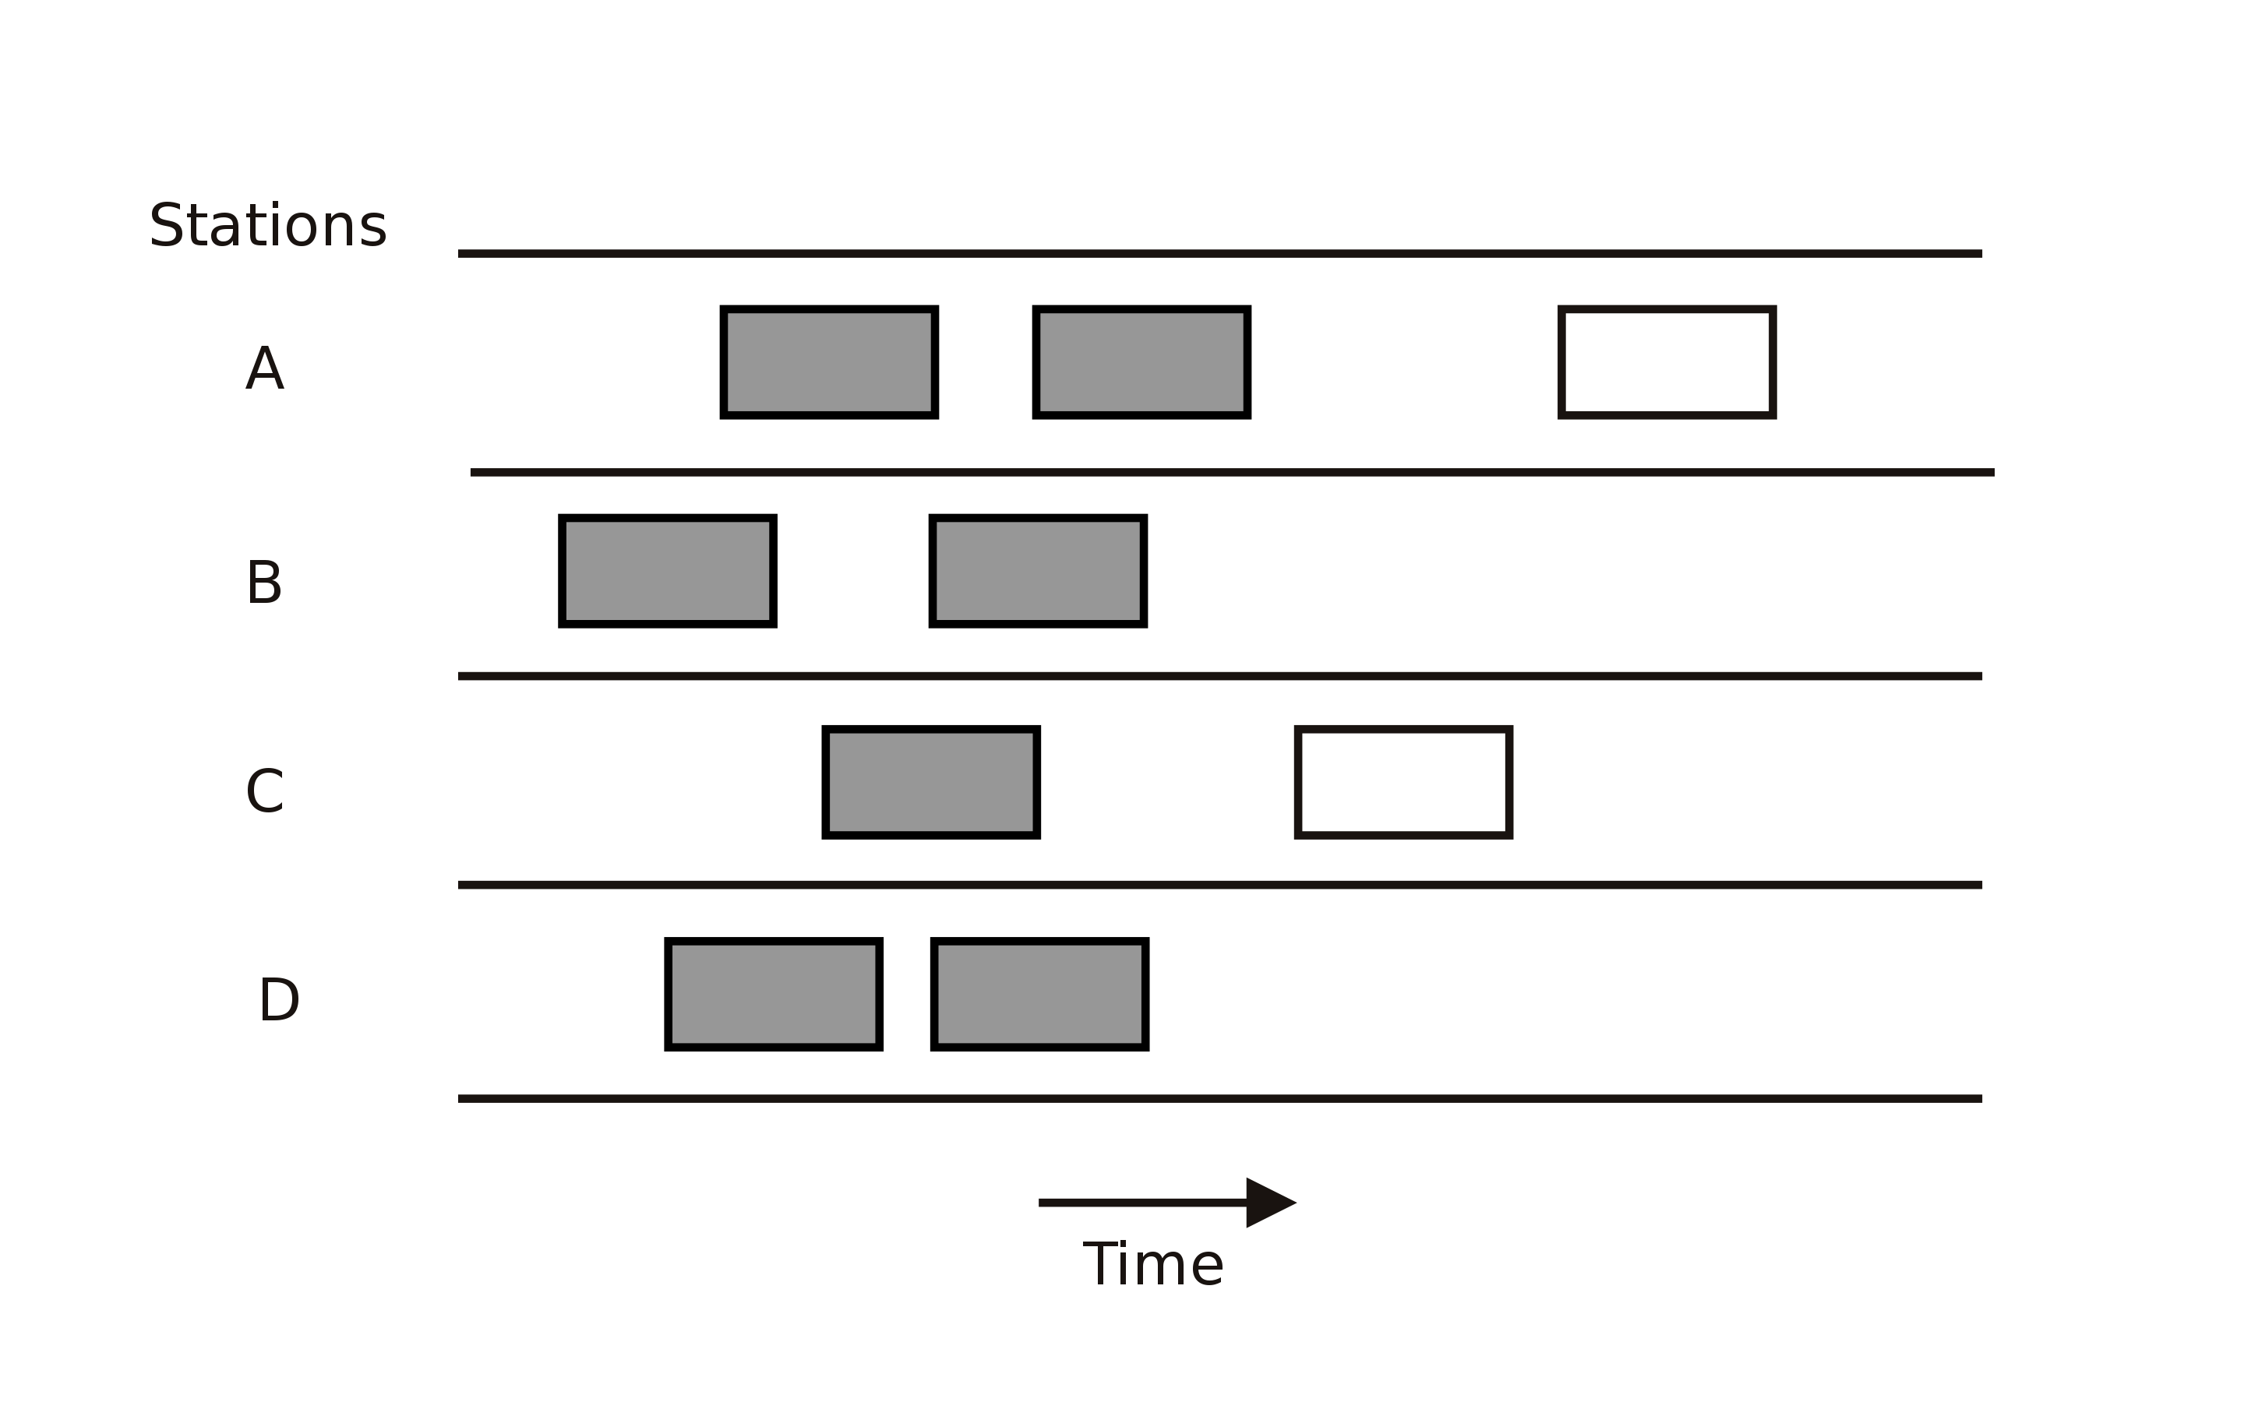
Pure Aloha
If you have data to send, send it.
While transmitting, if you hear from anyone else, collision!
Try retransmitting later.
Notes:
Ndn can help organizing the namespaces
Once that’s done, data discovery and provenance is
Straight forward
Retrieval, transparent failover, and specialized operations
In this work, we take a real access log and try to quantify NDN’s improvements to a climate
workflow

Slide 7
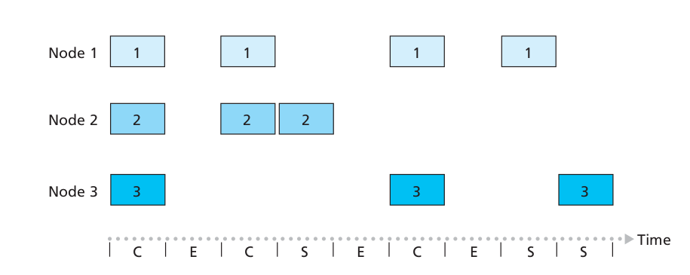
Slotted ALOHA
Notes:
Ndn can help organizing the namespaces
Once that’s done, data discovery and provenance is
Straight forward
Retrieval, transparent failover, and specialized operations
In this work, we take a real access log and try to quantify NDN’s improvements to a climate
workflow

Slide 8
Slotted ALOHA - Problems
Wasted slots
Idle slots
Need to sync
Low efficiency
Notes:
Ndn can help organizing the namespaces
Once that’s done, data discovery and provenance is
Straight forward
Retrieval, transparent failover, and specialized operations
In this work, we take a real access log and try to quantify NDN’s improvements to a climate
workflow

Slide 9
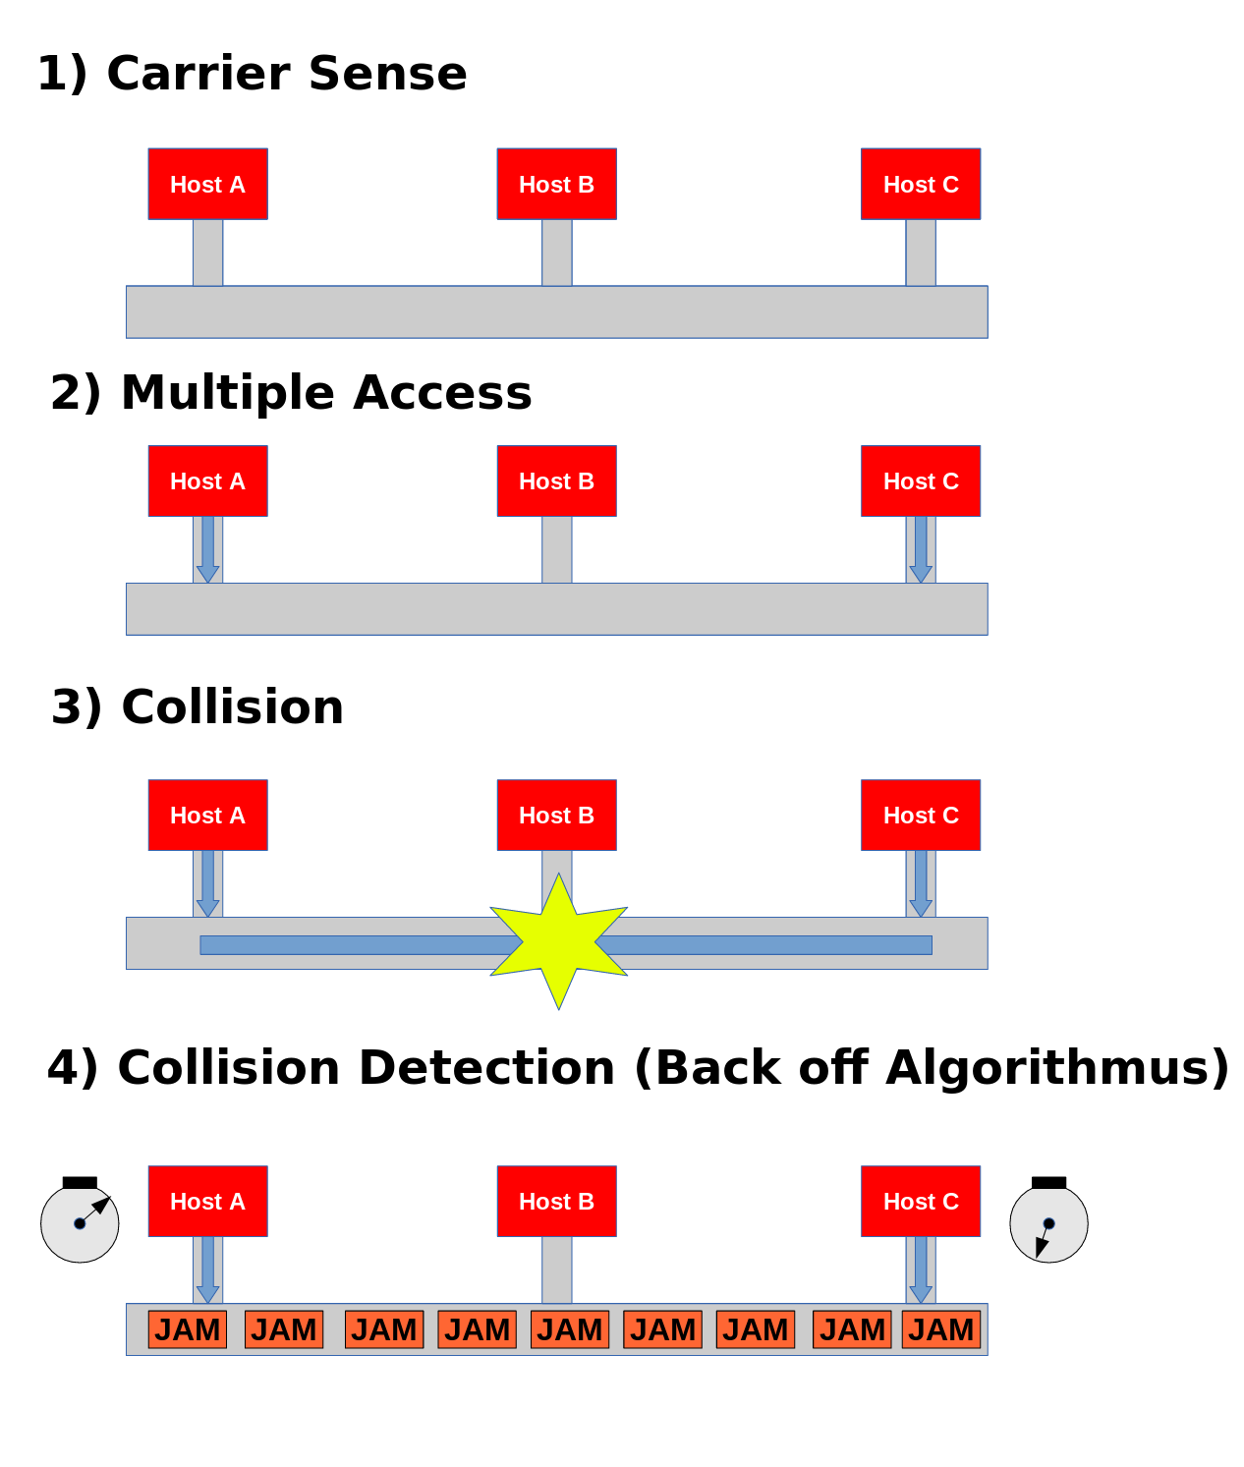
CSMA – Improvement over Aloha
Listen first -
If chennel is idle, send
If channel is busy, wait and send later
Propagation delay
You may not hear others
before it’s too late!
wikipedia
Notes:
Ndn can help organizing the namespaces
Once that’s done, data discovery and provenance is
Straight forward
Retrieval, transparent failover, and specialized operations
In this work, we take a real access log and try to quantify NDN’s improvements to a climate
workflow

Slide 10
Ethernet – Wire as Shared Medium
Most successful local area networking technology of last 20 years.
Developed in the mid-1970s by researchers at the Xerox Palo Alto Research Centers (PARC).
For alohanet the medium was the atmosphere, for ethernet, coax cables
Frames
Frames
Notes:
Ndn can help organizing the namespaces
Once that’s done, data discovery and provenance is
Straight forward
Retrieval, transparent failover, and specialized operations
In this work, we take a real access log and try to quantify NDN’s improvements to a climate
workflow

Slide 11
Ethernet – IEEE Standard 802.3
How to allow many adaptors to send frames over the wire?
Access protocol
Frames
Frames
Notes:
Ndn can help organizing the namespaces
Once that’s done, data discovery and provenance is
Straight forward
Retrieval, transparent failover, and specialized operations
In this work, we take a real access log and try to quantify NDN’s improvements to a climate
workflow

Slide 12
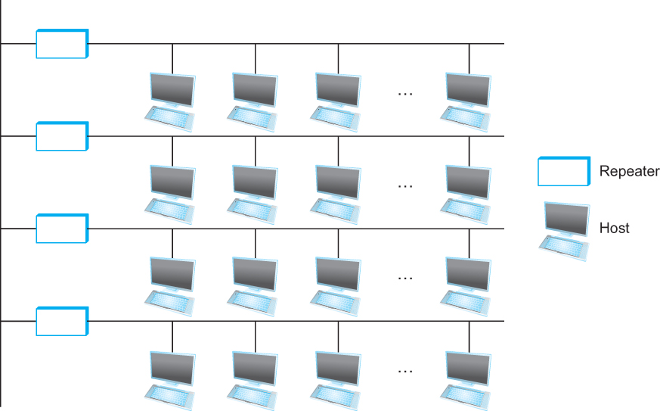
Ethernet
Ethernet repeater
Notes:
The University of Adelaide, School of Computer Science
September 7, 2023
Chapter 2 — Instructions: Language of the Computer
39

Slide 13
Ethernet – Random Access
How to allow many adaptors to send frames over the wire?
Random access
When you have data – send at Full channel rate!
No coordination needed.
If collision happens
Detect
Recover
Retransmit
Notes:
Ndn can help organizing the namespaces
Once that’s done, data discovery and provenance is
Straight forward
Retrieval, transparent failover, and specialized operations
In this work, we take a real access log and try to quantify NDN’s improvements to a climate
workflow

Slide 14
CSMA/CD – Listen first, talk later!
CSMA – Carrier sense Multiple access
Listen if anyone is transmitting
Wait until carrier is free, do not interrupt others
What is the carrier here?
CD – Collision Detection
If you hear anyone while talking, collision, stop!
Monitor signal strength at the adapter
Higher than normal = collision
Random wait before retransmitting
Why?
Notes:
Ndn can help organizing the namespaces
Once that’s done, data discovery and provenance is
Straight forward
Retrieval, transparent failover, and specialized operations
In this work, we take a real access log and try to quantify NDN’s improvements to a climate
workflow

Slide 15
CSMA/CD – Ethernet
CS – wait until idle
Channel idle – trasmit
Channel busy – wait
CD – listen while transmitting
No collision: transmission successful
Collission: abort, send jam signal (32bit special sequence)
Wait random time
Try again
After m^{th} collision, t = random(0,2^{m –} 1),
Wait t*512 bit times before retry
Notes:
Ndn can help organizing the namespaces
Once that’s done, data discovery and provenance is
Straight forward
Retrieval, transparent failover, and specialized operations
In this work, we take a real access log and try to quantify NDN’s improvements to a climate
workflow

Slide 16

Ethernet Frame
SYNC- 7 bytes of 10101010 1 byte of 10101011
Payload
Upper layer protocol
(usually IP)
MAC ADDRESSES
Notes:
The University of Adelaide, School of Computer Science
September 7, 2023
Chapter 2 — Instructions: Language of the Computer
39

Slide 17
Access Protocol for Ethernet
The algorithm is commonly called Ethernet’s Media Access Control (MAC).
It is implemented in Hardware on the network adaptor.
Frame format
Preamble (64bit): allows the receiver to synchronize with the signal (sequence of alternating 0s and 1s).
Host and Destination Address (48bit each).
Hardcoded
Packet type (16bit): acts as demux key to identify the higher level protocol.
Data (up to 1500 bytes)
Minimally a frame must contain at least 46 bytes of data.
Frame must be long enough to detect collision.
CRC (32bit)
Notes:
The University of Adelaide, School of Computer Science
September 7, 2023
Chapter 2 — Instructions: Language of the Computer
39

Slide 18
Ethernet Transmitter Algorithm
Once an adaptor has detected a collision, and stopped its transmission, it waits a certain amount of time and tries again.
Each time the adaptor tries to transmit but fails, it doubles the amount of time it waits before trying again.
This strategy of doubling the delay interval between each retransmission attempt is known as Exponential Backoff.
Notes:
The University of Adelaide, School of Computer Science
September 7, 2023
Chapter 2 — Instructions: Language of the Computer
39

Slide 19
Ethernet Transmitter Algorithm
The adaptor first delays either 0 or 51.2 μs, selected at random
If this effort fails, it then waits 0, 51.2, 102.4, 153.6 μs (selected randomly) before trying again;
This is k * 51.2 for k = 0, 1, 2, 3
After the third collision, it waits k * 51.2 for k = 0…2³ – 1 (again selected at random).
In general, the algorithm randomly selects a k between 0 and 2^{n} – 1 and waits for k * 51.2 μs, where n is the number of collisions experienced so far.
Notes:
The University of Adelaide, School of Computer Science
September 7, 2023
Chapter 2 — Instructions: Language of the Computer
39

Slide 20
Ethernet Transmitter Algorithm
An adaptor may begin transmitting at/near the same time
Either because both found the line to be idle,
Or, both had been waiting for a busy line to become idle.
Simultaneously transmitted frames collide
Each sender can detect collisions (CDMA/CS)
Detection MUST happen during transmission
Each transmits a 32-bit jamming sequence
Will minimally send 96 bits (runt frame)
64-bit preamble + 32-bit jamming sequence
Works if hosts are close to each other
Worst case: transmitter may need to send up to 512 bits
Every Ethernet frame must be at least 512 bits (64 bytes) long.
14 bytes of header + 46 bytes of data + 4 bytes of CRC
Notes:
The University of Adelaide, School of Computer Science
September 7, 2023
Chapter 2 — Instructions: Language of the Computer
39

Slide 21
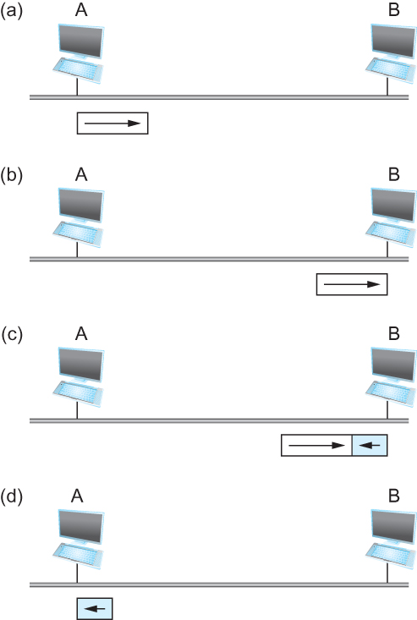
Ethernet Transmitter Algorithm
Worst-case scenario:
(a) A sends a frame at time t;
(b) A’s frame arrives at B at time t + d;
(c) B begins transmitting at time t + d, collides with A’s frame;
(d) B’s runt (32-bit) frame arrives at A at time t + 2d.
(e) A is no longer transmitting – so, it does nothing!
Notes:
The University of Adelaide, School of Computer Science
September 7, 2023
Chapter 2 — Instructions: Language of the Computer
39

Slide 22
Ethernet Minimum Frame Size
Ethernet max length = 2500 meters
RTT in worst case is 51.2 μs, which corresponds to the transmission time of 512 bits
Each ethernet frame MUST be at least 512 bits
Notes:
The University of Adelaide, School of Computer Science
September 7, 2023
Chapter 2 — Instructions: Language of the Computer
39

Slide 23
Experience with Ethernet
Ethernets work best under lightly loaded conditions.
Under heavy loads, too much of the network’s capacity is wasted by collisions.
Most Ethernets are far shorter than 2500m with a round-trip delay of closer to 5 μs than 51.2 μs.
Ethernets are easy to administer and maintain.
There are no switches that can fail and no routing and configuration tables that have to be kept up-to-date.
Cable is cheap, and only other cost is the network adaptor on each host.
Notes:
The University of Adelaide, School of Computer Science
September 7, 2023
Chapter 2 — Instructions: Language of the Computer
39

Slide 24
Wireless
Wireless links transmit electromagnetic signals
Radio, microwave, infrared
Wireless links all share the same “wire” (so to speak)
The challenge is to share it efficiently without unduly interfering with each other
Most of this sharing is accomplished by dividing the “wire” along the dimensions of frequency and space
Exclusive use of a particular frequency in a particular geographic area may be allocated to an individual entity such as a corporation
Notes:
The University of Adelaide, School of Computer Science
September 7, 2023
Chapter 2 — Instructions: Language of the Computer
39

Slide 25
Wireless Links
Wireless technologies differ in a variety of dimensions
How much bandwidth they provide
How far apart the communication nodes can be
Four prominent wireless technologies
Bluetooth
Wi-Fi (more formally known as 802.11)
WiMAX (802.16)
Cellular wireless (3/4/5G) – 6G anyone?
Notes:
The University of Adelaide, School of Computer Science
September 7, 2023
Chapter 2 — Instructions: Language of the Computer
39

Slide 26
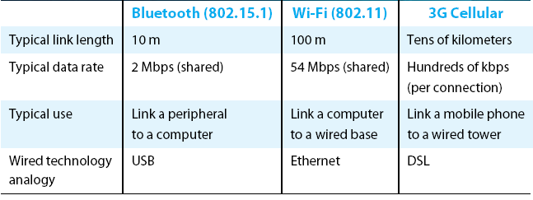
Wireless Links
Overview of leading wireless technologies

Slide 27


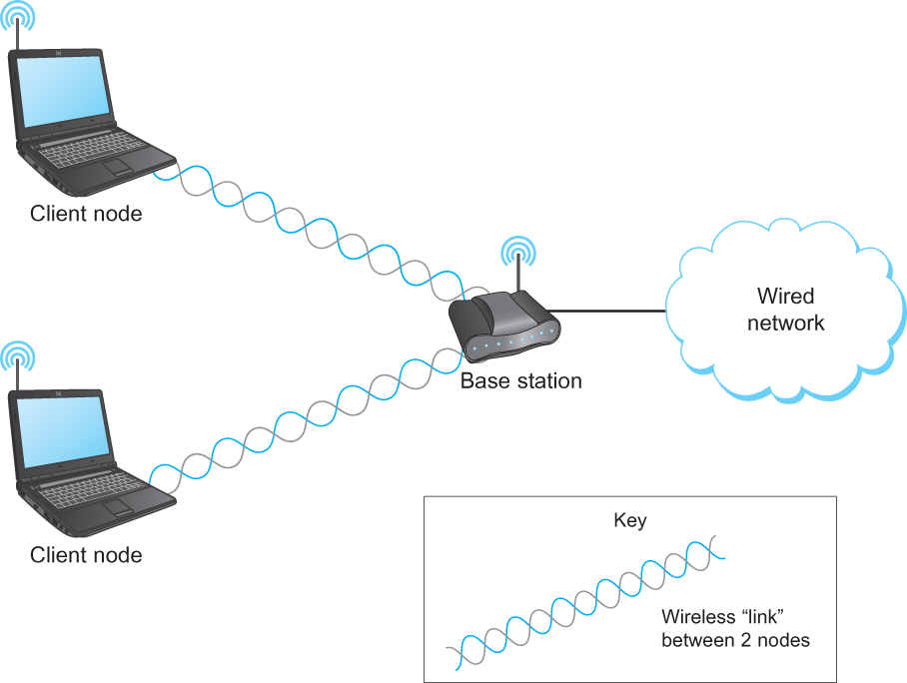
Wireless Links - Infrastructure
Typically connects to
Base stations Multiple access Handoff protocols
Wireless != Mobile
A wireless network using a base station

Slide 28
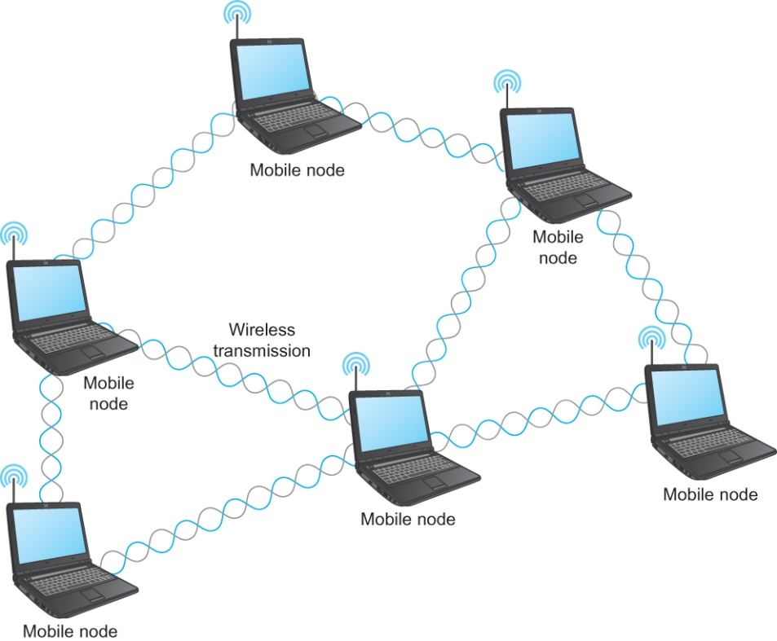
Wireless Links – Ad hoc
Mesh or Ad-hoc network
Nodes are peers
Messages may be forwarded via a chain of peer nodes
Notes:
The University of Adelaide, School of Computer Science
September 7, 2023
Chapter 2 — Instructions: Language of the Computer
39

Slide 29



Wireless Links – Characteristics
Difference from wired?
Decreased signal strength (radio signals travel through the atmosphere)
Interference (Other signals interfere, microwave, phones, each other)
Multipath and noise
Reflects of objects
Can’t hear you!!!!
Notes:
The University of Adelaide, School of Computer Science
September 7, 2023
Chapter 2 — Instructions: Language of the Computer
39

Slide 30



Wireless Links – other problems
B
Hidden terminal
Signal Fading
C
A
B
C
A
A’s signal
strength
C’s signal
strength
A and C can talk
B and C can talk
A and B can not!!! Interference at B
space
Notes:
The University of Adelaide, School of Computer Science
September 7, 2023
Chapter 2 — Instructions: Language of the Computer
39

Slide 31
WiFi – 802.11 Wireless Lan
802.11 b
2.4-5 GHZ unlicensed spectrum
Divided into 11 (or 13) channels
Widely deployed
Uses base stations, 11Mbps
802.11 G
54Mbps
802.11 N
450Mbps
802.11 A/C
1.3 Gbps
All use base station or ac-hoc versions
All use CSMA/CA for multiple access
Notes:
The University of Adelaide, School of Computer Science
September 7, 2023
Chapter 2 — Instructions: Language of the Computer
39

Slide 32
802.11 – CSMA/Collision Avoidance (CA)
802.11: no collision detection! Why?
It won’t work anyway, hidden node, signal fading
Avoid Collisions
CSMA - sense before transmitting
Notes:
The University of Adelaide, School of Computer Science
September 7, 2023
Chapter 2 — Instructions: Language of the Computer
39

Slide 33


IEEE 802.11: Multiple Access
A
B
C
Avoid collisions: 2⁺ nodes transmitting at same time
802.11: CSMA - sense before transmitting
don’t collide with ongoing transmission by other node
802.11: no collision detection!
difficult to receive (sense collisions) when transmitting due to weak received signals (fading)
can’t sense all collisions in any case: hidden terminal, fading
goal: avoid collisions: CSMA/C(ollision)A(voidance)
A’s signal
strength
C’s signal
strength
space
C
B
Wireless, Mobile Networks
6-29
A
Notes:
39

Slide 34
IEEE 802.11 MAC Protocol: CSMA/CA
802.11 sender
1 if sense channel idle for DIFS then
transmit entire frame (no CD)
2 if sense channel busy then
start random backoff time
timer counts down while channel idle
transmit when timer expires
if no ACK, increase random backoff interval, repeat 2
802.11 receiver
- if frame received OK
return ACK after SIFS (ACK needed due to hidden terminal problem)
DIFS = SIFS + (2 * Slot time)
sender
receiver
DIFS Defined by
Standard (34-50µs)
data
SIFS
Defined by
Standard (10-16µs)
ACK
Notes:
39

Slide 35
Avoiding collisions – Reserve before Send
idea: allow sender to “reserve” channel rather than random access
sender first transmits small request-to-send (RTS) packets to BS using CSMA
RTSs may still collide with each other (but they’re short)
BS broadcasts clear-to-send CTS in response to RTS
CTS heard by all nodes
sender transmits data frame
other stations defer transmissions
avoid data frame collisions completely
using small reservation packets!
Notes:
39

Slide 36



Collision Avoidance: RTS-CTS exchange
A
B
AP
RTS(B)
RTS(A)
reservation collision
RTS(A)
CTS(A)
CTS(A)
DATA (A)
defer
time
ACK(A)
ACK(A)
Wireless, Mobile Networks
6-35
Notes:
39

Slide 37
802.11 frame: Addressing
2
2
6
6
6
2
6
0 - 2312
4
frame
control
duration
address
1
address
2
address
3
seq
control
address
4
payload
CRC
Address 4: used only in ad hoc mode
Address 1: MAC address
of wireless host or AP
to receive this frame
Address 3: MAC address
of router interface to which AP is attached
Address 2: MAC address
of wireless host or AP
transmitting this frame
Wireless, Mobile Networks
6-35
Notes:
39

Slide 38
802.11 frame: More
frame seq #
(for RDT)
duration of reserved
transmission time (RTS/CTS)
2
2
6
6
6
2
6
0 - 2312
4
frame
control
duration
address
1
address
2
address
3
seq
control
address
4
payload
CRC
2
2
4
1
1
1
1
1
1
1
1
Protocol
version
Type
Subtype
To
AP
From
AP
More
frag
Retry
Power
mgt
More
data
WEP
Rsvd
frame type
(RTS, CTS, ACK, data)
Wireless, Mobile Networks
6-35
Notes:
39

Slide 39
Wireless – How do nodes communicate?
Two modes:
Infrastructure mode
Ad-hoc mode
Notes:
39

Slide 40
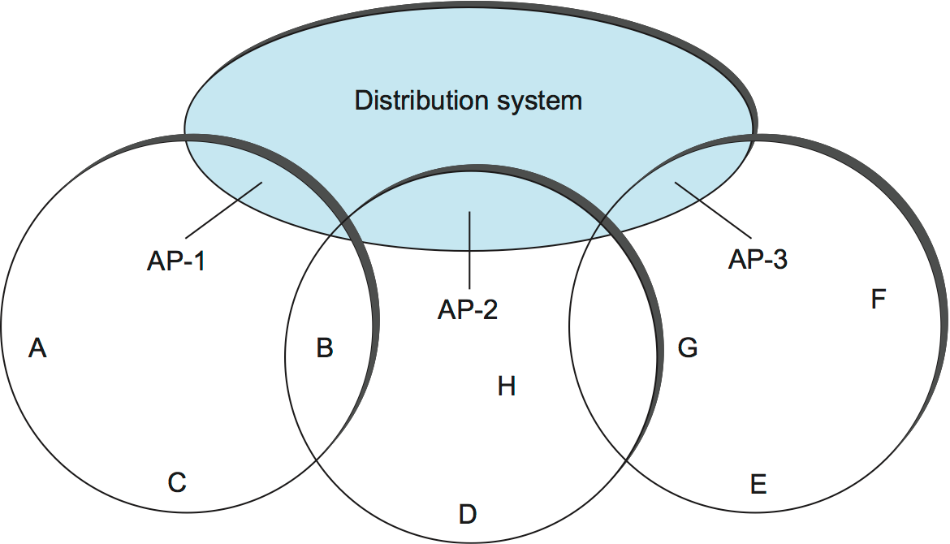
Wireless – Infrastructure Mode
A node (e.g., G) sends a Probe frame.
All APs within reach reply with a Probe Response frame.
The node selects one of the access points The node sends that AP an Association Request frame.
The AP replies with an Association Response frame.
Notes:
39

Slide 41
Wireless – Communication
Access points are connected
Using copper/fiber/wifi – doesn’t matter Nodes go through APs
Notes:
<number>

Slide 42
Wireless – Handover
Node chooses a new AP
The new AP notifies old AP
Similar in mobile networks
- Almost similar
Notes:
<number>

Slide 43
Ad-hoc Mode
Notes:
<number>

Slide 44
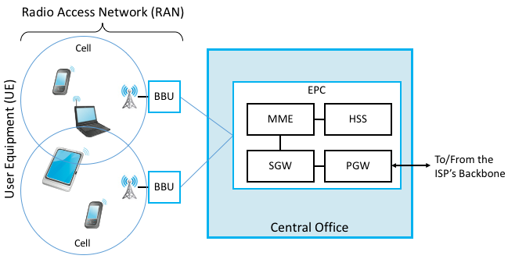
Mobile Networks – 4G LTE
Notes:
<number>

Slide 45
Reading Assignment
Ethernet
Chapter 2.6
30-40 minutes read
Wireless:
Chapter 2.7.1
Mobile/Access Network
https://book.systemsapproach.org/direct/access.html#cellular-network
Ignore PON
Read from “While cellular telephone technology had its roots” to “in the process of transitioning to 5G
(with the promise of a tenfold increase in data rates).”
Notes:
<number>

Slide 46
Link Layer Recap – All this for a cat picture
Apps (HTTP)
Data
Apps (HTTP)
Segments
Transport (TCP/UDP)
Transport (TCP/UDP)
Network (IP)
Packets
Network (IP)
Link (Ethernet)
Frames
Link (Ethernet)
Ethernet Interface
Ethernet Interface
Bits (1010001)

