Slide 1
A Two-bit Differentiated Services Architecture for the Internet
Nichols, Jacobson, and Zhang
Presentation by: Thomas Hines

Slide 2
Two Bit Architecture
Combine Premium and Assured services
One bit flag for each service
Overlap in the infrastructure required for the two services

Slide 3
Premium Service
Guaranteed bit-rate
Separate queue from best effort traffic
Premium packets are always sent first
Boundary routers
Set premium bit on packets
Burst packets over the guarantee are dropped
Internal routers
Simply forward premium packets first

Slide 4
Assured Service
Specify bursty service
“3 mb/s with a 5% duty cycle measured over 5 minutes”
Packets over the specification are best-effort
Assured packets are dropped after best effort packets

Slide 5
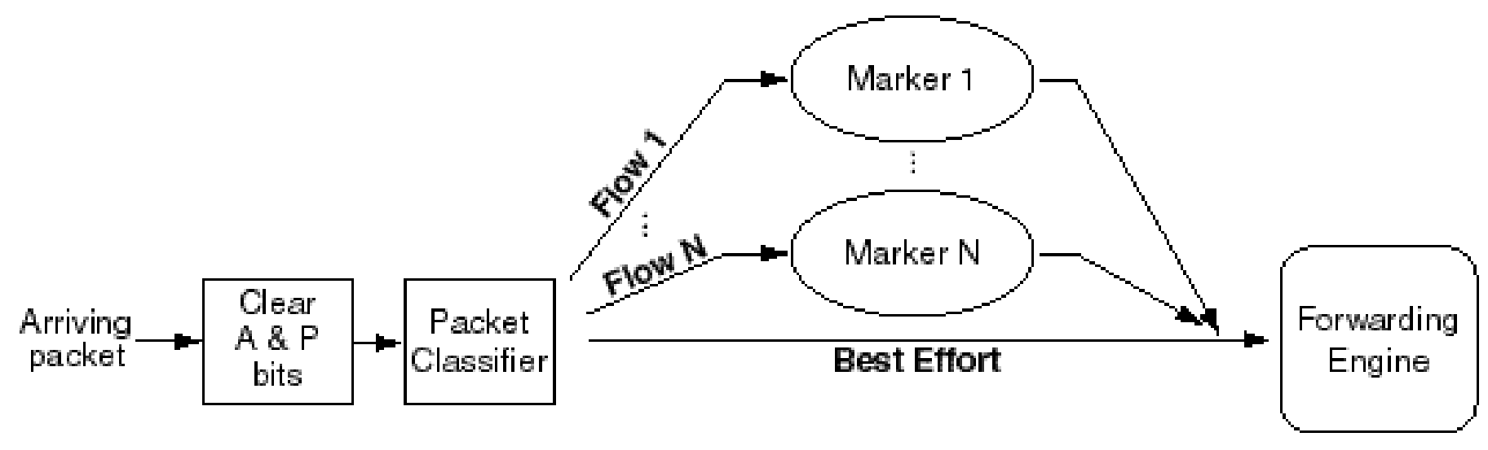
Leaf Router Ingress

Slide 6
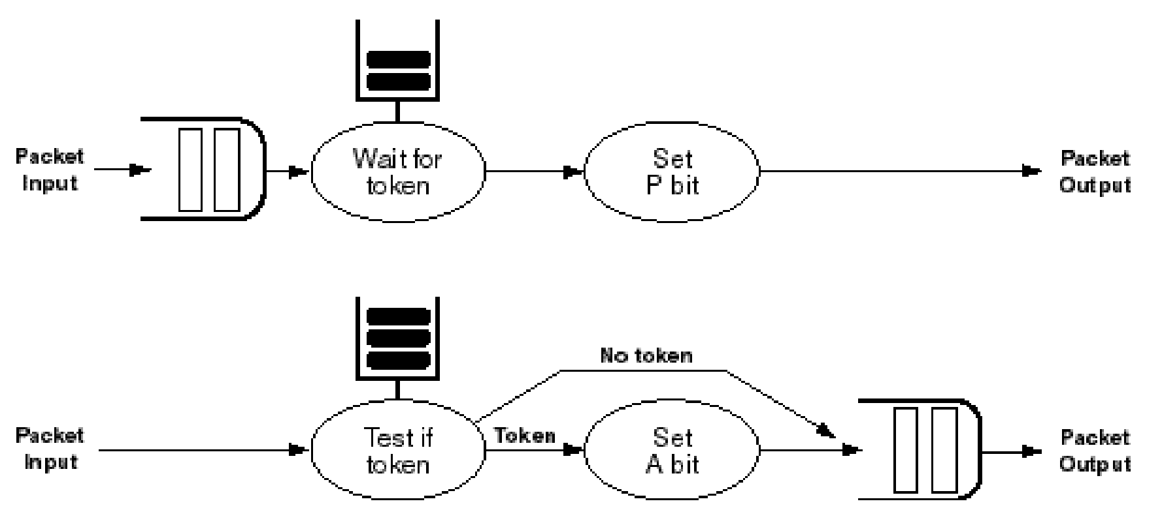
Marker

Slide 7
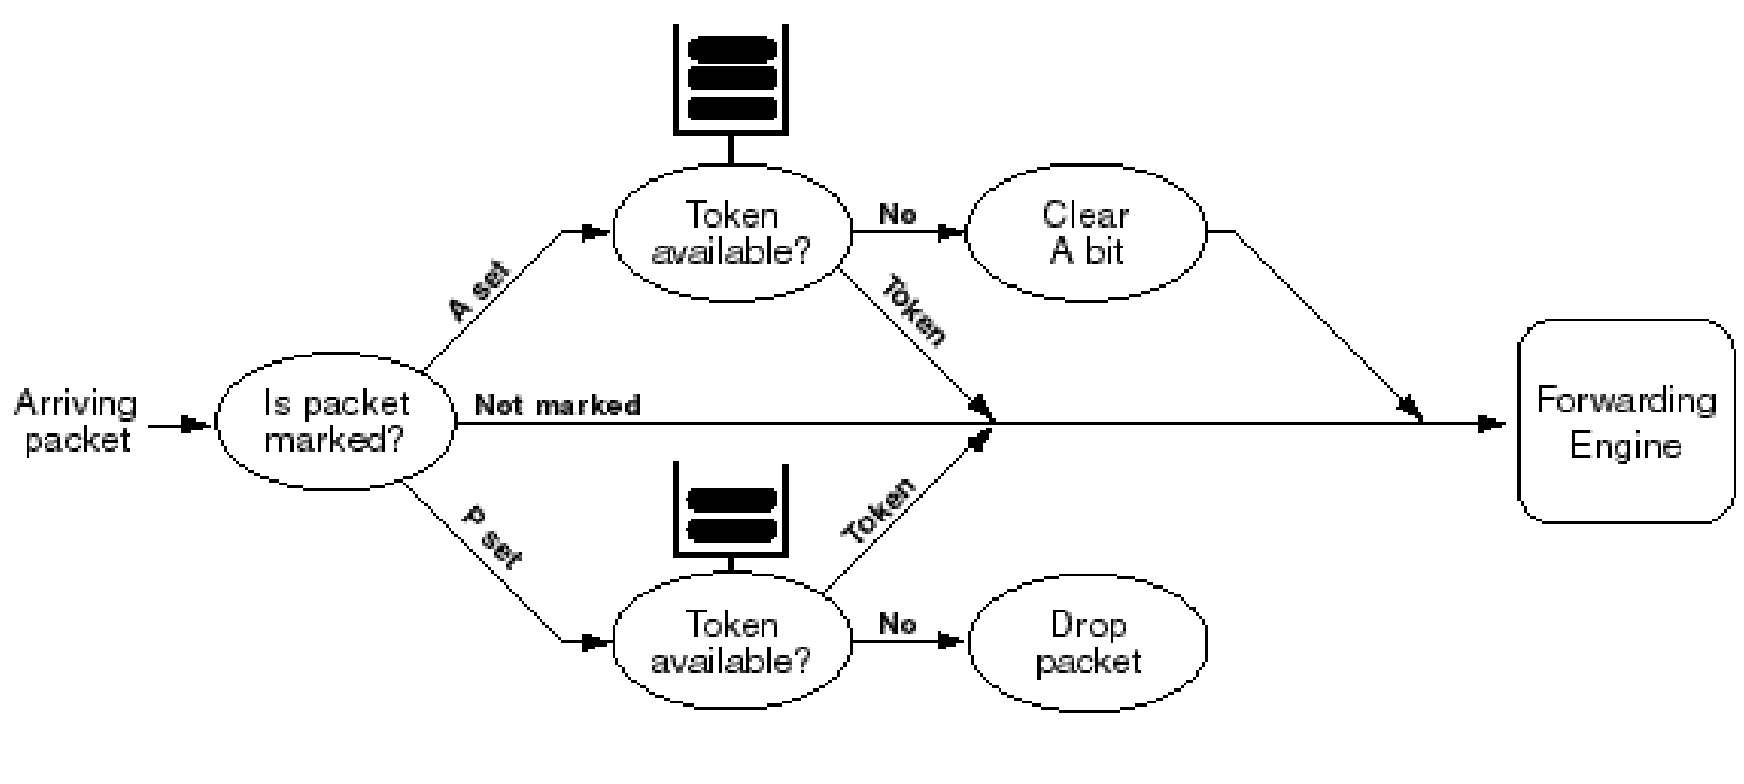
Border Router Profile Meter

Slide 8
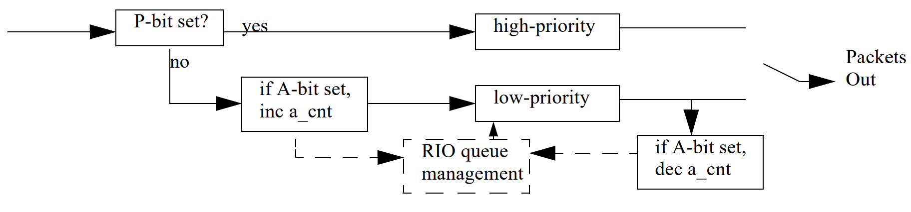
Router Egress

Slide 9
Bandwidth Brokers
One per trust domain (AS)
In charge of what and how much traffic is marked
Sets policies for leaf routers and rate limits for border routers
Only needs to know about neighbors
Could negotiate with other BBs to increase rate limits

Slide 10
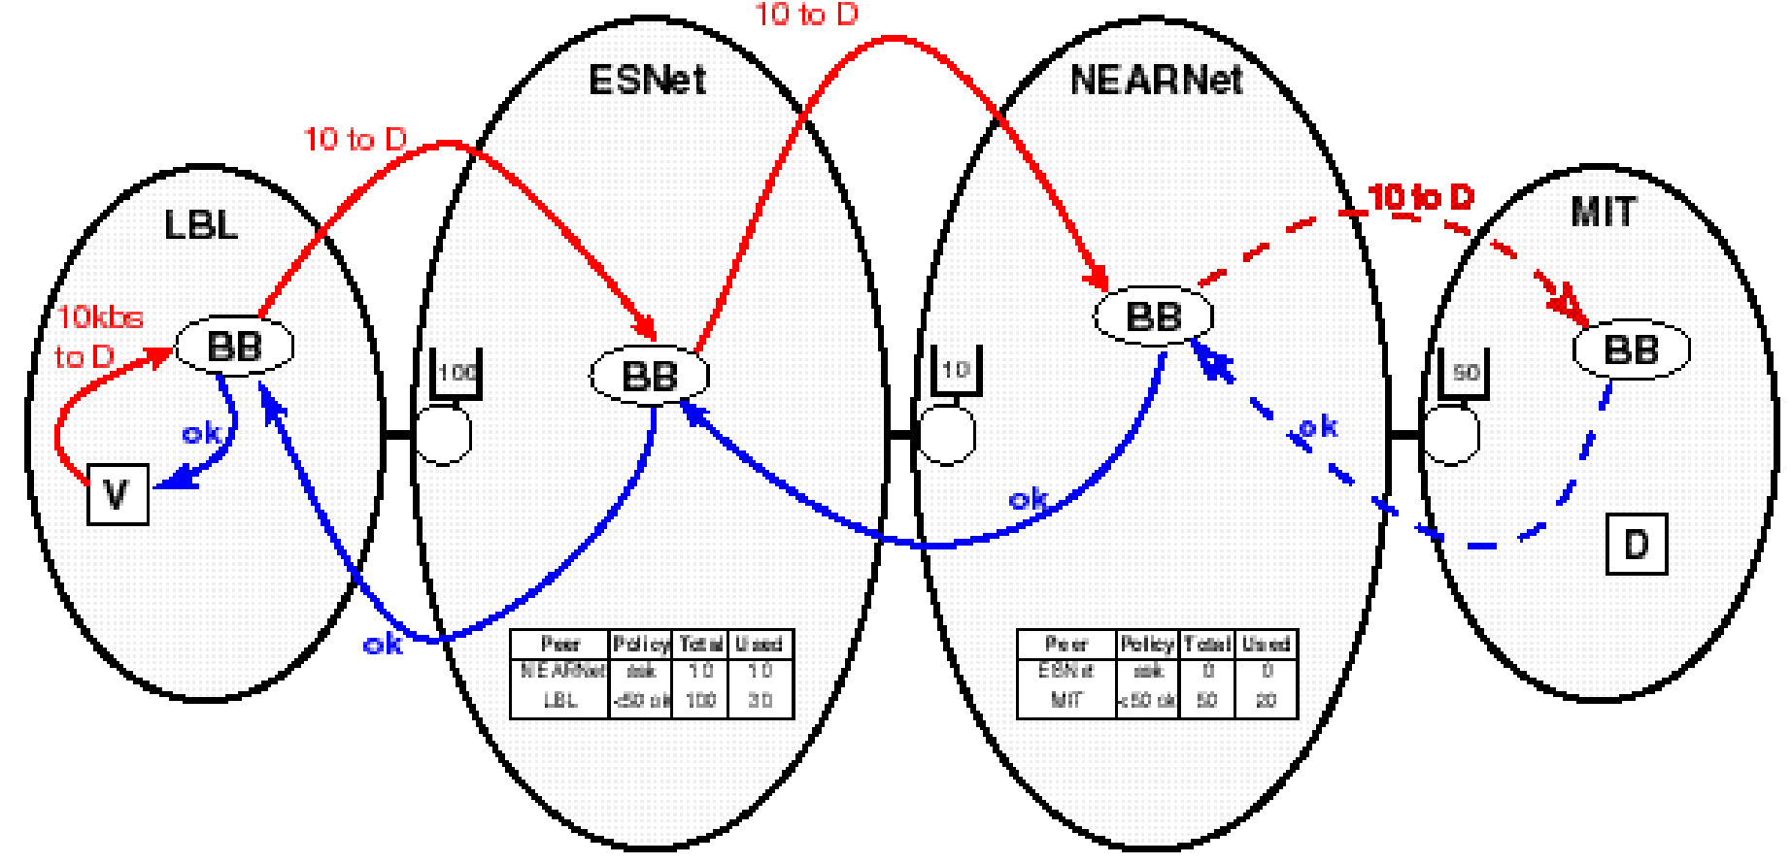
Bandwidth Broker Communication

Slide 11
Thoughts About the Paper
Metering per flow type scales better than metering per flow
Unsure how BB’s work with BGP
Seems to assume a static graph of AS’s

