Slide 1
OpenFlow: Enabling Innovation in Campus Networks
McKeown, Anderson, Balakrishnan, Parulkar, Peterson, Rexford, Shenker, Turner
Presentation by: Richard Grant Brown – CSC 7970

Slide 2
Overview
“White Paper” about OpenFlow
Goal of this paper:
Convince Networking vendors to add OpenFlow to their switch products for deployment in college campus backbones and wiring closets.
Experimentation Tool
Designed for researchers on College Campuses
Works with pre-existing networks
Supports a multitude of experiments.
How OpenFlow works
Manipulating Flow, network traffic

Slide 3
Introduction
Reluctance to experiment with production traffic has led to the lack of new ideas
Problem:
No easy way to experiment with new network protocols realistically enough.
Solutions:
Programmable Networks
GENI
Proposed nationwide research facility for experiments
Virtualized Programmable Networks
Takes too long to deploy, too expensive
OpenFlow

Slide 4
Convenient Campus Experimentation
How can we achieve a convenient campus experimentation system that doesn’t interrupt production traffic but still is realistic and port-dense enough to be fruitful?
Major Questions to Achieve This
How will college network admins get comfortable putting experimental equipment into their network?
How will researchers control a portion of their local network in a way that does not disrupt others who depend on it?
And exactly what functionality is needed in network switches to enable experiments?
“Propose new switch which helps extend programmability into the wiring closet of college campuses.”
OpenFlow Switch

Slide 5
The OpenFlow Switch
Goals of OpenFlow’s Switch Flexibility
Must be able to support high-performance and low-cost implementations
Can support broad range of research
Must isolate experimental traffic from normal production traffic
Operates without affecting vendors' need for closed platforms.
Basic Idea
Most switches and routers contain flow-tables that run at line-rate to implement firewalls, NAT, QoS, and to collect statistics.
There is a common set of functions that they run.
OpenFlow works with that set of functions.

Slide 6
The OpenFlow Switch
An OpenFlow Switch consists of 3 parts
A Flow Table
Flow entries use actions associated with them to manipulate flow.
A Secure Channel
Connects the switch to a controller, allowing commands and packets to be sent between the two.
Uses the OpenFlow Protocol.
The OpenFlow Protocol
Provides an open and standard way for a controller to communicate with a switch.
External definition of flow table entries.
No need for researchers to directly program the switch.

Slide 7
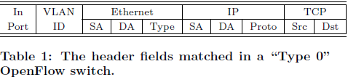
The OpenFlow Switch
Flow Table has 3 Fields
Packet header
Defines the flow
Action which defines how the packets should be processed
Statistics which keep track of the number of packets and bytes for each flow, and the time since the last packet matched the flow

Slide 8
The OpenFlow Switch
OpenFlow’s Open Protocol
Flow Tables in the switches and routers can be programmed.
Network Admins divide traffic into production and research flows.
Researchers can control their flows by choosing the packet routes and how they are processed.
OpenFlow Datapath
Consists of a flow table, and an action associated with each flow entry.
Minimum Requirements
Datapath is flexible, but can’t specify arbitrary handling of each packet.
For high performance and low cost
Generalized packet processing

Slide 9
The OpenFlow Switch
Two Ways to Have An OpenFlow Switch
Dedicated and Enabled
Dedicated OpenFlow Switches
Switches created for the main purpose of OpenFlow.
A simple datapath element forwards packets between ports defined by a controller.
Flows are broadly defined
Implementation of the Flow Table dictates what the flows can be.
TCP connection, packets from a particular MAC or IP address, same VLAN tag, same switch port.

Slide 10
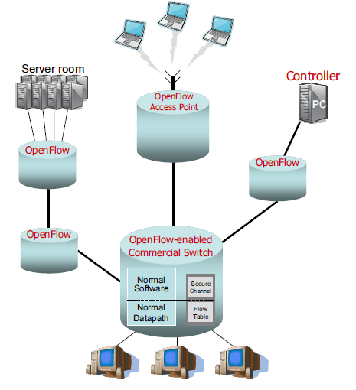
The OpenFlow Switch
OpenFlow-Enabled
Pre-existing Hardware from a vendor that is enabled to do OpenFlow.
Simply add the flow table, secure channel and open flow protocol.
Flow table will use the tables in a switch’s/router’s memory components like TCAM.
Ternary content-addressable memory
Secure Channel and OpenFlow Protocol runs on the Switch’s OS.

Slide 11
The OpenFlow Switch
Isolating Traffic
Dedicated OpenFlow switches
Automatically divides production and experimental traffic.
Open Flow-enabled
Two ways to do this separation:
Add Fourth Action: Forward flow’s packets through normal processing pipeline.
Define separate sets of VLANS for experimental and production traffic.
At least one of these two approaches must be used.

Slide 12
The OpenFlow Switch
Type 0
Switch supports
header formats
four basic actions
Type 1
A new set of features designates a “Type 1” switch. Can do more than Type 0.
Switch supports more than four actions
Can rewrite parts of packet header
Arbitrary matching of packet headers.
Not many in use.

Slide 13
The OpenFlow Switch
Controllers
Controllers add and removes flow entries from the flow table on behalf of experiments.
Simple Controllers
Can be a simple app running on a PC to statically establish flows to interconnect a set of test computers.
Dynamic Controllers
Adds and removes flows during experiments
Support multiple researchers and access control for different experiments on different flows.
More control on how flows are processed.
Ethane controller used low-cost desktop PC to process over 10,000 new flows per second. Easily scalable.
Can be Stateless

Slide 14
The OpenFlow Switch
Example
“ Amy, invents Amy-OSPF, a new routing protocol to replace OSPF. She wants to test it without changing any end-host software. Amy-OSPF will run in a controller; each time a new application flow starts Amy-OSPF picks a route through a series of OpenFlow Switches, and adds a flow-entry in each switch along the path. Amy decides to use Amy-OSPF for the traffic entering the OpenFlow network from her own desktop PC— so she doesn’t disrupt the network for others. To do this, she defines one flow to be all the traffic entering the Open-Flow switch through the switch port her PC is connected to, and adds a flow-entry with the action “Encapsulate and forward all packets to a controller”. When her packets reach a controller, her new protocol chooses a route and adds a new flow-entry (for the application flow) to every switch along the chosen path. When subsequent packets arrive at a switch, they are processed quickly (and at line-rate) by the Flow Table.”

Slide 15
The OpenFlow Switch
“Amy is testing her new protocol in a network used by lots of other people in the production-side of the network.” We need two new properties:
1. Packets belonging to users other than Amy should be routed using a standard and tested routing protocol running in the switch or router from a 'name-brand" vendor.
Achieved by Open-Flow Enabled switches since they’re from a “name-brand” vendor.
For the experiment, the default action for all packets that don’t come from Amy’s PC could be to forward them through the normal processing pipeline.
Amy’s packets would be forward to outgoing port, not processed by normal pipeline.
2. Amy should only be able to add flow entries for her traffic, or for any traffic her network admin has allowed her to control.
Depends on controller and how it enables researchers to implement various experiments.
Restrictions of Property 2 can be achieved with the appropriate use of controller-based access control.

Slide 16
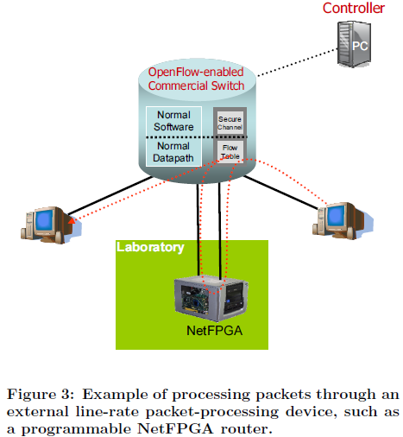
The OpenFlow Switch
Other Examples of Experiments OpenFlow Can Do
Network Management and Access Control
Ethane
VLANs
VLAN IDs, declare set of flows with specified ports, Controller does authentication.
Mobile Wireless VOIP Clients
VOIP clients can establish a new connection over the OpenFlow-enabled network. T
Track the location of clients, re-routing connections as users move through the network,
seamless handoff from one access point to another.
Non-IP Networks
OpenFlow doesn’t require packets to fit a specific format.
Processing Packets rather than Flows
Example: Intrusion Detection Systesms
Processing packets in an OpenFlow-enabled network
Two Ways
Force all of a flow’s packets to pass through a controller which performs actions.
Process Packets to route them to a programmable switch that does packet processing.

Slide 17

The OpenFlow Switch
OpenFlow Consortium
Group of researchers wanting to popularize use of OpenFlow for colleges and vendors.
Conclusion of the paper
A call to Vendors and Researchers.
Free to Join
Email join@OpenFlowSwitch.org
Once Again, this is a White Paper.

Slide 18
Major Takeaways
OpenFlow wants to make innovation in Networking easier
Convenient
Easy to Adopt
Non-intrusive
Can support experimental protocols
It works with the flow table, secure channel, OpenFlow protocol
There are many types of experiments that can’t easily be tested realistically in conventional programmable networks
Routers and Switches can easily be OpenFlow enabled

Slide 19
Critique
Occasionally introduces two related concepts and will get off topic.
Dedicated Switches and OpenFlow-Enabled Switches
Type 0 and Type 1 switches
Only explains OpenFlow enough to describe why it should be adopted.
Good for Whitepaper
Not as good for users seeking for more details.
Ultimately, a good argument for a great cause

Slide 20
Discussion

