Slide 1
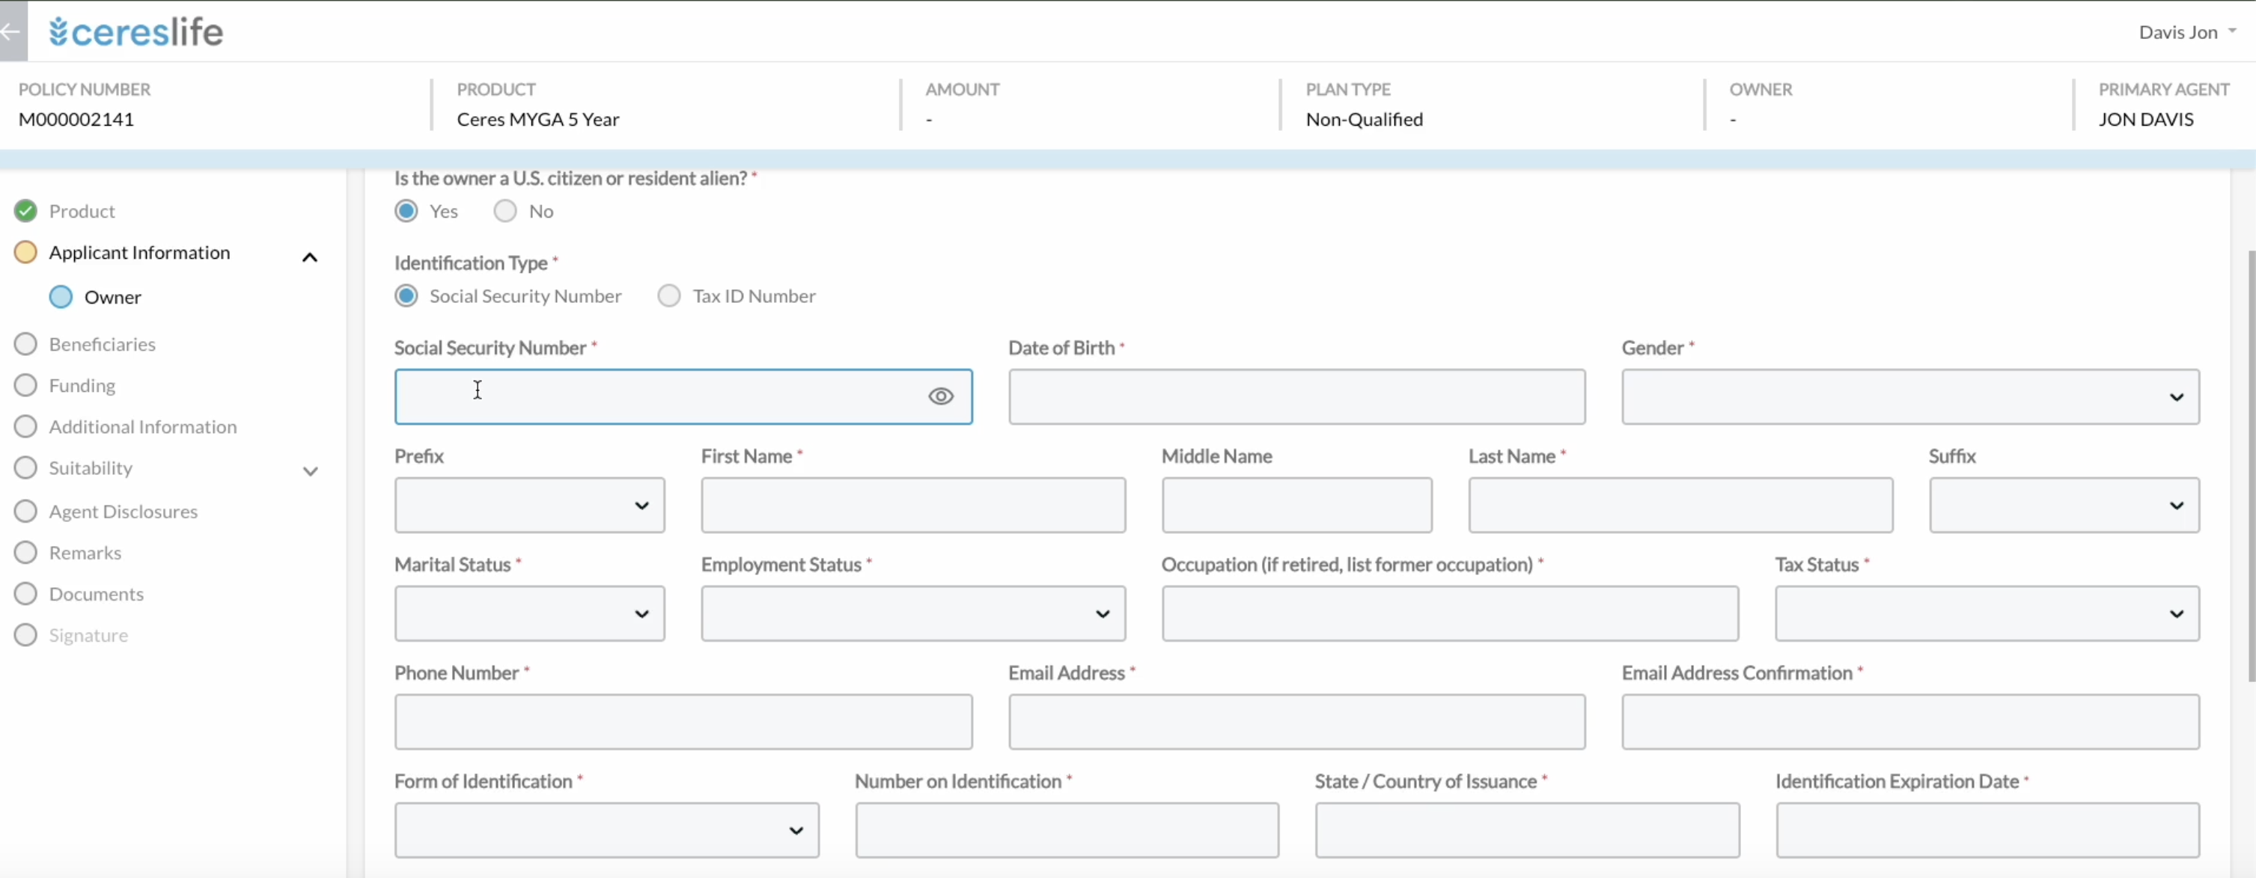
Ceres Life has built a proprietary eApp that is modular and reflexive

Slide 2
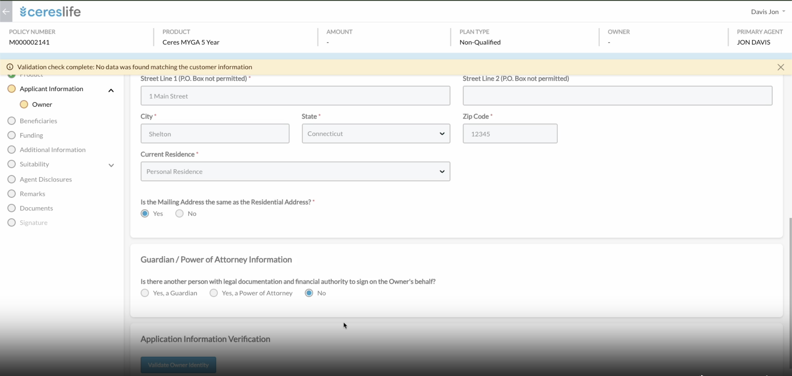
Ceres eApp provides user –friendly interface and real time error prevention

