Slide 1
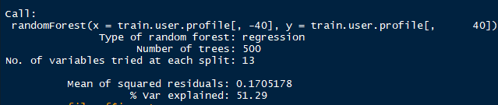
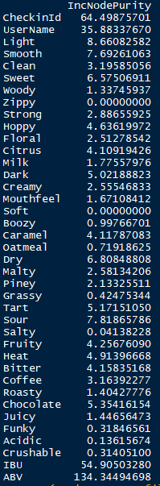
First Run
Observations
Check-in Id is included – Needs to be removed
Soft & Zippy have a value of 0 – Not used much?

Slide 2
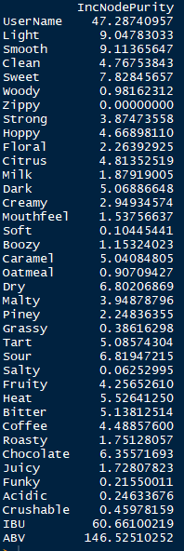
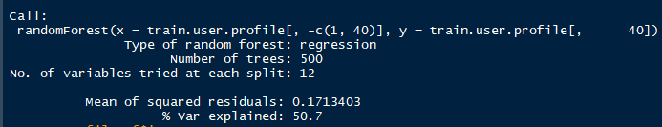
Second Run – Without Check-in Id
Observations
% var explained came down

